Slide 1
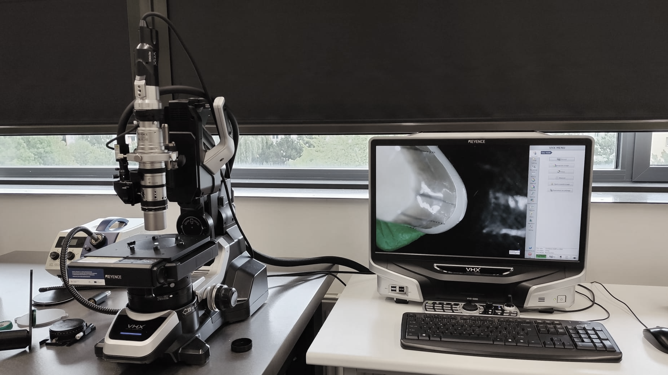

Manufacturing of CAD/CAM crowns with and without a 3D printed model in terms of marginal fit
Dr. Marwan Al Akkad & Mgr. Václav Prokůpek

Slide 2
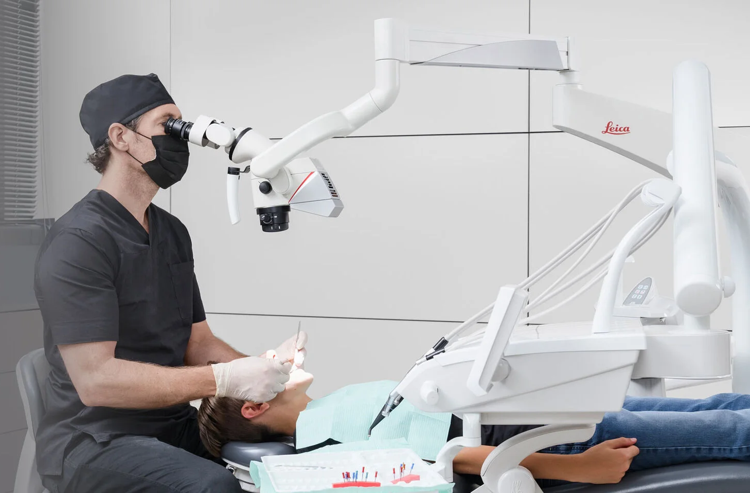
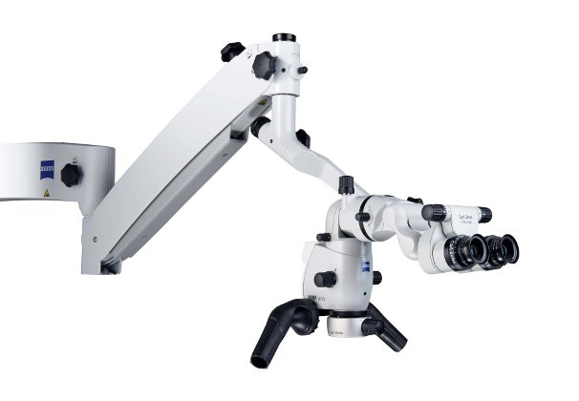

Slide 3
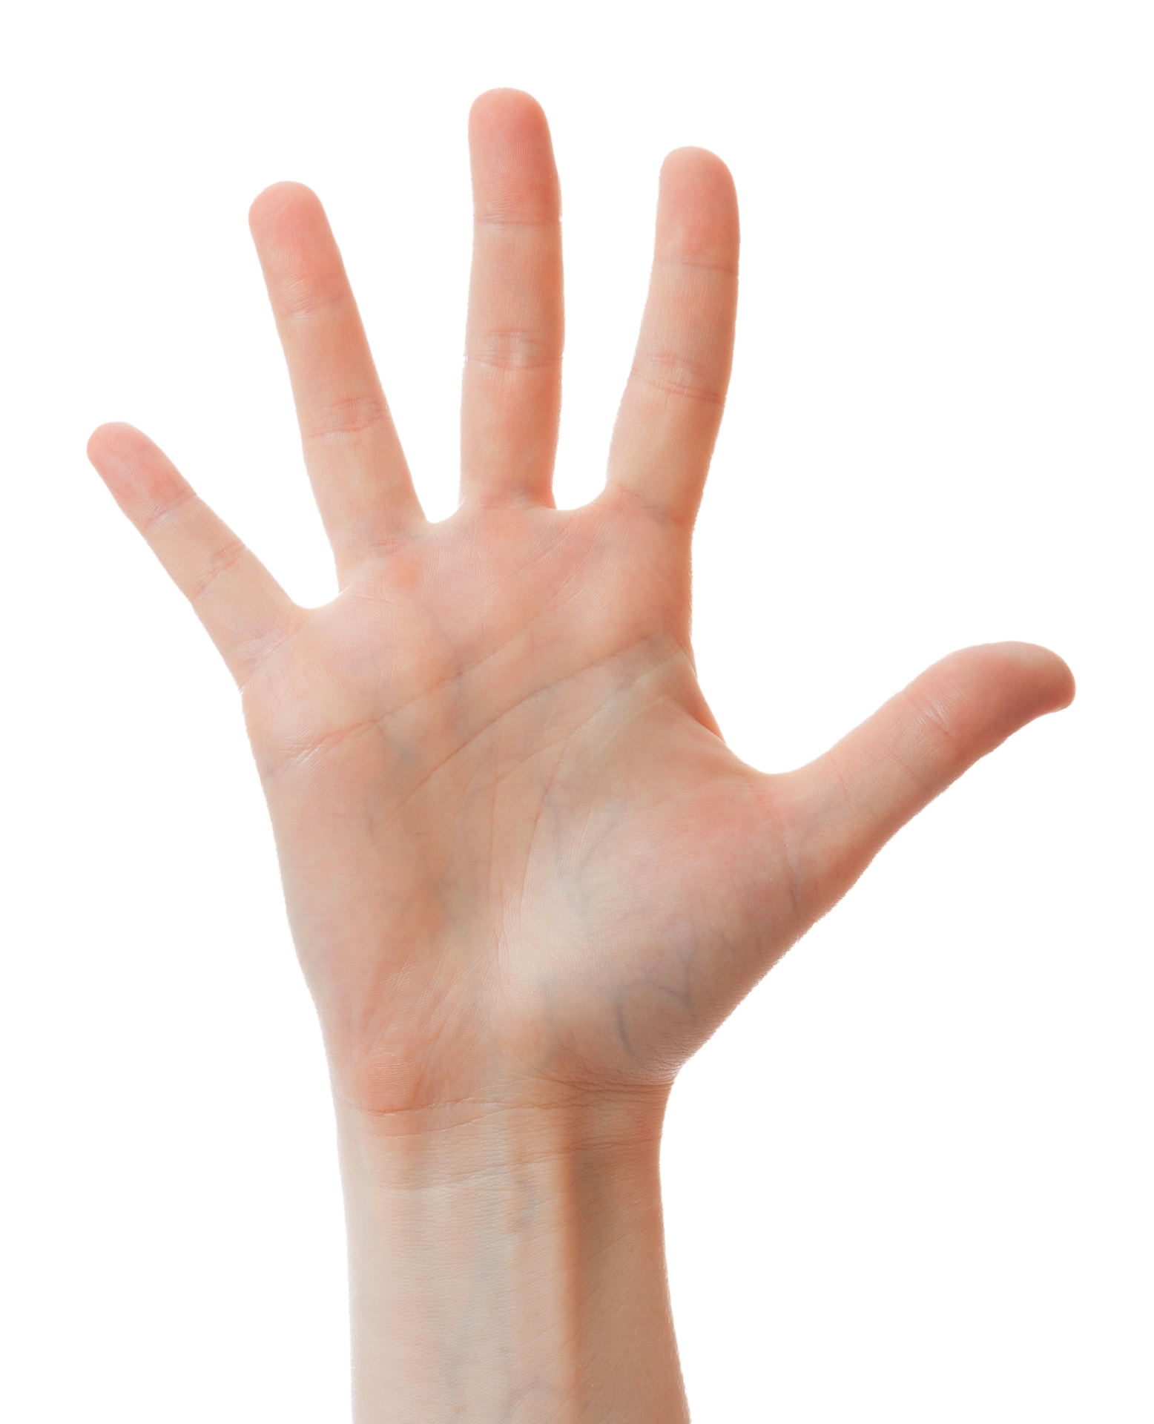
Five questions in five minutes
What are crown, CAD/CAM, 3D printed resin models, and marginal fit?
What to measure under a microscope?
Why is marginal fit important?
How to perform microscopy?
What are the results?

Slide 4
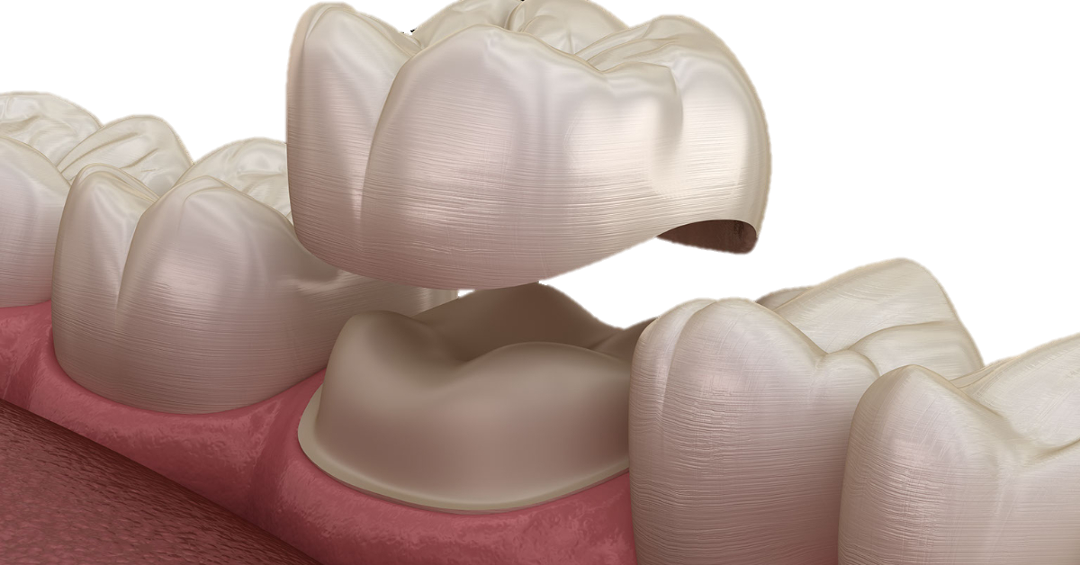
1. What are crown, marginal fit, CAD/CAM and 3D printed resin models?
A crown or a dental cap is a type of dental restoration that completely caps or encircles a tooth or dental implant.

Slide 5
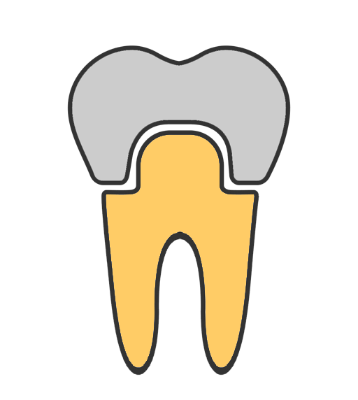
1. What are crown, marginal fit, CAD/CAM and 3D printed resin models?
Marginal fit is a tight seal with no space between the margin of the crown and the finish line of the tooth.

Slide 6

1. What are crown, marginal fit, CAD/CAM and 3D printed resin models?
CAD/CAM is a software used to design and digitally model, it is also the process of manufacturing

Slide 7
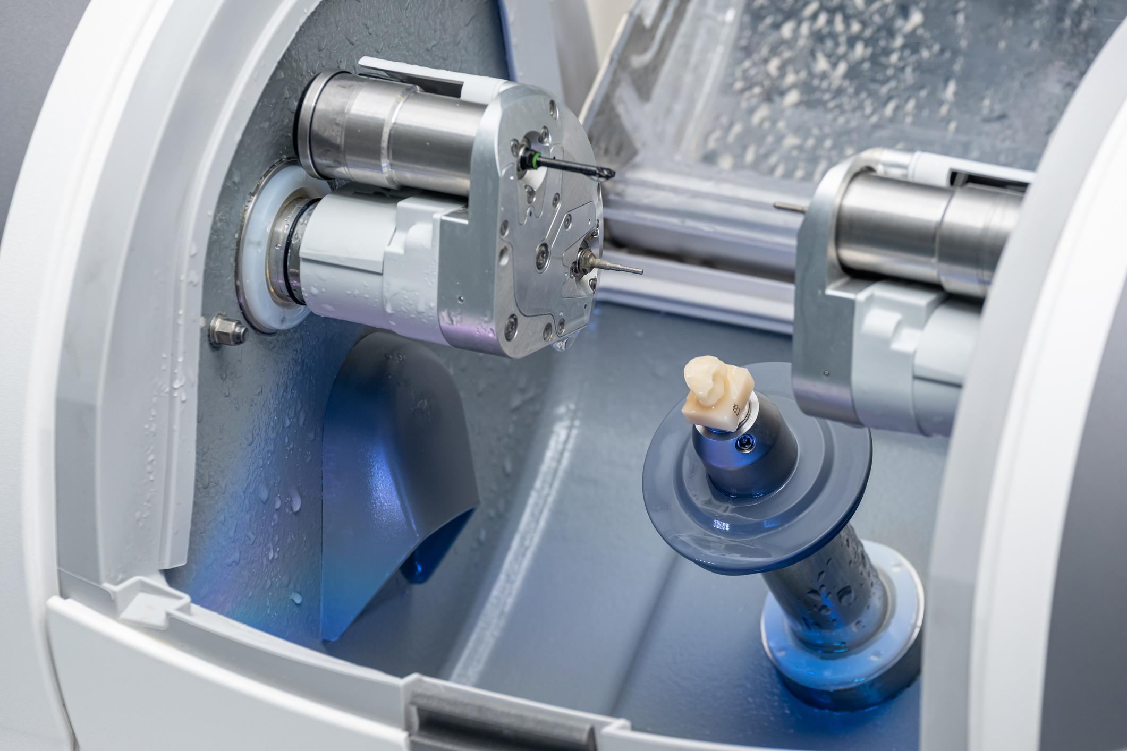
1. What are crown, marginal fit, CAD/CAM and 3D printed resin models?

Slide 8
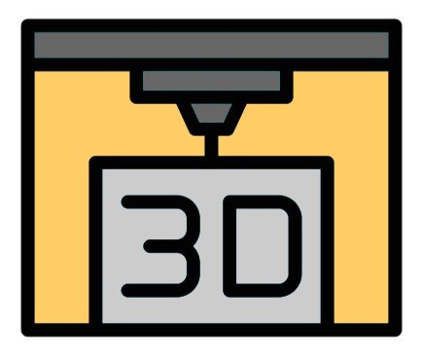
1. What are crown, marginal fit, CAD/CAM and 3D printed resin models?
3D printed resin models are physical models created layer by layer from liquid resin using a 3D printer.

Slide 9
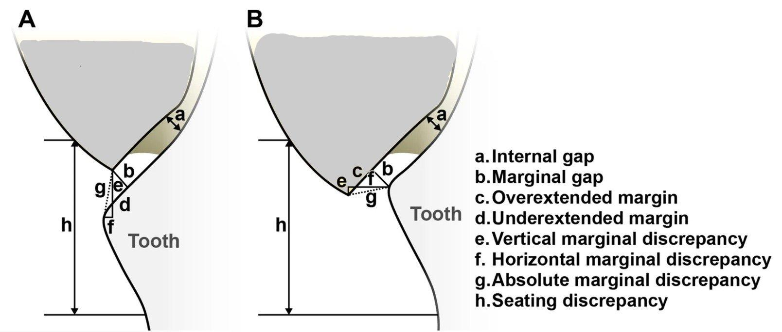
2. What to measure under a microscope?

Slide 10


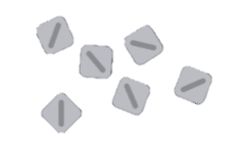
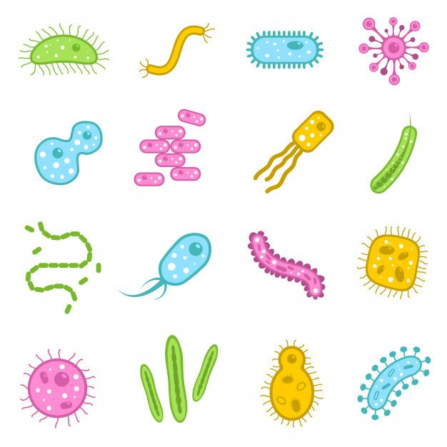
3. Why is it important?
Plaque retention,
secondary caries,
and gingivitis
Cement dissolution and debonding
Marginal discoloration

Slide 11
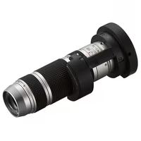
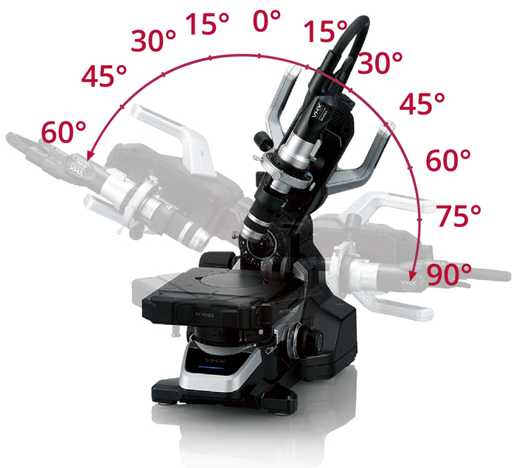
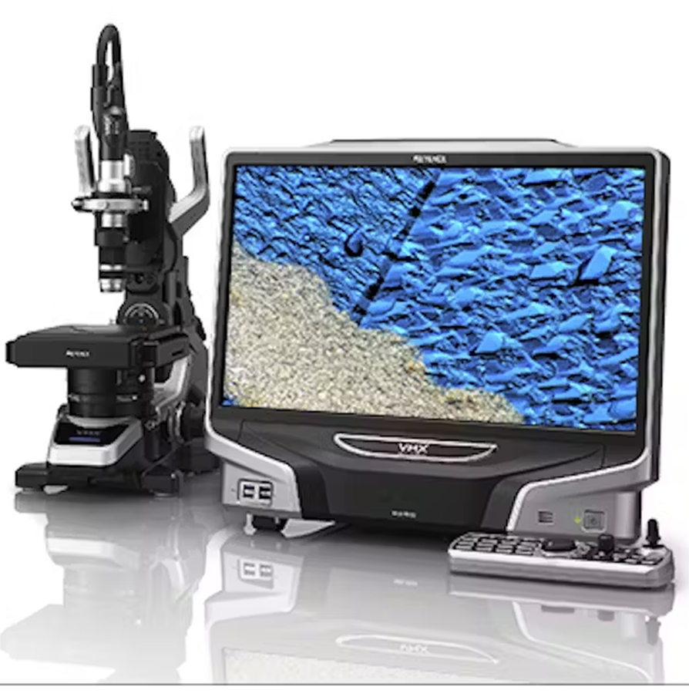
4. How to perform microscopy?
Keyence VHX5000, VH-Z20T lens, VHX-S550E free angle unit

Slide 12
Why digital microscopy?
Advantages of digital microscopy:
High resolution (μm scale)
Saving the images (further analysis and comparison)
Non-destructive, repeatable (unlike SEM or μCT)
Fast and cheap
Disadvantages of digital microscopy:
Incorrect angle
Limited field of depth
Less accurate (compared with SEM and μCT)

Slide 13
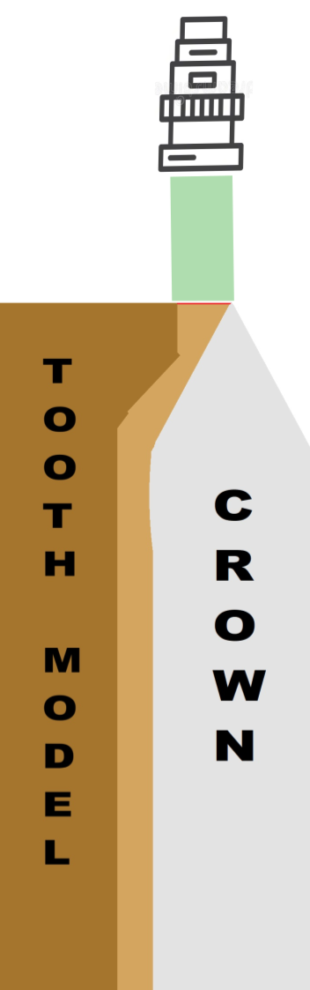
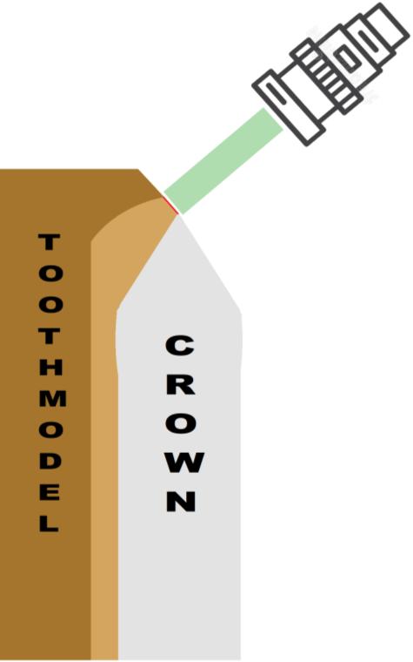
How to perform measurement?
Fit the crown onto modelling clay to fix its position
Put tooth model into the crown, so it can sit as naturally as possible
Adjust the angle of the microscope
Identify the MG
Zoom in (200x)
Use „In-Depth“ function
Measure the MG

Slide 14
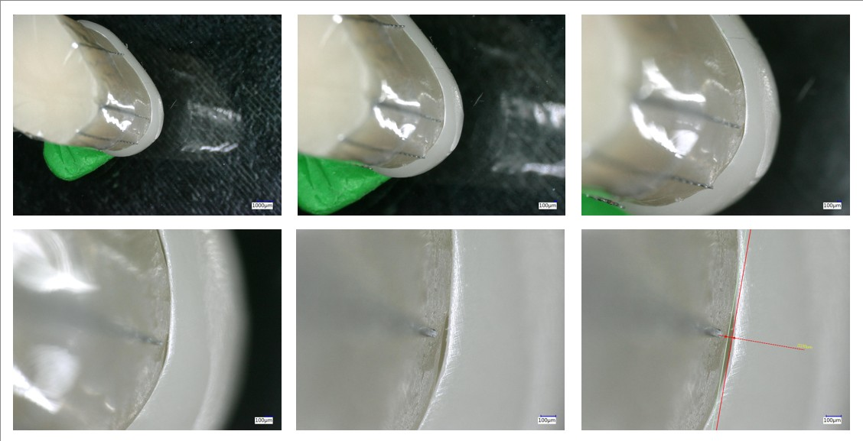

Slide 15
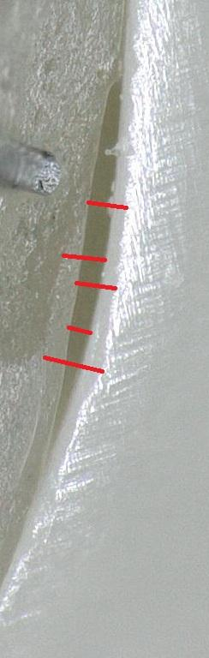
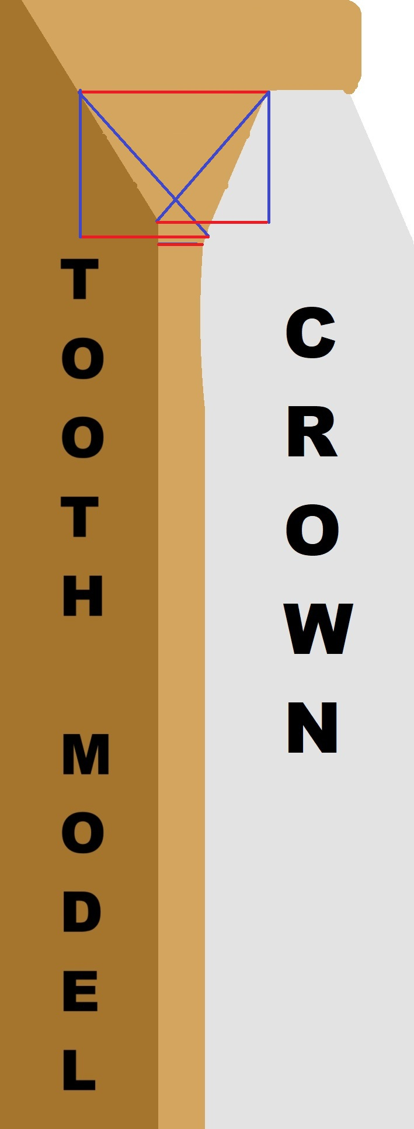
Issues
Where is the MG?
Solution:
Two people consensus

Slide 16
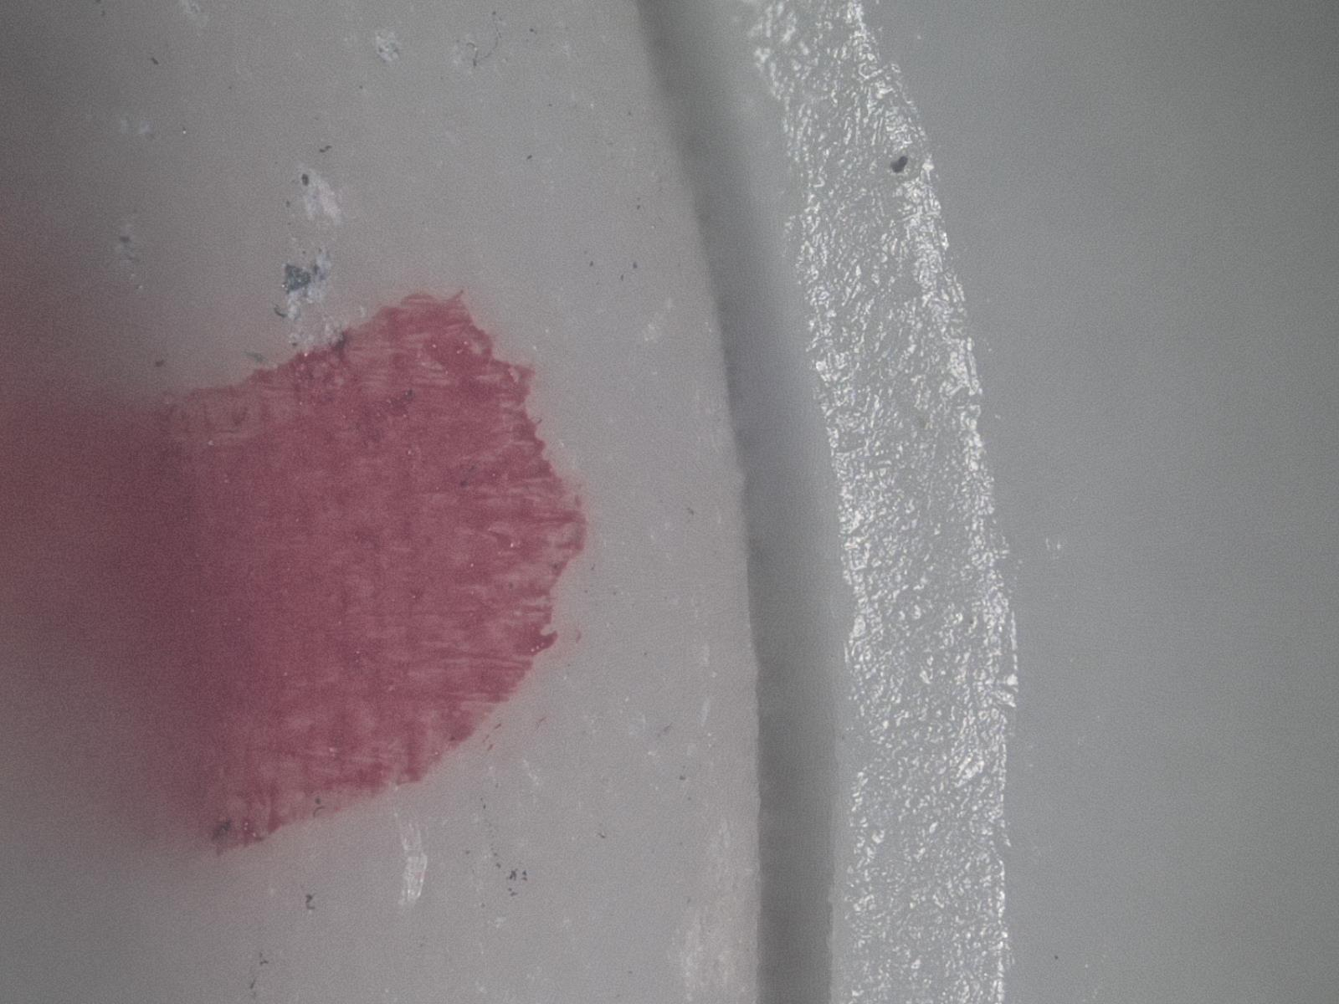
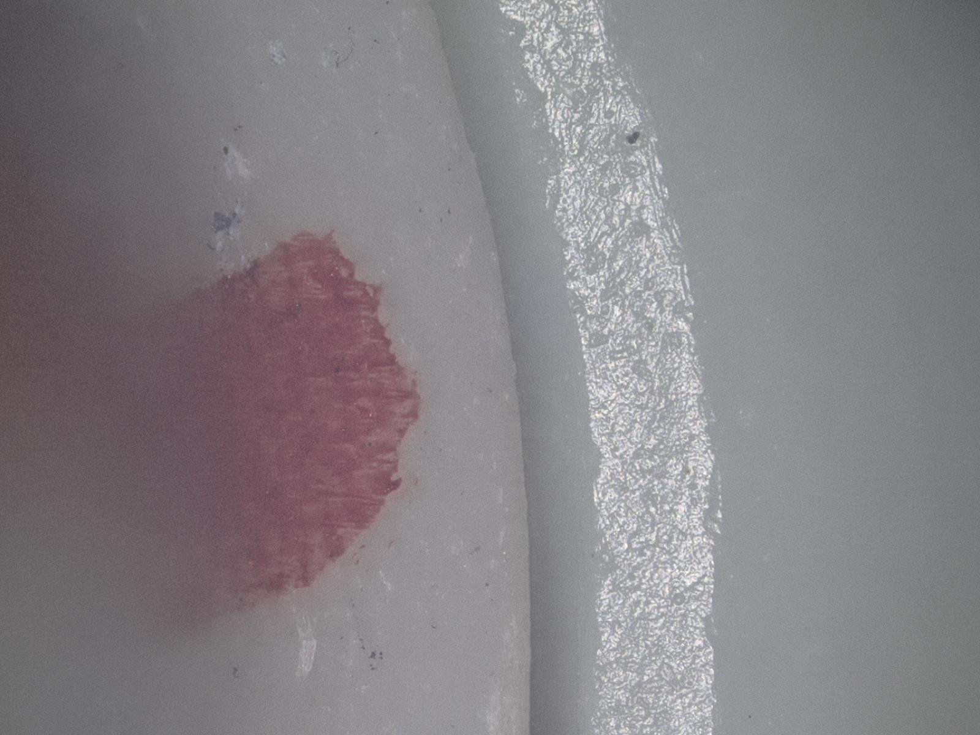
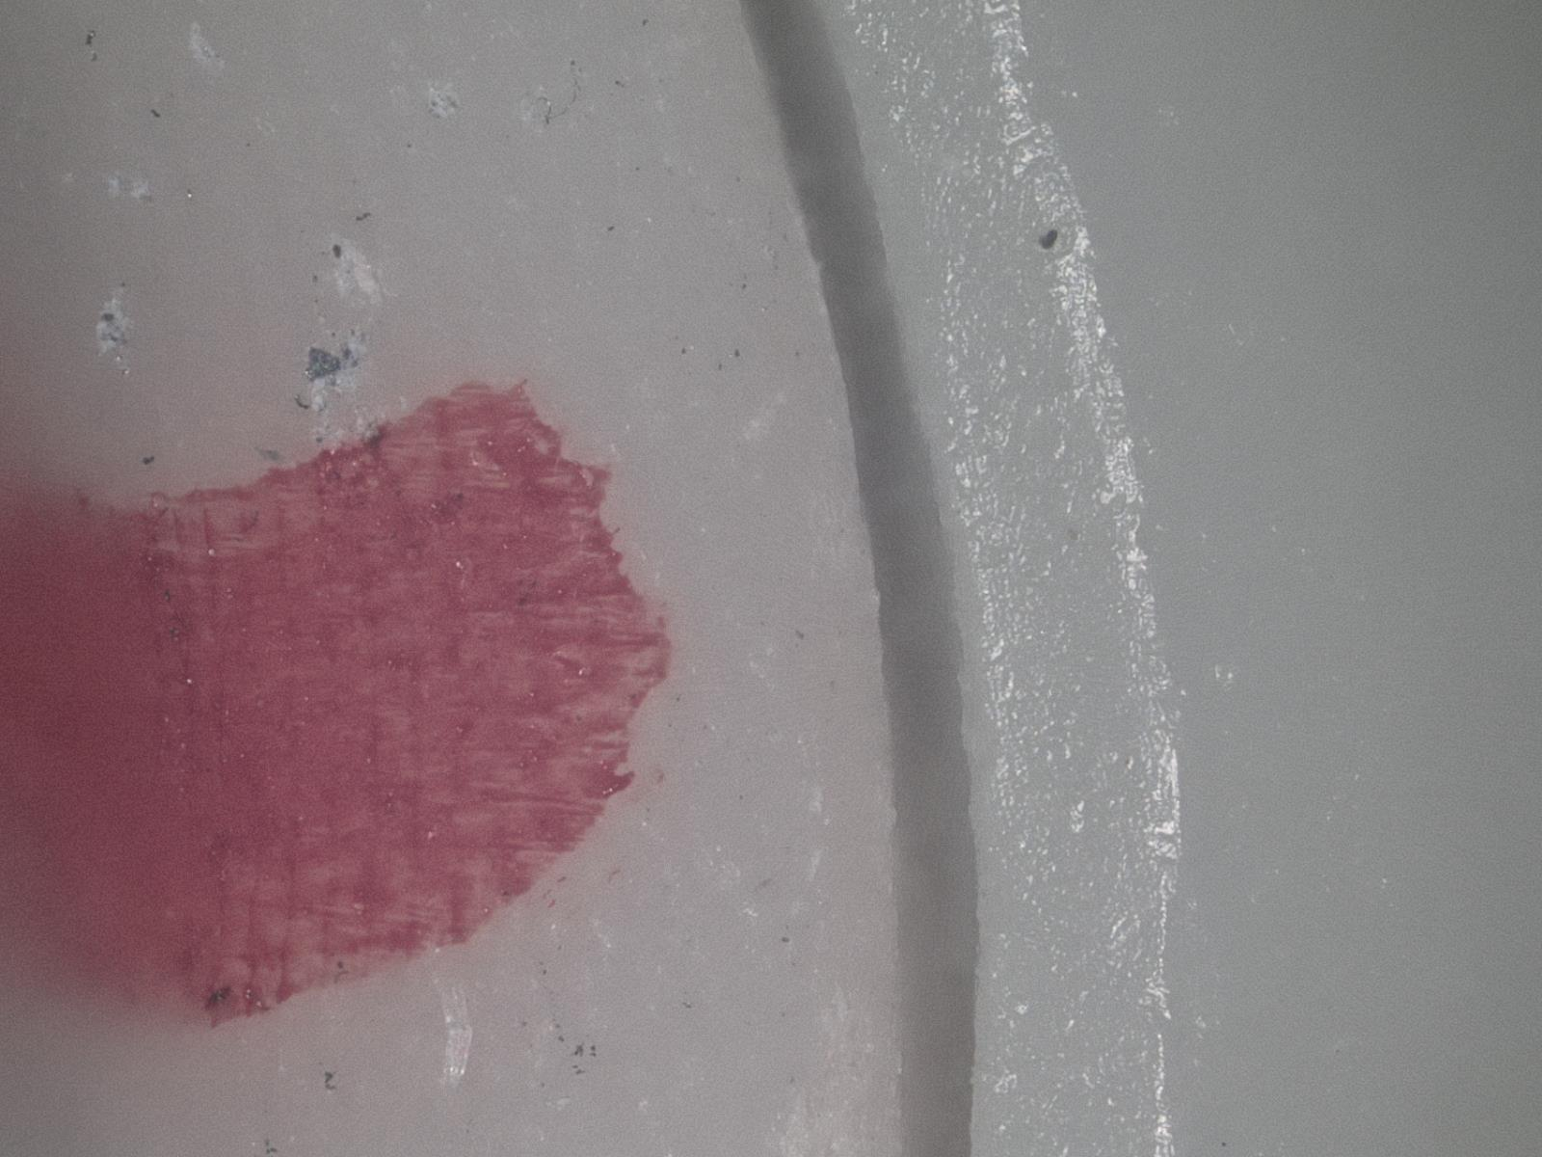
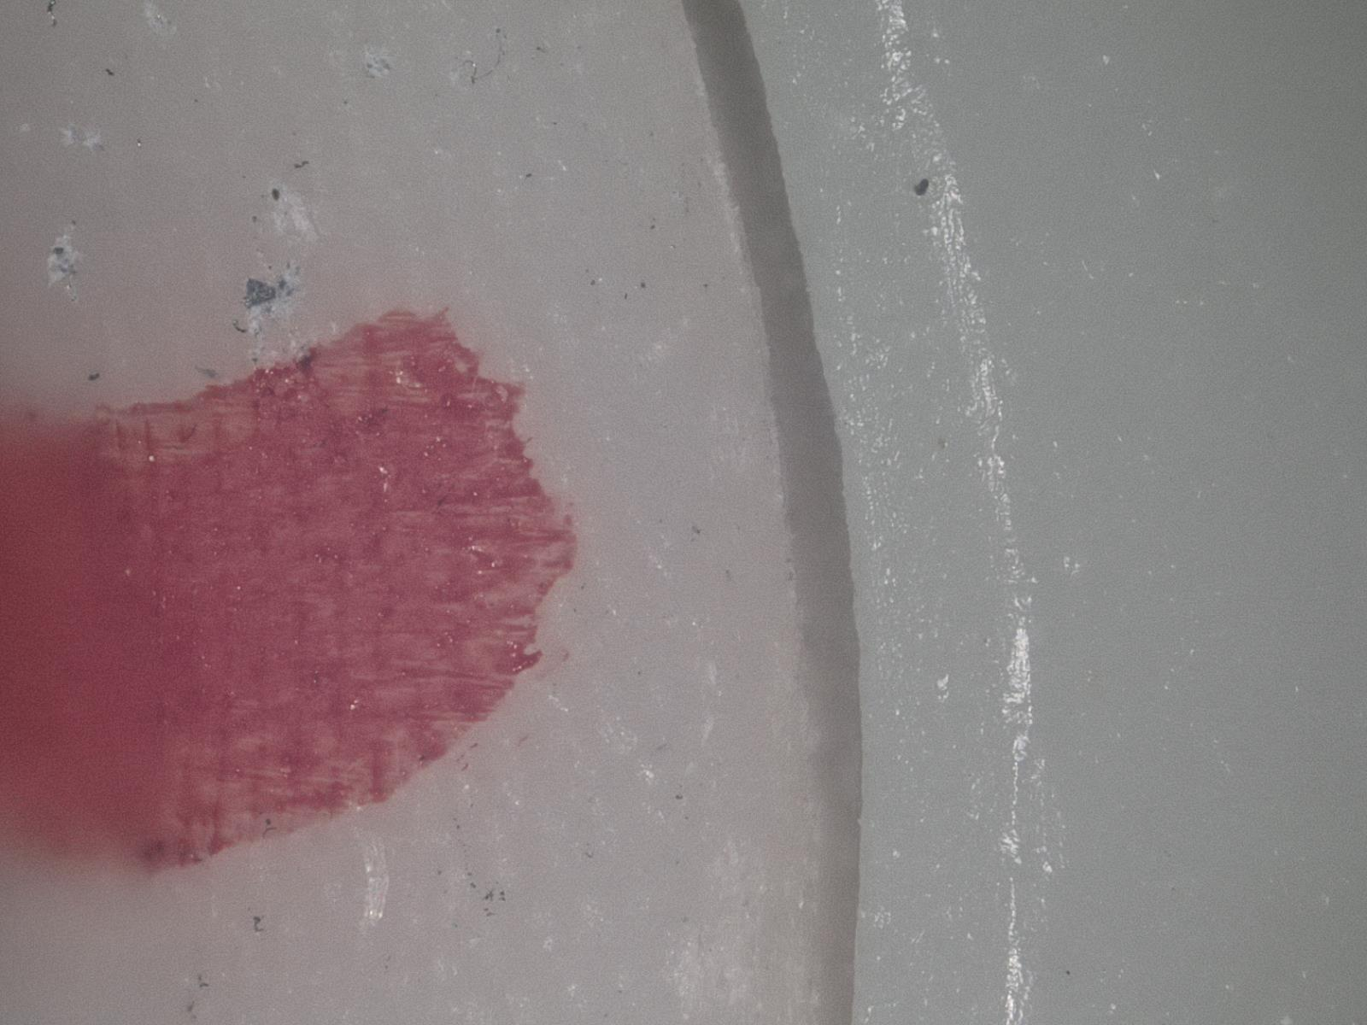
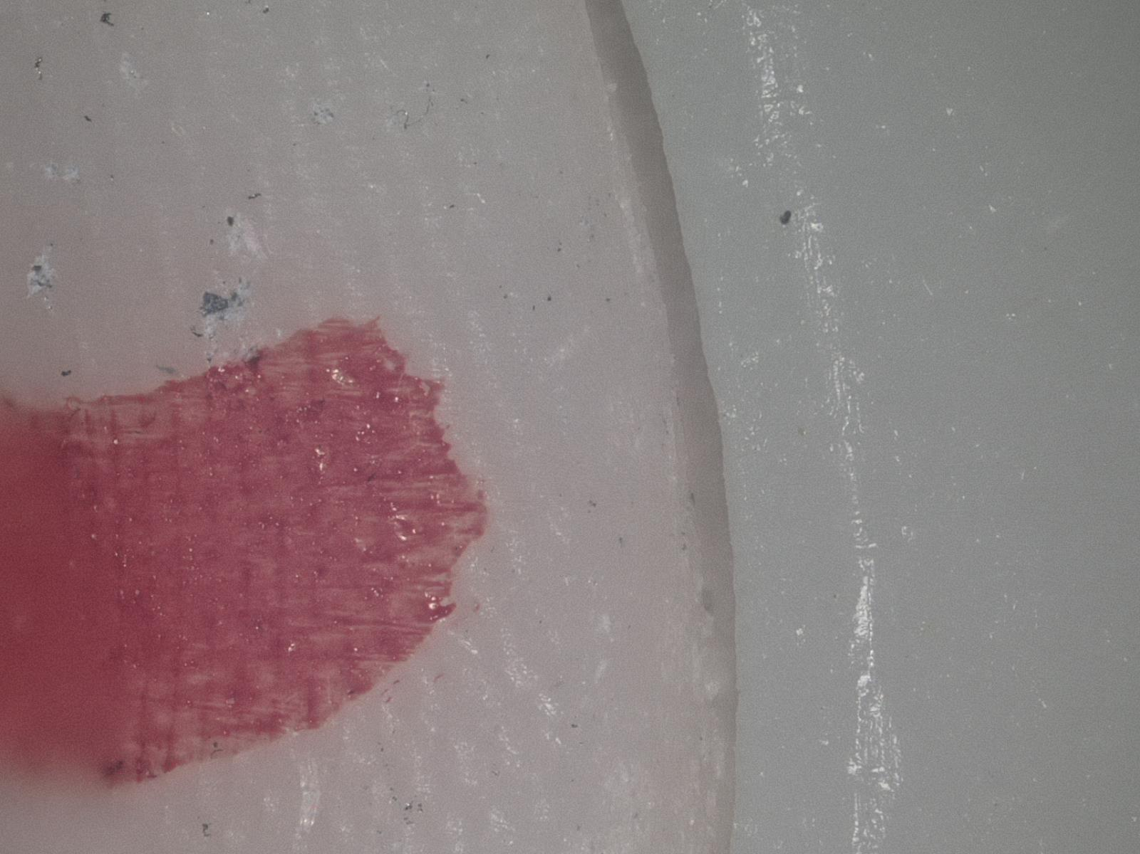
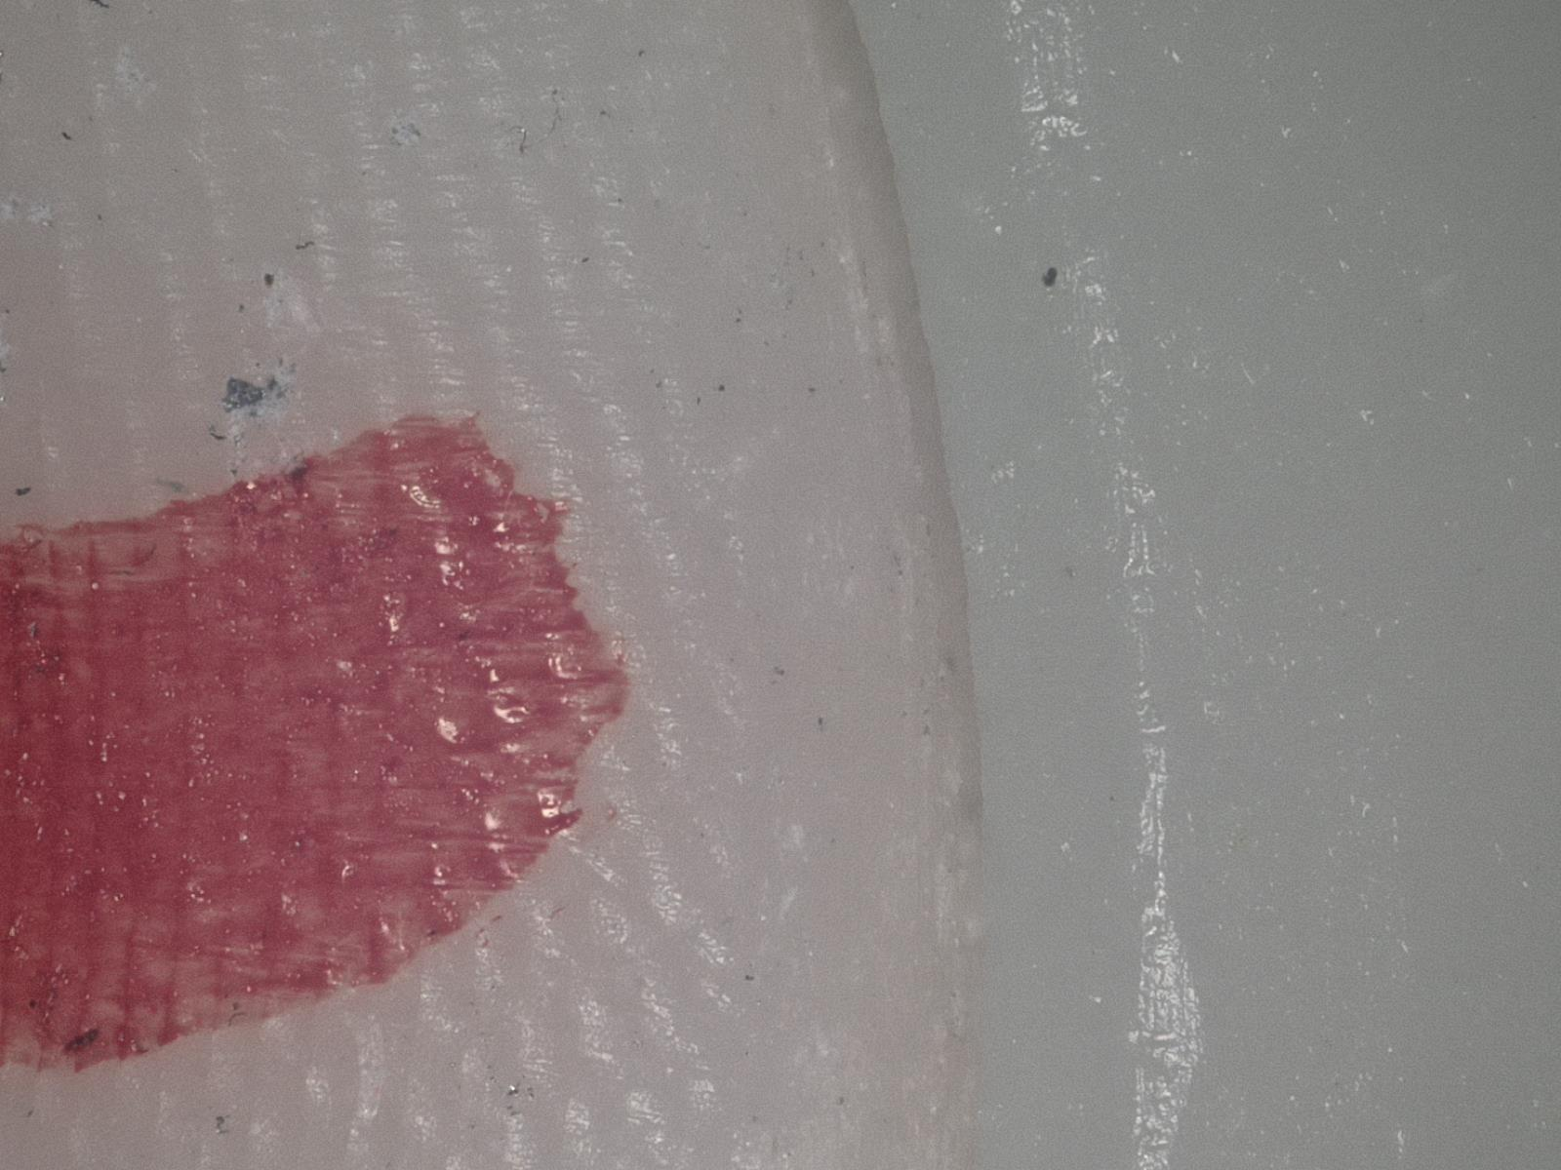
Issues
0°
5°
What angle to choose?
Solution:
Two people consensus.
10°
15°
20°
25°

Slide 17
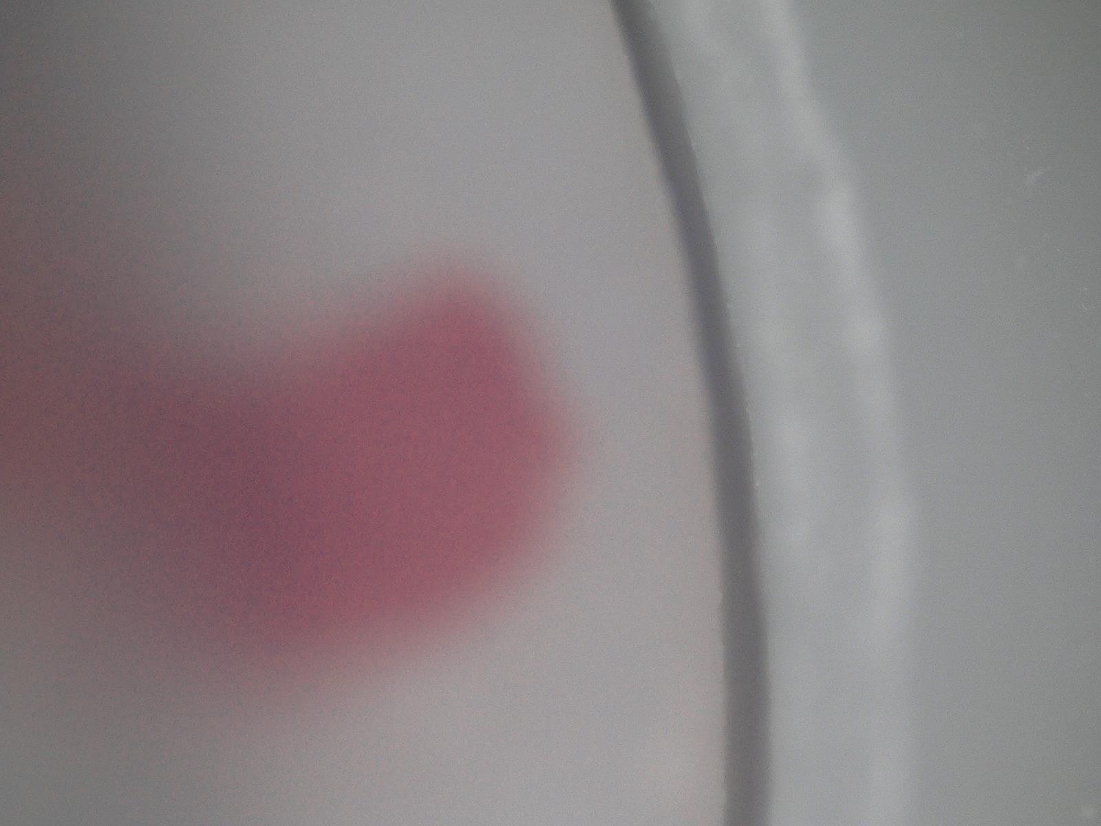
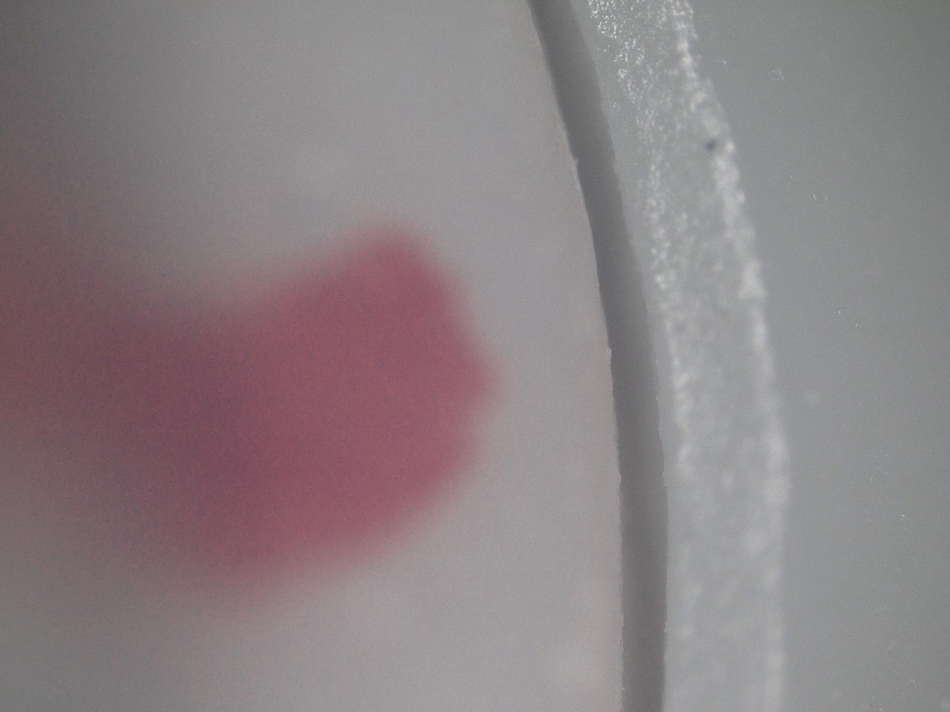
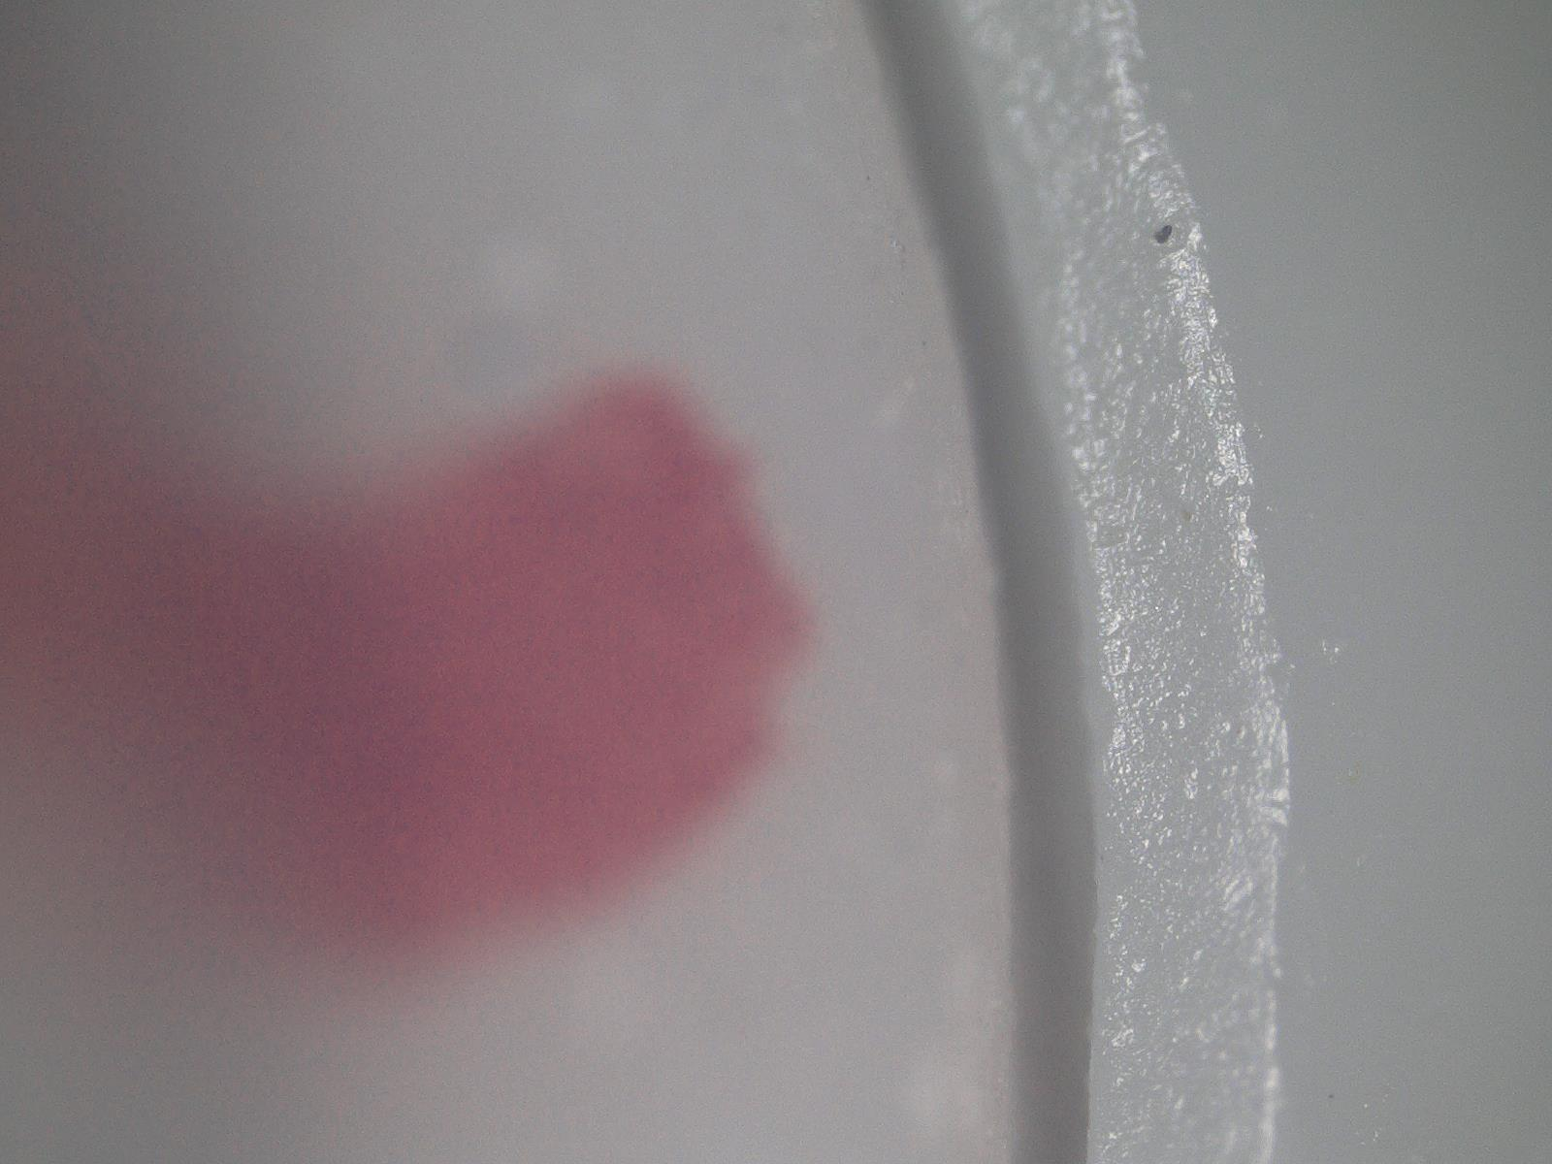
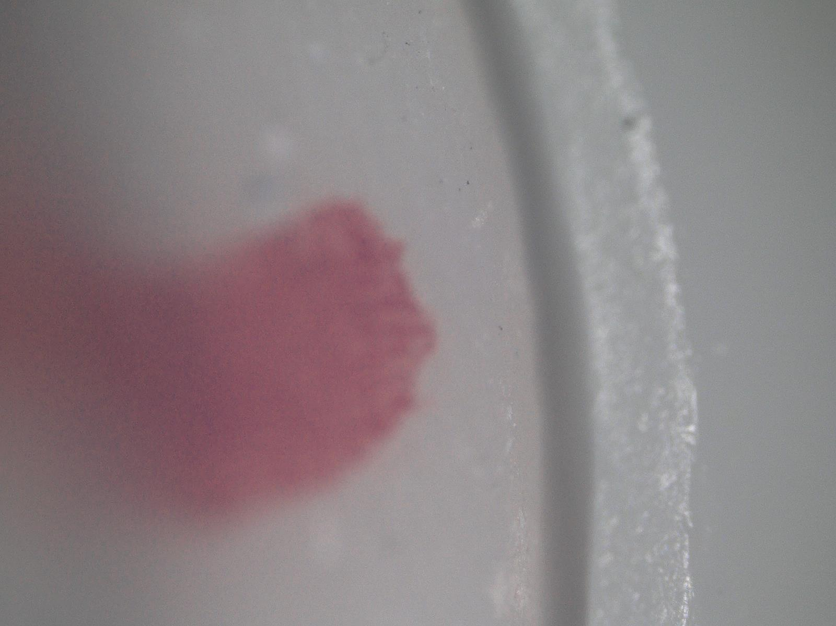
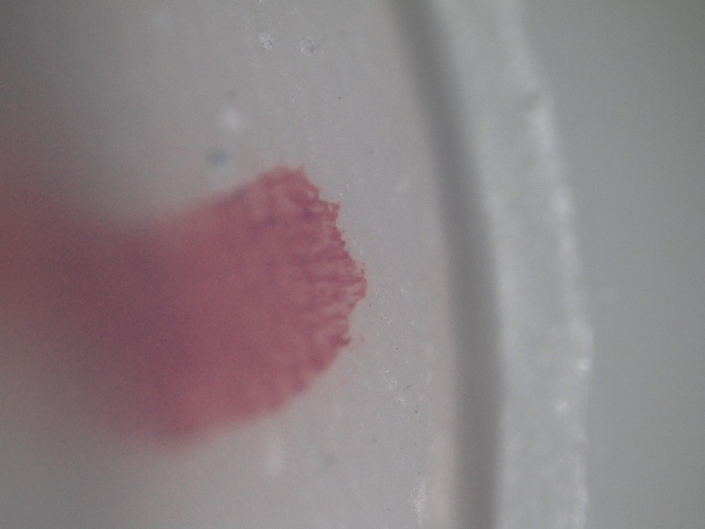



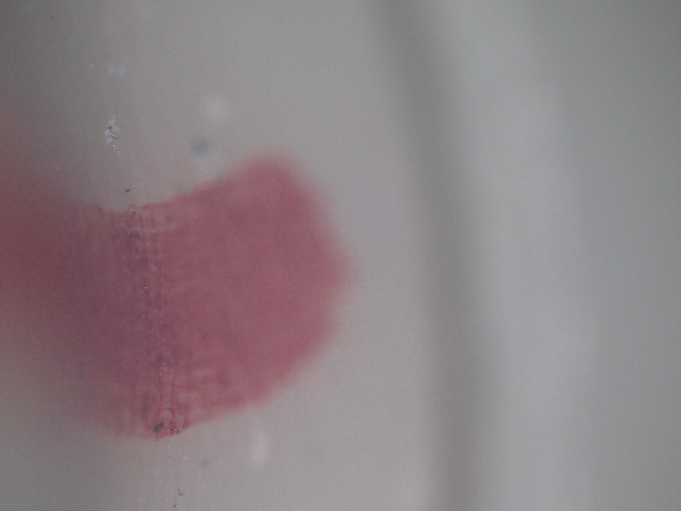
Issues
Limited field of depth
Solution:
In-depth composition

Slide 18
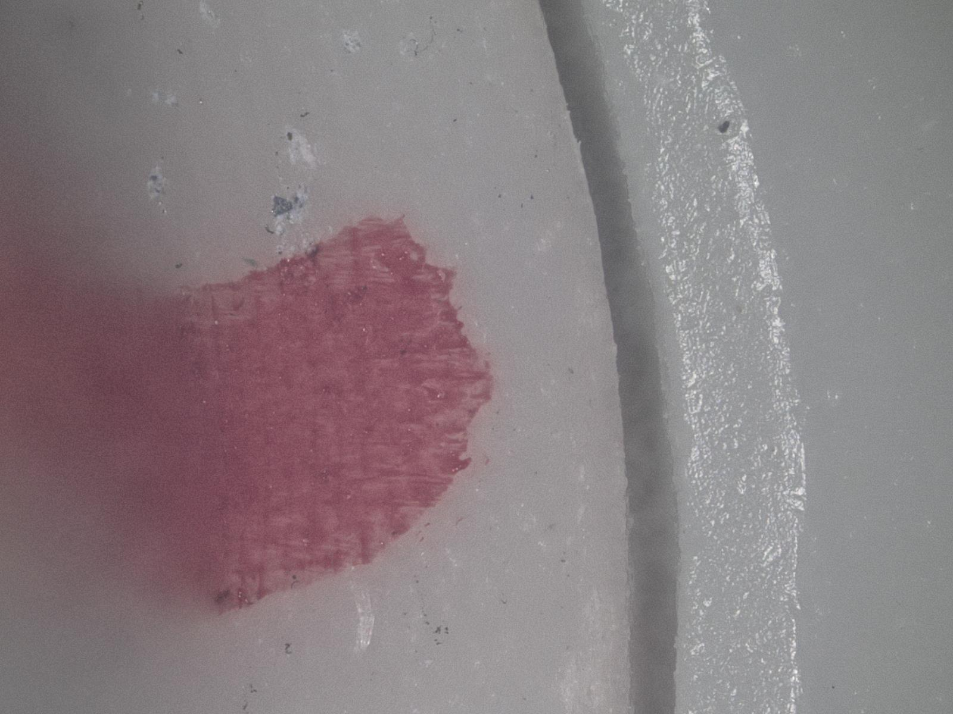
Issues
Limited field of depth
Solution:
In-depth composition

Slide 19
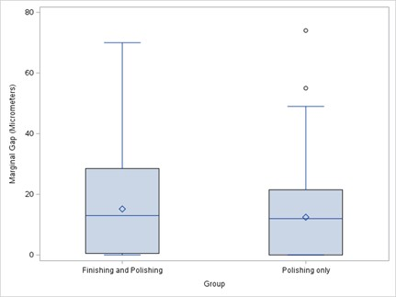
5. What are the results?
The Mann–Whitney U test showed a significant difference in marginal gaps between the two groups (U = 15529.00, Z = 2.02, p = 0.043).

Slide 20
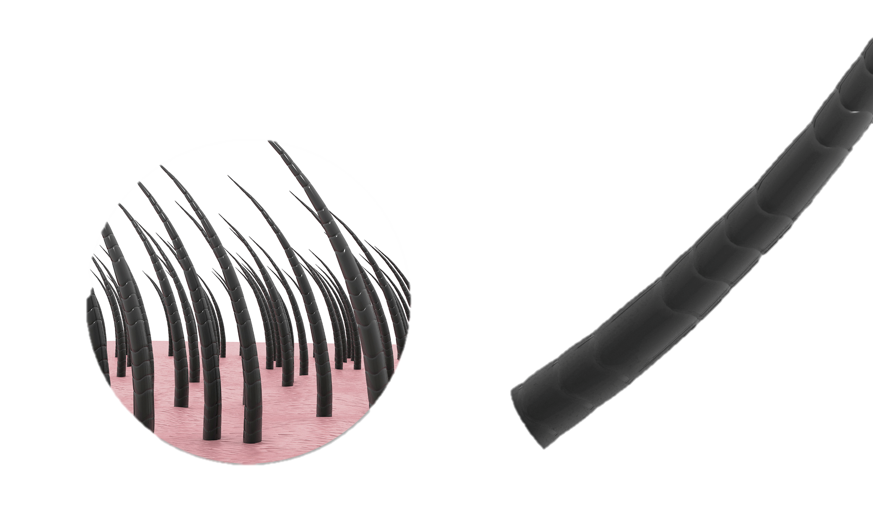
Quick discussion
Marginal fit is within the clinically accepted value.
Dimensional stability of the 3D resin material need to be improved.

Slide 21




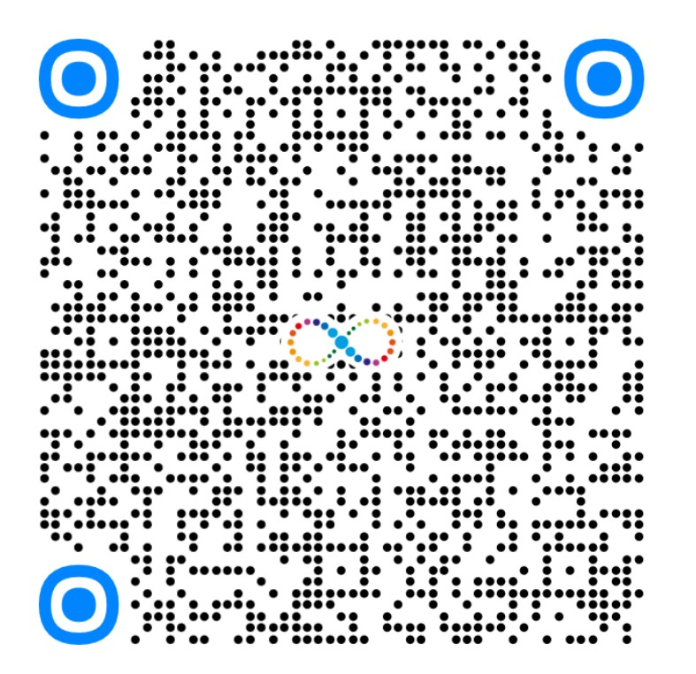
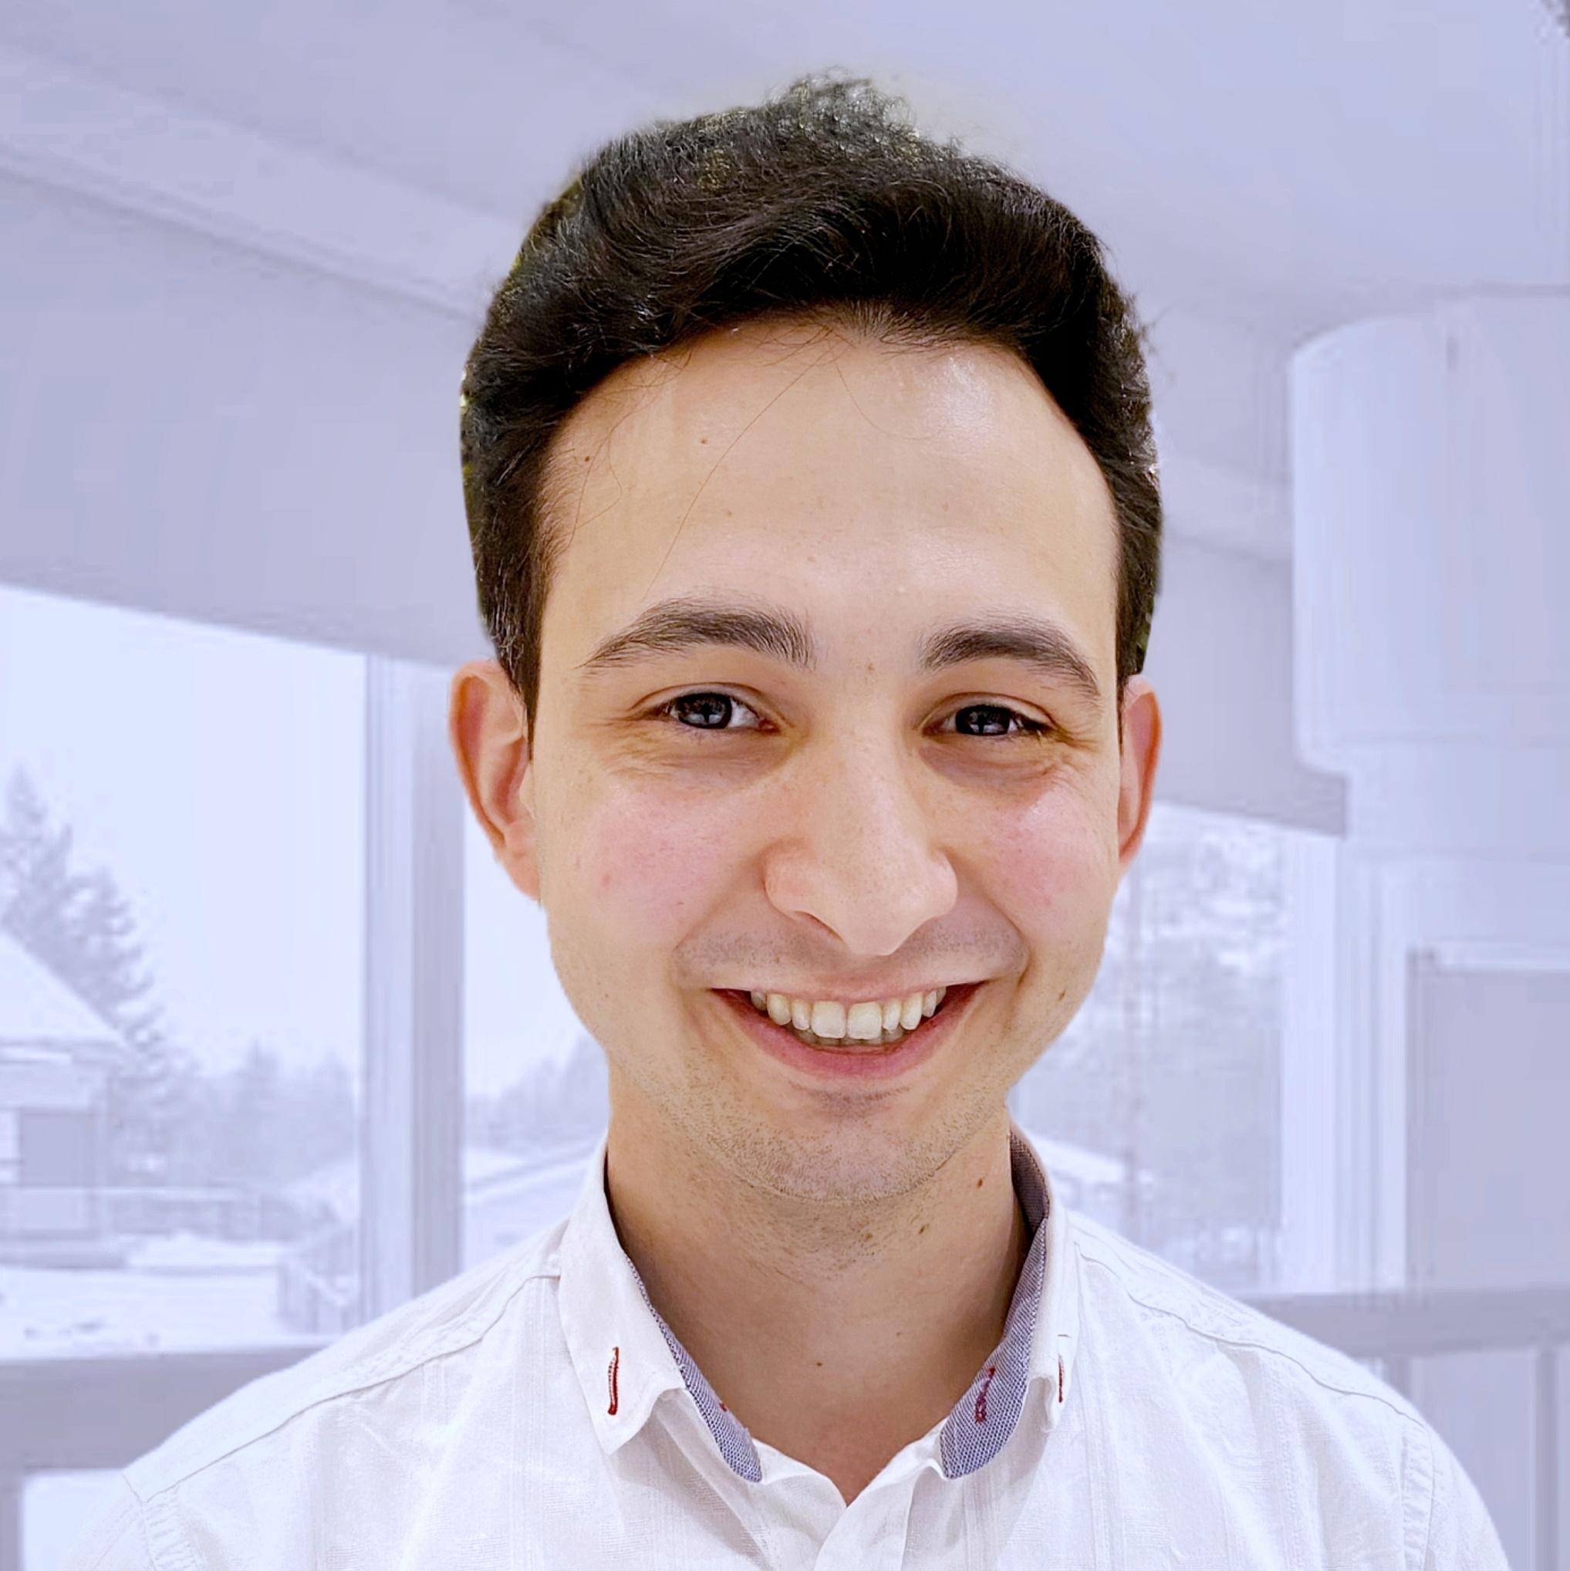

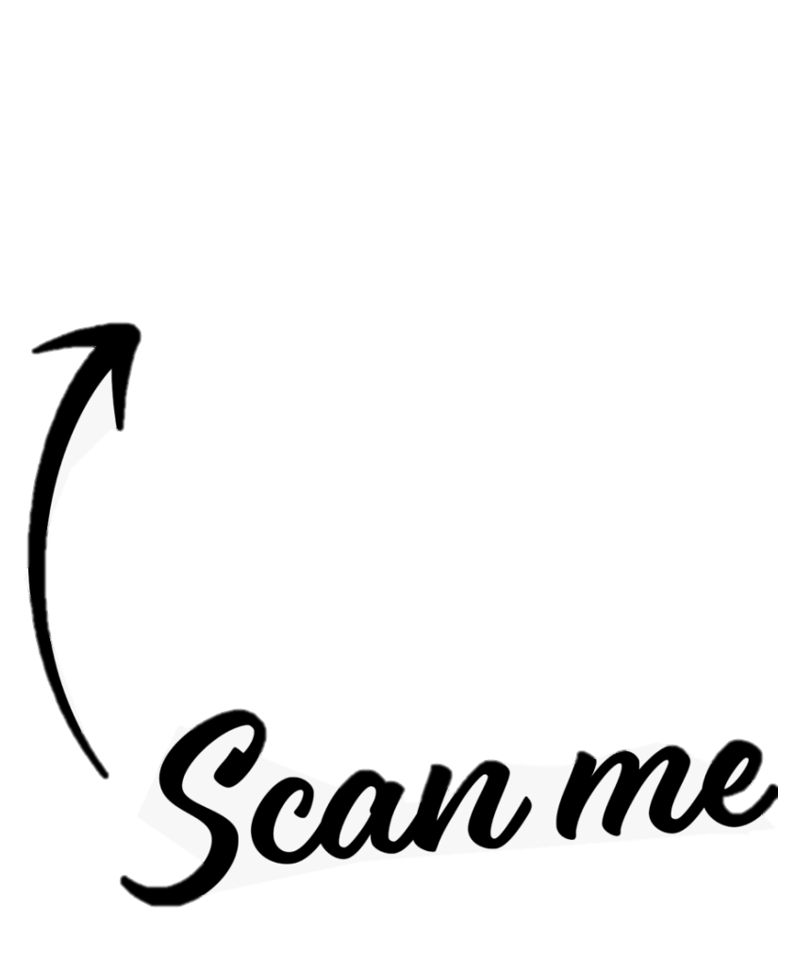



Acknowledgment
Palacky University supported this work with the grant IGA_LF_2024_009.
Dr. Marwan Al Akkad
Marwan.alakkad01@upol.cz
Mgr. Václav Prokůpek
vaclav.prokupek@upol.cz

