Slide 1
Multimodal AFM and optical microscopy reveals mechanical properties of multi-phase biomolecular condensates
Jakub Cibulka
Lumír Krejčí lab
Multimodal Microscopy Workshop 2025
Brno
Notes:
Our initial experience…..Combination of afm and optical microscopy to study biomolecular condensates

Slide 2
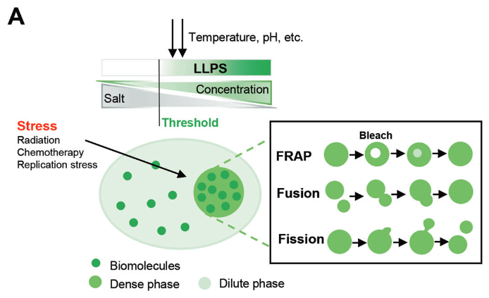
Biomolecular condensates form by phase transitions
Wang et al. Liquid-liquid phase separation in DNA double-strand breaks repair. Cell Death Dis 2023
Notes:
Focus on technique….introducing the sample
Biomolecular condensate…form in cells…demixing NAs/proteins…denser face…formation of droplets/foci
Dynamic process…..regulated….
LLPS but also other transitions

Slide 3
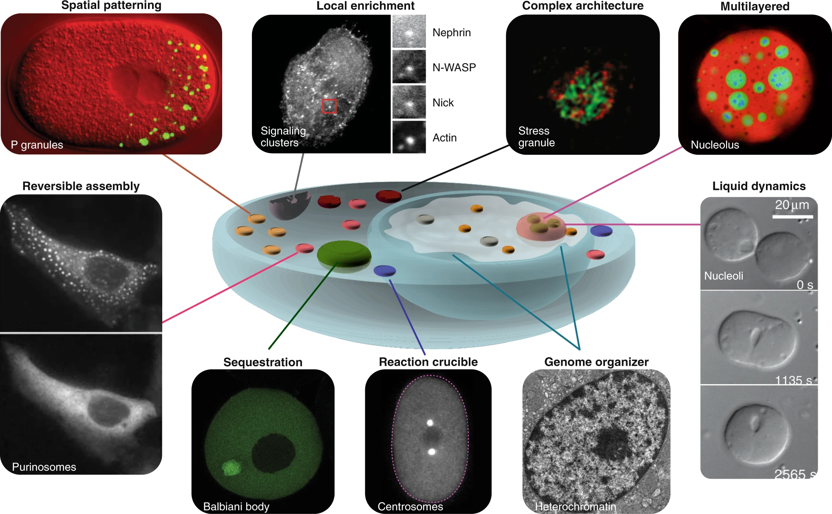
Biomolecular condensates organize cellular processes
Bracha et al. Probing and engineering liquid-phase organelles. Nat Biotechnol 2019
Notes:
Important organizers of cell interior
non-membrane-bound organells, bodies, stress granules
Compartmentalize and facilitate reactions, storage, force generation….
Often complex architecture with multiple non-miscible phases (nucleolus)
what determines complex behavior of condensates?

Slide 4
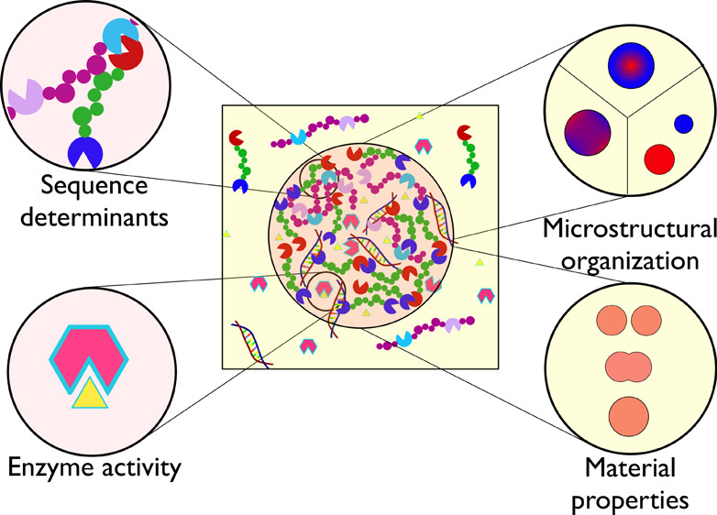
Determinants of condensate function
Interfacial tension
Stiffness
Viscoelasticity
Fluidity
Schuster et al. Biomolecular Condensates: Sequence Determinants of Phase Separation, Microstructural Organization, Enzymatic Activity, and Material Properties. J Phys Chem B. 2021
Notes:
Number of determinants that influence condensate function
Apart of sequence….focus on microstructural organization and material/mechanical properties (stiffness, interfacial tension, viscosity…) influence their behavior, fusion with other condensates, permeability….interconnected
Difficult to study
Link to in vitro reconstitution

Slide 5
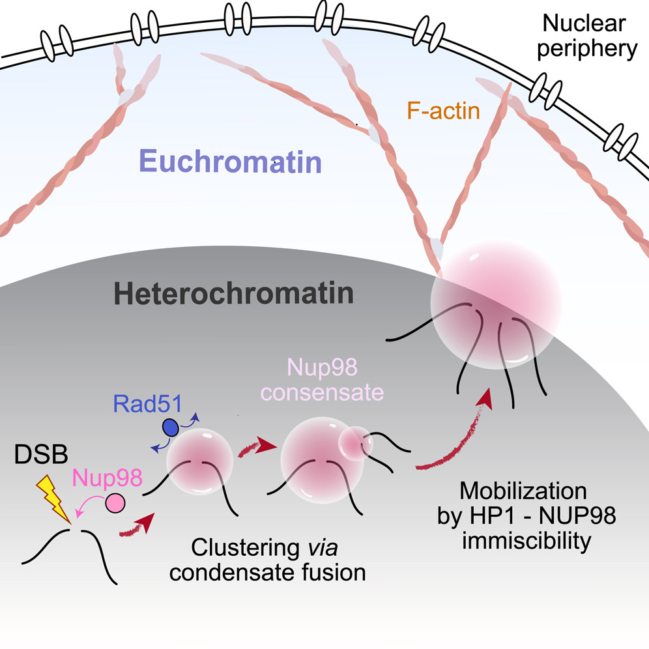
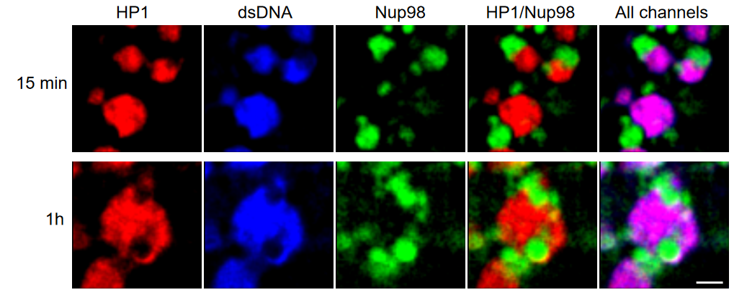
In vitro reconstitution of complex condensates (NUP98/HP1 as example)
“Heterochromatin“
Scale bar = 1um
Merigliano et al. Off-pore Nup98 condensates mobilize heterochromatic breaks and exclude Rad51. Mol Cell 2025
Notes:
To study mechanical properties….molecular mechanisms….reconstitution…difficult in cells
Biological example that we study….our lab interested in DNA repair
DSBs in heterochromatin are protected from aberrant recombination by Nup98 condensates
Our data suggests….NUP98 condensate within heterochromatin condensate---capilary forces…movement/push-out effect….safe reapir
To study mechanisticaly….reconstitution in simplified system….HP1/DNA = heterochtomatin, NUP98
Form co-comdensates but don‘t mix….NUP98 accupying holes at the surface of HP1…supports are hypothesis (capilary forces)
One step further…..mechanical properties…important for function in relocalization/generation of capillary

Slide 6
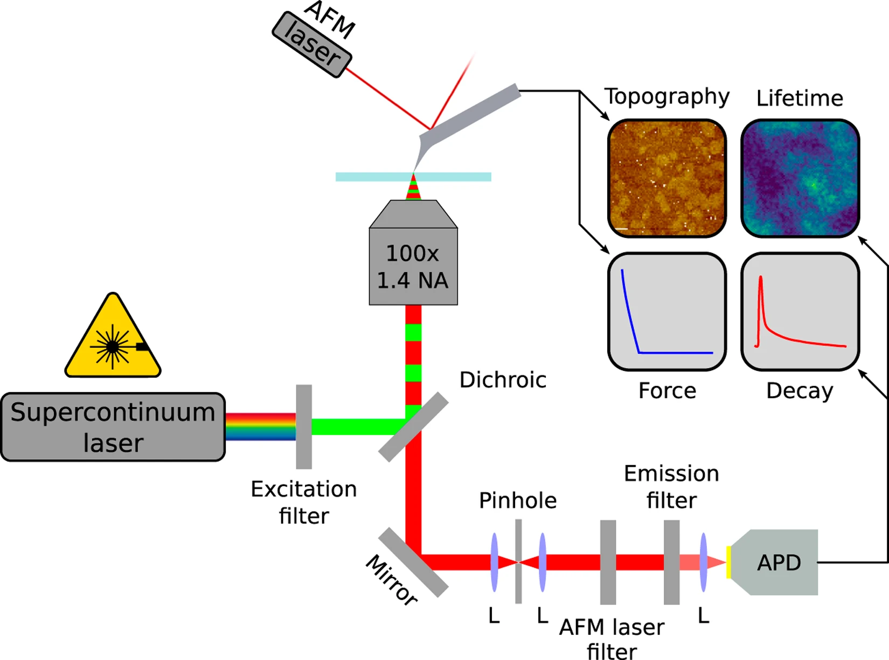
Multimodal microscopy of NUP98/HP1 condensates in solution
Fernandes et al. Synchronous, Crosstalk-free Correlative AFM and Confocal Microscopies/Spectroscopies. Sci Rep 2020
Notes:
To study our model condensates in higher resolution and measure mechanical properties…
Core facility
Multimodal AFM and optical (confocal) microscopy, both AFM and optical imaging in one chamber
….distinguish HP1/NUP98 phases within complex condensate by fluorescence….use AFM for surface mapping and mechanical properties

Slide 7

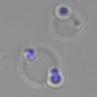

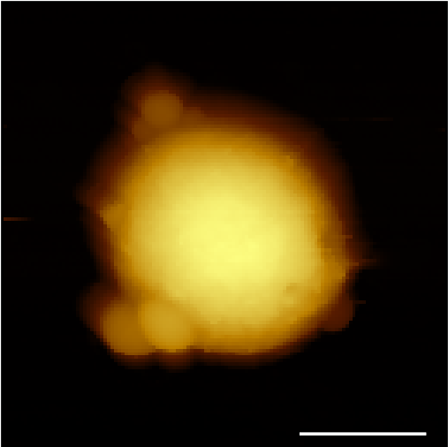
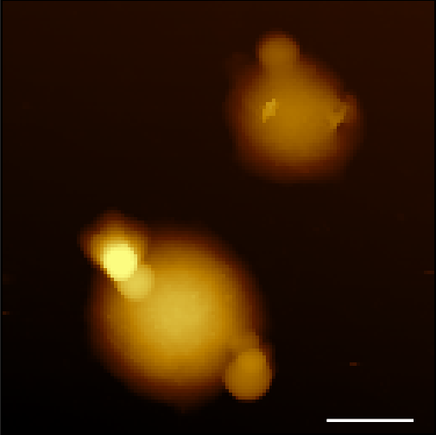
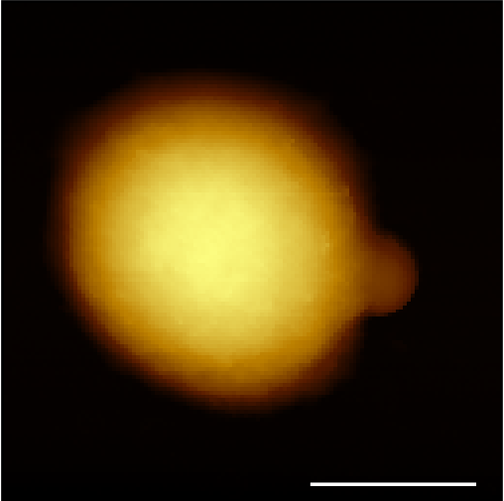
Multimodal microscopy of NUP98/HP1 condensates in solution
HP1 + DNA
Optical microscopy
NUP98
2 µm
2
Height (µm)
AFM (height)
0
Š. Vrána, K. Krejčí
Bruker bio-AFM NanoWizard 3 AFM (Bruker) + Olympus IX-81 + Olympus FL1200
Notes:
In solution, native
Extensive optimization…surfaces, cantilevers…
….distinguish HP1/NUP98….only NUP98 fluorescence
Observe the surface of condensates (higher resolution)

Slide 8
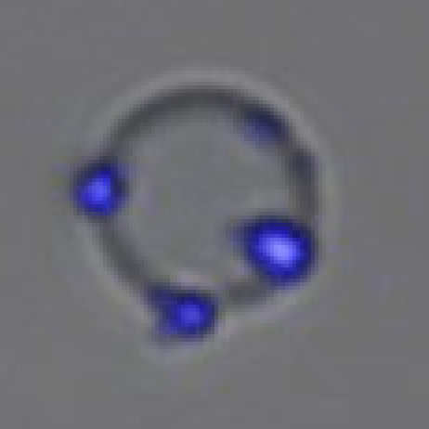
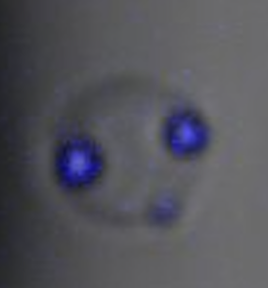
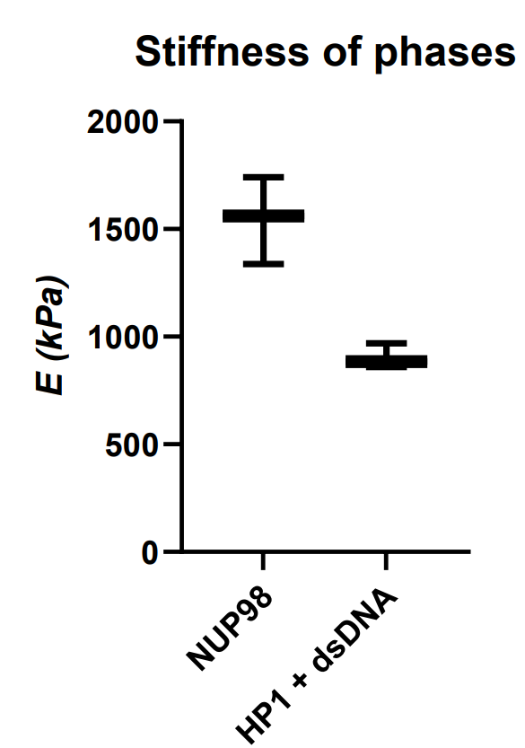
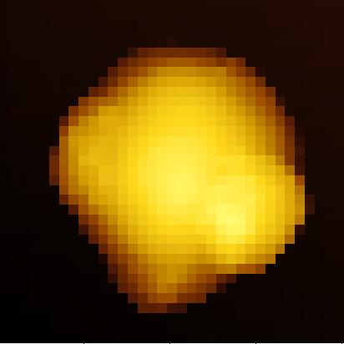
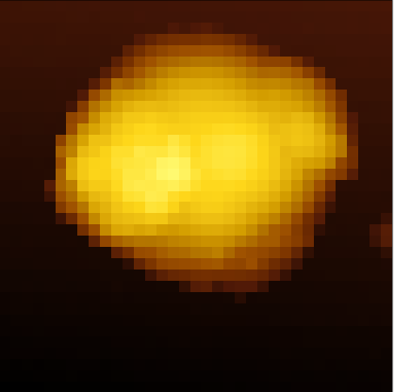
Multimodal microscopy of NUP98/HP1 condensates in solution
HP1 + DNA
NUP98
Optical microscopy
AFM (height)
Š. Vrána, K. Krejčí
Bruker bio-AFM NanoWizard 3 AFM (Bruker) + Olympus IX-81 + Olympus FL1200; NITRA tall cantilever
Notes:
Mechanical properties
Stifness of individual phases…HP1 condensates less stiff…could reflect interfacial tension…

Slide 9
Future perspective: multiparameter condensate characterization
Direct measurement of interfacial tension
Effect of regulatory factors on condensate properties
Correlation with condensate permeability
Extension to other biological systems
Schuster et al. Biomolecular Condensates: Sequence Determinants of Phase Separation, Microstructural Organization, Enzymatic Activity, and Material Properties. J Phys Chem B. 2021
Notes:
Built on the preliminary data
One setp-up/instrument to measure….

Slide 10




Acknowledgements
Kateřina Krejčí
Šimon Vrána (CEITEC Nanobiotechnology CF)
Jan Přibyl (CEITEC Nanobiotechnology CF)
Lumír Krejčí lab
Irene Chiolo lab (USC)
Patrick Sung lab (UTHSCSA)

