Slide 1





Measurement of SEM charging directly via AFM
Jakub Hruška
jakub.hruska@ceitec.muni.cz

Slide 2
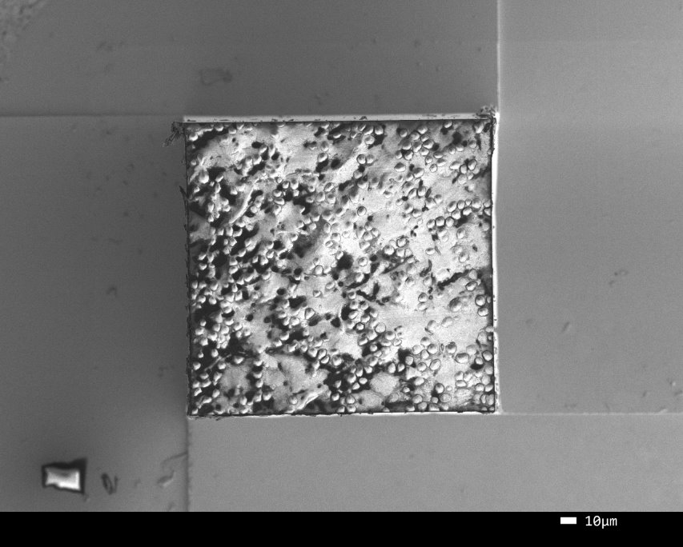
Motivation
Charging distorts the image – especially biological samples
Develop new resins with enhanced charge dissipation
(Czech Academy of Science, Prague ) to mitigate charging artefacts
Aim:
Characterise charging of newly synthesised resins –with AFM – in EFM mode
possible semiquantitative analysis of samples
SE image

Slide 3
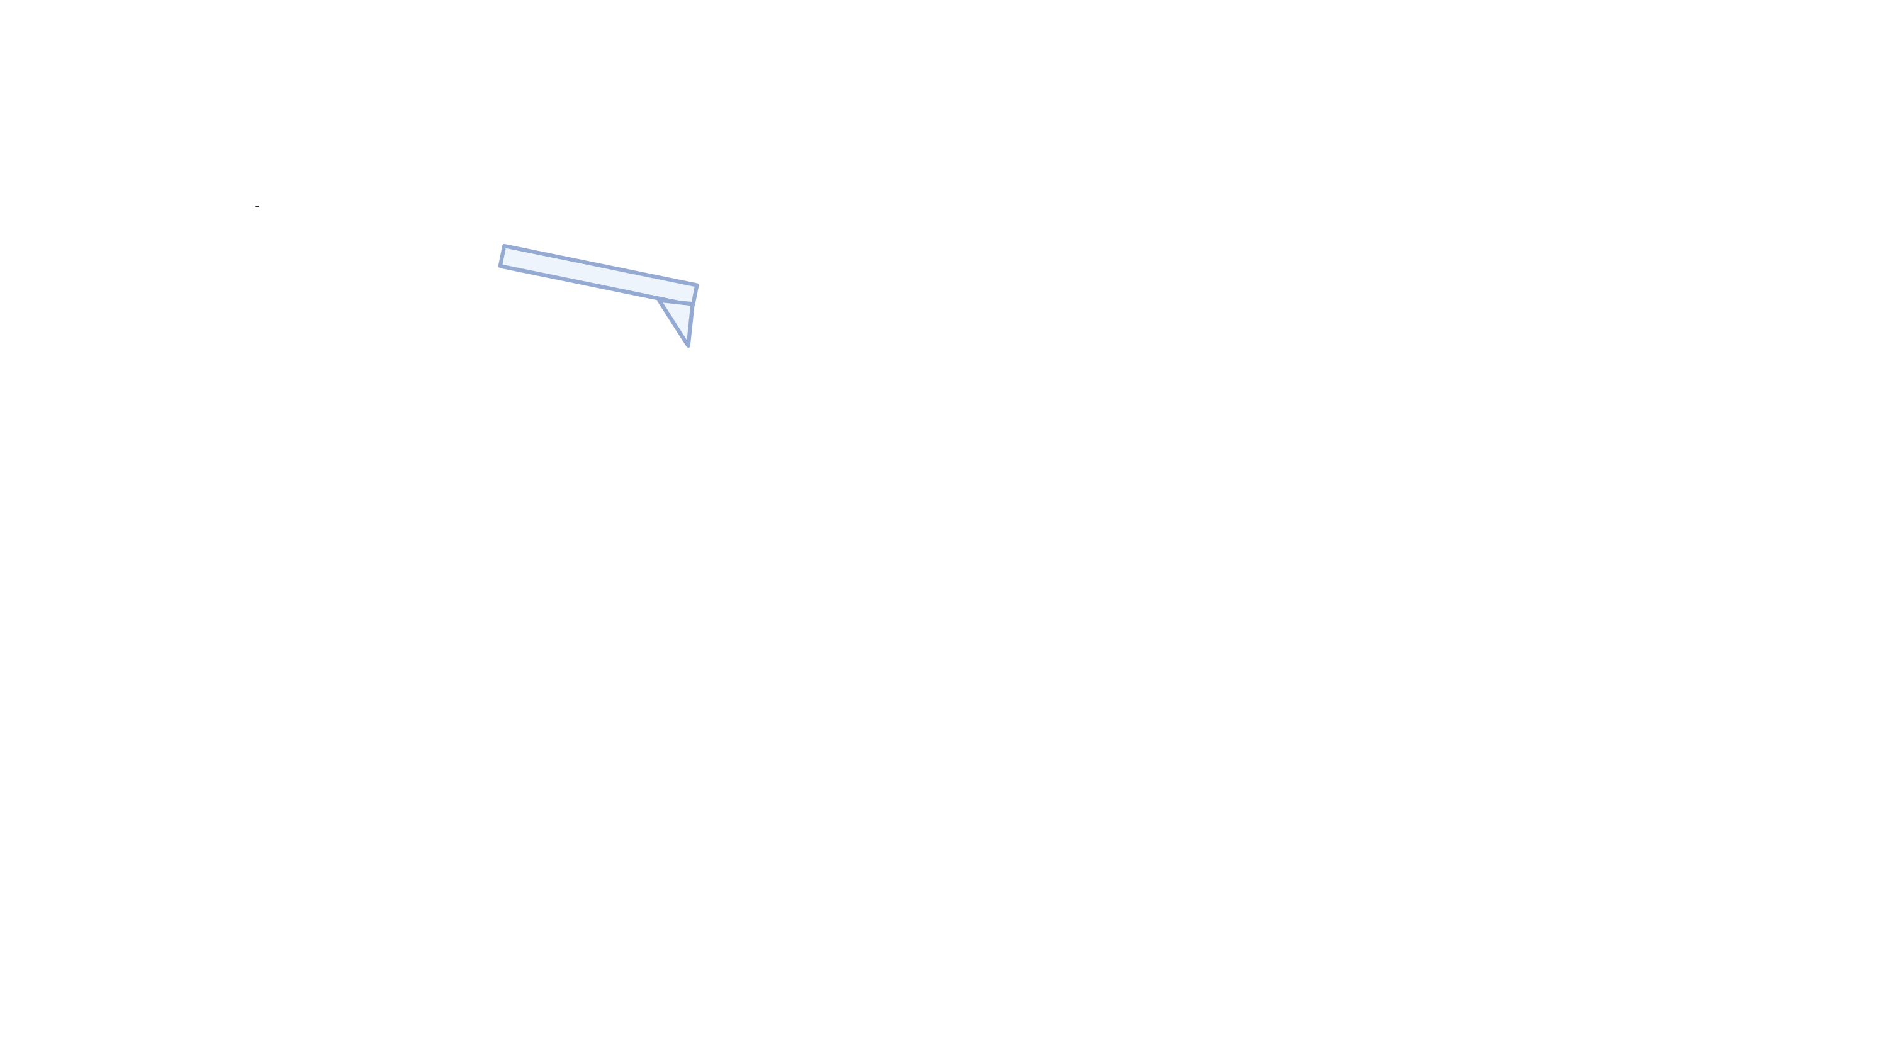
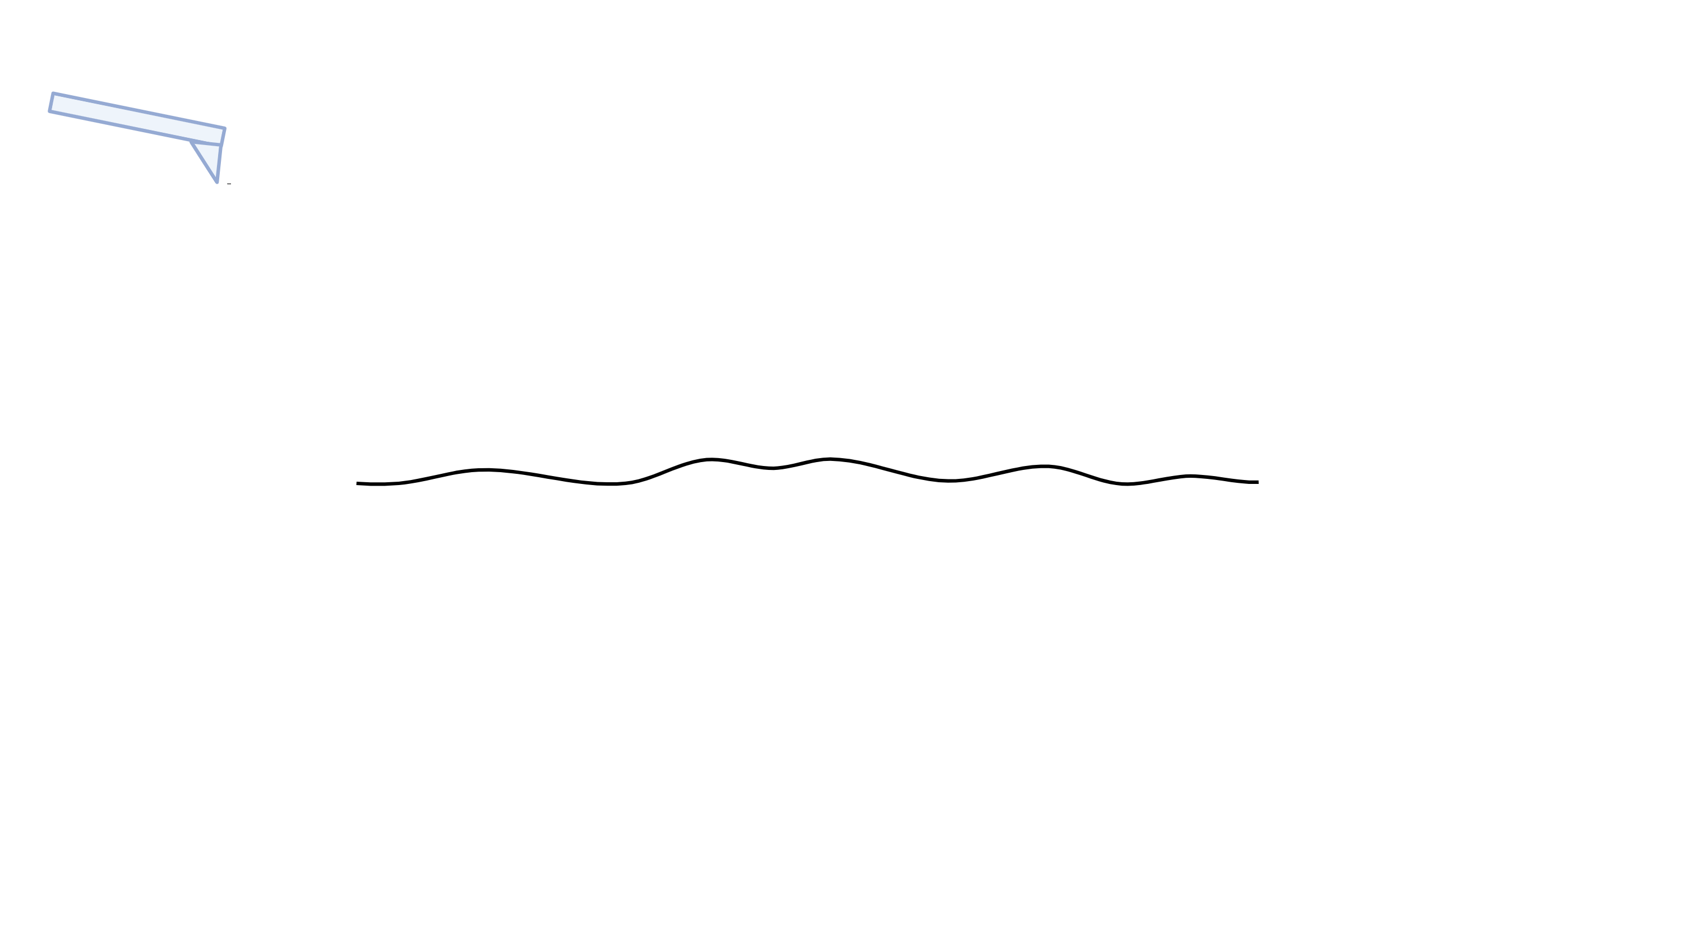
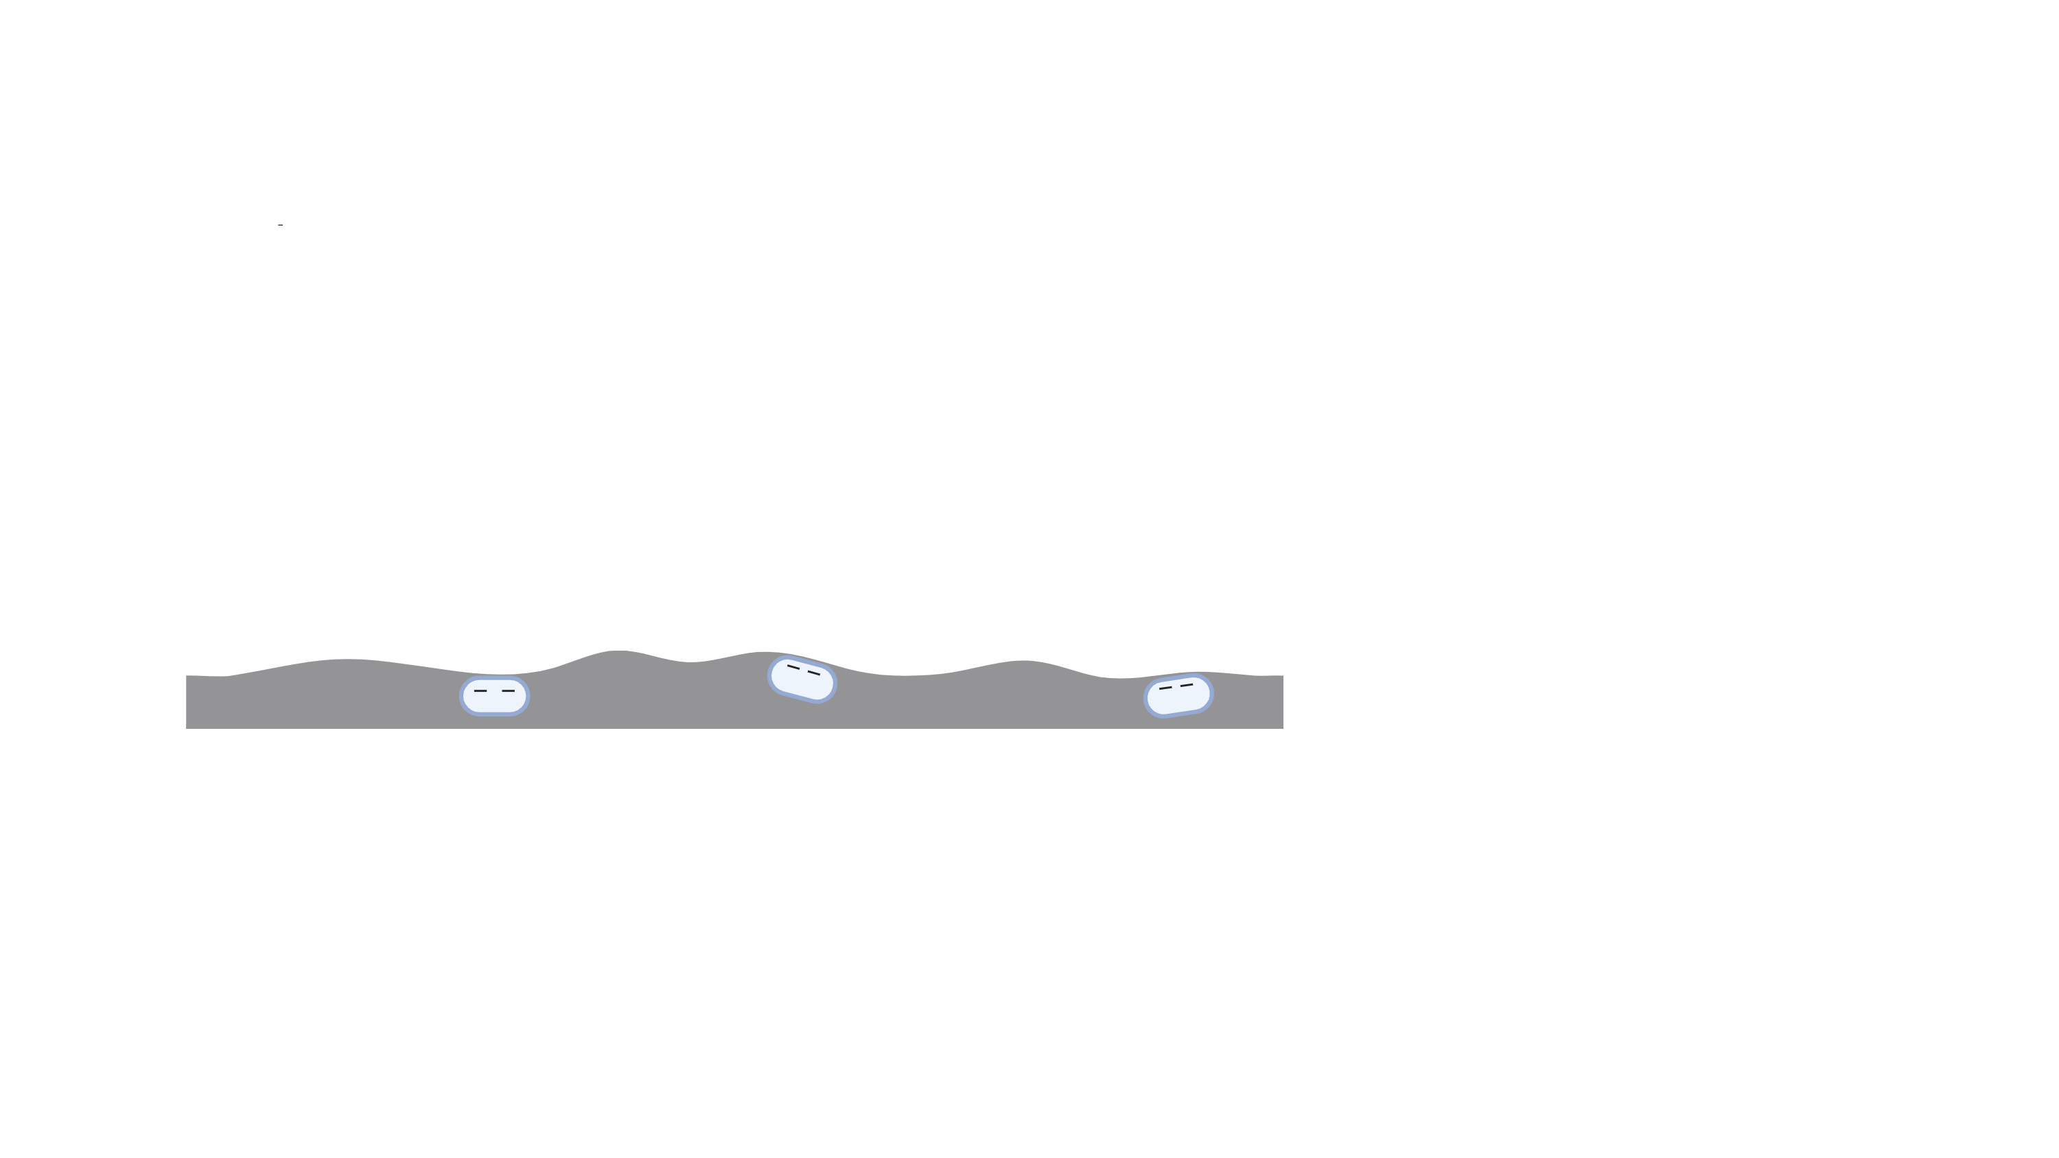
Electrostatic Force Microscopy
EFM signal
Second pass
offset
First pass
Topography
Conductive tip
Partially charged sample by electron gun
Notes:
Just to remind u the EFM principle. In our cawse it is two pass systém. Firstly the topography is scanned. After that (to mitigate the wanderval forces), the conductive tip is offset and the tip follows the topography profile and senses the charged parts. The tip is either repulsed or acrated to the charged parts depeinding on the poteincial

Slide 4
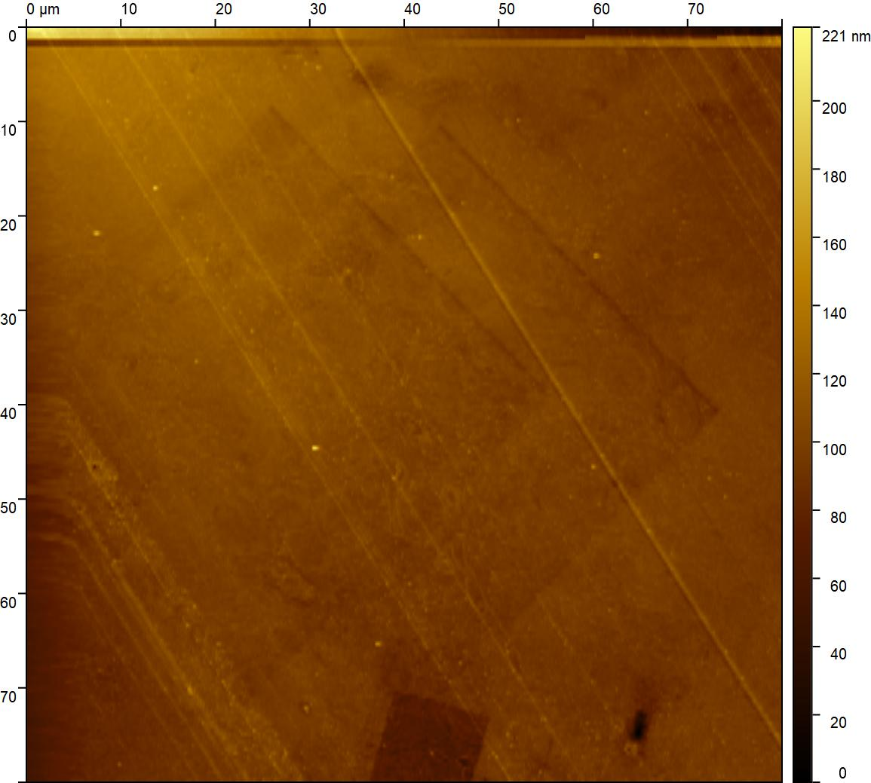
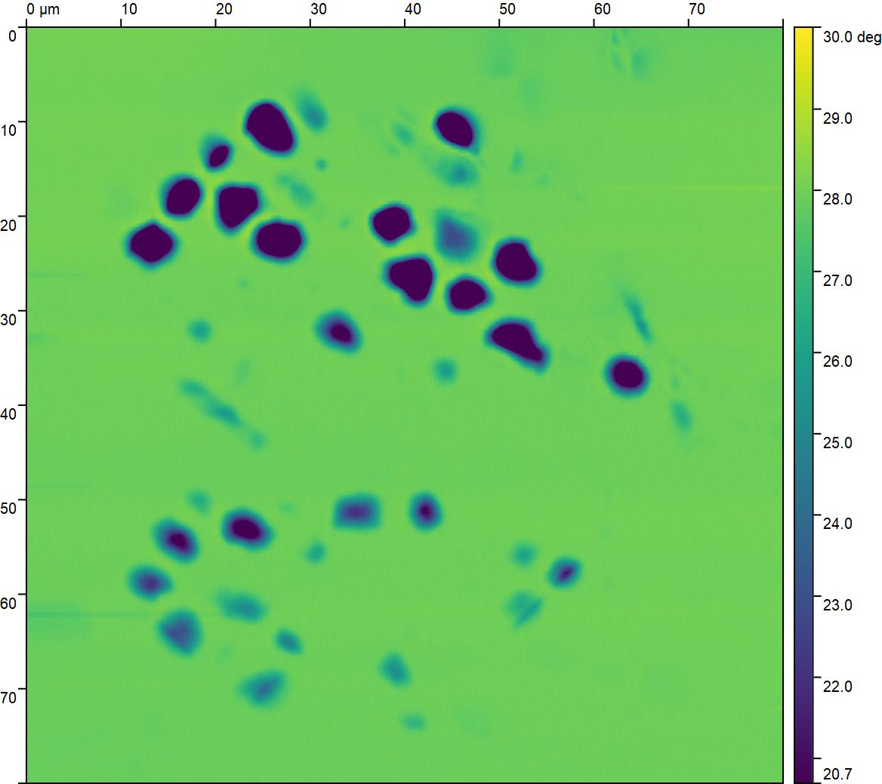
Preliminary data
Sample - brain cells embedded in resin - cut with a microtome – surface should be flat – not in the SEM
SE
Topography
EFM
Red indicated part of the sample irradiated by electrons
The yellow circle indicated area where the tip was present during irradiation, which caused a block of electron deposition onto the surface
Charging distorts the image of the surface in SE
Notes:
The topography is flat. Scars from the microtome knife. The red parts indicated the area where the sample was irradiated this is where blue dots appierd in the EFM channal. According to collegues those parts should be nucleii od the cells. Irradiated parts of the sample can be even seen in the topography. As a small dimmer square.

Slide 5
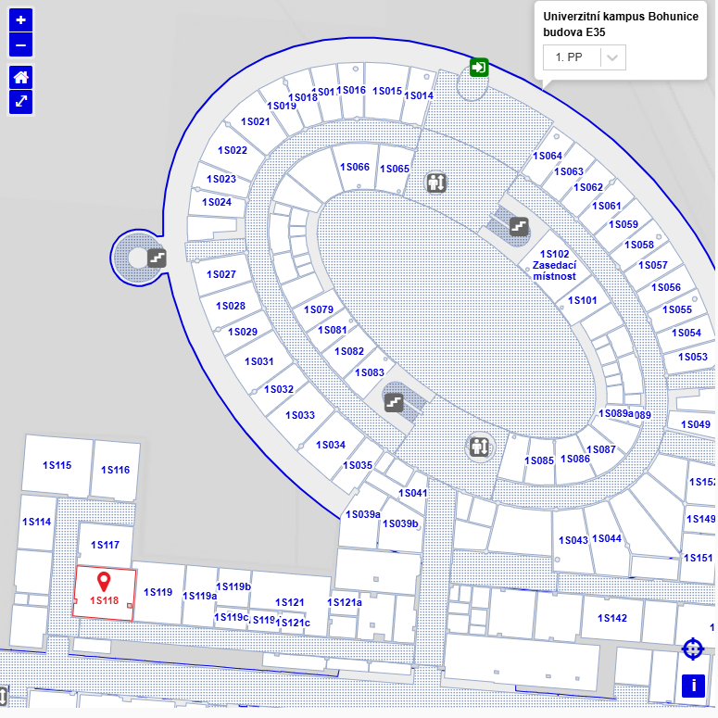
Join the demos AFM in SEM!
Thursday, 11th 13:30 – 17:30
Friday, 12th 9:30 – 12:30
Room 1S118
System: LiteScope 2.5 (AFM) and Versa 3D (SEM)

