Slide 1



Characterization of bacterial film with piezoelectric properties
Markéta Khýrová
10.9.2025
Multimodal Microscopy Workshop 2025

Slide 2
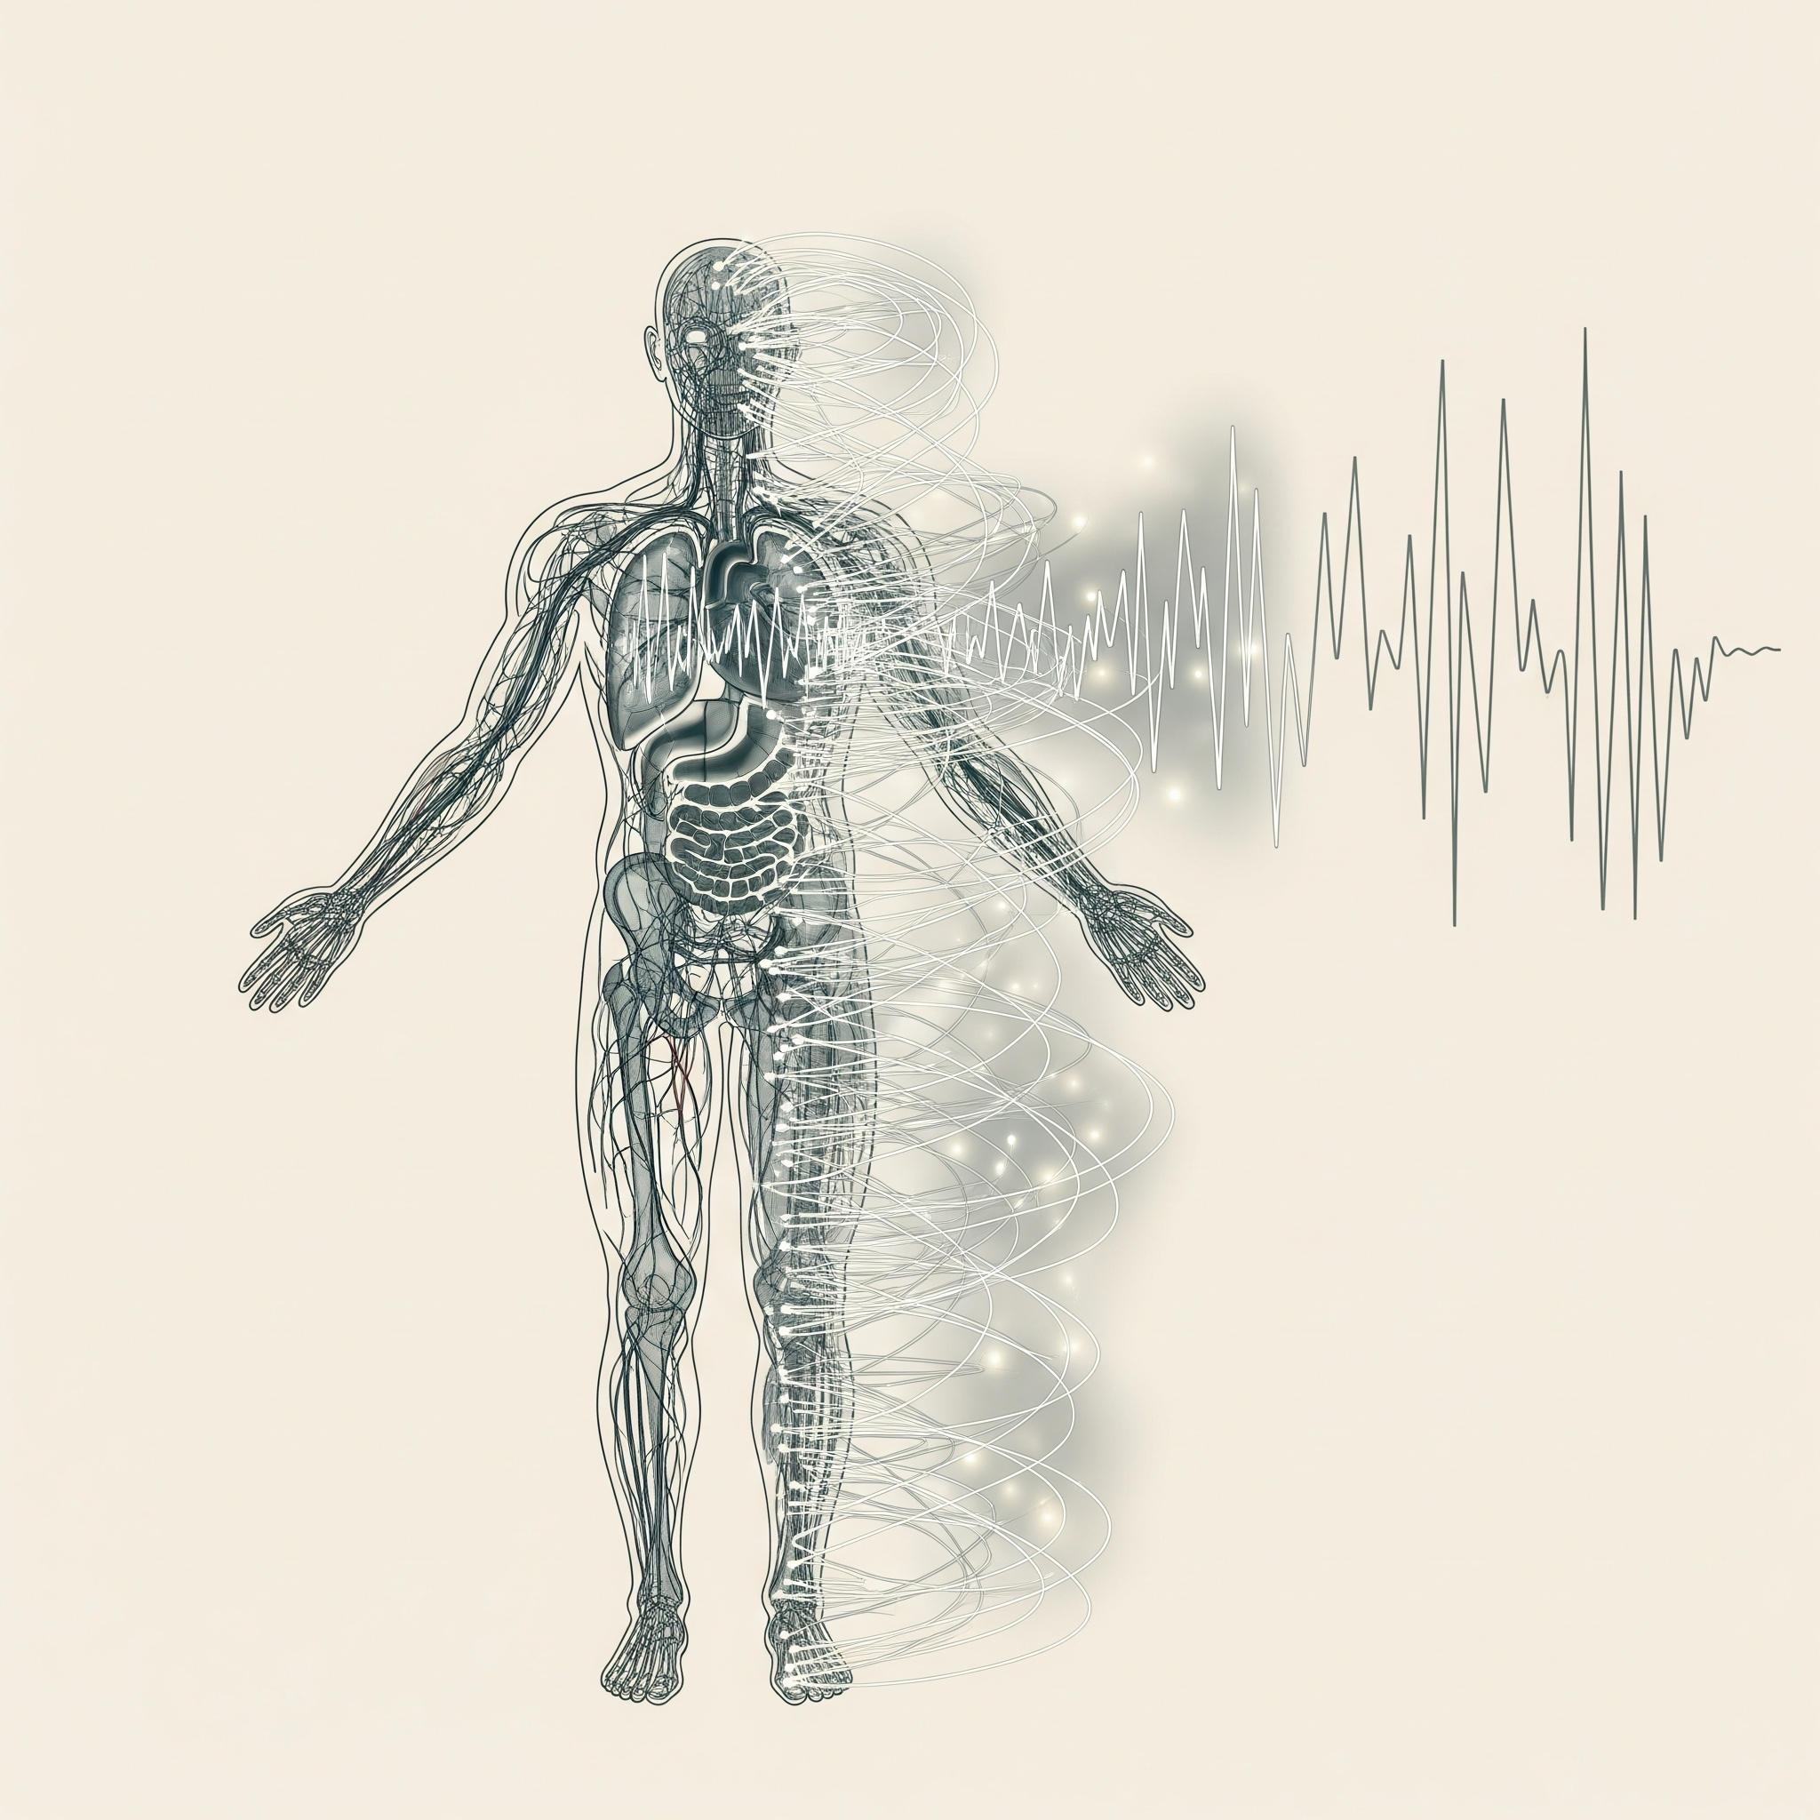




Slide 3
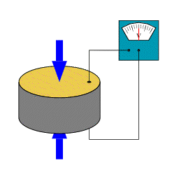
Piezoelectrics
In medicine:
Non-toxic
High piezoelectric response
Biocompatibility
Mechanical flexibility
Stability (biodegradability)

Slide 4





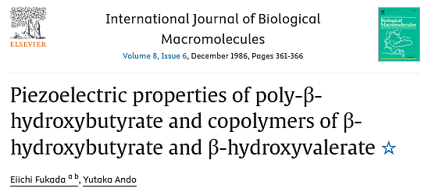
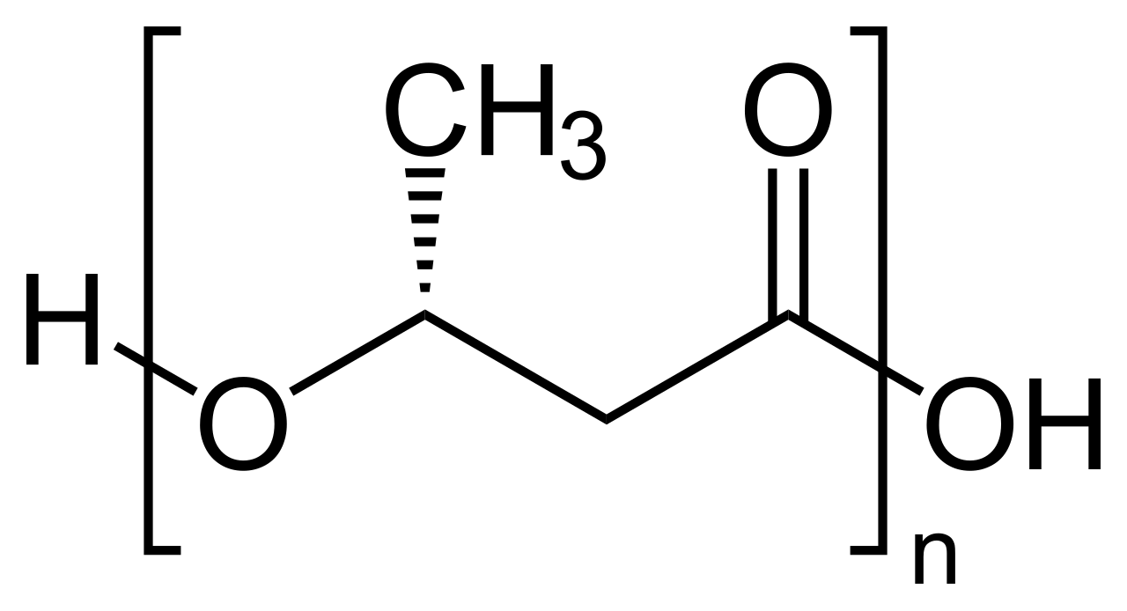
Polyhydroxyalkanoates
(PHA)
Polyhydroxybutyrate (PHB)

Slide 5


pH
osmotic stress
temperature
Cupriavidus
necator H16
Biocrystallization
Orientation

Slide 6
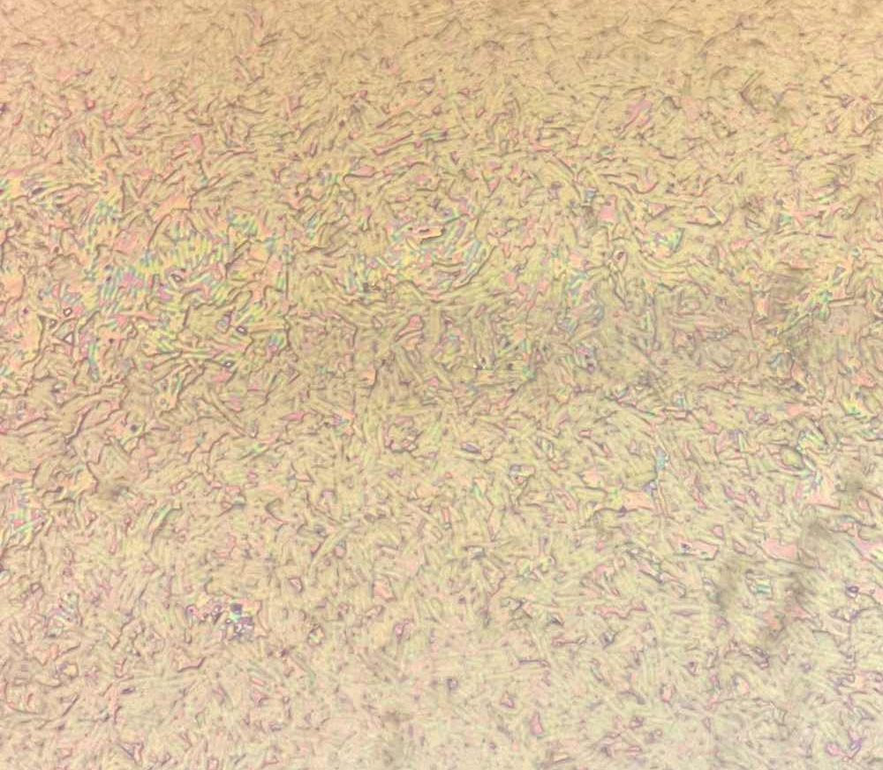
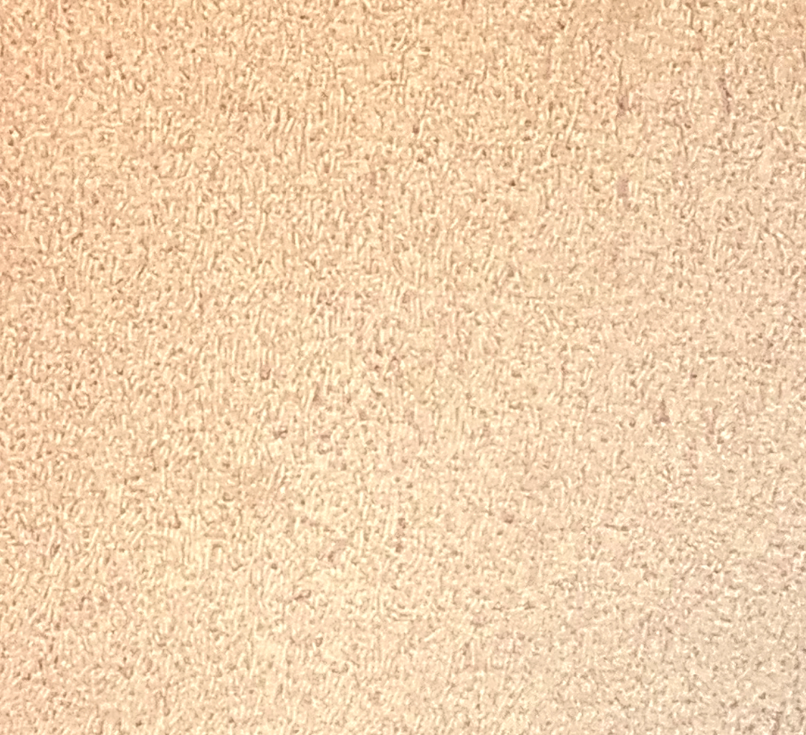
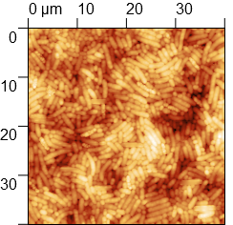
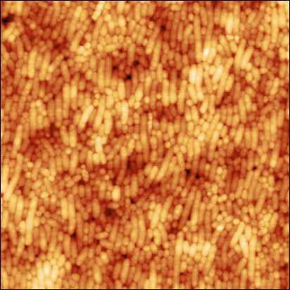

Slide 7
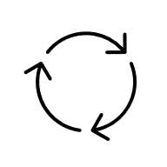

pH
osmotic stress
Spin-coating
temperature
SSAW
Cupriavidus
necator H16
Biocrystallization
Orientation

Slide 8
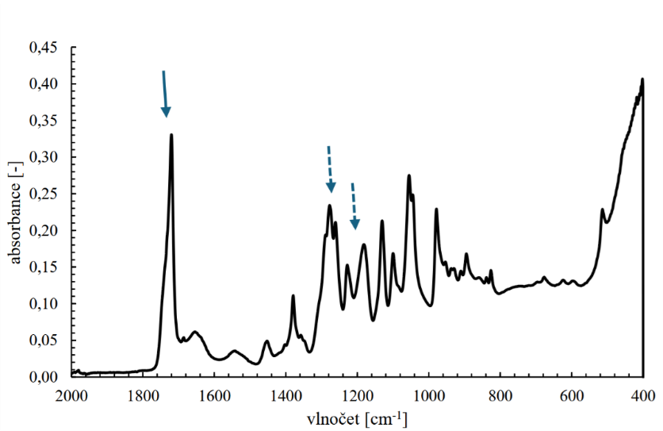
absorbance [-]
wavenumber [cm⁻¹]

Slide 9
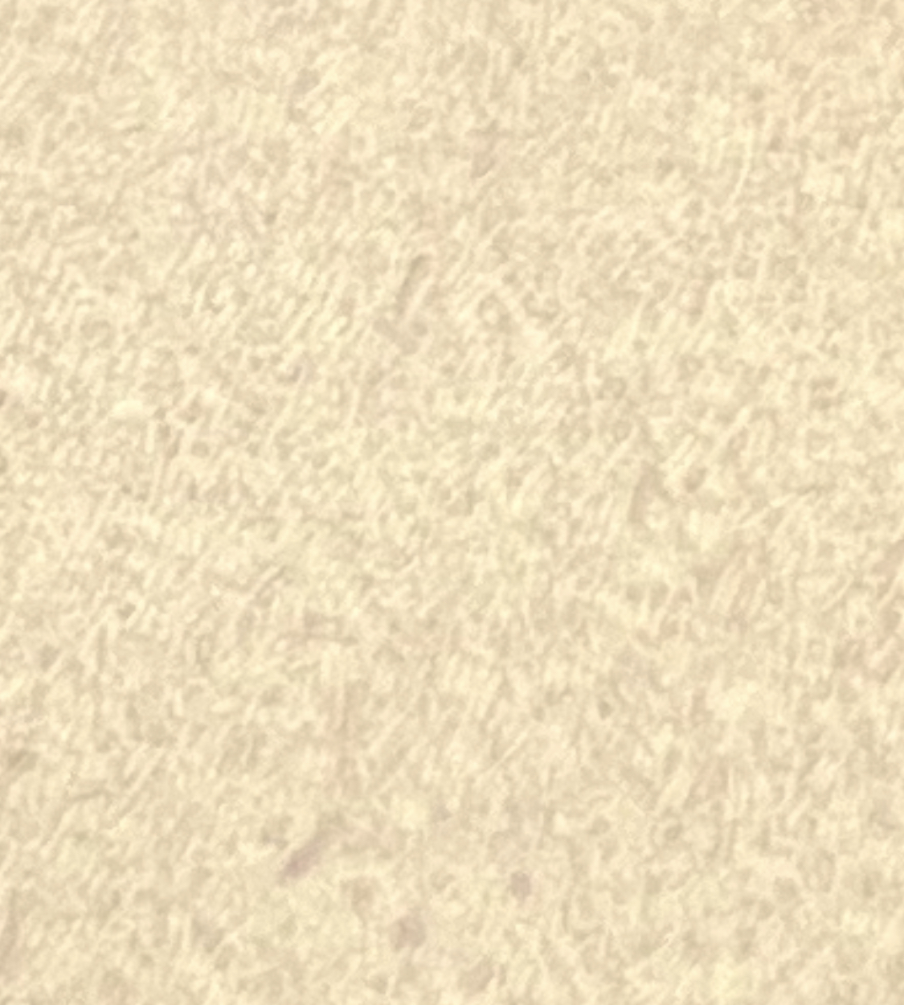
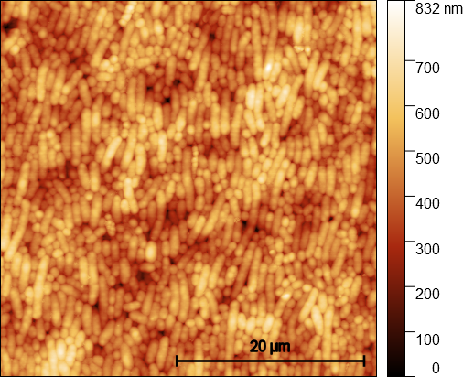
Confocal microscopy
Atomic force microscopy
20 μm

Slide 10
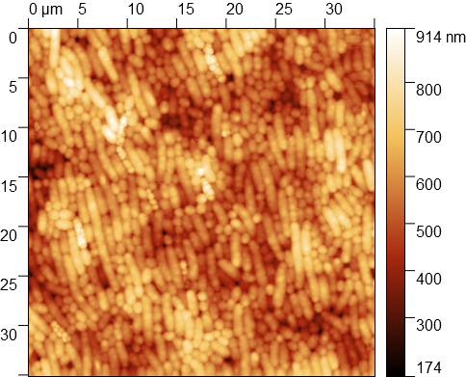
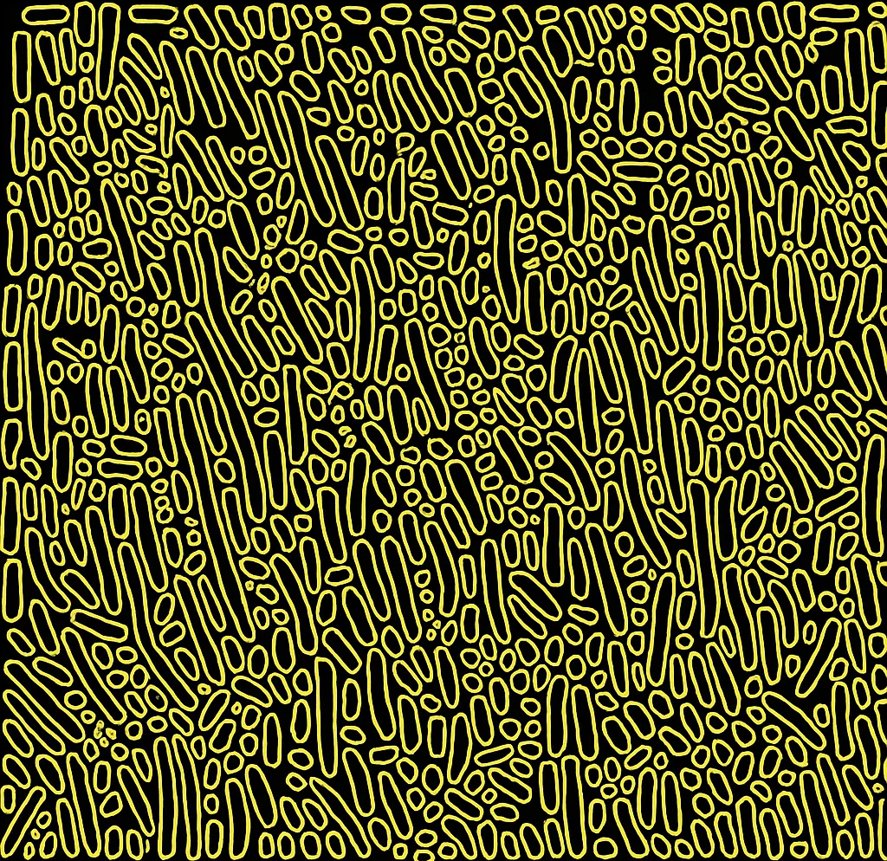
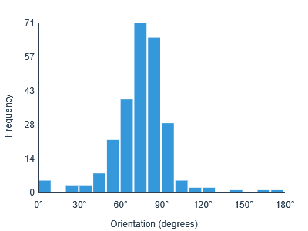

Slide 11
NEXT?
PFM

