Slide 1
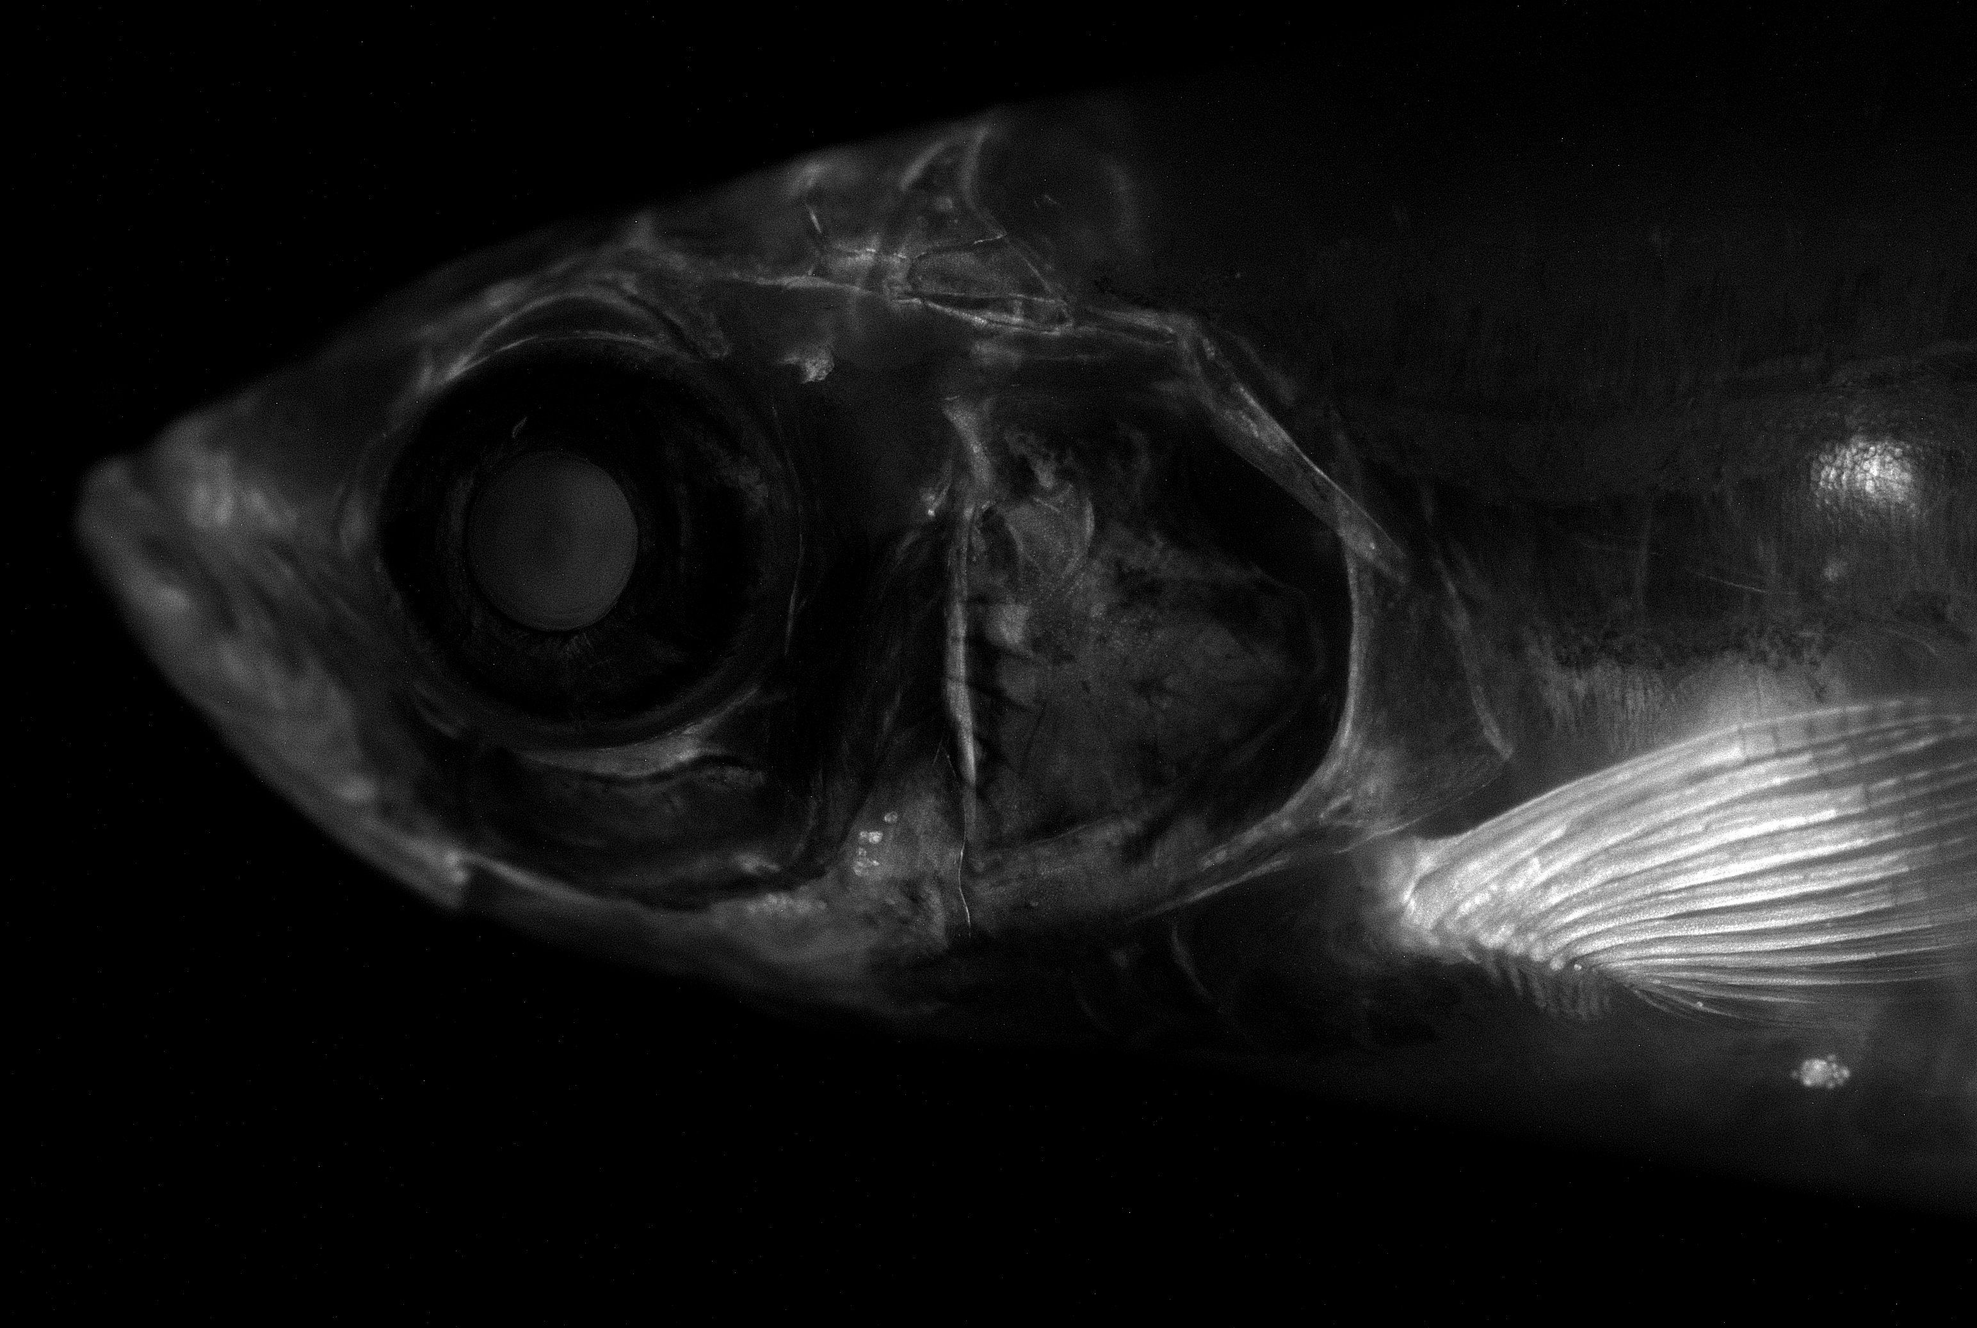
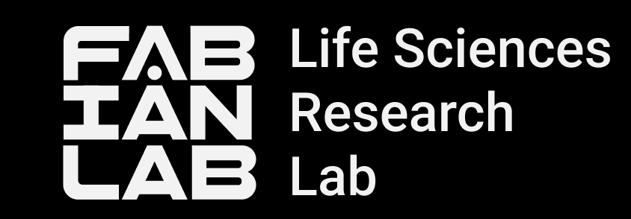
Alkaptonuria Zebrafish Model:
Metabolites Tracking via Raman Microscopy
Barbora Lišková and Andrea Benčeková
11.09.2025

Slide 2
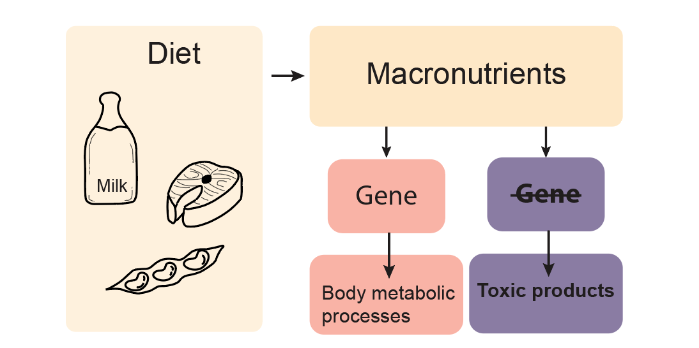
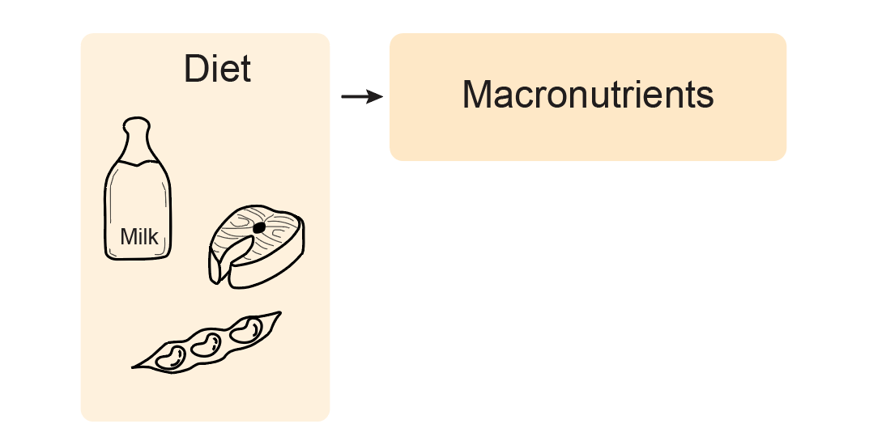
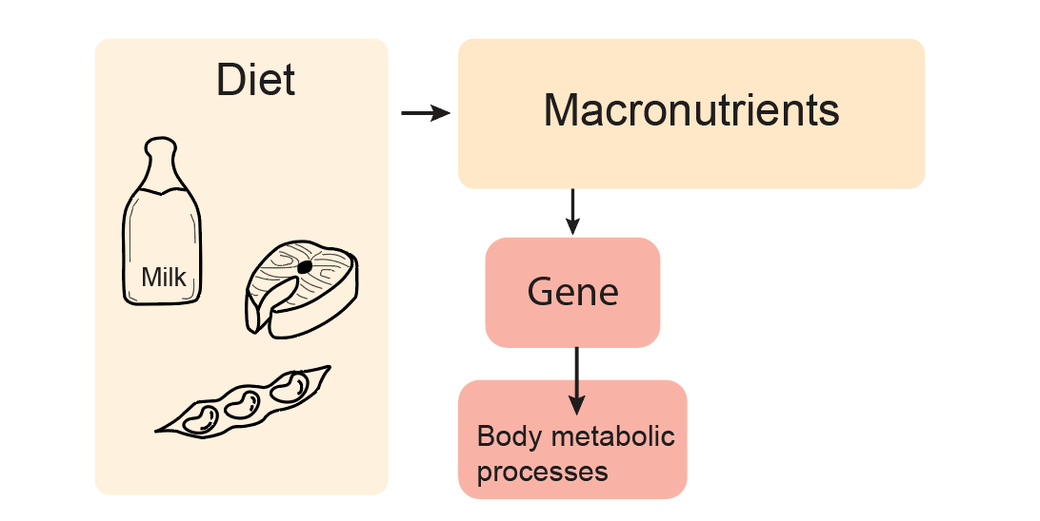
Metabolic diseases caused by macronutrients metabolism dysregulation

Slide 3

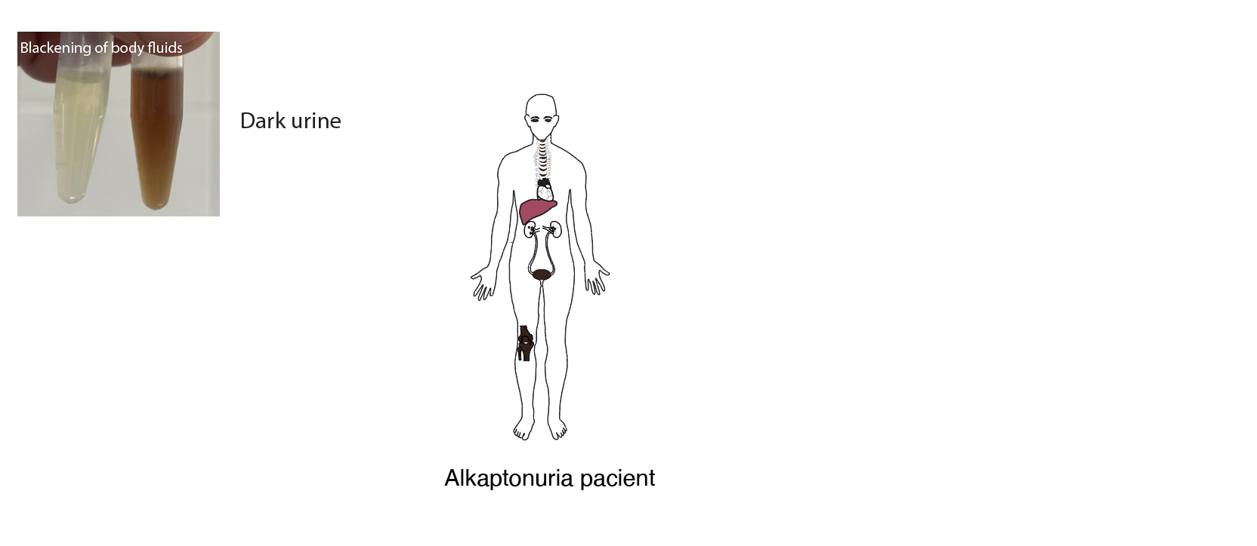
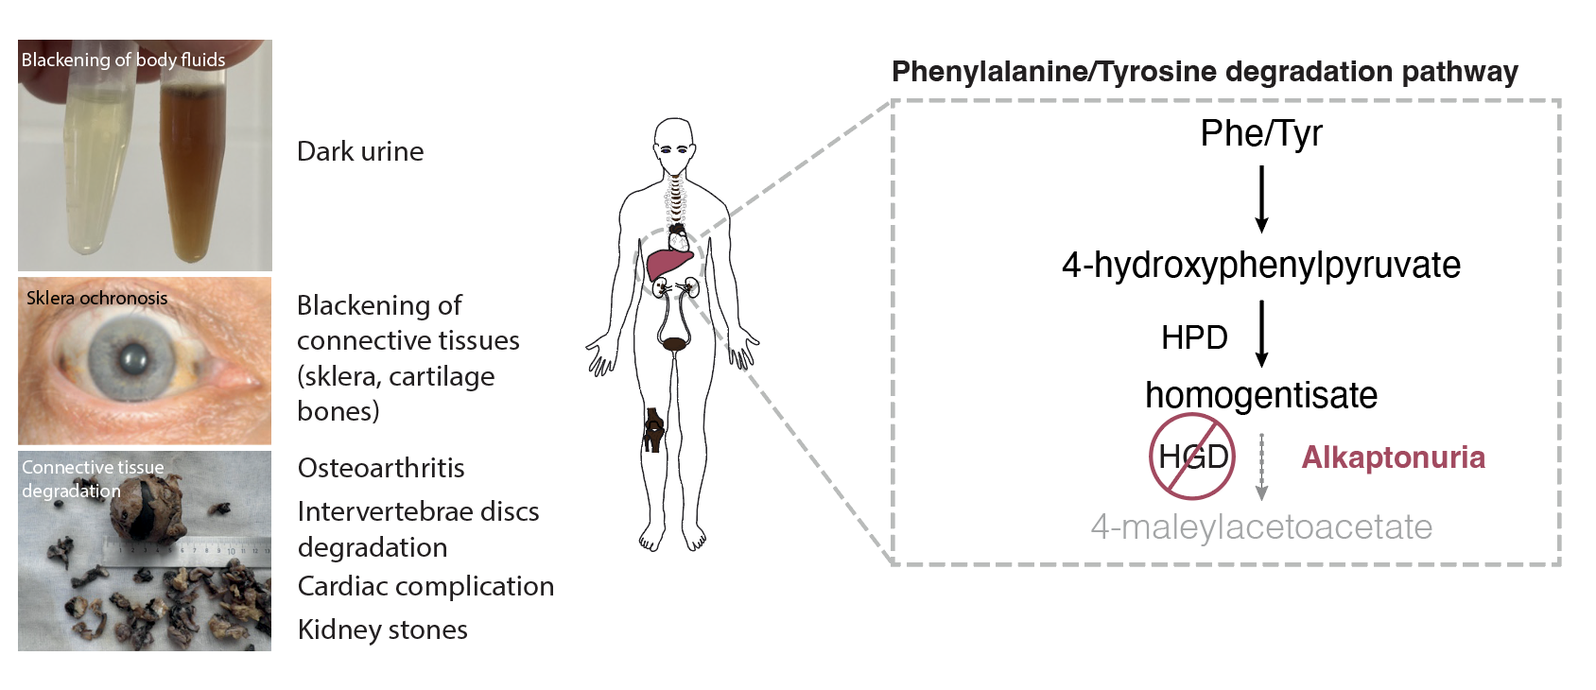
Alkaptonuria (AKU)

Slide 4
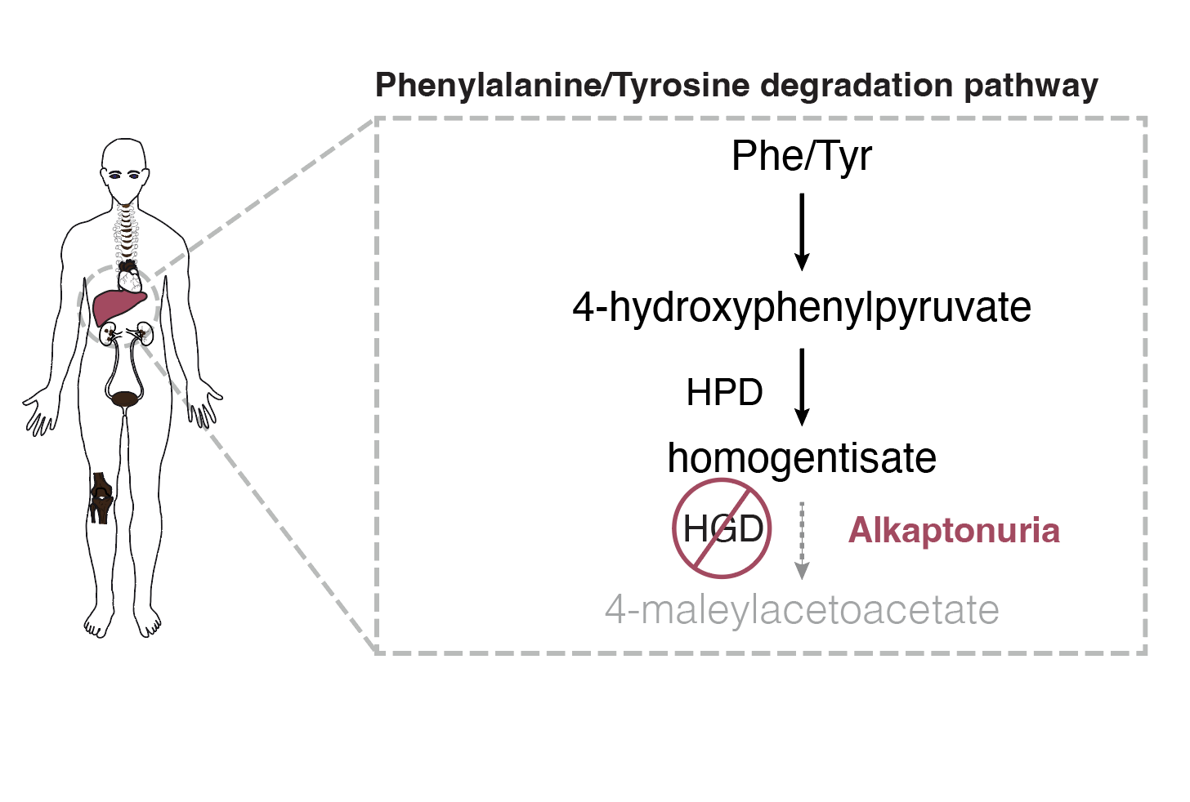
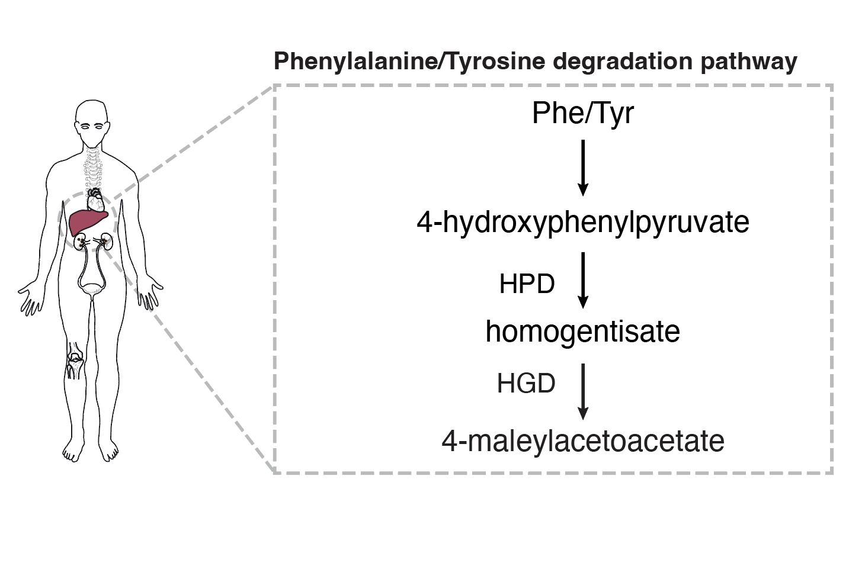
Chemical composition of the black pigment
What is the black pigment in AKU patients?

Slide 5
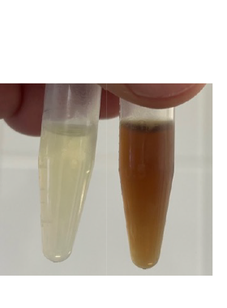
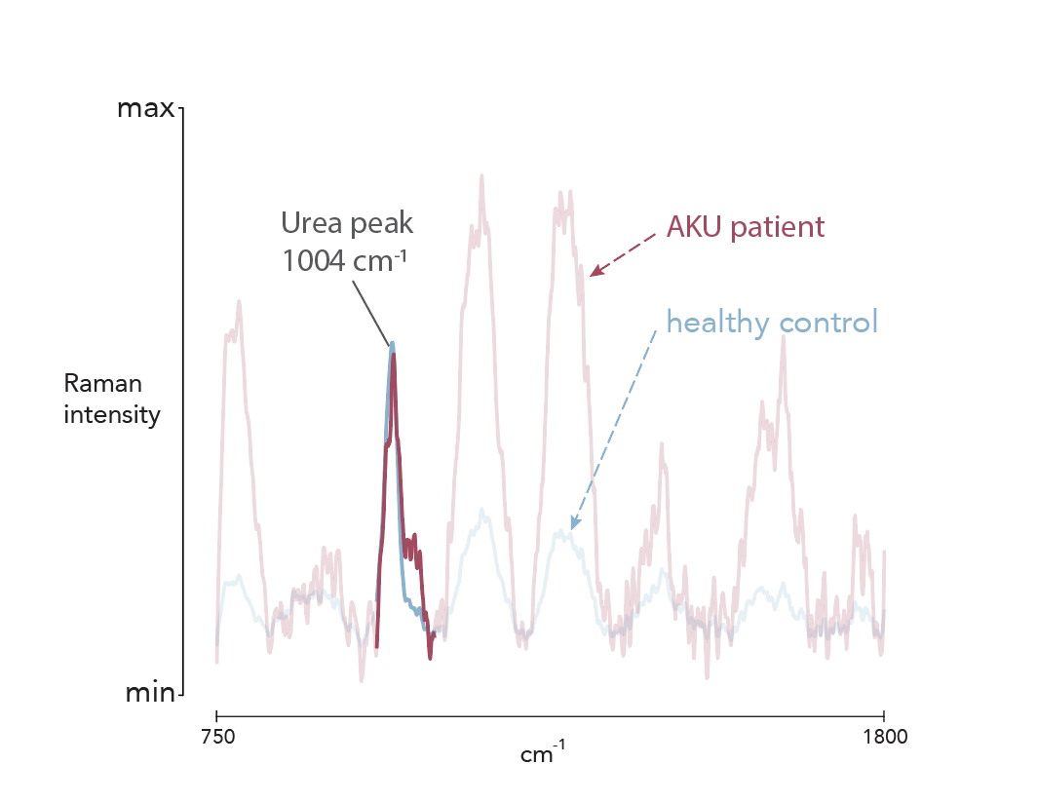
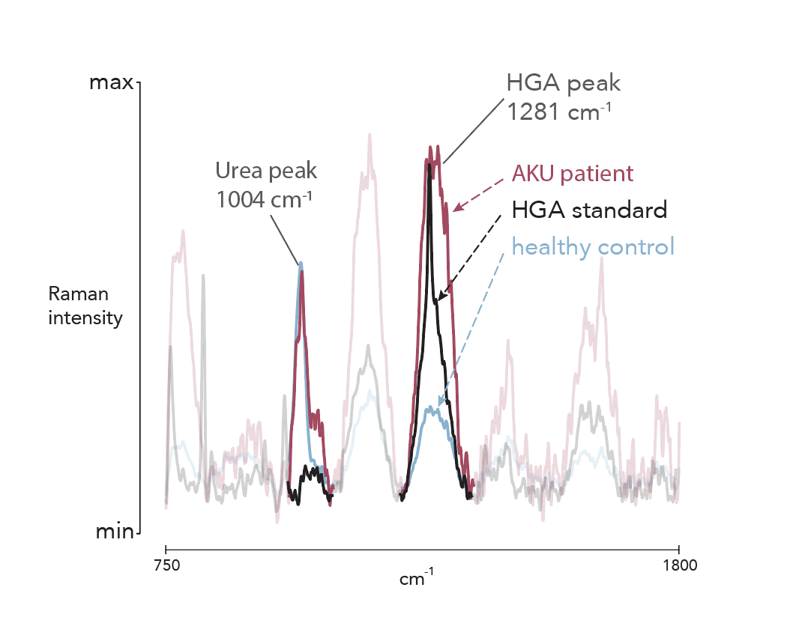
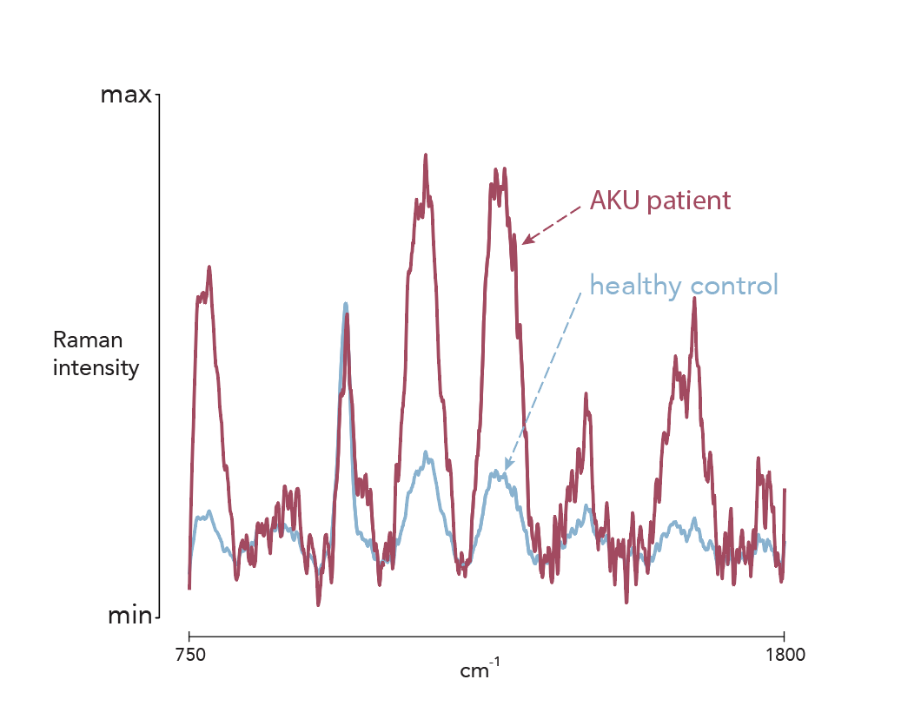
Raman microscopy identified homogentisate (HGA) in human urine samples
Raman spectra of human urine
healthy control
AKU patient

Slide 6
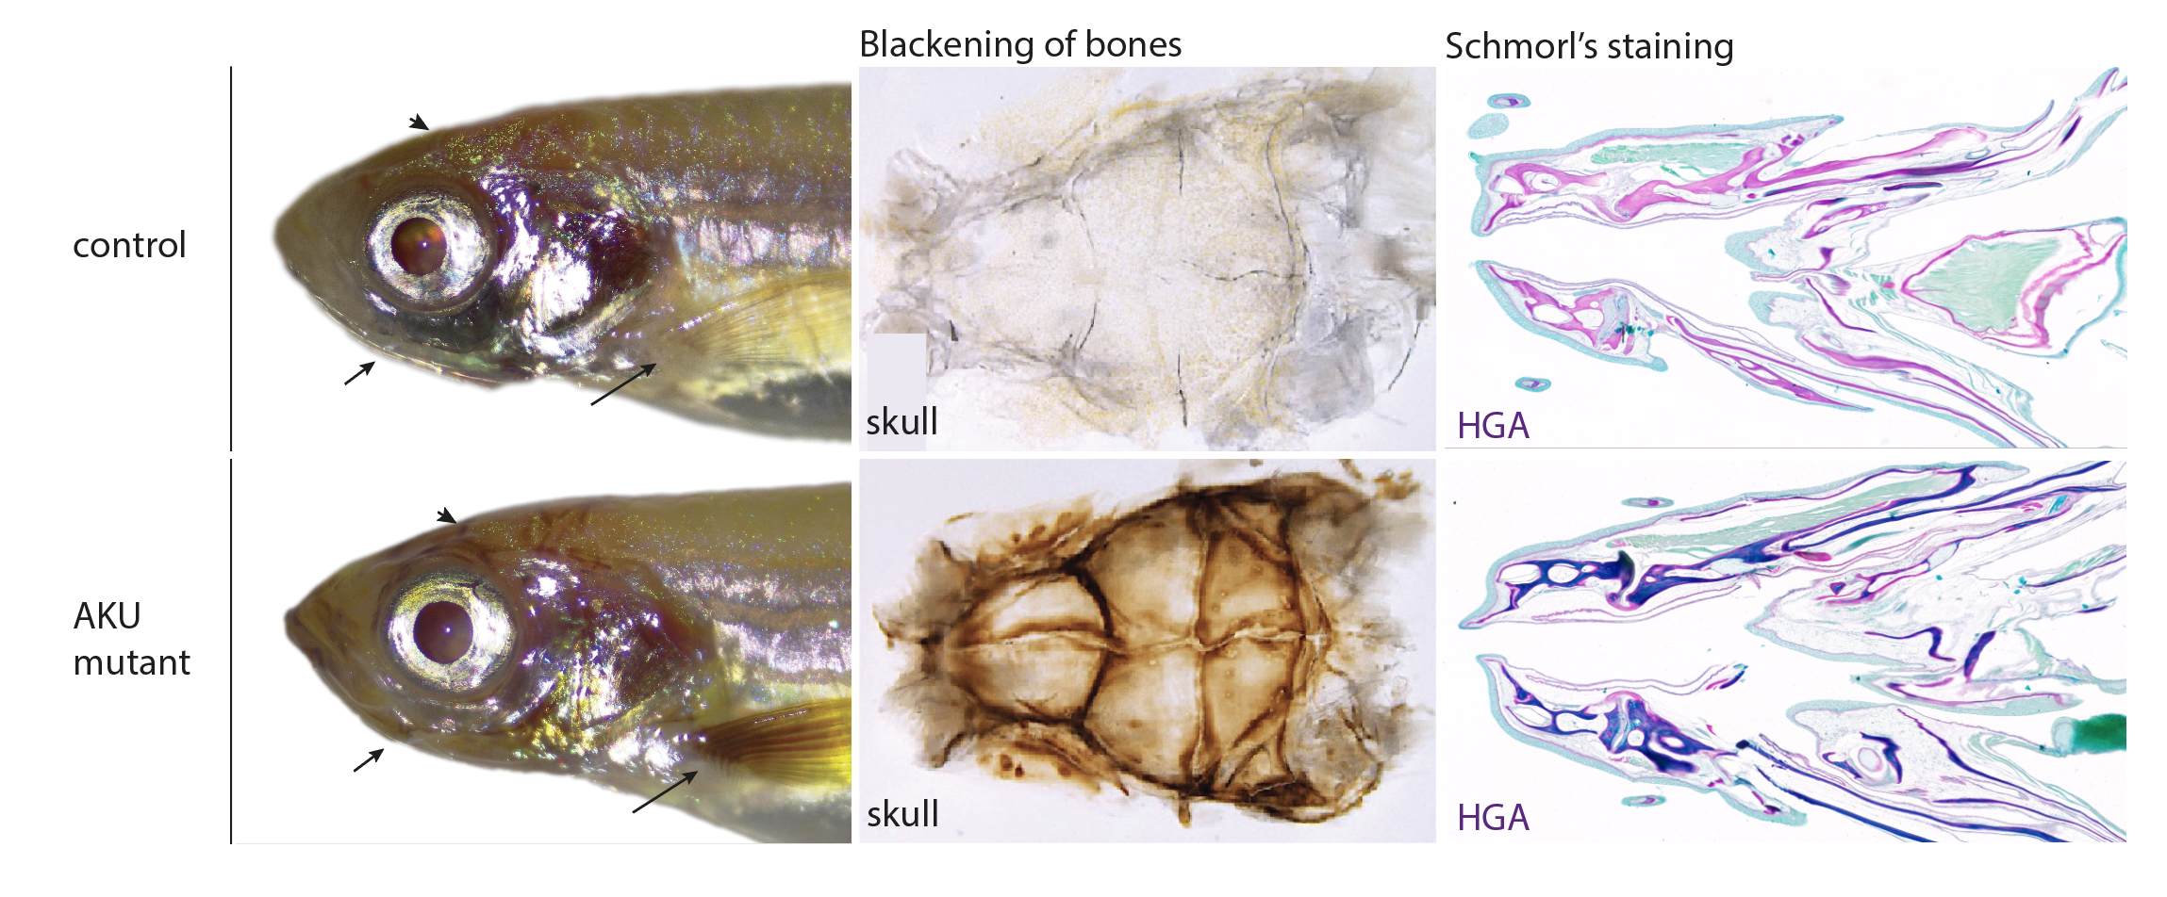
New zebrafish model for alkaptonuria disease
Does the black pigment in the zebrafish mutant chemically match that in humans?

Slide 7
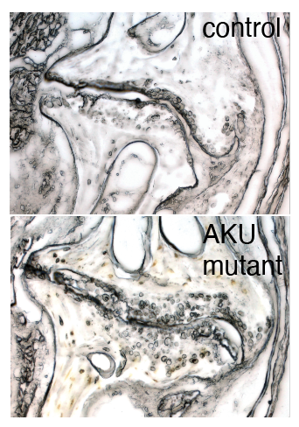
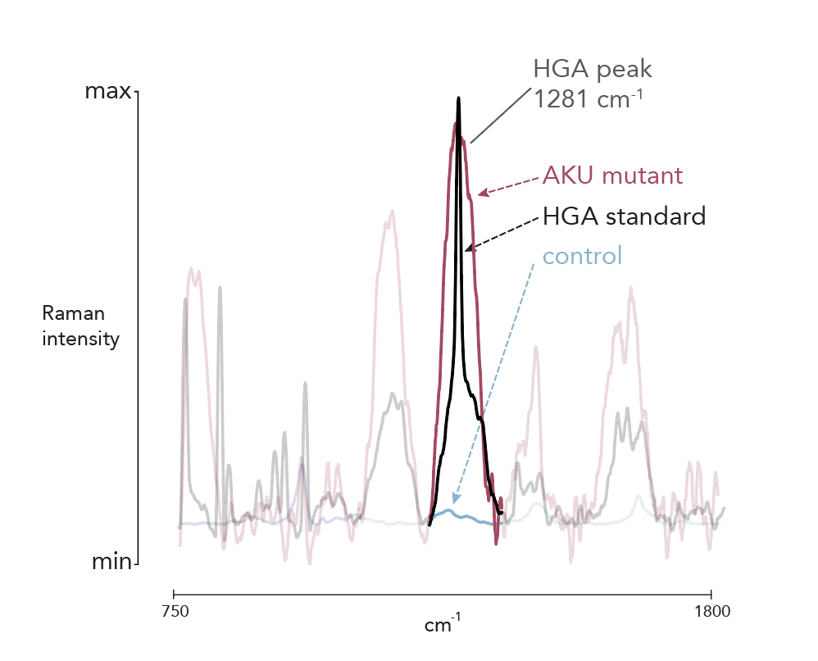
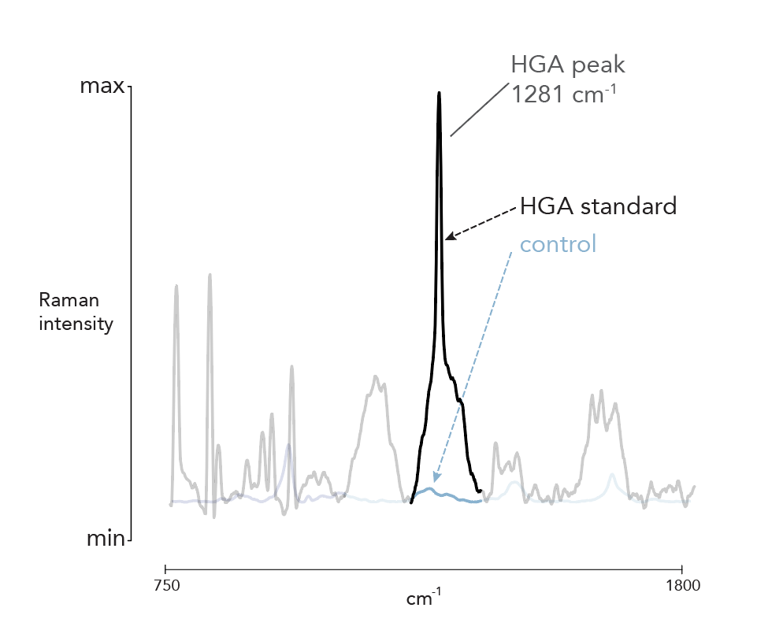
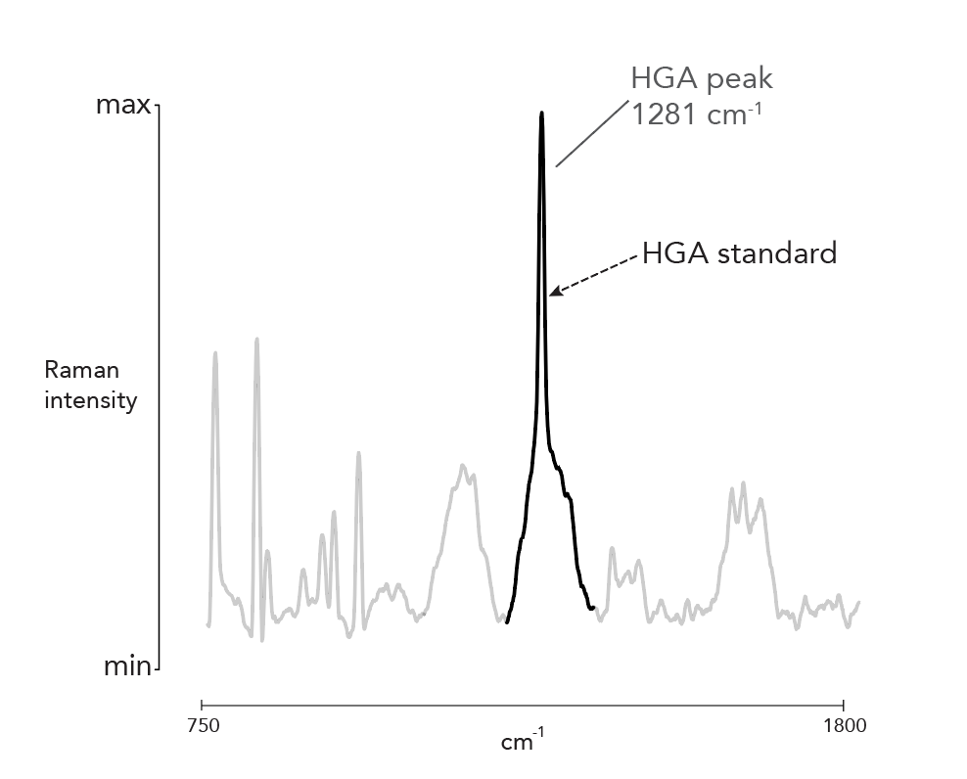
Raman spectra of zebrafish mutant bones revealed presence of homogentisate
Raman spectra of zebrafish bones
ZF AKU mutant‘s bones contain chemically identical metabolite as human patients samples

Slide 8

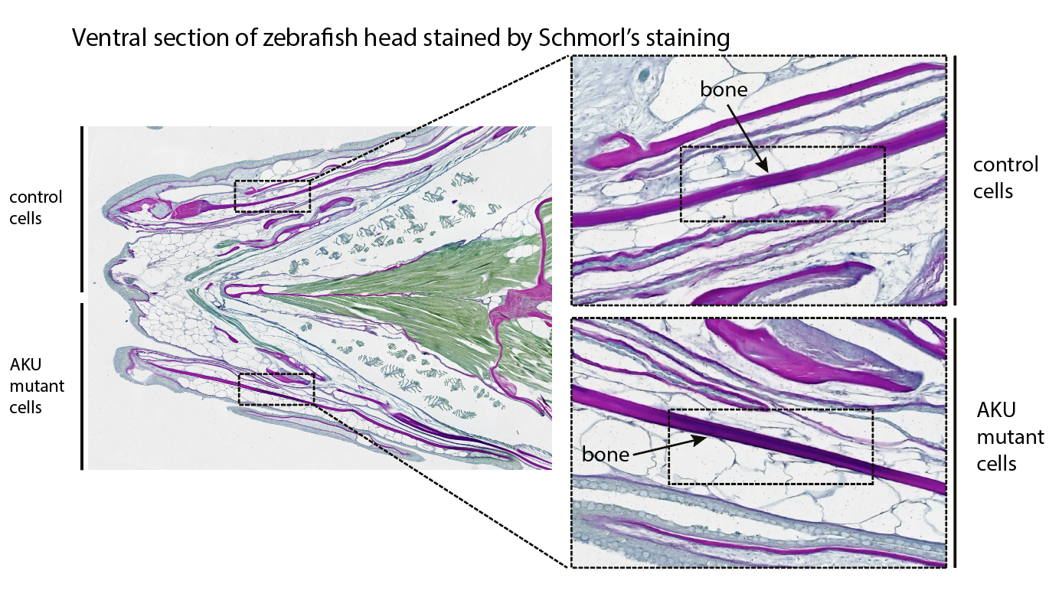
AKU mutant cells transplantation increased homogentisate levels in affected tissues

Slide 9
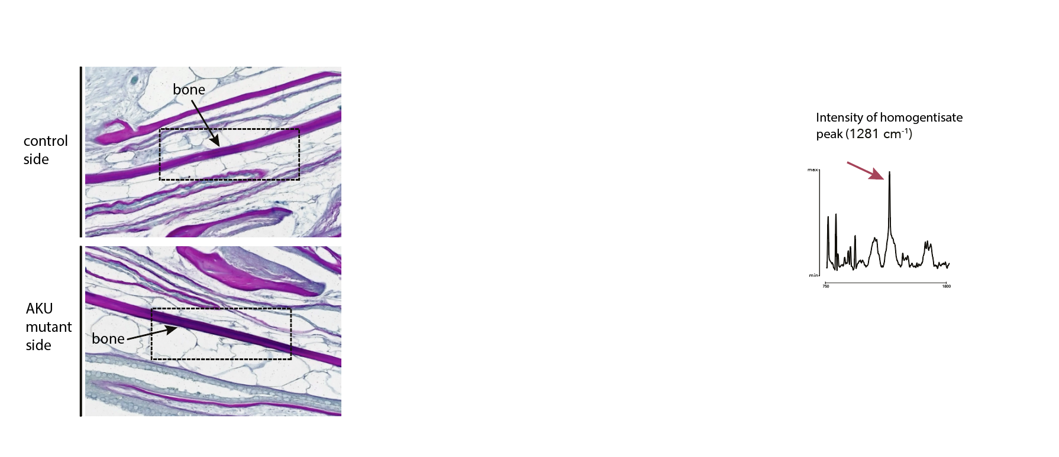
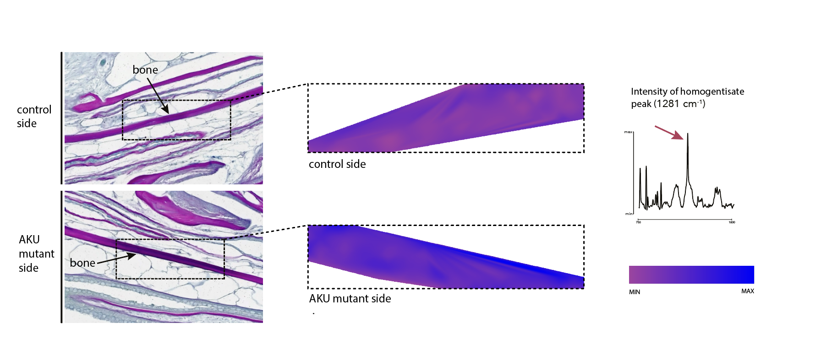
Can Raman microscopy reliably detect small changes in homogentisate accumulation?
Homogentisate specifically accumulates in the bone periosteum

Slide 10
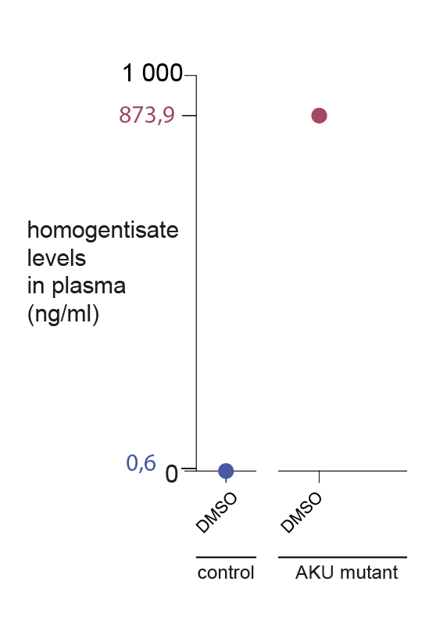
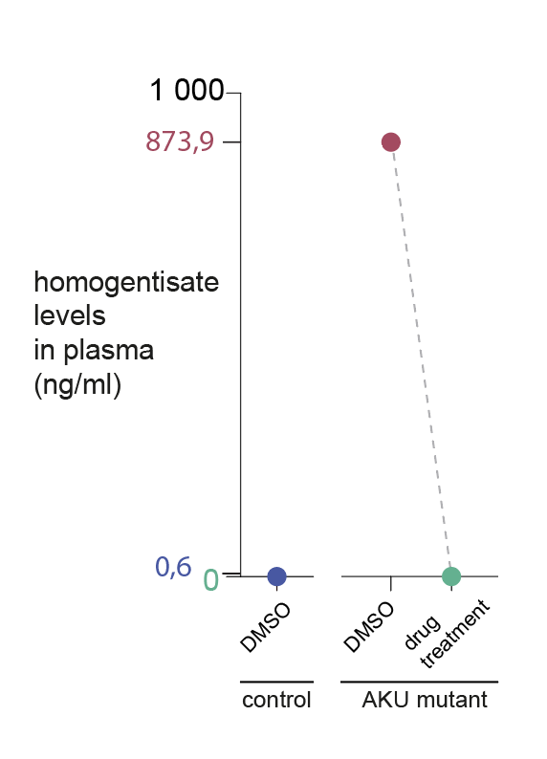
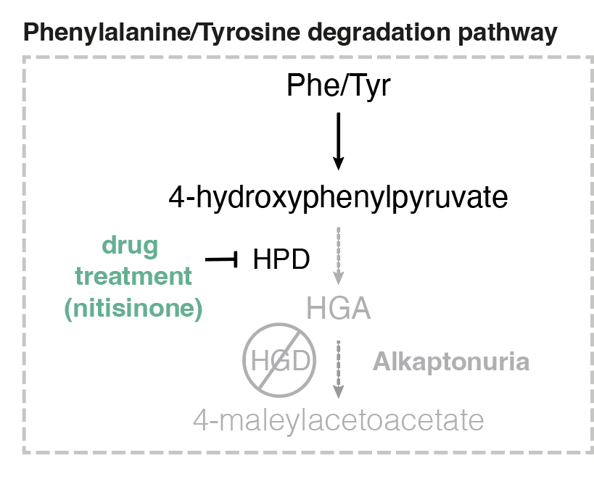
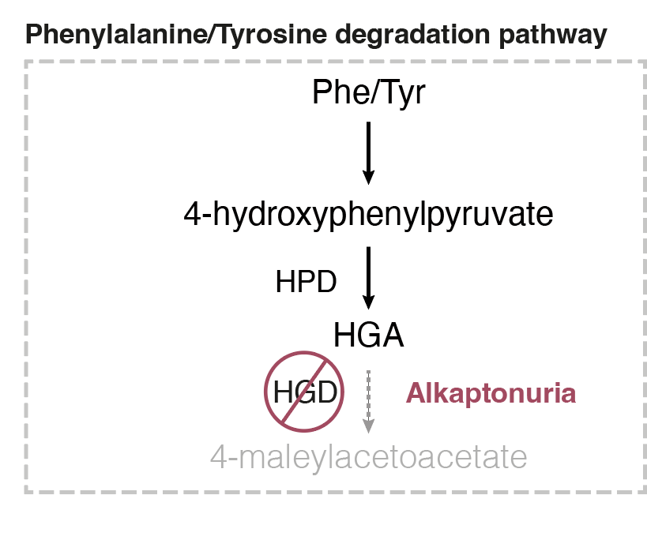
Human drug treatment reduces homogentisate levels in zebrafish blood
Mass spectrometry of zebrafish blood

Slide 11
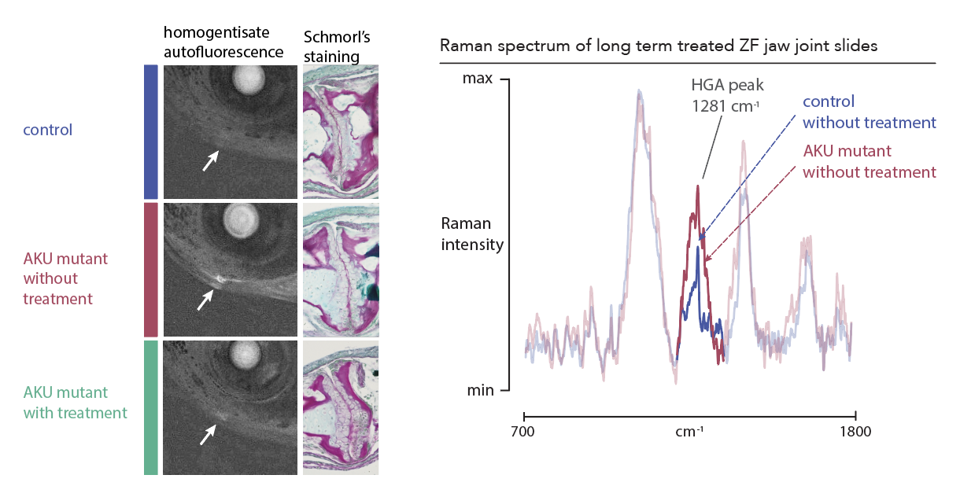
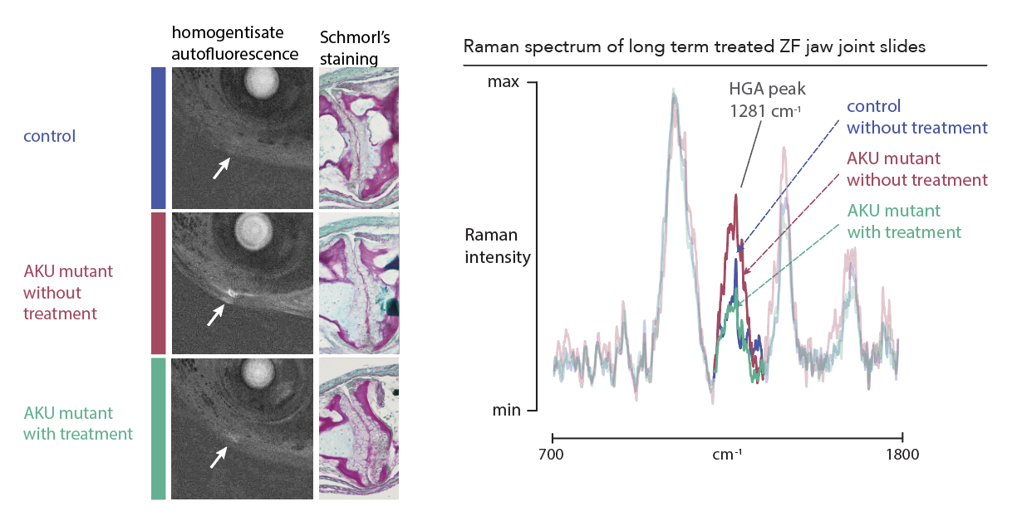
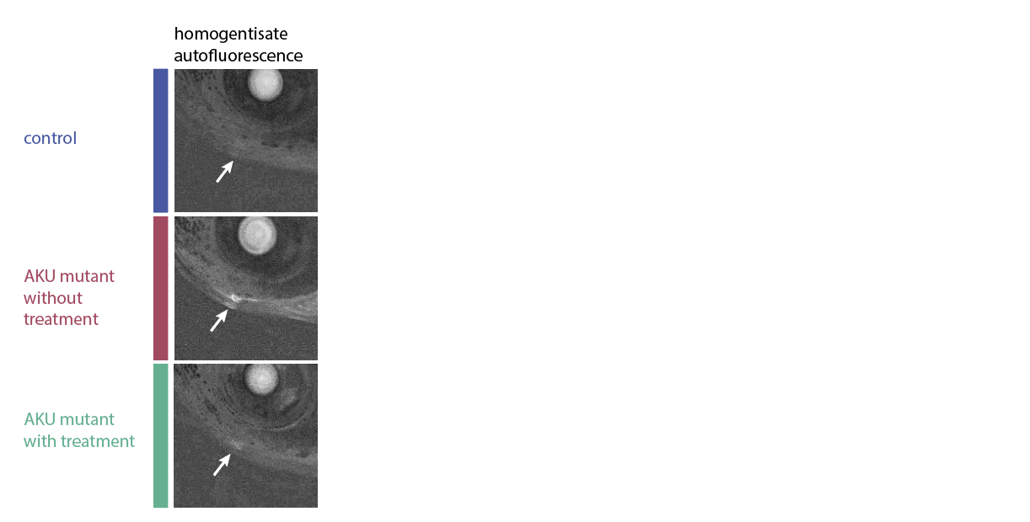
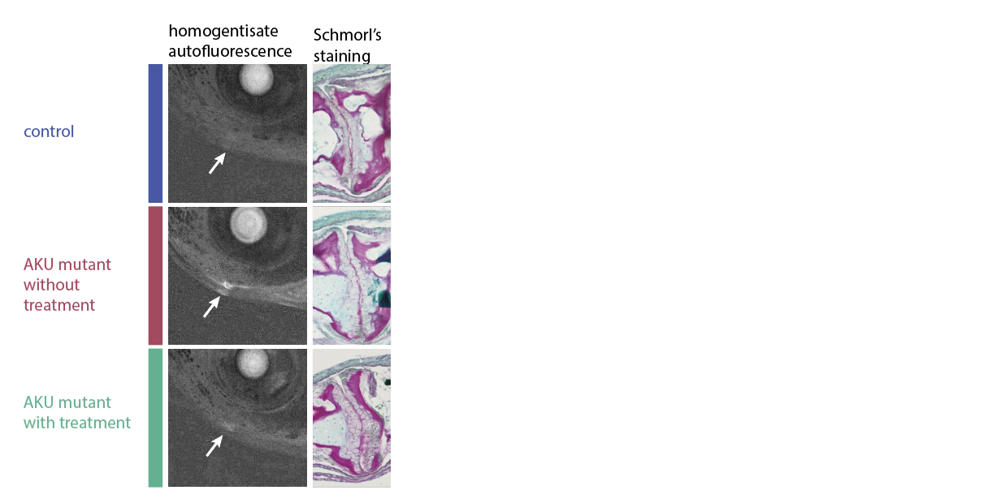
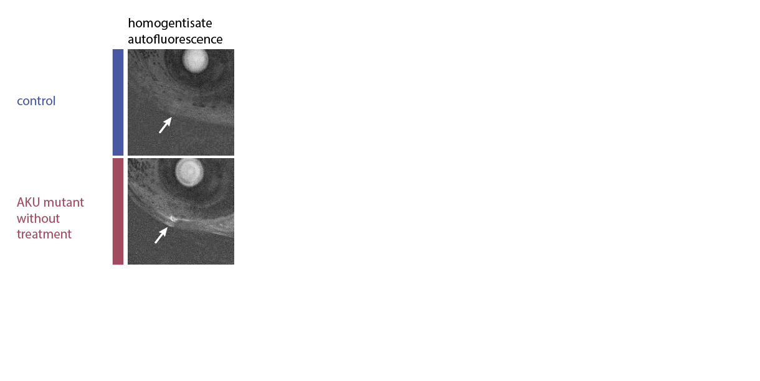
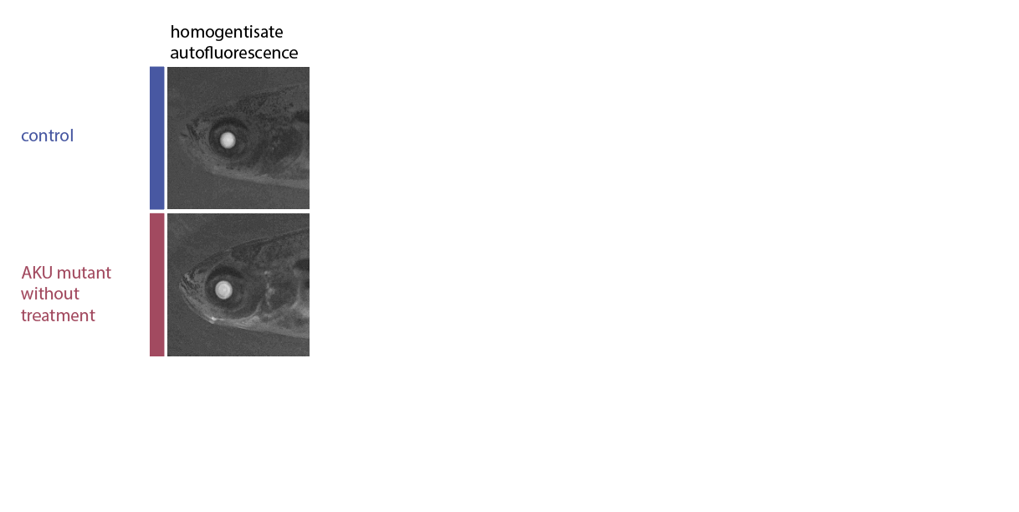
Changes in homogentisate levels after treatment of juveniles can be detected by Raman
Raman microscopy could serve as a quantitative method

Slide 12
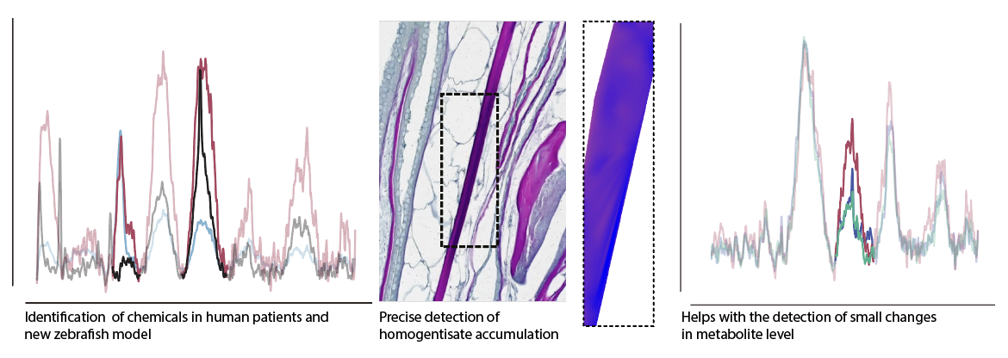
Conclusion

Slide 13





Acknowledgement
Fabian lab:
Mgr. Peter Fabian PhD.
Mgr. Petra Čermáková PhD.
Mgr. Martina Bőhmová
Ing. Andrea Benčeková
Mgr. Petra Lišková
Msc. Ziyaurrahman MS
Mgr. Bohumil Fafílek PhD.
Mgr. Ľubomíra Chmelová PhD.
Mgr. Josef Bryja
Msc. Mounica Kondepudi
Bc. Jolana Bodinková
Markéta Křížová
Viktor Kerzl
Adam Jech
Táňa Zemčíková
Collaborators:
Doc. MuDr. Richard Imrich DrSc.
Mgr. Jan Přibyl PhD.
Mgr. Radka Obořilová PhD.
Ing. Jakub Máčala PhD.
Funded by the European Union. Views and opinions expressed are however those of the author(s) only and do not necessarily reflect those of the European Union or European Research Council Executive Agency. Neither the European Union nor the granting authority can be held responsible for them.

