Slide 1
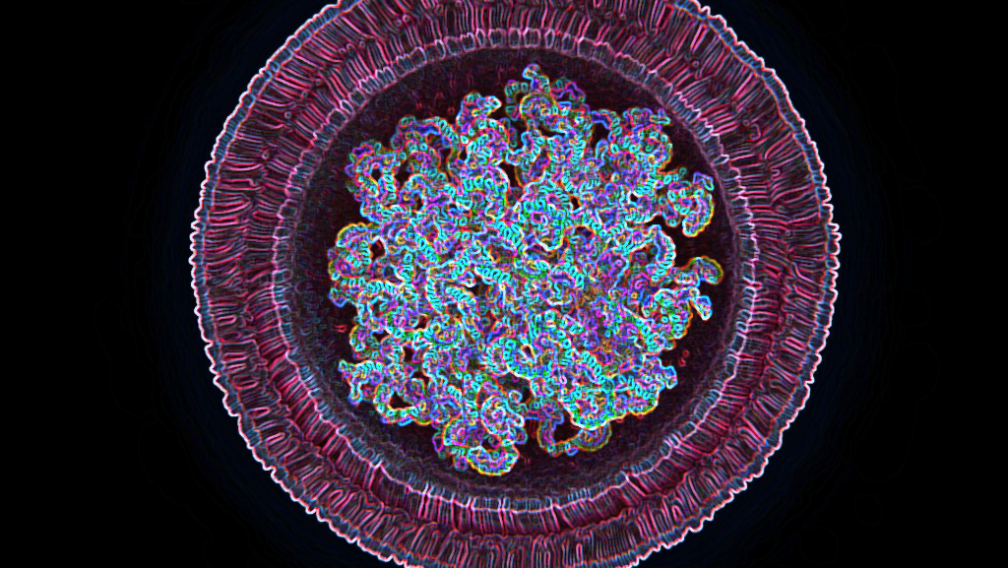


Advanced Imaging of Lipid-Based Nanoparticles for Drug Delivery
M. Malásková, E. Maráková, M. Vojníková
Notes:
Good afternoon, my name is Magdaléna Malásková and today I’ll be presenting our work on Advanced Imaging of Lipid-Based Nanoparticles for Drug Delivery. This is a joint project with my colleague Ester Maráková. Ttogether we focus on how advanced techniques like atomic force microscopy can help us better understand the structure and stability of lipid-based nanoparticles.

Slide 2
Research focus
Atomic force microscopy (AFM)
Theranostic therapy
Ellipticine-loaded therapeutic liposomes (Elli@TNPs)
Brain delivery
Cancer therapy with apoptotic protein cytochrome c (CYT)
Bio-inspired lipid nanoparticles with cardiolipin (CYT CL-LNPs)
Bio-inspired lipid nanoparticles with 1,2-dioleoyl-sn-glycero-3-phosphate (CYT EM-LNPs)
AFM for nanoparticles
Solid lipid nanoparticles (SLNs)
Gadolinium-containing therapeutic liposomes (TNPs)
2
Notes:
Before going into the details, let me briefly summarise what you’ll see in this presentation. There are four main directions. First, atomic force microscopy as a powerful tool for nanoparticle characterisation. This technique underpins much of the work I’ll show today. Then, three projects where AFM was applied:
The theranostic liposome project, which combines ellipticine or gadolinium for therapy and diagnosis, is led by my colleagues Michaela Vojníková and Ester Maráková, while my main focus is on the design and characterisation of solid lipid nanoparticles that can cross the blood–brain barrier. The cytochrome c project, where bio-inspired lipid nanoparticles are developed for cancer therapy, is also led by Ester.. All AFM imaging, profiling, and mechanical measurements were performed at CEITEC MUNI using their instrumentation.

Slide 3
Research focus
Atomic force microscopy (AFM)
Theranostic approach
Ellipticine-loaded TNPs (Elli@TNPs)
Brain delivery
Cancer therapy with apoptotic protein cytochrome c (CYT)
Bio-inspired lipid nanoparticles with cardiolipin (CYT CL-LNPs)
Bio-inspired lipid nanoparticles with 1,2-dioleoyl-sn-glycero-3-phosphate (CYT EM-LNPs)
AFM for nanoparticles
Solid lipid nanoparticles (SLNs)
MRI traceable therapeutic liposomes (TNPs)
2

Slide 4
Research focus
Atomic force microscopy (AFM)
Theranostic approach
Ellipticine-loaded TNPs (Elli@TNPs)
Cytochrome c (CYT) cancer therapy
Cancer therapy with apoptotic protein cytochrome c (CYT)
Bio-inspired lipid nanoparticles with cardiolipin (CYT CL-LNPs)
Bio-inspired lipid nanoparticles with 1,2-dioleoyl-sn-glycero-3-phosphate (CYT EM-LNPs)
AFM for nanoparticles
Bio-inspired lipid nanoparticles with cardiolipin (CYT CL-LNPs)
MRI traceable therapeutic liposomes (TNPs)
Bio-inspired lipid nanoparticles with basic phospholipid (CYT EM-LNPs)
2

Slide 5
Research focus
Atomic force microscopy (AFM)
Theranostic approach
Ellipticine-loaded TNPs (Elli@TNPs)
Cytochrome c (CYT) cancer therapy
Brain delivery
Solid lipid nanoparticles (SLNs)
AFM for nanoparticles
Bio-inspired lipid nanoparticles with cardiolipin (CYT CL-LNPs)
MRI traceable therapeutic liposomes (TNPs)
Bio-inspired lipid nanoparticles with basic phospholipid (CYT EM-LNPs)
2

Slide 6

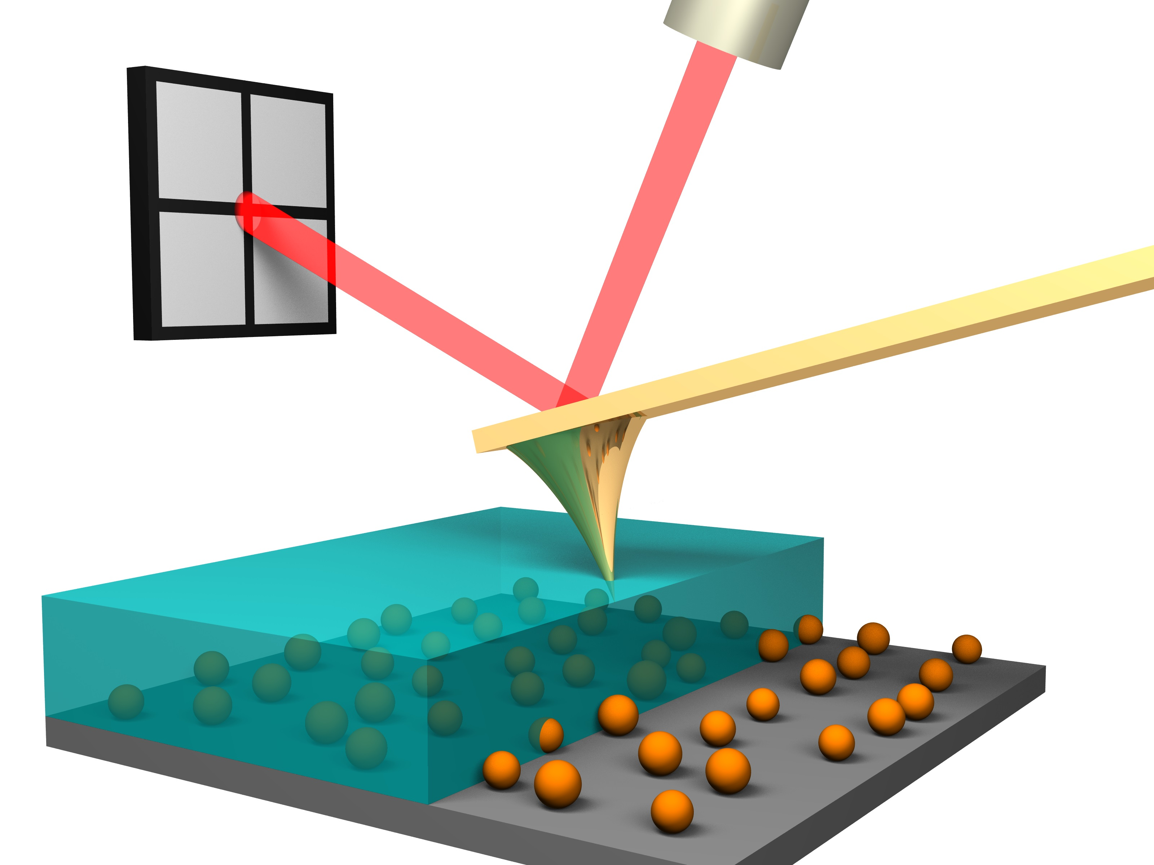
AFM for nanoparticles
AFM imaging of lipid-based nanoparticles (LBNPs):
Imaging in liquid, no drying or staining.
Particles immobilised gently on a surface.
Reveals size, shape, rigidity.
3
Notes:
AFM is particularly well-suited for lipid-based nanoparticles because it allows us to image them directly in liquid, which keeps them in near-native conditions. Thanks to PEG–COOH in their structure, the particles gently attach to the surface without collapsing, so we avoid artefacts from drying or staining.
The real advantage of AFM is that it goes beyond simple imaging. We get nanometre-scale topography and, at the same time, mechanical properties such as stiffness, elasticity, or adhesion forces. This is especially important for soft, deformable lipid nanoparticles, which are often difficult to study reliably with electron microscopy alone.
Finally, AFM is highly versatile. We can see how nanoparticles respond to environmental changes like pH or temperature and follow their stability over time. Altogether, AFM gives us both structure and function in a physiologically relevant context, which is why it’s the method of choice in our work.

Slide 7
AFM for nanoparticles
AFM imaging of lipid-based nanoparticles (LBNPs):
Imaging in liquid, no drying or staining.
Particles immobilised gently on a surface.
Reveals size, shape, rigidity.
3
Notes:
AFM is particularly well-suited for lipid-based nanoparticles because it allows us to image them directly in liquid, which keeps them in near-native conditions. Thanks to PEG–COOH in their structure, the particles gently attach to the surface without collapsing, so we avoid artefacts from drying or staining.
The real advantage of AFM is that it goes beyond simple imaging. We get nanometre-scale topography and, at the same time, mechanical properties such as stiffness, elasticity, or adhesion forces. This is especially important for soft, deformable lipid nanoparticles, which are often difficult to study reliably with electron microscopy alone.
Finally, AFM is highly versatile. We can see how nanoparticles respond to environmental changes like pH or temperature and follow their stability over time. Altogether, AFM gives us both structure and function in a physiologically relevant context, which is why it’s the method of choice in our work.

Slide 8
AFM for nanoparticles
AFM imaging of lipid-based nanoparticles (LBNPs):
Imaging in liquid, no drying or staining.
Particles immobilised gently on a surface.
Reveals size, shape, rigidity.
3
Notes:
AFM is particularly well-suited for lipid-based nanoparticles because it allows us to image them directly in liquid, which keeps them in near-native conditions. Thanks to PEG–COOH in their structure, the particles gently attach to the surface without collapsing, so we avoid artefacts from drying or staining.
The real advantage of AFM is that it goes beyond simple imaging. We get nanometre-scale topography and, at the same time, mechanical properties such as stiffness, elasticity, or adhesion forces. This is especially important for soft, deformable lipid nanoparticles, which are often difficult to study reliably with electron microscopy alone.
Finally, AFM is highly versatile. We can see how nanoparticles respond to environmental changes like pH or temperature and follow their stability over time. Altogether, AFM gives us both structure and function in a physiologically relevant context, which is why it’s the method of choice in our work.

Slide 9

AFM for nanoparticles
Why AFM?
Unique method, preserves the structure of deformed particles, monitors topography under pH and tempterature changes, predicts behavior in organisms
AFM imaging of lipid-based nanoparticles (LBNPs):
Imaging in liquid, no drying or staining.
Particles immobilised gently on a surface.
Reveals size, shape, rigidity.
3
Notes:
AFM is particularly well-suited for lipid-based nanoparticles because it allows us to image them directly in liquid, which keeps them in near-native conditions. Thanks to PEG–COOH in their structure, the particles gently attach to the surface without collapsing, so we avoid artefacts from drying or staining.
The real advantage of AFM is that it goes beyond simple imaging. We get nanometre-scale topography and, at the same time, mechanical properties such as stiffness, elasticity, or adhesion forces. This is especially important for soft, deformable lipid nanoparticles, which are often difficult to study reliably with electron microscopy alone.
Finally, AFM is highly versatile. We can see how nanoparticles respond to environmental changes like pH or temperature and follow their stability over time. Altogether, AFM gives us both structure and function in a physiologically relevant context, which is why it’s the method of choice in our work.

Slide 10
AFM for nanoparticles
Why AFM?
Unique method, preserves the structure of deformed particles, monitors topography under pH and tempterature changes, predicts behavior in organisms
AFM imaging of lipid-based nanoparticles (LBNPs):
Imaging in liquid, no drying or staining.
Particles immobilised gently on a surface.
Reveals size, shape, rigidity.
3
Notes:
AFM is particularly well-suited for lipid-based nanoparticles because it allows us to image them directly in liquid, which keeps them in near-native conditions. Thanks to PEG–COOH in their structure, the particles gently attach to the surface without collapsing, so we avoid artefacts from drying or staining.
The real advantage of AFM is that it goes beyond simple imaging. We get nanometre-scale topography and, at the same time, mechanical properties such as stiffness, elasticity, or adhesion forces. This is especially important for soft, deformable lipid nanoparticles, which are often difficult to study reliably with electron microscopy alone.
Finally, AFM is highly versatile. We can see how nanoparticles respond to environmental changes like pH or temperature and follow their stability over time. Altogether, AFM gives us both structure and function in a physiologically relevant context, which is why it’s the method of choice in our work.

Slide 11
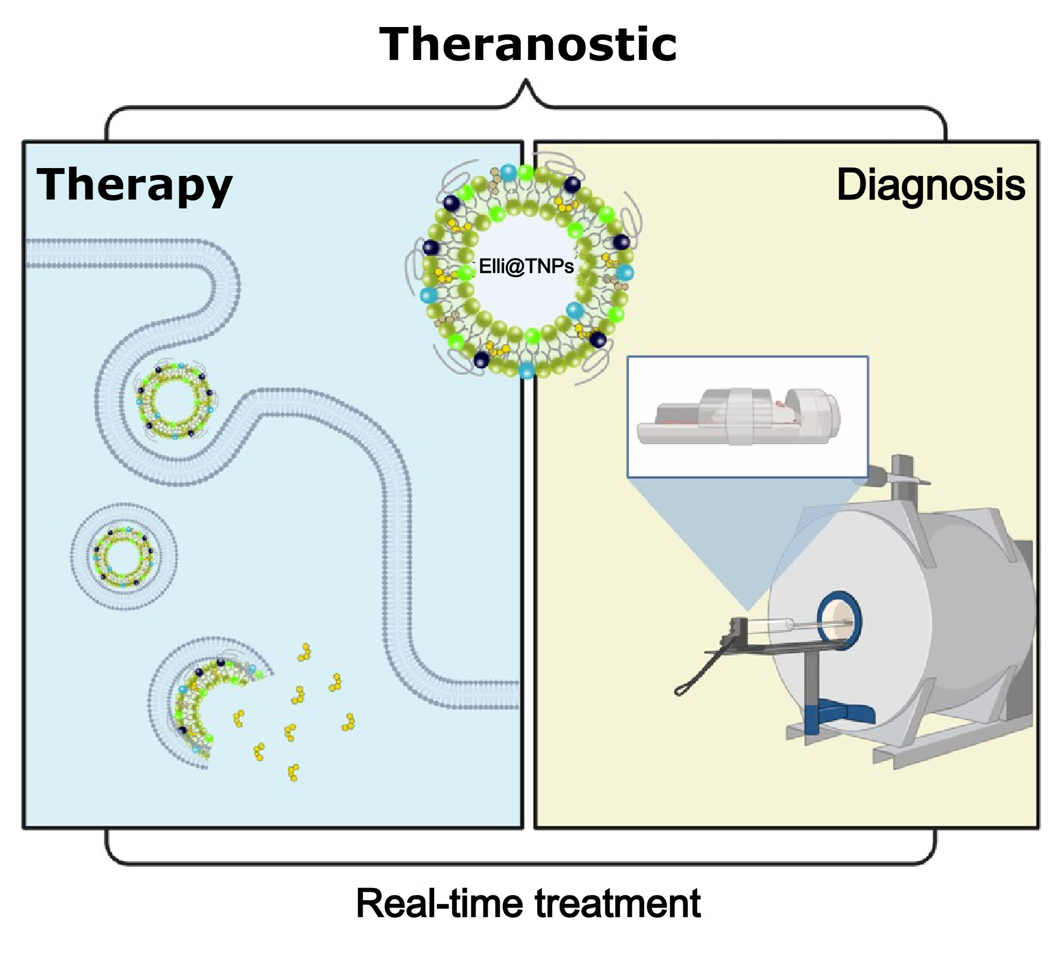
Theranostic approach
4
Notes:
This image highlights the theranostic concept of Elli@TNPs. On the left, you can see the therapeutic side, where the nanoparticles are internalised by cells, fuse with membranes, and release their drug payload into the cytoplasm. On the right, the same particles can be detected by imaging techniques such as MRI, allowing us to track their distribution and treatment effect in real time. This dual functionality means Elli@TNPs can provide both effective therapy and simultaneous diagnosis, which is the core idea of theranostics.

Slide 12
Theranostic approach
Theranostic potential: combines treatment + diagnosis
4

Slide 13
Theranostic approach
Theranostic potential: combines treatment + diagnosis
Therapy: cellular uptake, membrane fusion, drug release, DNA intercalation, cell death
4

Slide 14
Theranostic approach
Theranostic potential: combines treatment + diagnosis
Therapy: cellular uptake, membrane fusion, drug release, DNA intercalation, cell death
Diagnosis: MRI detection and biodistribution monitoring
4

Slide 15
Theranostic approach
Theranostic potential: combines treatment + diagnosis
Therapy: cellular uptake, membrane fusion, drug release, DNA intercalation, cell death
Diagnosis: MRI detection and biodistribution monitoring
Real-time treatment: enables simultaneous therapy and monitoring
4

Slide 16

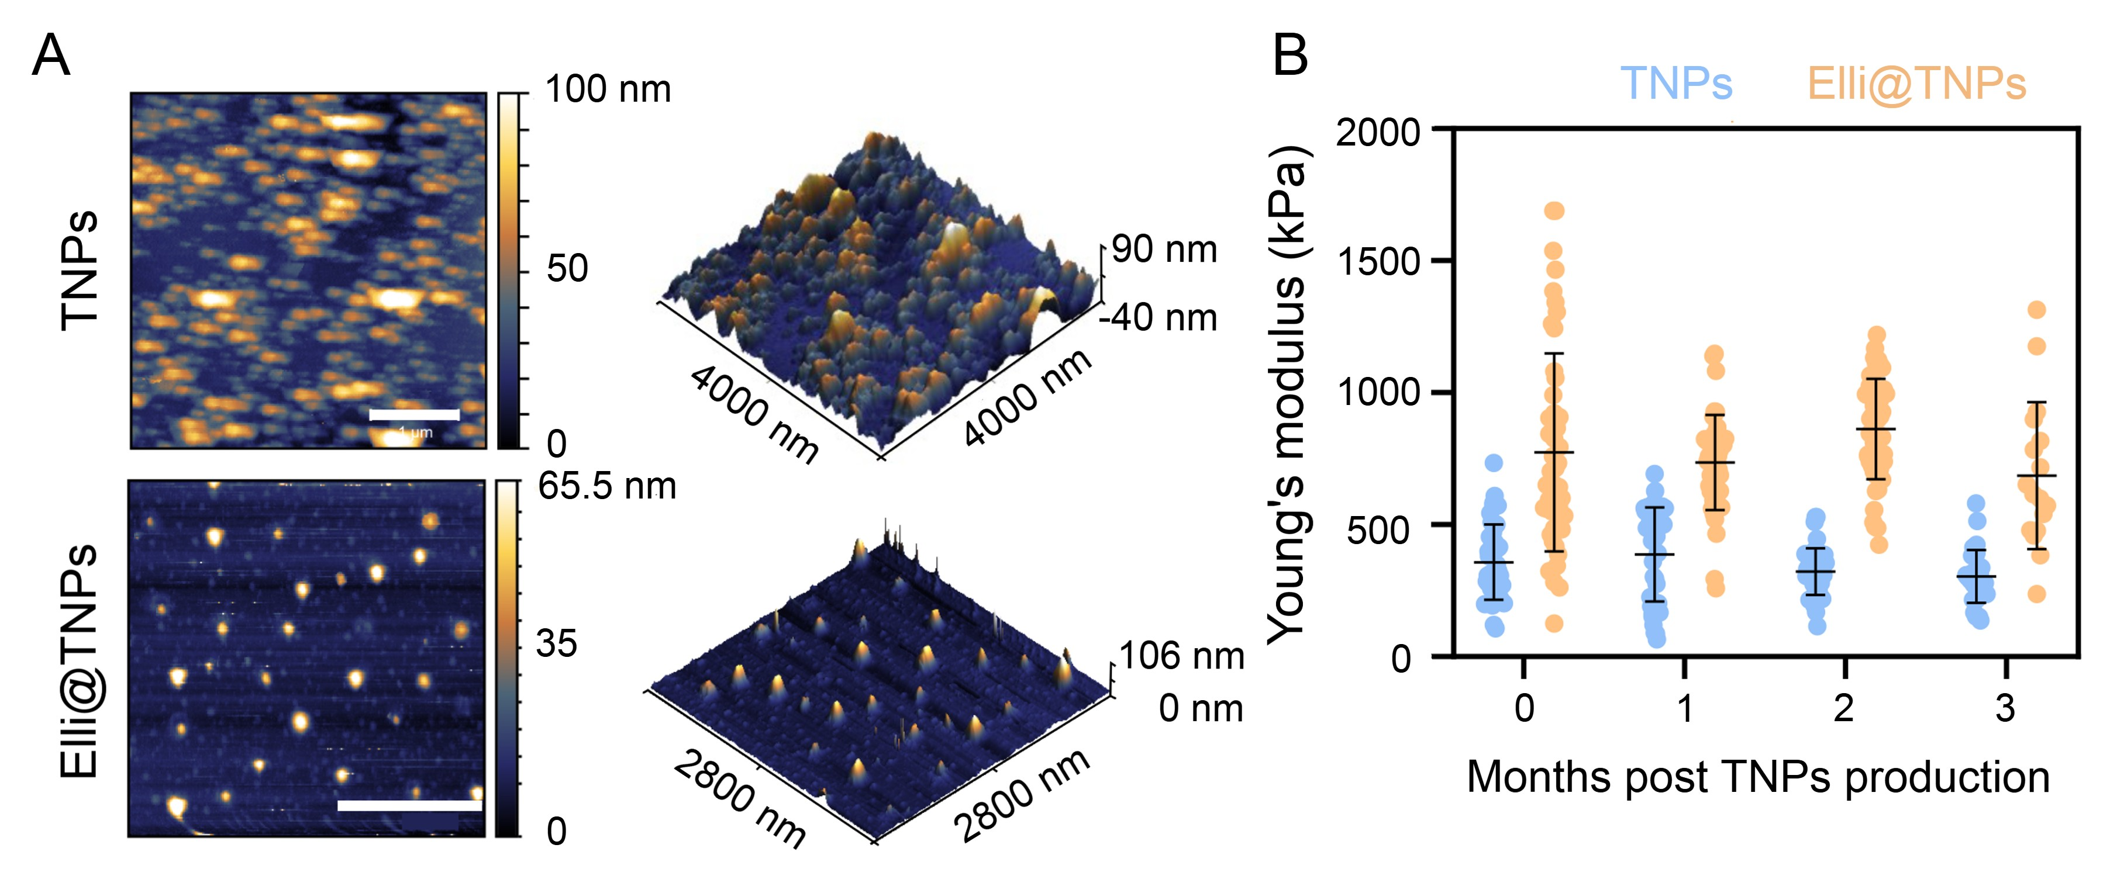

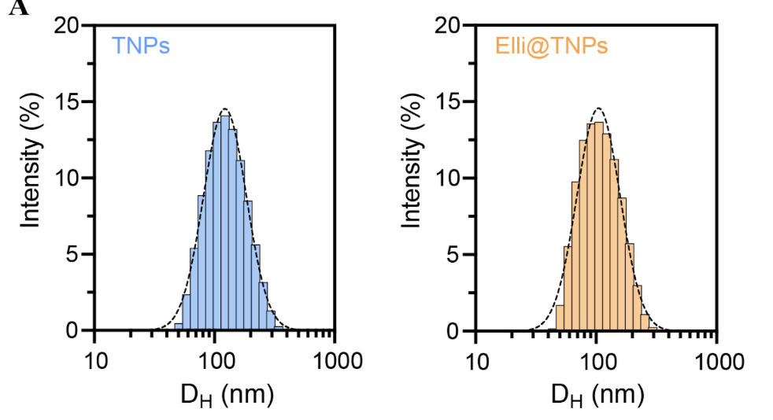
Theranostic approach
Dynamic light scattering (DLS)
5
Notes:
Figure B (Young’s modulus):
Here we assessed the mechanical properties of the particles by measuring Young’s modulus over a three-month period. We observed that Elli@TNPs consistently displayed higher stiffness compared to TNPs, suggesting that Elli induces condensation within the lipid bilayer. This increased stiffness may influence how the particles interact with cellular membranes, their uptake efficiency, and subsequent drug release. Importantly, both TNPs and Elli@TNPs maintained stable mechanical behaviour over time with no significant changes in stiffness, demonstrating excellent long-term stability of both formulations at 4 °C.

Slide 17
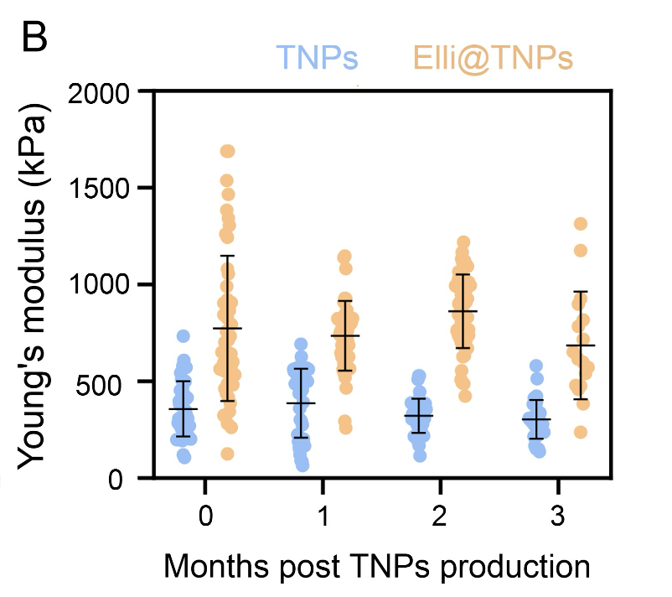
Theranostic approach
6
Notes:
Figure B (Young’s modulus):
Here we assessed the mechanical properties of the particles by measuring Young’s modulus over a three-month period. We observed that Elli@TNPs consistently displayed higher stiffness compared to TNPs, suggesting that Elli induces condensation within the lipid bilayer. This increased stiffness may influence how the particles interact with cellular membranes, their uptake efficiency, and subsequent drug release. Importantly, both TNPs and Elli@TNPs maintained stable mechanical behaviour over time with no significant changes in stiffness, demonstrating excellent long-term stability of both formulations at 4 °C.

Slide 18
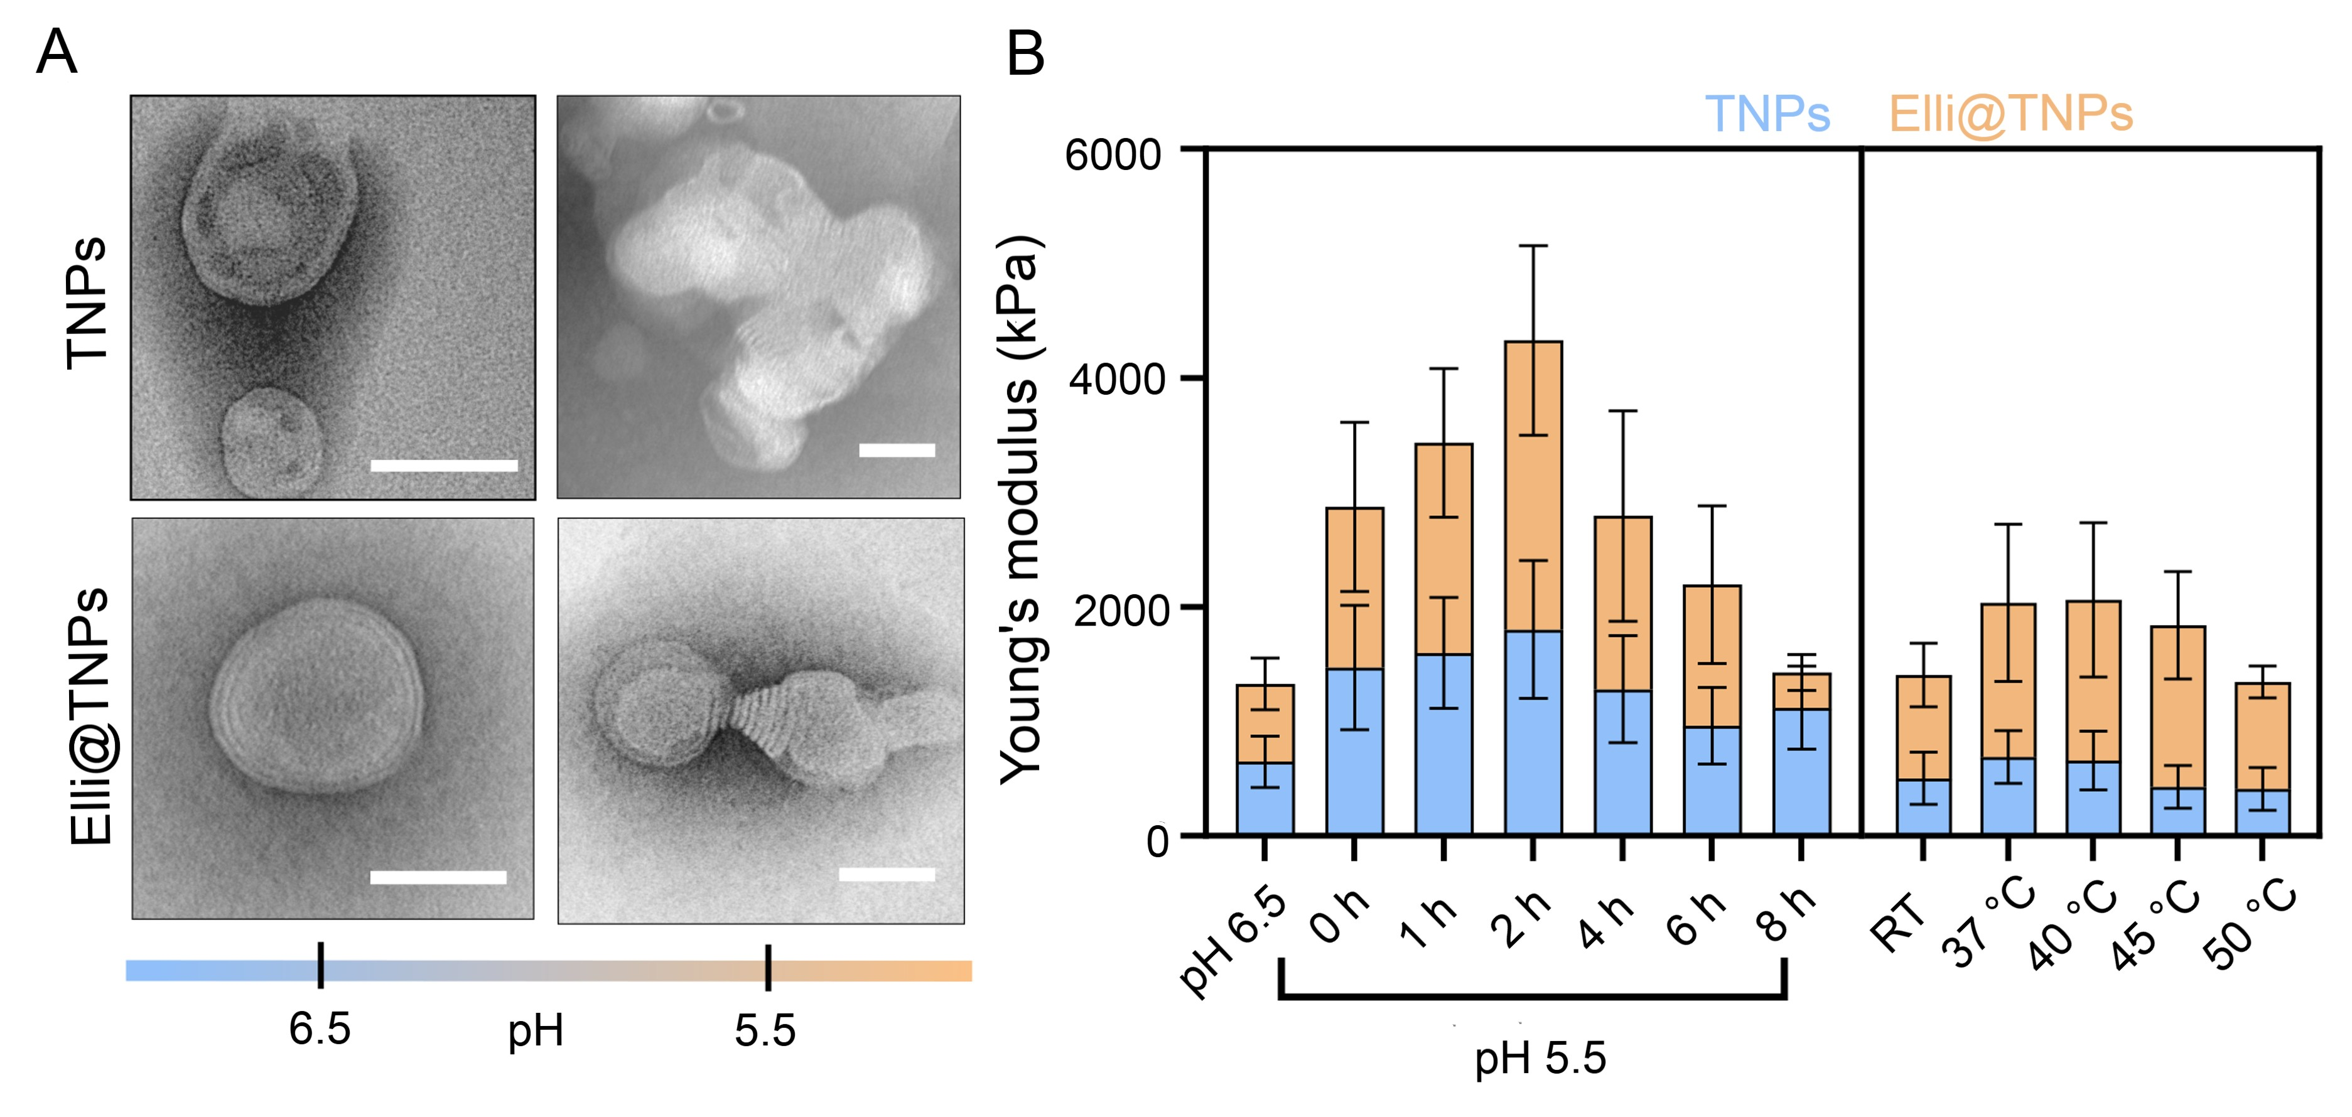
Theranostic approach
7
Notes:
Figure B (Young’s modulus):
To complement the TEM data, we analysed the mechanical properties under pH and temperature stress. At acidic pH, both TNPs and Elli@TNPs showed a time-dependent increase in stiffness, peaking at around 2 hours before decreasing again, which reflects initial bilayer reorganisation followed by destabilisation. Biologically, this indicates that efficient fusion with cell membranes should occur early after uptake, before the bilayer becomes too rigid. With temperature stress, both formulations stayed stable at 37 °C, while higher temperatures increased stiffness and eventually led to softening at 50 °C due to membrane fluidisation. Importantly, Elli@TNPs consistently maintained higher stiffness, supporting their enhanced stability.

Slide 19
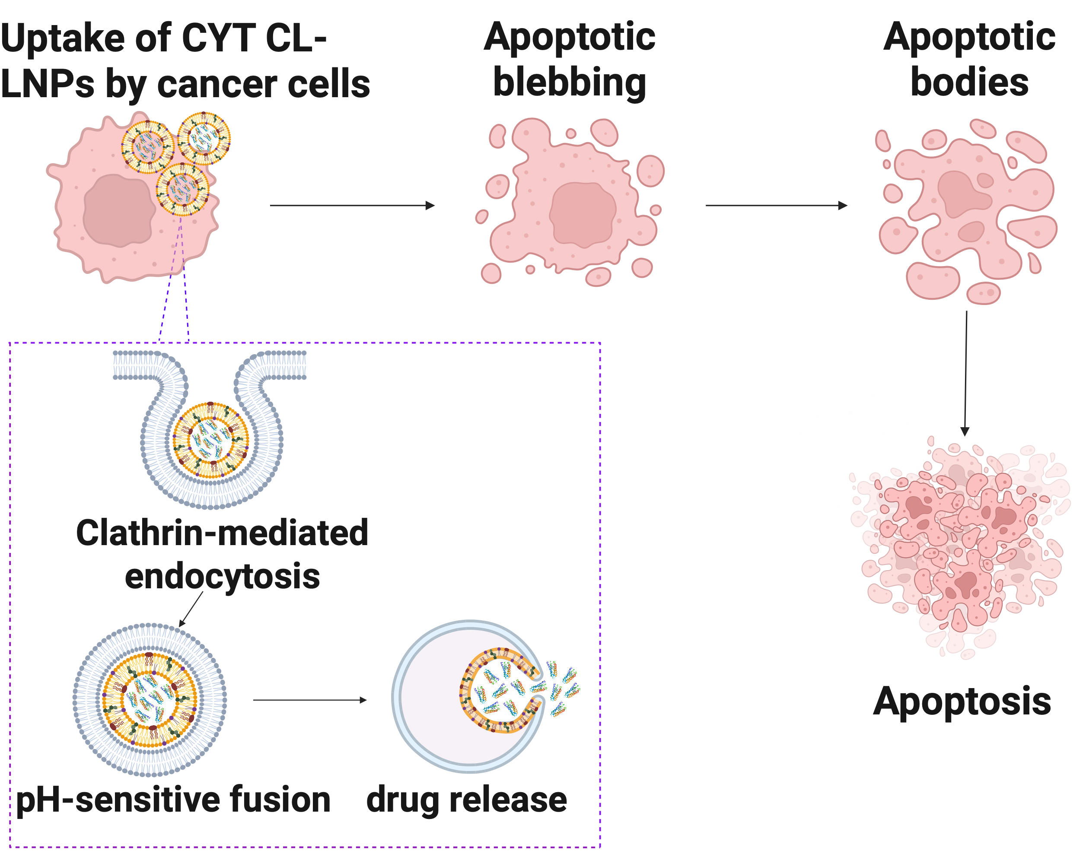
CYT cancer therapy
8
Notes:
LBNPs enter cancer cells primarily through clathrin-mediated endocytosis. Once inside, the acidic environment triggers pH-sensitive fusion of the nanoparticles with the endosomal membrane, leading to drug release into the cytoplasm. The released drug activates apoptotic pathways, and the cancer cell begins to change its structure. First, membrane blebbing occurs, followed by the formation of apoptotic bodies. These steps ultimately result in complete apoptosis, effectively eliminating the cancer cell.

Slide 20
CYT cancer therapy
Uptake by cancer cells: LBNPs internalized via clathrin-mediated endocytosis
8
Notes:
LBNPs enter cancer cells primarily through clathrin-mediated endocytosis. Once inside, the acidic environment triggers pH-sensitive fusion of the nanoparticles with the endosomal membrane, leading to drug release into the cytoplasm. The released drug activates apoptotic pathways, and the cancer cell begins to change its structure. First, membrane blebbing occurs, followed by the formation of apoptotic bodies. These steps ultimately result in complete apoptosis, effectively eliminating the cancer cell.

Slide 21
CYT cancer therapy
Uptake by cancer cells: LBNPs internalized via clathrin-mediated endocytosis
Endosomal processing: pH-sensitive fusion with endosomal membrane triggers drug release
8
Notes:
LBNPs enter cancer cells primarily through clathrin-mediated endocytosis. Once inside, the acidic environment triggers pH-sensitive fusion of the nanoparticles with the endosomal membrane, leading to drug release into the cytoplasm. The released drug activates apoptotic pathways, and the cancer cell begins to change its structure. First, membrane blebbing occurs, followed by the formation of apoptotic bodies. These steps ultimately result in complete apoptosis, effectively eliminating the cancer cell.

Slide 22
CYT cancer therapy
Uptake by cancer cells: LBNPs internalized via clathrin-mediated endocytosis
Endosomal processing: pH-sensitive fusion with endosomal membrane triggers drug release
Apoptotic initiation: released drug activates apoptosis pathways inside the cell
8
Notes:
LBNPs enter cancer cells primarily through clathrin-mediated endocytosis. Once inside, the acidic environment triggers pH-sensitive fusion of the nanoparticles with the endosomal membrane, leading to drug release into the cytoplasm. The released drug activates apoptotic pathways, and the cancer cell begins to change its structure. First, membrane blebbing occurs, followed by the formation of apoptotic bodies. These steps ultimately result in complete apoptosis, effectively eliminating the cancer cell.

Slide 23
CYT cancer therapy
Uptake by cancer cells: LBNPs internalized via clathrin-mediated endocytosis
Endosomal processing: pH-sensitive fusion with endosomal membrane triggers drug release
Apoptotic initiation: released drug activates apoptosis pathways inside the cell
Morphological changes: membrane blebbing and apoptotic body formation
8
Notes:
LBNPs enter cancer cells primarily through clathrin-mediated endocytosis. Once inside, the acidic environment triggers pH-sensitive fusion of the nanoparticles with the endosomal membrane, leading to drug release into the cytoplasm. The released drug activates apoptotic pathways, and the cancer cell begins to change its structure. First, membrane blebbing occurs, followed by the formation of apoptotic bodies. These steps ultimately result in complete apoptosis, effectively eliminating the cancer cell.

Slide 24
CYT cancer therapy
Uptake by cancer cells: LBNPs internalized via clathrin-mediated endocytosis
Endosomal processing: pH-sensitive fusion with endosomal membrane triggers drug release
Apoptotic initiation: released drug activates apoptosis pathways inside the cell
Morphological changes: membrane blebbing and apoptotic body formation
Final outcome: complete apoptosis and elimination of cancer cells
8
Notes:
LBNPs enter cancer cells primarily through clathrin-mediated endocytosis. Once inside, the acidic environment triggers pH-sensitive fusion of the nanoparticles with the endosomal membrane, leading to drug release into the cytoplasm. The released drug activates apoptotic pathways, and the cancer cell begins to change its structure. First, membrane blebbing occurs, followed by the formation of apoptotic bodies. These steps ultimately result in complete apoptosis, effectively eliminating the cancer cell.

Slide 25
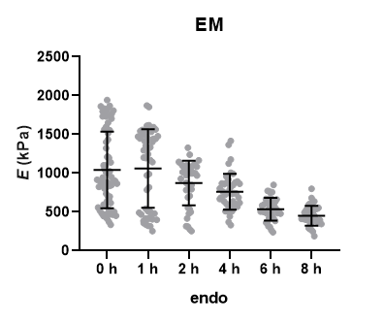

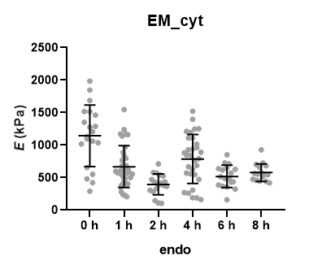
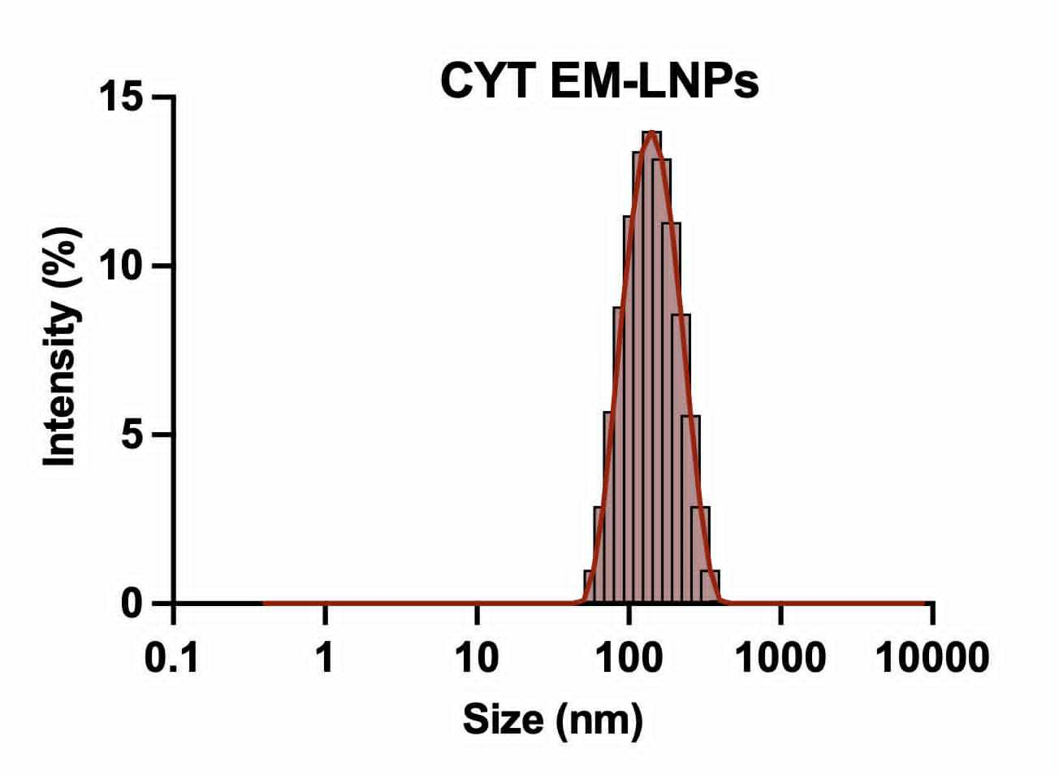
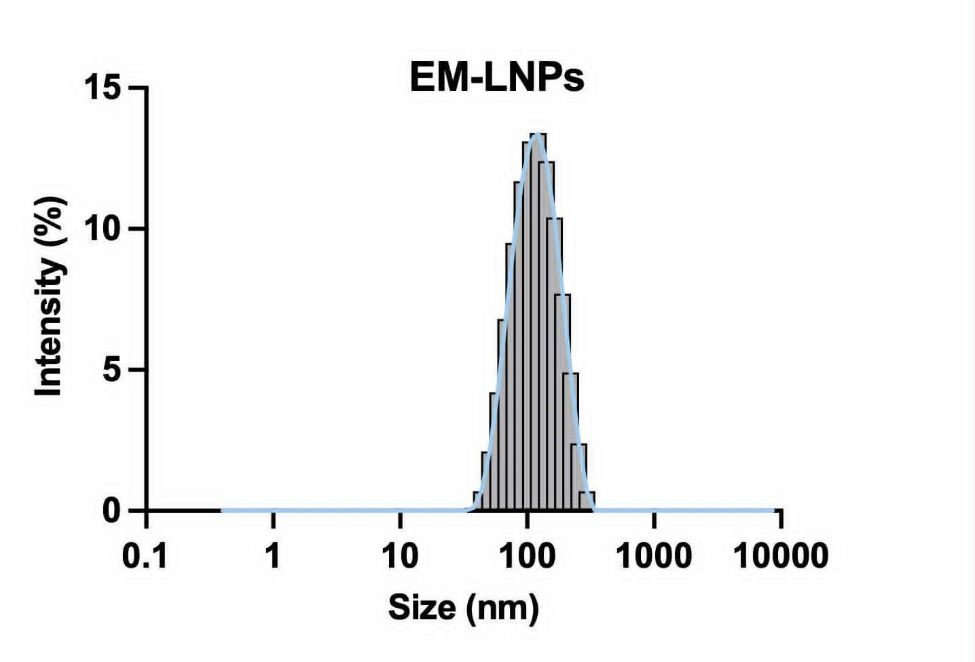

CYT cancer therapy
EM - nanoparticles with basic phospholipid
Transmission electron microscopy (TEM)
EM-LNPs
pH 5.5
DLS
EM-LNPs
pH 7.4
9
Notes:
In these graphs, we can observe how the Young’s modulus, or stiffness of the nanoparticles, changes over time in an acidic environment. As the pH decreases, the Young’s modulus gradually drops, which means the membrane becomes less stable.
When cytochrome is added, the physicochemical properties are no longer clearly defined, and the particles show even lower stability. That is why the development of CL-LNPs was necessary.

Slide 26
CYT cancer therapy
EM - nanoparticles with basic phospholipid
Transmission electron microscopy (TEM)
EM-LNPs
pH 5.5
DLS
EM-LNPs
pH 7.4
9
Notes:
In these graphs, we can observe how the Young’s modulus, or stiffness of the nanoparticles, changes over time in an acidic environment. As the pH decreases, the Young’s modulus gradually drops, which means the membrane becomes less stable.
When cytochrome is added, the physicochemical properties are no longer clearly defined, and the particles show even lower stability. That is why the development of CL-LNPs was necessary.

Slide 27
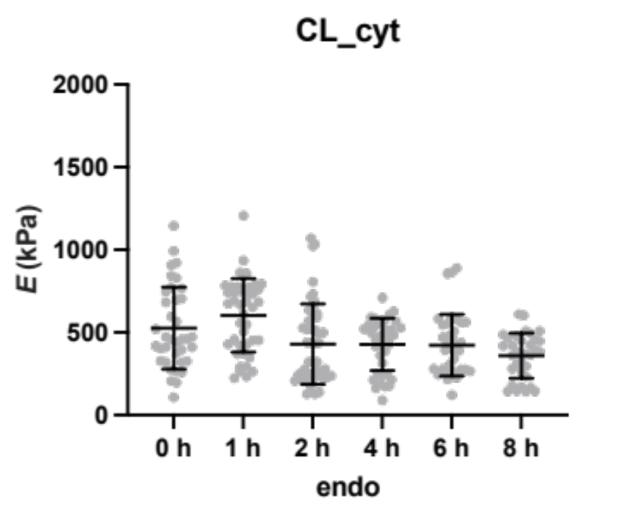
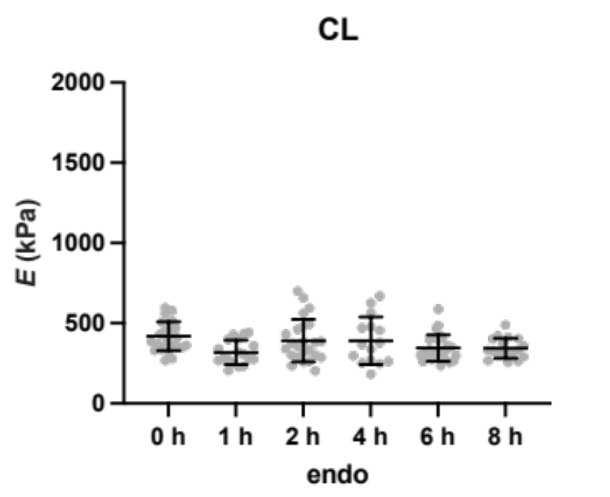

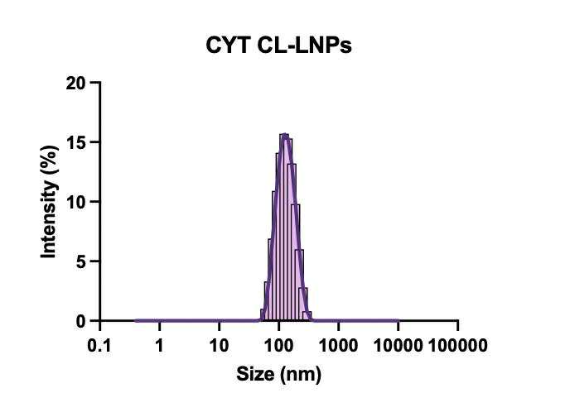
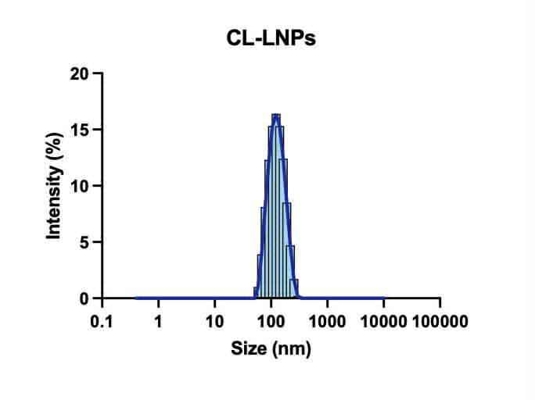
CYT cancer therapy
CL - nanoparticles with cardiolipin
TEM
CL-LNPs
pH 5.5
DLS
CL-LNPs
pH 7.4
10
Notes:
In this set of measurements, we can see the Young’s modulus of CL and CL–cyt formulations over time. At the starting point, around 0 hours, the particles are stable and no aggregation is observed. After about 2 hours, there is a slight shift due to membrane fusion, but overall the particles remain stable in the acidic environment.
Interestingly, when cytochrome is added, the stability pattern is very similar. The CL–cyt particles also maintain their mechanical properties over time, which indicates that this formulation is resistant to degradation and preserves its structure under endosomal conditions.

Slide 28
CYT cancer therapy
CL - nanoparticles with cardiolipin
TEM
CL-LNPs
pH 5.5
DLS
CL-LNPs
pH 7.4
10
Notes:
In this set of measurements, we can see the Young’s modulus of CL and CL–cyt formulations over time. At the starting point, around 0 hours, the particles are stable and no aggregation is observed. After about 2 hours, there is a slight shift due to membrane fusion, but overall the particles remain stable in the acidic environment.
Interestingly, when cytochrome is added, the stability pattern is very similar. The CL–cyt particles also maintain their mechanical properties over time, which indicates that this formulation is resistant to degradation and preserves its structure under endosomal conditions.

Slide 29
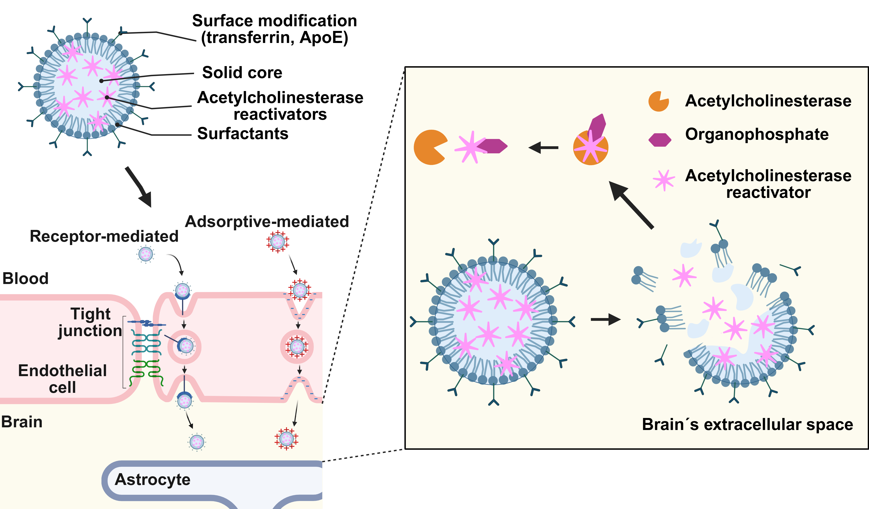
Brain delivery
11
Notes:
This figure shows the strategy of delivering acetylcholinesterase reactivators into the brain using solid lipid nanoparticles. The particles are composed of a solid lipid core, surfactants, and encapsulated reactivators, and they can be further modified with targeting ligands such as transferrin or ApoE to improve brain delivery. To cross the blood–brain barrier, they exploit two main pathways: receptor-mediated and adsorptive-mediated transport. Once in the brain’s extracellular space, the nanoparticles release their cargo, allowing acetylcholinesterase reactivators to bind to and reactivate enzymes that have been inhibited by organophosphates. This mechanism is crucial because it directly addresses the challenge of organophosphate poisoning, where standard oximes struggle to reach the central nervous system effectively. SLNs enable oximes to reach the brain and restore enzyme function after OP poisoning

Slide 30

Brain delivery
Composition: solid lipid core + surfactants + acatylcholinesterase reactivators + targeting ligands
Blood-brain barrier crossing: receptor-mediated and adsorptive-mediated pathways
Release in brain: reactivators released into extracellular space
Therapeutic action: reactivation of inhibited acetylcholinesterase
11
Notes:
This figure shows the strategy of delivering acetylcholinesterase reactivators into the brain using solid lipid nanoparticles. To cross the blood–brain barrier, they exploit two main pathways: receptor-mediated and adsorptive-mediated transport. The particles are composed of a solid lipid core, surfactants, and encapsulated reactivators, and they can be further modified with targeting ligands such as transferrin or ApoE to improve brain delivery. Once in the brain’s extracellular space, the nanoparticles release their cargo, allowing acetylcholinesterase reactivators to bind to and reactivate enzymes that have been inhibited by organophosphates. This mechanism is crucial because it directly addresses the challenge of organophosphate poisoning, where standard oximes struggle to reach the central nervous system effectively.

Slide 31
Brain delivery
Composition: solid lipid core + surfactants + acatylcholinesterase reactivators + targeting ligands
Blood-brain barrier crossing: receptor-mediated and adsorptive-mediated pathways
Release in brain: reactivators released into extracellular space
Therapeutic action: reactivation of inhibited acetylcholinesterase
11
Notes:
This figure shows the strategy of delivering acetylcholinesterase reactivators into the brain using solid lipid nanoparticles. To cross the blood–brain barrier, they exploit two main pathways: receptor-mediated and adsorptive-mediated transport. The particles are composed of a solid lipid core, surfactants, and encapsulated reactivators, and they can be further modified with targeting ligands such as transferrin or ApoE to improve brain delivery. Once in the brain’s extracellular space, the nanoparticles release their cargo, allowing acetylcholinesterase reactivators to bind to and reactivate enzymes that have been inhibited by organophosphates. This mechanism is crucial because it directly addresses the challenge of organophosphate poisoning, where standard oximes struggle to reach the central nervous system effectively.

Slide 32
Brain delivery
Composition: solid lipid core + surfactants + acatylcholinesterase reactivators + targeting ligands
Blood-brain barrier crossing: receptor-mediated and adsorptive-mediated pathways
Release in brain: reactivators released into extracellular space
Therapeutic action: reactivation of inhibited acetylcholinesterase
11
Notes:
This figure shows the strategy of delivering acetylcholinesterase reactivators into the brain using solid lipid nanoparticles. To cross the blood–brain barrier, they exploit two main pathways: receptor-mediated and adsorptive-mediated transport. The particles are composed of a solid lipid core, surfactants, and encapsulated reactivators, and they can be further modified with targeting ligands such as transferrin or ApoE to improve brain delivery. Once in the brain’s extracellular space, the nanoparticles release their cargo, allowing acetylcholinesterase reactivators to bind to and reactivate enzymes that have been inhibited by organophosphates. This mechanism is crucial because it directly addresses the challenge of organophosphate poisoning, where standard oximes struggle to reach the central nervous system effectively.

Slide 33
Brain delivery
Composition: solid lipid core + surfactants + acatylcholinesterase reactivators + targeting ligands
Blood-brain barrier crossing: receptor-mediated and adsorptive-mediated pathways
Release in brain: reactivators released into extracellular space
Therapeutic action: reactivation of inhibited acetylcholinesterase
11
Notes:
This figure shows the strategy of delivering acetylcholinesterase reactivators into the brain using solid lipid nanoparticles. To cross the blood–brain barrier, they exploit two main pathways: receptor-mediated and adsorptive-mediated transport. The particles are composed of a solid lipid core, surfactants, and encapsulated reactivators, and they can be further modified with targeting ligands such as transferrin or ApoE to improve brain delivery. Once in the brain’s extracellular space, the nanoparticles release their cargo, allowing acetylcholinesterase reactivators to bind to and reactivate enzymes that have been inhibited by organophosphates. This mechanism is crucial because it directly addresses the challenge of organophosphate poisoning, where standard oximes struggle to reach the central nervous system effectively.

Slide 34
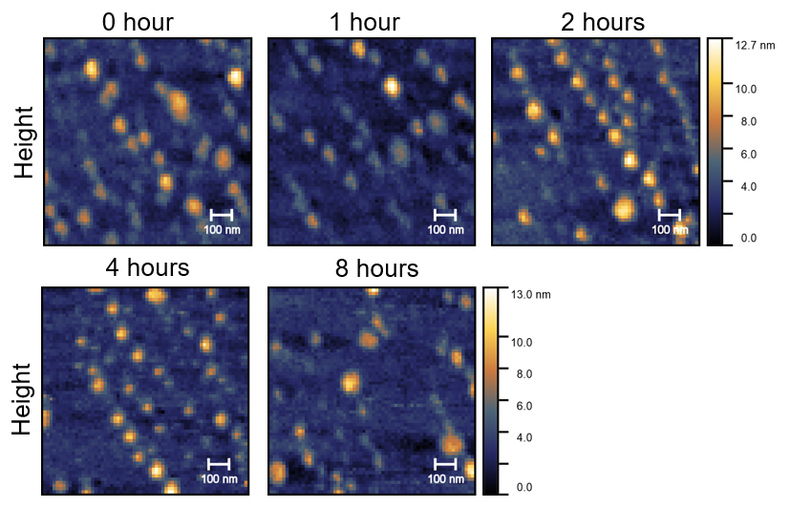
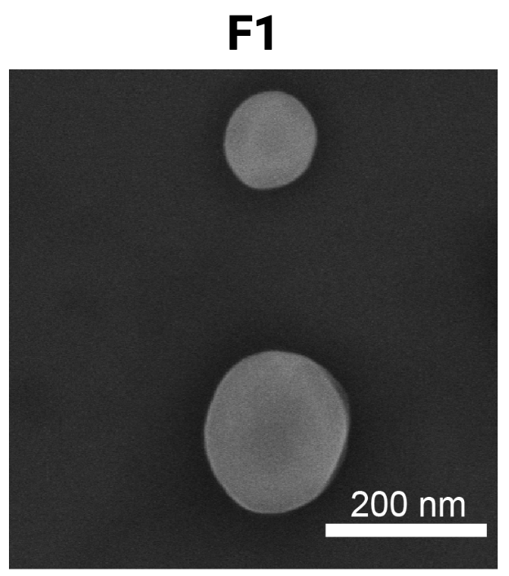
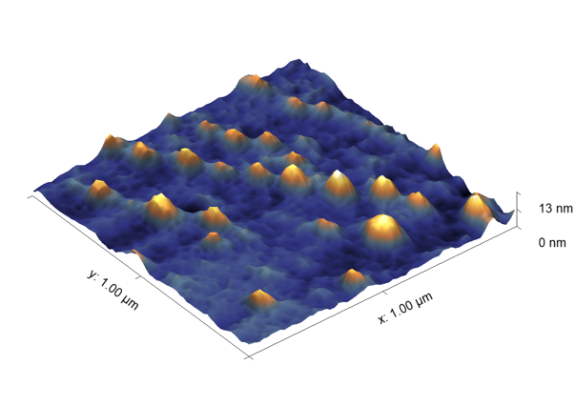
Brain delivery
2D and 3D topography
Scanning electron microscopy
12
Notes:
In this project we created four different formulations designed for blood–brain barrier crossing, but at this stage we are focusing on the proper characterization of the standard formulation. In the first figure, you can see 2D and 3D AFM topography over a period of 0 to 8 hours. The nanoparticles remain spherical, evenly dispersed, and structurally intact without aggregation, showing excellent stability in time.

Slide 35

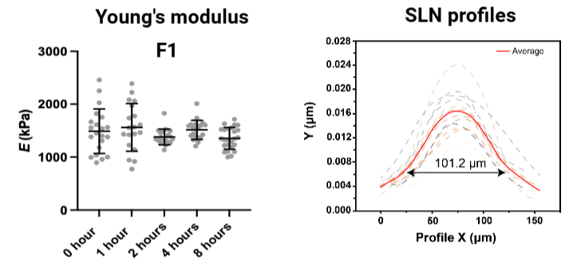
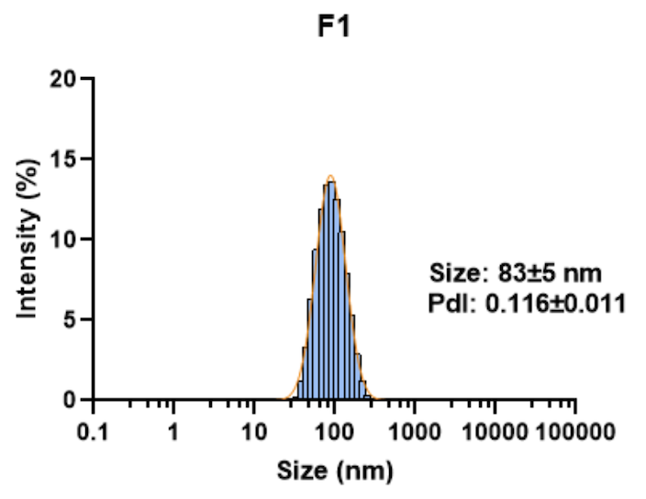
Brain delivery
DLS
13
Notes:
The second figure highlights the mechanical properties. Young’s modulus values stayed consistent across all time points, confirming that the particles preserve their stiffness and membrane integrity. The SLN profiles further show a uniform size distribution of around 100 nanometres. Together, these results confirm that our standard formulation has strong structural and mechanical stability, which is an essential foundation before moving on to the comparative analysis of the other formulations.

Slide 36


Outlooks
TNPs:
pH sensitivity to enable drug release, temperature stability for future FUS applications
CL-LNPs:
EM particles show less stability with encapsulated protein, while CL formulations remain stable
SLNs:
SLNs show spherical morphology, stable and mechanical properties over time
Acknowledgement:
Internal Grant Agency:
IGA25-AF-IP-025
IGA25-AF-IP-032
Czech Science Foundation:
Project no. 25-15339S
14
Notes:
FUS – focused ultrasound

