Slide 1
Electromechanical cell-based biosensors for drug and disease of 3D cardiac models
Martin Pešl

Slide 2
Arrhythmia and Heart Failure preclinical management
screening responses of new developed compounds
improvement of drug and treatment strategies
in silico
in vitro
small animal models
large animal models
healthy and diseased human participants

Slide 3
Cardiac risk assessment
in vitro Electrophysiology, no standardized contractlity safety studies
  I_{Kr} assays (adequate to QT assays) ICH S7B guidance EMA / similar FDA
  multi-ion channel comprehensive proarrhythmia assay (CiPA, Fermini 2016)
Animal Cardiomyoctes
  zebrafish with two heart chambers, rodents with aberrant ion channel levels
  dog, porcine and ovine cells with subtle differences and very complex handling
Stem cell derived cardiomyocytes (iPSC-CMs)
  spontaneous beat and partially immature phenotype
  single cells lack organ-dependent factors and cell-cell interactions
  cardiac organoid model approximates an optimal translational value and repeatability
    enables both safety and disease phenotype studies

Slide 4
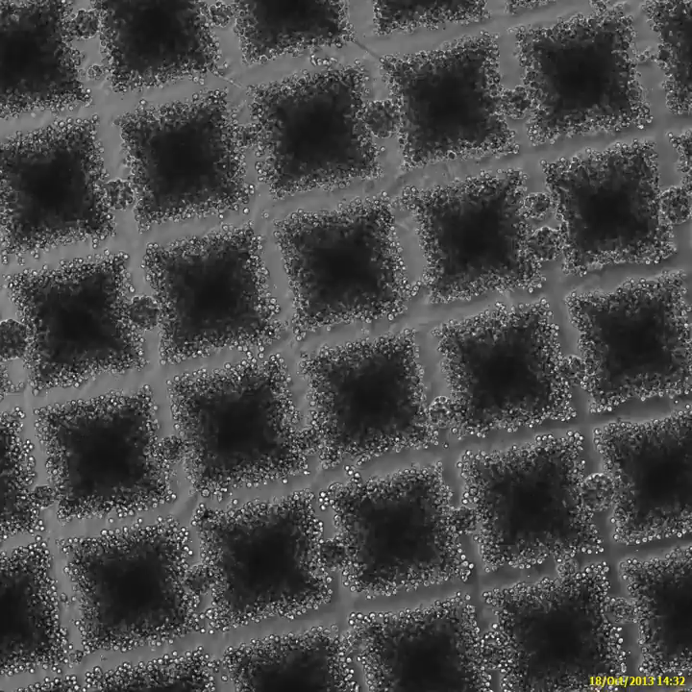
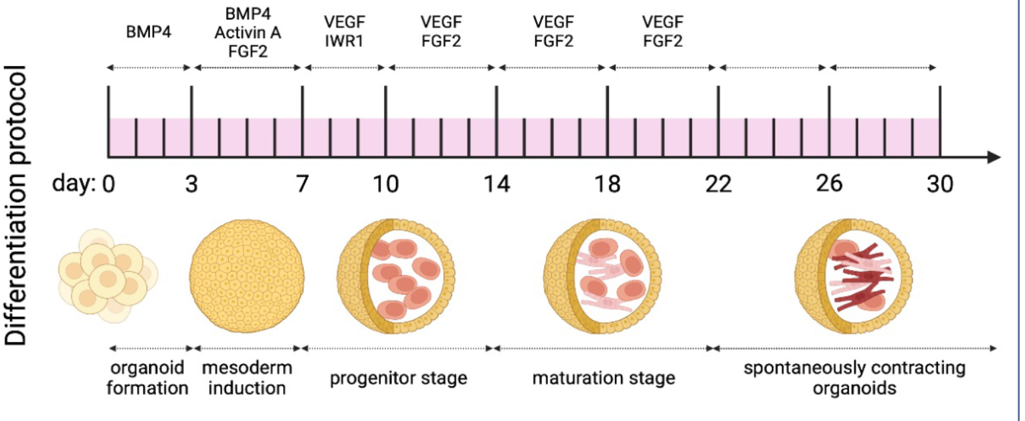
Stem cell derived cardiomyocytes (iPSC-CMs)
  cardiac organoid model (embryonic body EB)
Pesl et al. Heart and Vessels 2014
Notes:
Human pluripotent stem cells (hPSC) are massively available source of cells to be differentiated into cardiomyocytes. Spheroidal constructs known as embryoid bodies (EB), that can be used in cell-based biosensors.

Slide 5
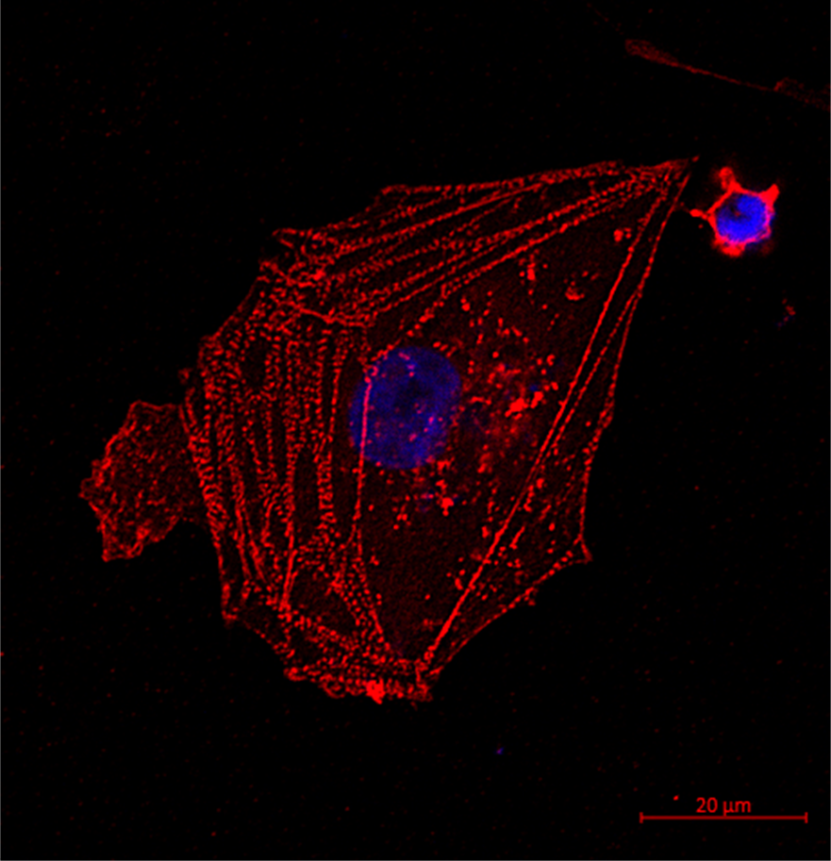
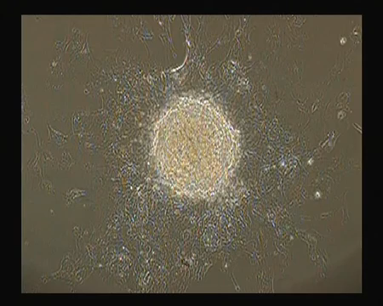
Stem cell derived cardiomyocytes (iPSC-CMs)
  cardiac organoid model (embryonic body EB)
CMs
dissociated
from an EB
Blue DAPI
Red cTnT
Pesl et al. Heart and Vessels 2014, Beckerová et al 2023

Slide 6
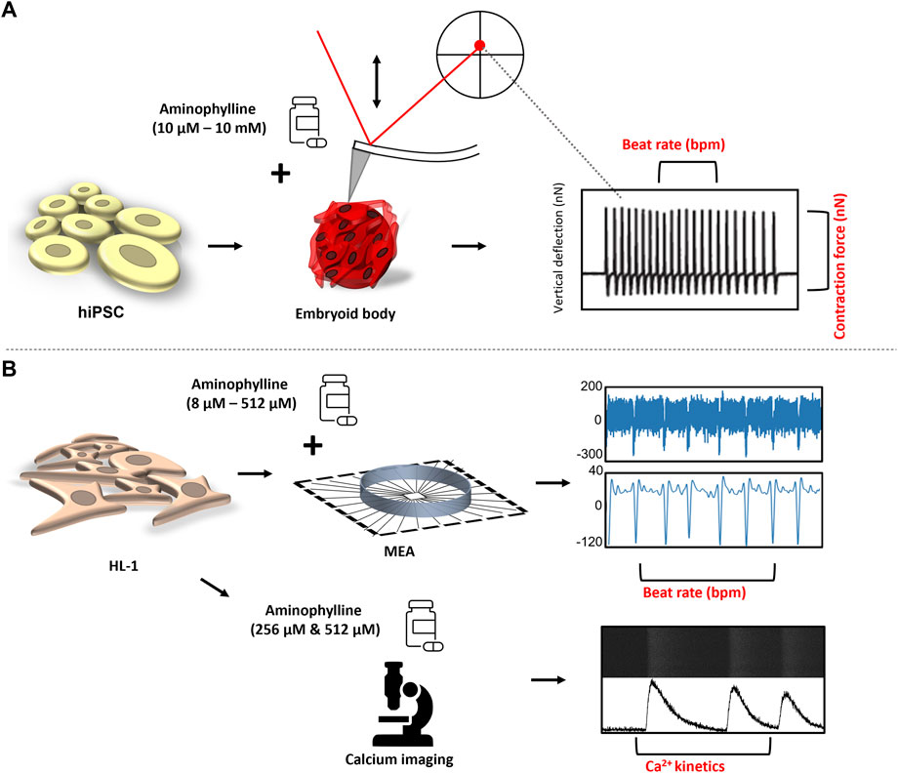
Phenotype analysis of iPSC-CMs
Atomic force microscopy
- cantilever deflection reflects contraction/relaxation
Microelectrode array
- field potential reflects syncytium action potential
Calcium Imaging
- intrinsic Ca²⁺ kinetics using calcium-binding Fluo-8

Slide 7
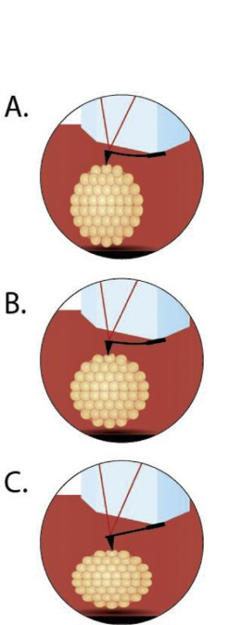
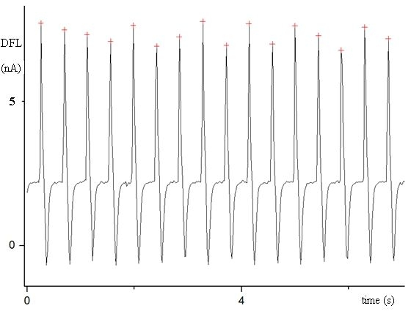
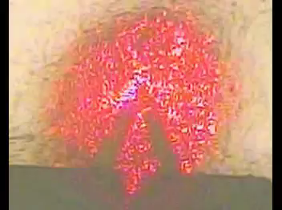
Atomic force microscopy of iPSC-CMs
Contraction
- first cantilever deflection in „QRS“ complex
Iso line in between the beats
- cantilever excercise 3-6nN force on the surface of cluster
Relaxation
- due to constant force cantilever follow (down) relaxing EB without loosing the contact
contraction rate, relaxation time, displacement / deflection - computed contraction force
Pesl et al. Heart and Vessels 2014

Slide 8
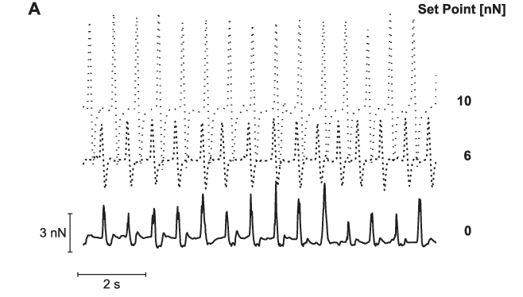
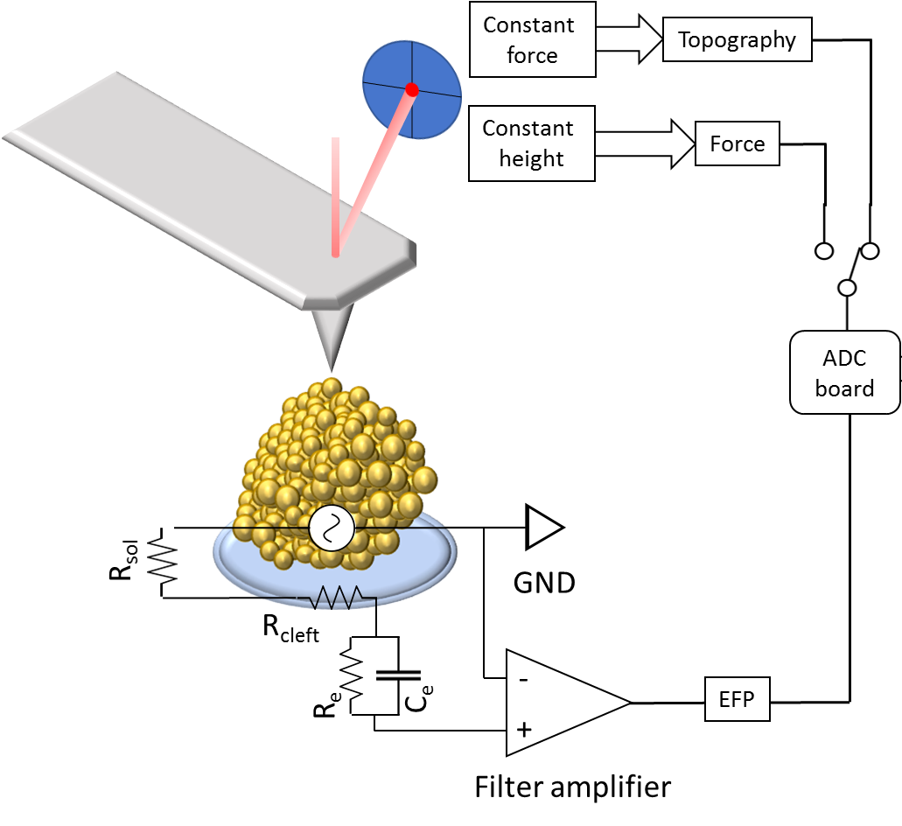
Atomic force microscopy of iPSC-CMs
Contraction
Iso-line
Relaxation
Set point = mimicking „afterloading“ resitance, preload mimicked by cantilever elasticity (drag)
Pesl et al. Biosens. Bioelectron 2016

Slide 9
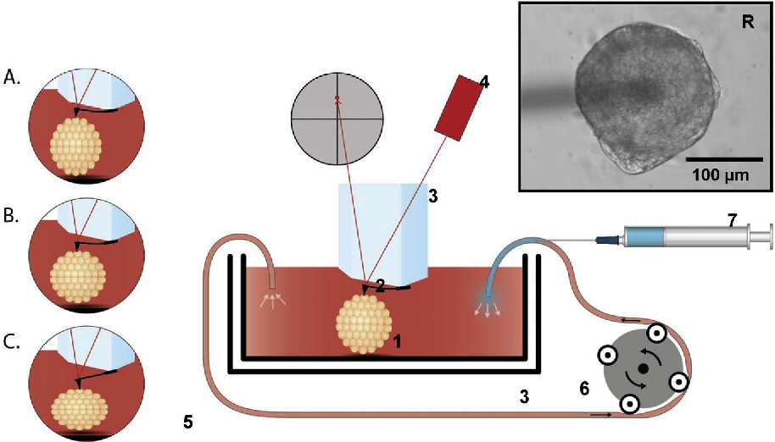
Atomic force microscopy of iPSC-CMs
contraction rate, relaxation time and force with influence of selected drugs and in mutated cell lines
Tyrod´s solution - stabilization- Drug administration - stabilization- Wash out - stabilization- Wrap up
Klimovic, Scurek, Pesl, Front Pharmacol. 2022

Slide 10
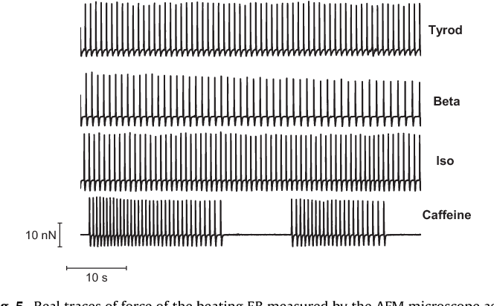
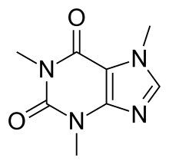
Atomic force microscopy of iPSC-CMs
Tyrod solution, Ca²⁺ 1,8mmol
Beta blocking Metoprolol
Beta stimulation Isoproterenol / Adrenalin
Calcium release methylxanthie - Caffein
Klimovic, Scurek, Pesl, Front Pharmacol. 2022

Slide 11
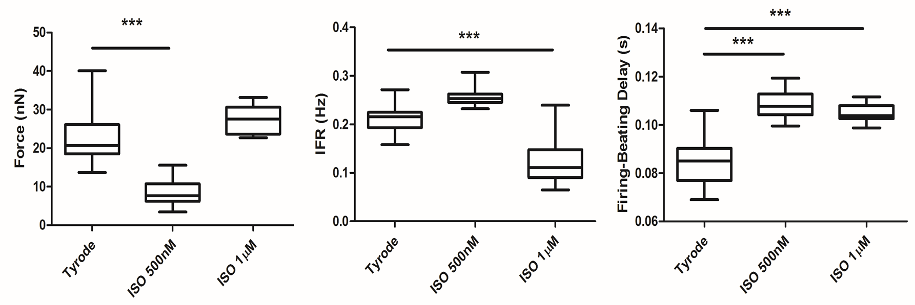
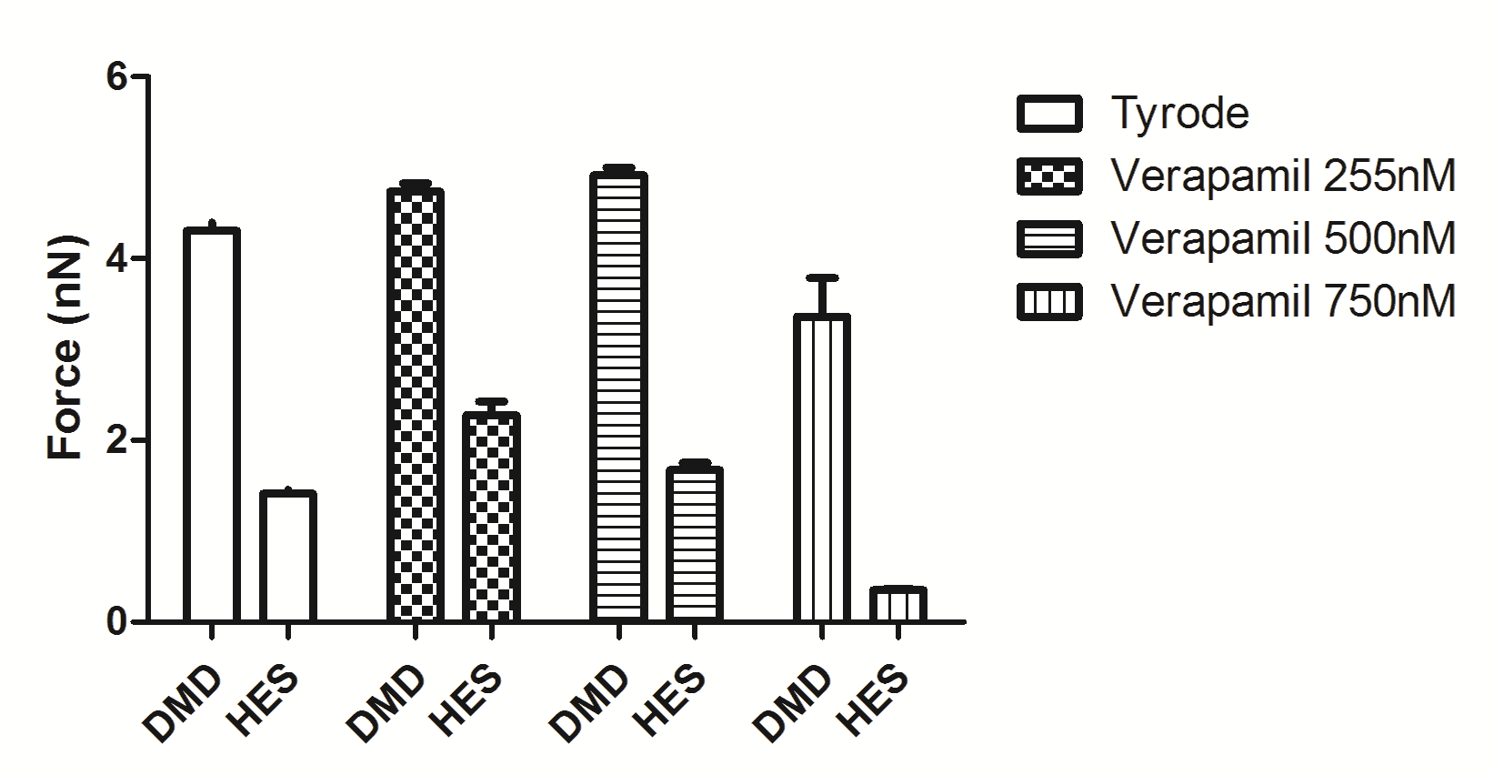
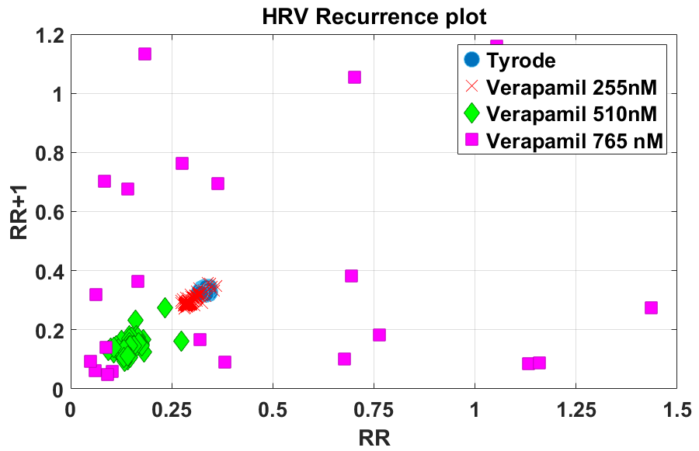
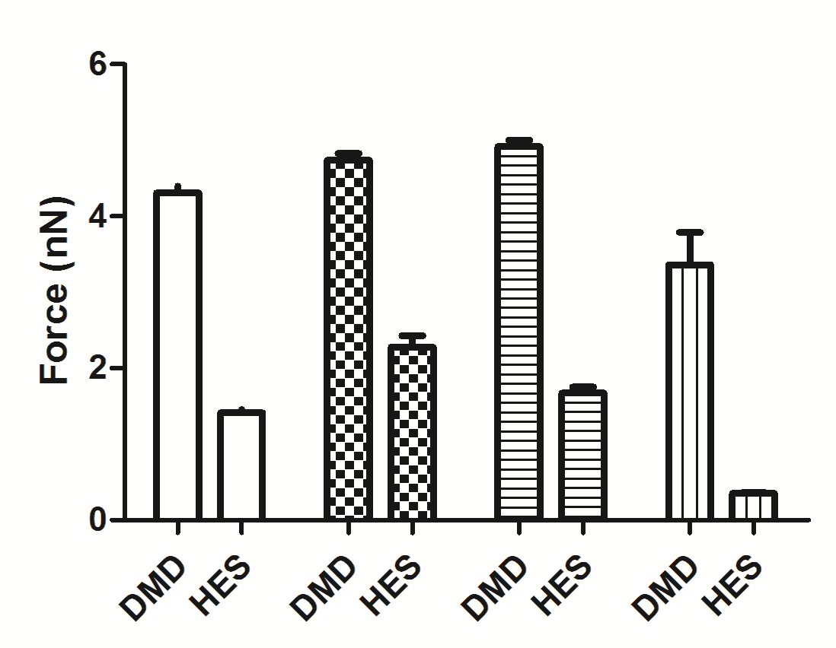
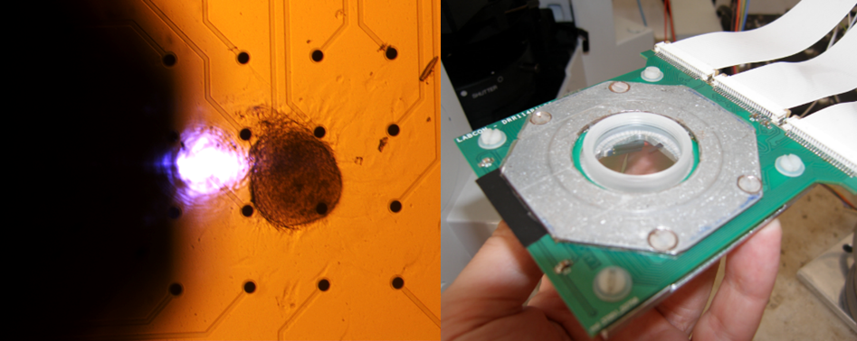
Combined AFM and MEA on iPSC-CMs
Microelectrode Array = planar EP grid
Standard Tyrod solution, Ca 1,8mmol
Beta stimulation Isoproterenol 500nM-1uM
Verapamil overdose as arrythmia induction
In WT and DMD pairs
Caluori, Biosens. Bioelectron 2019
Notes:
Representative result obtained with the AFM+MEA system. E) Averaged (>30 events) electrophysiological and contraction signals. The lag between the signals represents the mean delay between the two. F) hPSC-derived cardiac EB adrenergic response to isoproterenol (ISO) shows the negative frequency-force relationship typical of the fetal phenotype. G) Recurrence plot of heart rate variability (HRV) shows the effect of L-type calcium-channel blocker Verapamil on cardiac functionality. One can notice both frequency reduction and increasing of the data scattering due to erratic drug-induced activation. H) Confront of Verapamil response in different cell lines (Duchenne Muscular dystrophy, DMD and human embryonic-derived cardiomyocytes, HES). One can notice the common initial increase in the exerted force, followed by a marked parameter decrease in healthy control, whereas the DMD model is less responsive at the same drug concentration.
We have successfully implemented a combined electromechanical system for the evaluation of electrochemical response of hPSC-derived cardiomyocytes 3D models. The system is able, by the combination of AFM with MEA, to probe simultaneously different biophysical parameters and their correlation in response to well-known drug stimuli. Multiple drug trials on the same samples are possible in a non-destructive fashion. The system allows a reliable platform with reduced variability for the phenotypic response, drug sensitivity and cardiotoxicity evaluation employing in vitro human cardiac models.

Slide 12
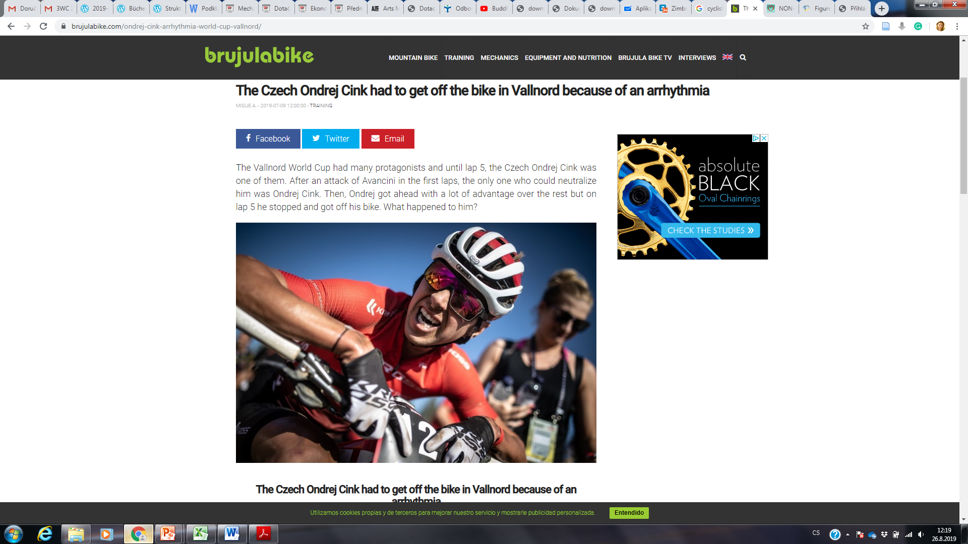
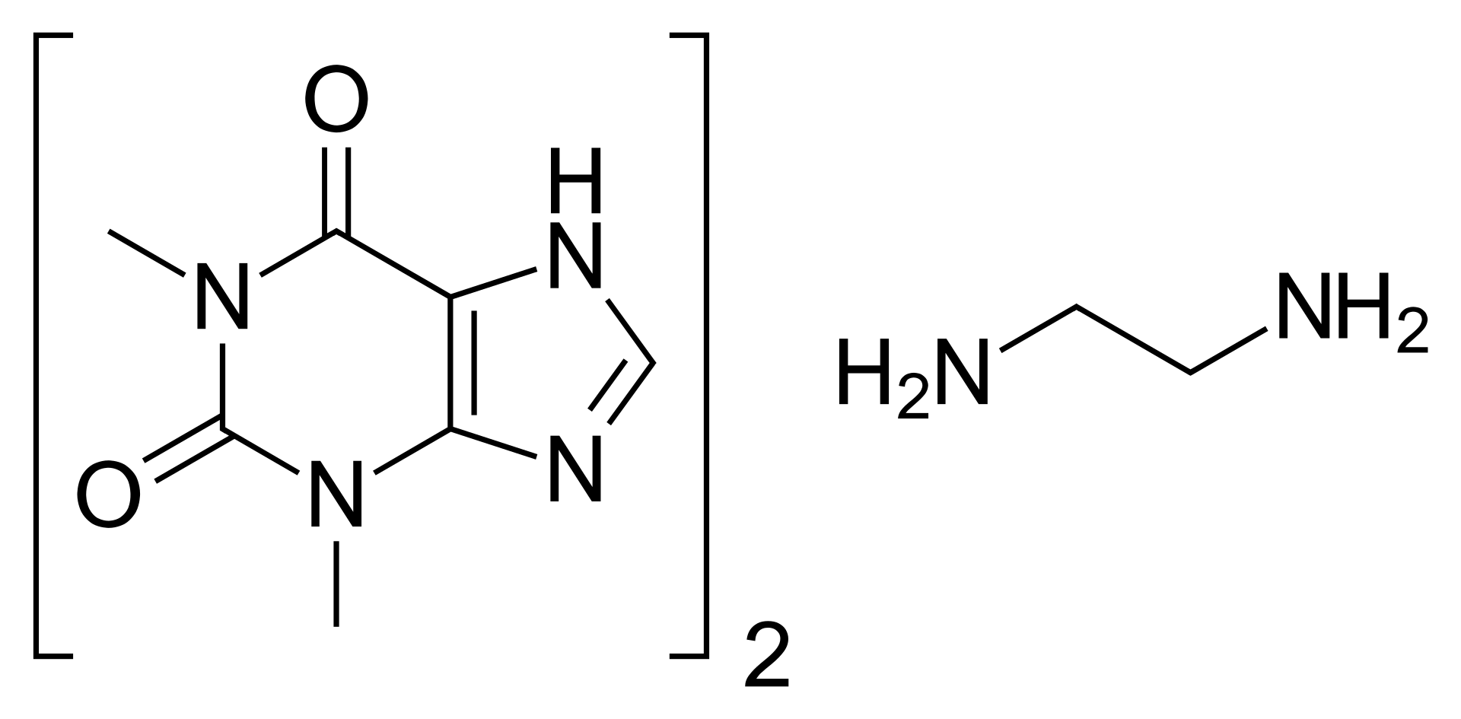
AFM drug testing
Klimovic Scurek Pesl Front Pharmacol.2022

Slide 13
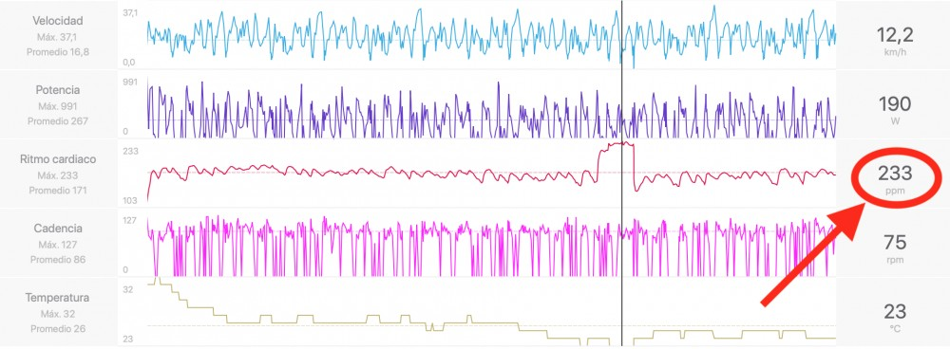
AFM drug testing
Klimovic Scurek Pesl Front Pharmacol.2022

Slide 14
AFM drug testing of Aminophilline
Theophylline with Ethylenediamine 2:1
nonselective adenosine receptor antagonist
competitive nonselective phosphodiesterase inhibitor
bronchodilation adjunct to inhaled beta-2 selective agonists and systemic corticosteroids
clinically relevant
concentrations
20-110 μmol/l
Klimovic Scurek Pesl Front Pharmacol.2022

Slide 15
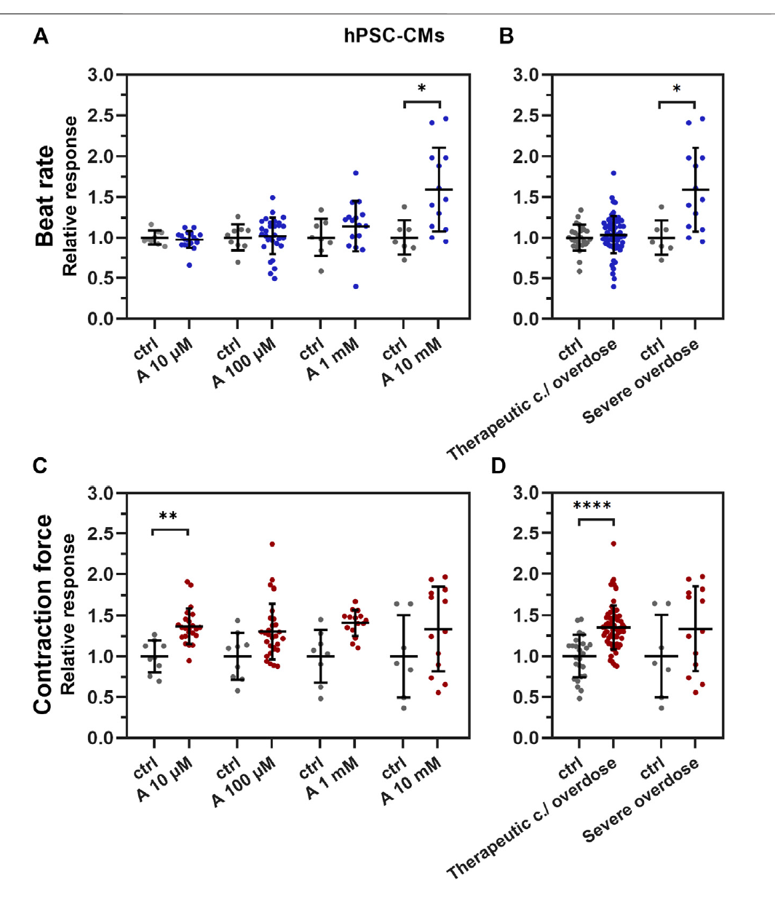
AFM drug testing of Aminophylline
linear concentration-dependent positive chronotropic effect of aminophylline significant up to the 10 mM (severe overdose)
Increased varition in beat to beat analysis (SDNN) = arrythmia
Mild, but statistically significant increase inotropy (contraction force of EBs) already in lower concentrations of aminophylline
washout decrease effects during the washout period = suggesting that the chronotropic and inotropic effects is likely due to the effect of aminophylline and not due to irreversible cellular damage
Klimovic Scurek Pesl Front Pharmacol.2022

Slide 16
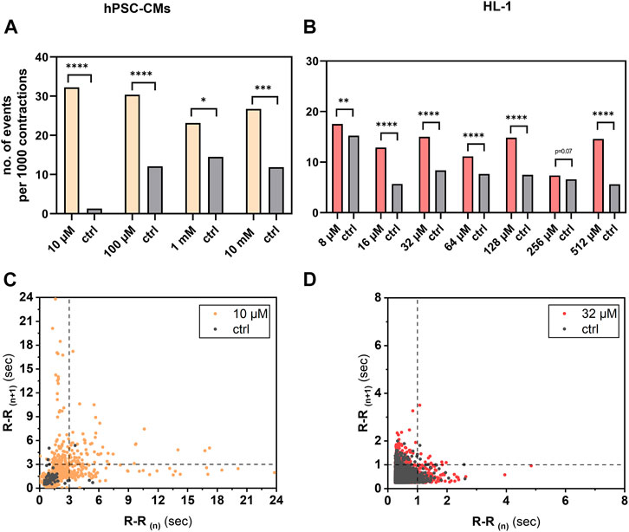
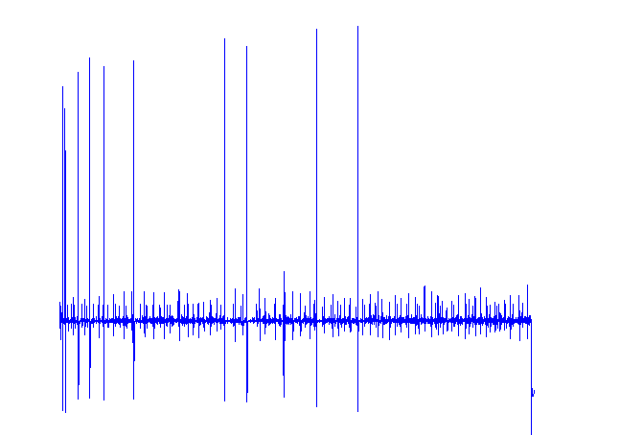
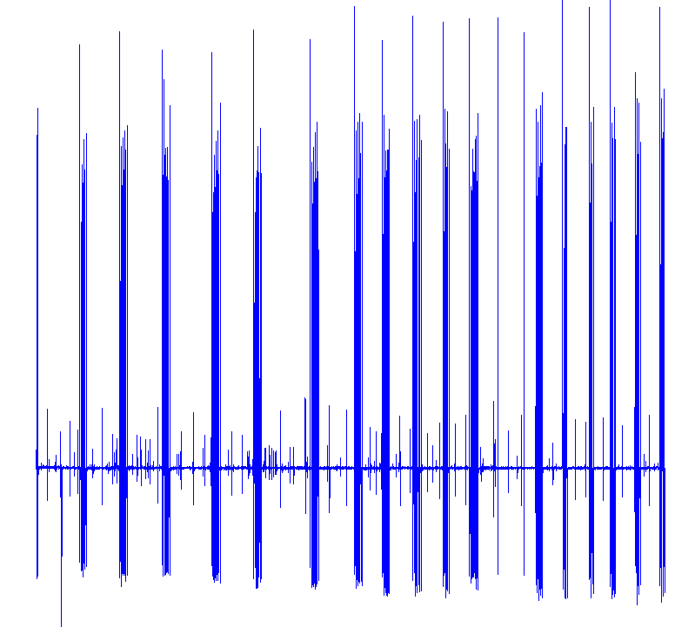
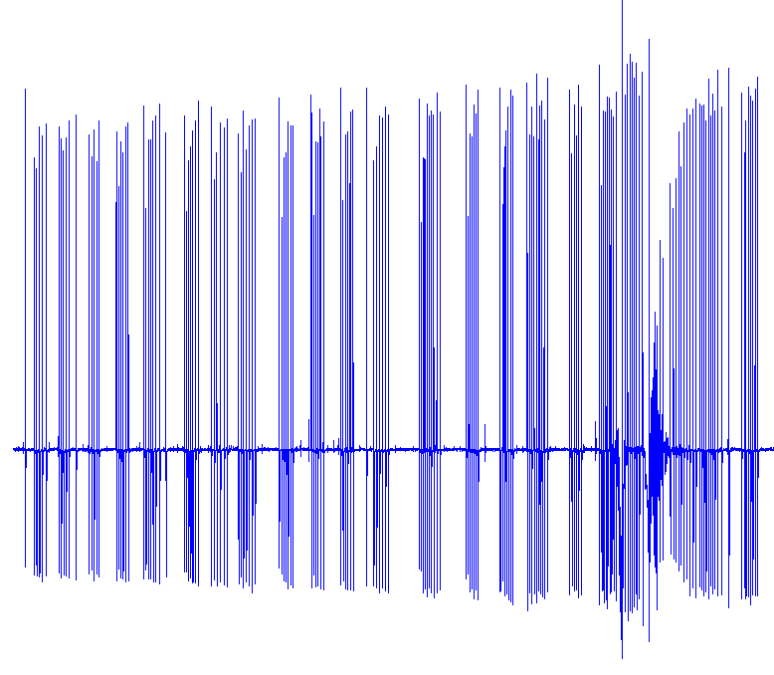
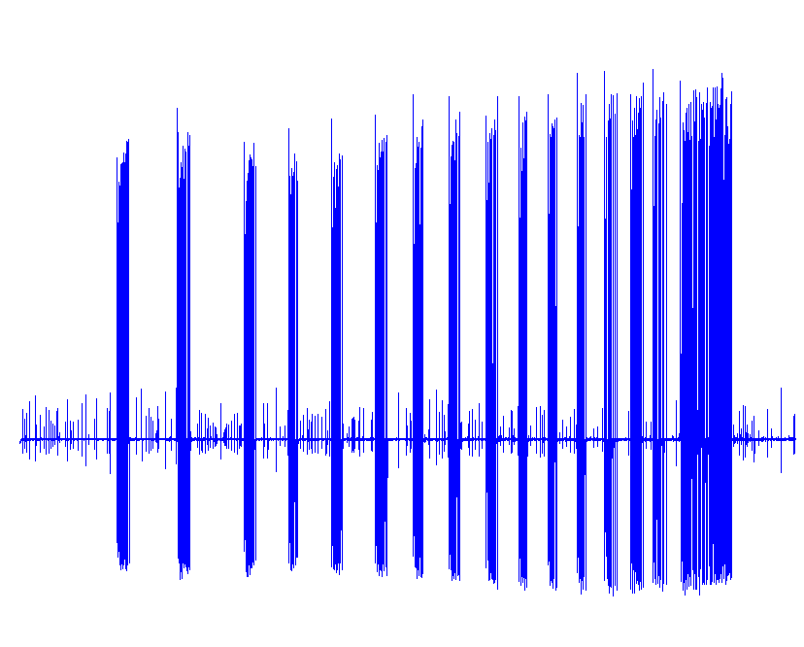
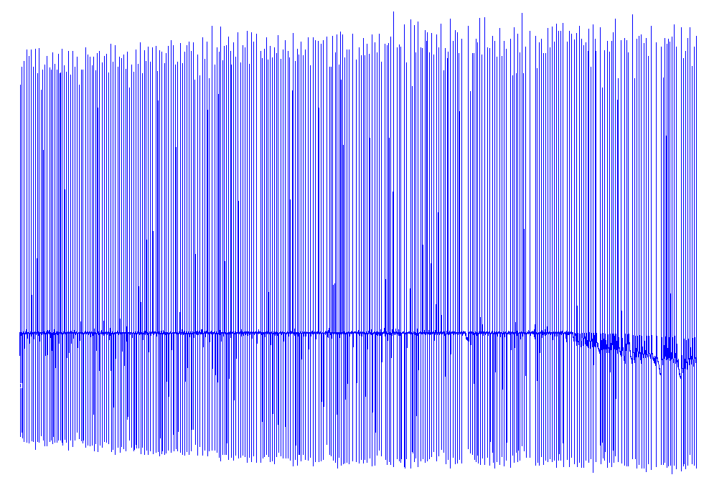
Aminophylline Stop&go effect
different cutoff R-R values tested
assessed the number of R-R intervals
  longer than 3s or 1s, respectively.
higher occurence of „stops“ than in non-treated controls in both cut-off models

Slide 17
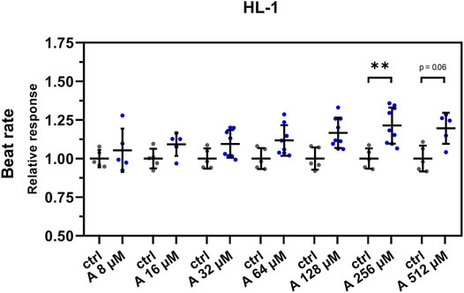
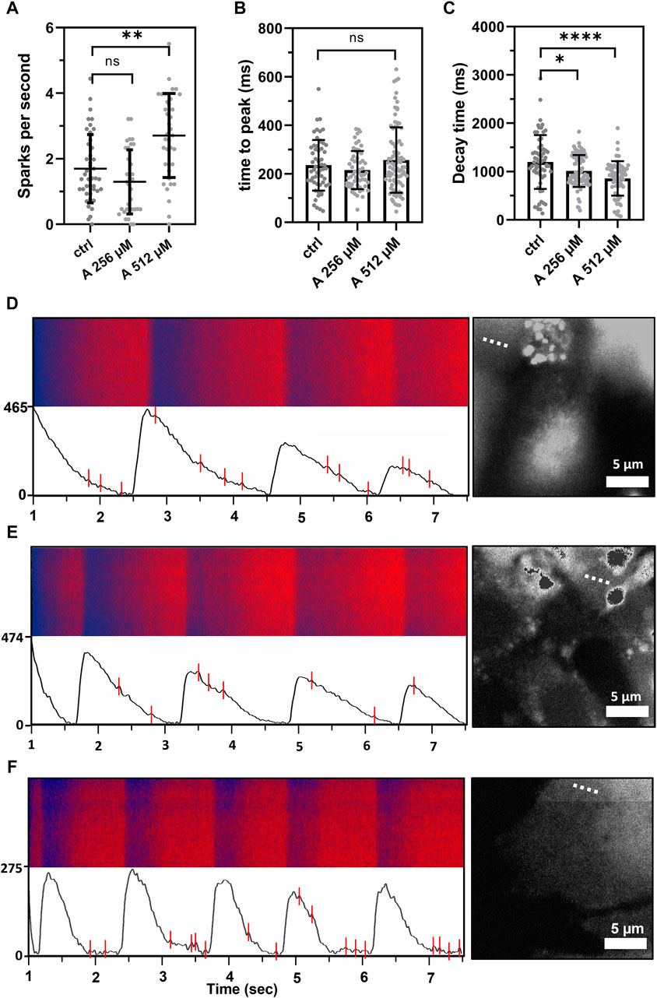
Aminophylline Stop&go effect
positive chronotropy with increasing concentration of aminophylline
linear contraction rate increase in the cells treated with 256 µM aminophylline, similar non-significant trend at 512-µM treatment
- intracellular cytosolic Ca²⁺ in HL-1 cells
- higher concentrations of aminophylline
calcium leakage (sparks),
shorter decay time = arrhythmic events
Klimovic Scurek Pesl Front Pharmacol.2022

Slide 18
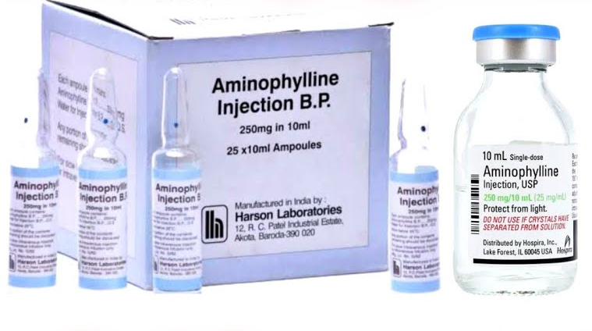
Aminophylline dual Arrythmogenic effect
- concentration-dependent (“deterministic”) effect, presenting with an increased beat rate
(potential clinical correlate: sinus tachycardia),
- concentration-independent (“stochastic”) effect, characterized by tachycardia-like episodes alternating with long pauses
(potential clinical correlate: atrial fibrillation).
New parameters for cardiotoxicity vs. safety testing of various molecules or drugs.
Klimovic Scurek Pesl Front Pharmacol.2022

Slide 19
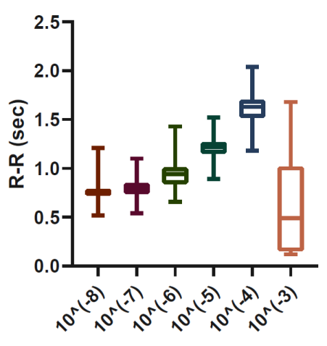
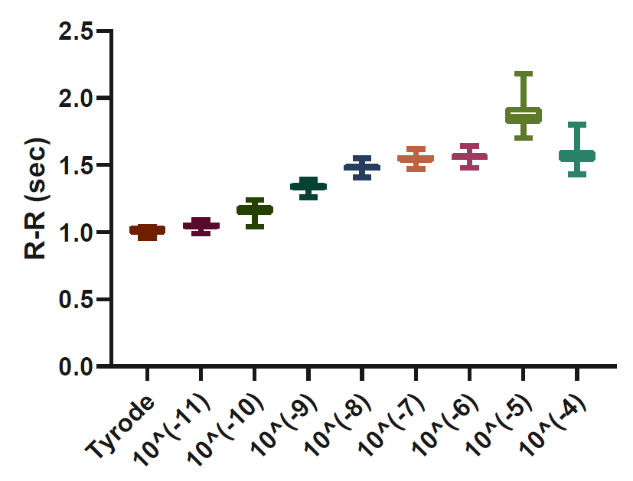
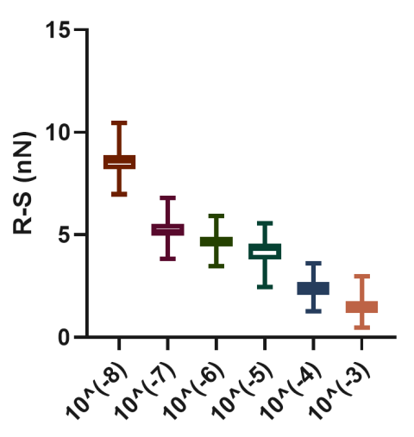
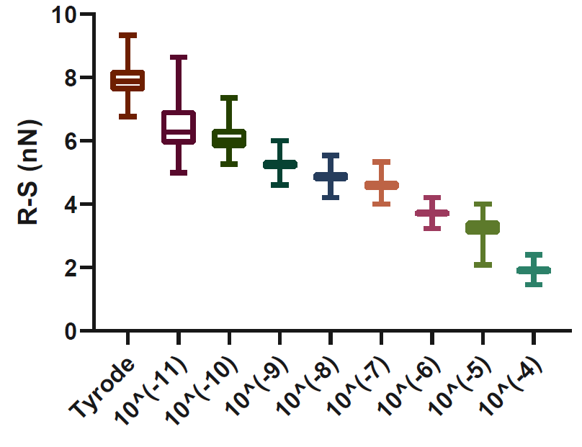
Salbutamol
Ipratropium
Agonist of β₂ receptors
10⁻⁸ up to 10⁻³M concentration
Antagonist of muscarinic acetylcholine receptors
10⁻¹¹ up to 10⁻⁴M concentration

Slide 20
AFM disease harbouring iPSC-CMs
Disease modelling from patient biopsies
neuromuscular diseases
channelopathies
Duchenne muscular dystrophy DMD
Catecholaminergic polymorfic ventricular tachycardia CPVT

Slide 21
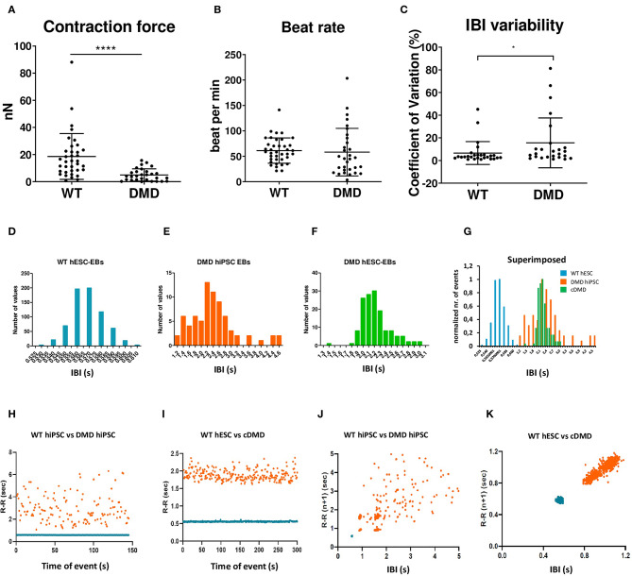
AFM DMD-iPSC-CMs
EBs lacking dystrophin showed weaker contraction force and signs of arrhythmias (beat rate not affected).
(n = 36 for WT, n = 29 DMD / n = 38 for WT, n = 31 DMD)
Superimposed representative inter-beat-interval (IBI)
- different variability in recorded IBI but also prevalence in shorter IBI in WT-EBs compared to DMD-EBs
Poincaré plots of control hiPSC with DMD-hiPSC-EBs (n = 145 time points for each EB)
- more scattered inter-contraction pattern in DMD-EBs compared to WT-EBs
Jelinkova et al. 2020

Slide 22
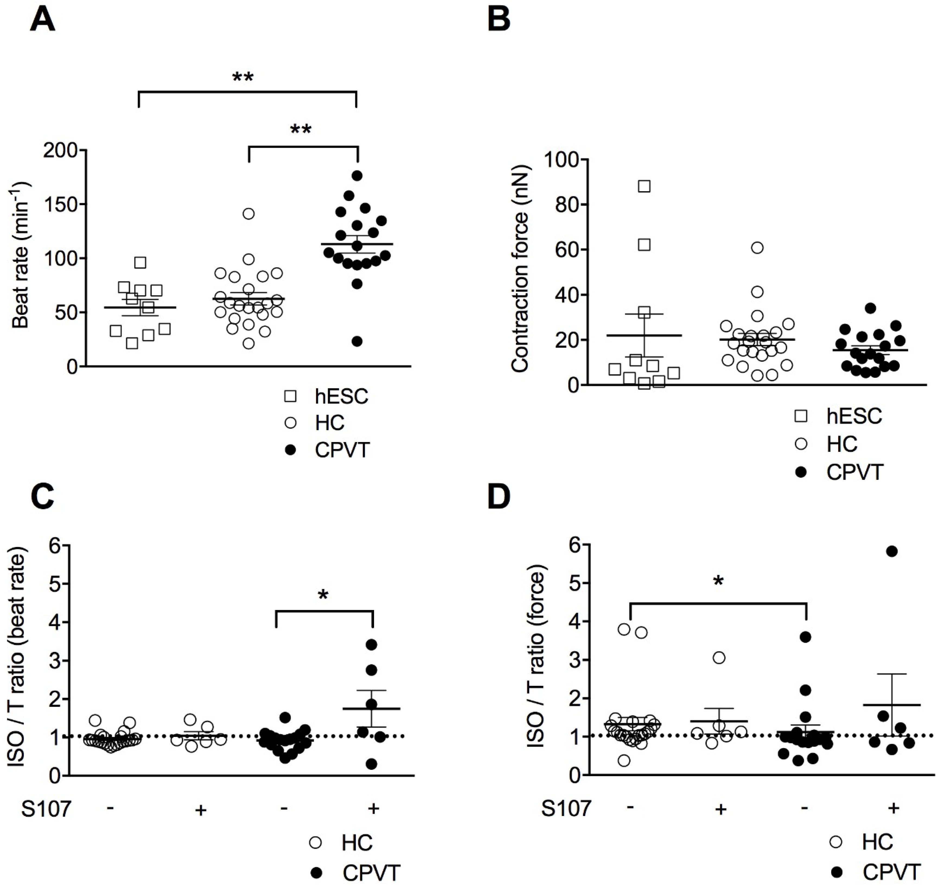
AFM CPVT-iPSC-CMs
Resting beat rate and contraction force for hES WT, Healthy Control HC and CPVT-EBs at rest.
CPVT-EBs have a weaker and/or abnormal rhytm response to ISO in force and beat rate.
Balanced by Ca stabilizer Rycals (S107)
- positive chronotropic effect on CPVT-EBs when compared to untreated CPVT-EBs / no effect on HC-EBs
Acimovic et al. 2018

Slide 23
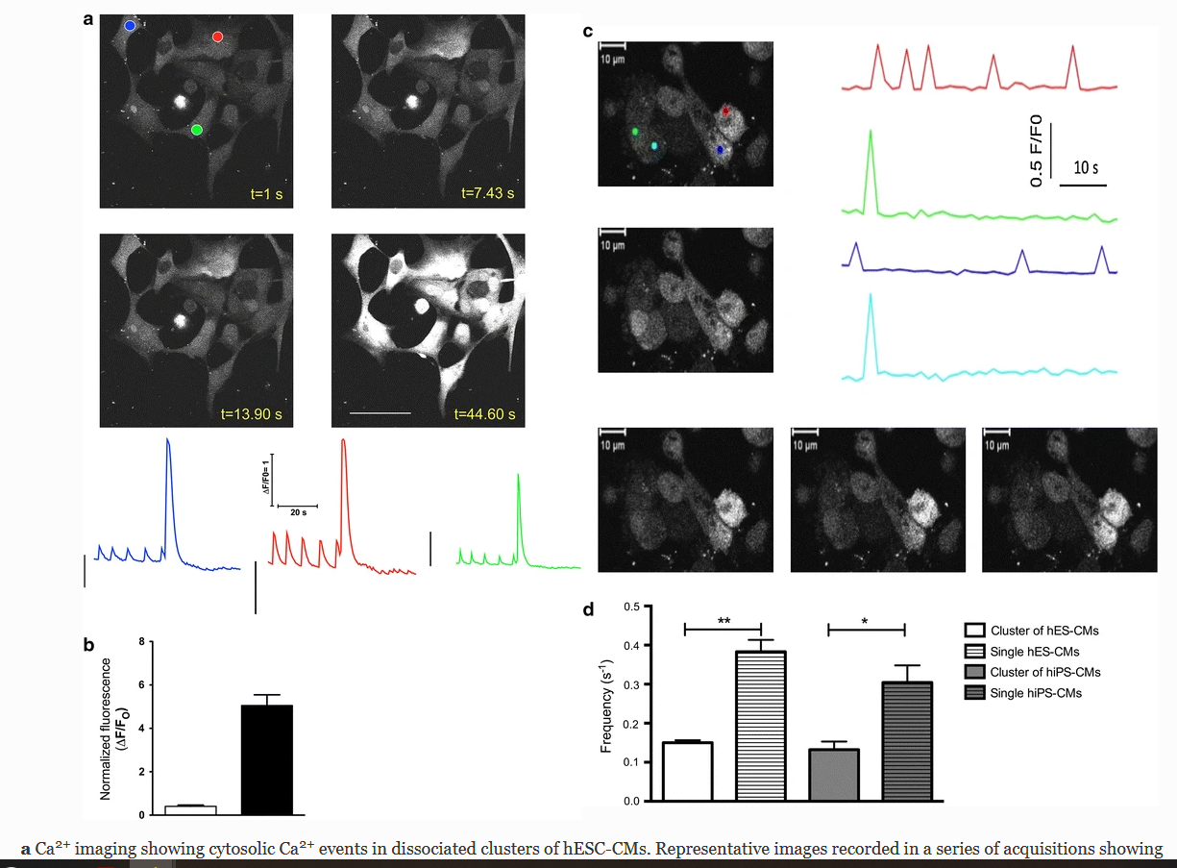
Calcium Imaging of iPSC-CMs
Ca²⁺ imaging showing cytosolic Ca²⁺
Spontaneous variations in fluorescence intensity in some cells with the time (t) in seconds. normalized to the basal level
Induced cytosolic Ca²⁺ elevations upon 10 mM caffeine
b the normalized fluorescence intensity related to spontaneous Ca²⁺ts (white bar, n = 11) and caffeine-induced Ca²⁺ts (black bar, n = 11).
d the frequency (per second) of spontaneous Ca²⁺ transients in
dissociated clusters of hESC-CMs (white bar, n = 10), single dissociated hESC-CMs (white and striped bar,n = 3), dissociated clusters of hiPSC-CMs (gray bar, n = 7)
single dissociated hESC-CMs (gray and striped bar, n = 6). Data are presented as mean ± SEM. *P < 0.05, **P < 0.0
Pesl et al. 2014
Notes:
a Ca²⁺ imaging showing cytosolic Ca²⁺ events in dissociated clusters of hESC-CMs. Representative images recorded in a series of acquisitions showing variation in fluorescence intensity in some cells with the time (t) in seconds. The time courses of fluorescence, relative to the colored dots (green, blue, and red) and normalized to the basal level, show spontaneous cytosolic Ca²⁺ elevations. The bottom right image represents the cytosolic Ca²⁺ elevations upon 10 mM caffeine. The scale bar at the bottom right is 50 μm. Illustrations of spontaneous Ca²⁺ transients in dissociated clusters of hESC-CMs followed by SR Ca²⁺ depletion induced by 10 mM caffeine are shown below the images. b Bar graph representing the normalized fluorescence intensity related to spontaneous Ca²⁺ transients (white bar, n = 11) and caffeine-induced Ca²⁺ transients (black bar, n = 11). c Ca²⁺ imaging showing spontaneous cytosolic Ca²⁺ events in dissociated clusters of hiPSC-CMs. Representative images recorded in a series of acquisitions showing variation in fluorescence intensity in some cells with the time in seconds. The time courses of fluorescence, relative to the colored dots (green, light blue, dark blue, red) and normalized to the basal level, show spontaneous cytosolic Ca²⁺ elevations. d Bar graph summarizes the frequency (per second) of spontaneous Ca²⁺ transients in dissociated clusters of hESC-CMs (white bar, n = 10), single dissociated hESC-CMs (white and striped bar, n = 3), dissociated clusters of hiPSC-CMs (gray bar, n = 7), and single dissociated hESC-CMs (gray and striped bar, n = 6). Data are presented as mean ± SEM. *P < 0.05, **P < 0.0

Slide 24
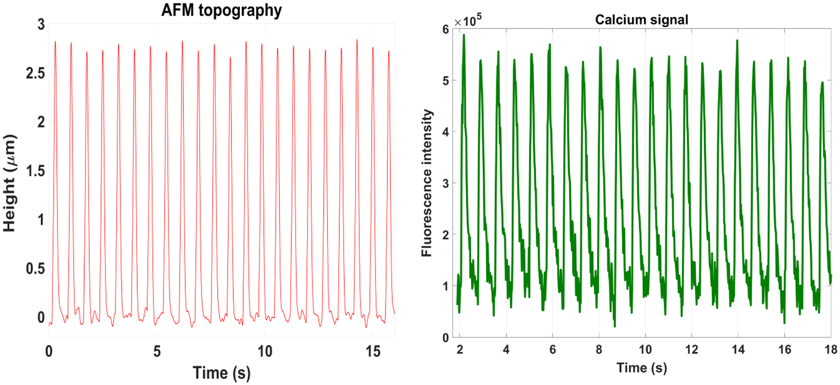
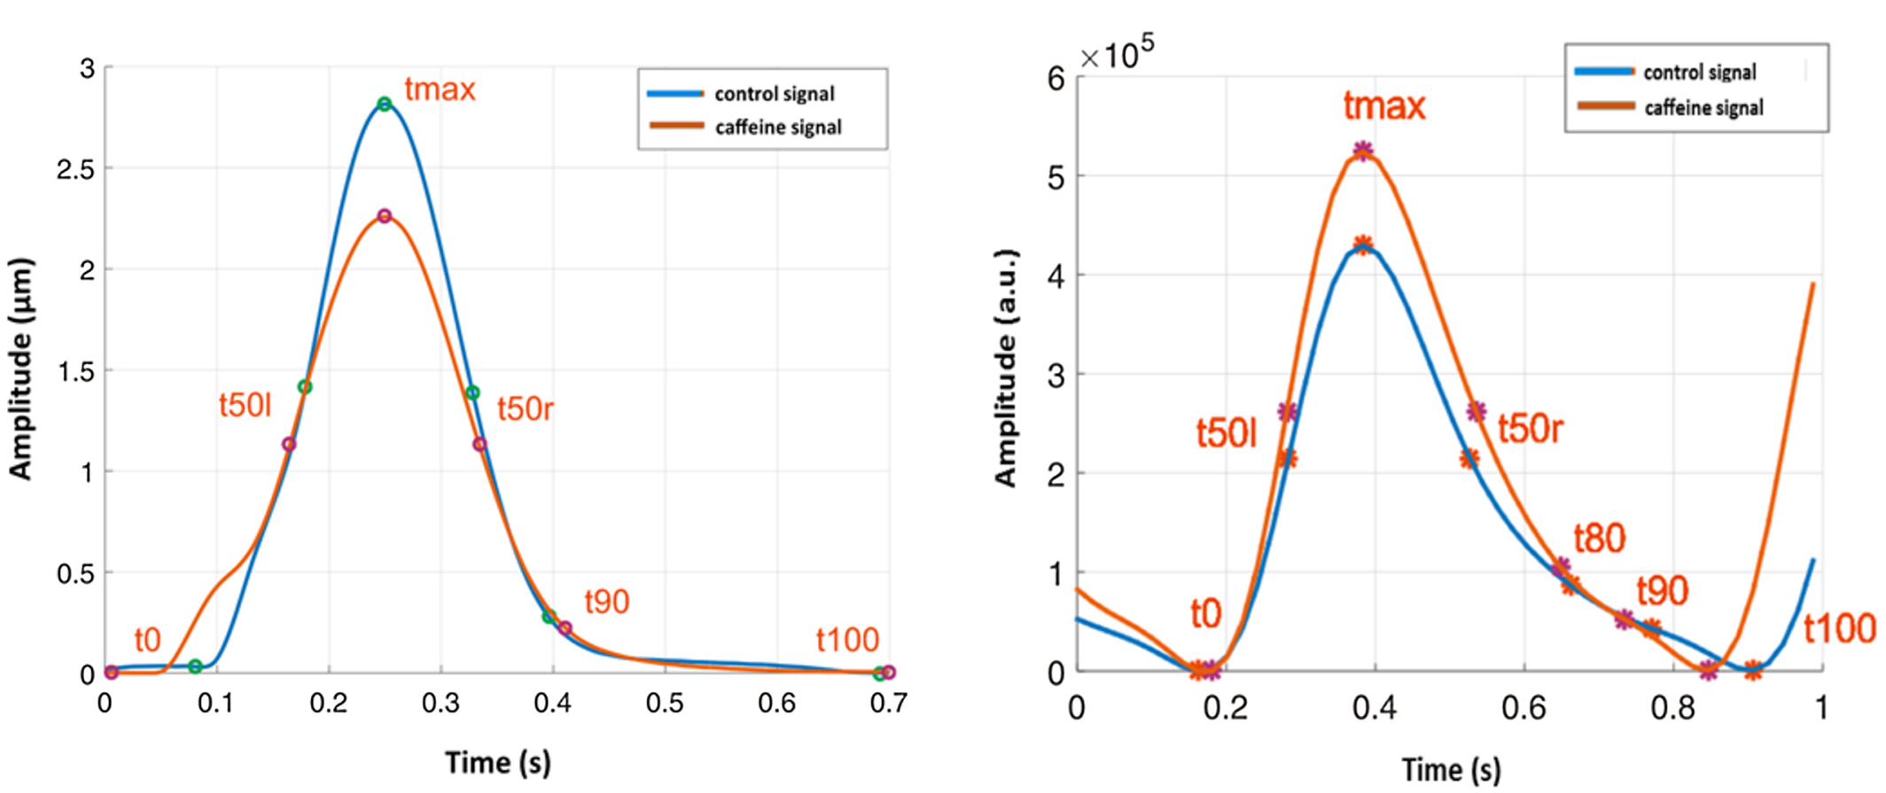
AFM and Calcium Imaging of iPSC-CMs
x
Simultaneous Ca²⁺ cycling and contractility of CM organid
The increase peak amplitude and elongated width of Ca²⁺ transients can also be explained with the stimulated and prolonged depletion of the SR storage by Caffein.
Caluori et al. 2019

Slide 25
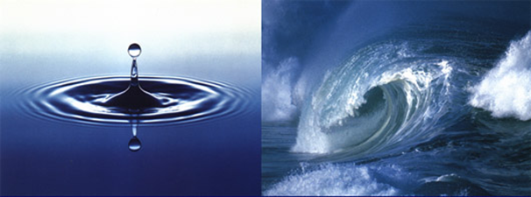
Rhythm diseases
Focal activation
single cell model
animal models
multicellular clusters
Propagation
cannot be studied on single cells
partially relevant in animal models,
limited in small cell clusters
Notes:
Abstract
Single cardiomyocytes present unstable beating patterns, which can be partially compensated in a clustered syncytium. Here we present a novel biosensor composed of two clusters of cardiomyocytes serving for advanced detection of cardiac arrhythmias and subsequent drug testing.
hESC's clusters were differentiated into CMs syncytium. Two such clusters were seeded on adherent plates in the vicinity and spontaneously formed electrically connected syncytium resembling the human myocardium and its conductive system. Contraction of twin clustered spontaneously synchronized within 4 days. The Atomic Force Microscope (AFM) vertical deflection enabled measurement and calculation of absolute cardiomyocyte contraction force [1], while lateral force measurement can distinguish synchronized and independent contraction behavior of twin clusters [2]. Caffeine induces arrhythmia as a model drug [3]. Subsequent beating patterns were monitored by AFM lateral force recording and calcium fluorescence imaging as a reference method for describing non-synchronized contractions of cardiomyocytes.
Caffeine addition increased the beat rate of the syncytium. This was reflected by both the change in vertical and lateral deflection. A significant increase in standard deviation was observed immediately after caffeine injection for both the lateral and the vertical deflection. Further, caffeine affected the synchronization of vertical and lateral displacement of the AFM cantilever. The lateral and vertical deflection peaks followed each other closely, adding caffeine produced independent lateral and vertical deflections, interpreted as defects in signal spreading through the bridge resulting in the irregular beat of the two clusters.
References
[1] Pesl M., Pribyl J., Acimovic A. et al. Atomic force microscopy combined with human pluripotent stem cell derived cardiomyocytes for biomechanical sensing Biosens.Bioelectron. 85,2016,10.1016/j.bios.2016.05.073
[2] Pivato R, Klimovic S, Kabanov D, et al hESC derived cardiomyocyte biosensor to detect the different types of arrhythmogenic properties of drugs. Anal Chim Acta. 2022 Jul 11;1216:339959. doi: 10.1016/j.aca.2022.339959.
[3] Voskoboinik A., Kalman J.M., Kistler P.M. Caffeine and arrhythmias: time to grind the data
JACC (J. Am. Coll. Cardiol.): Clinic. Electrophys., 4 (2018), pp. 425-432, 10.1016/j.jacep.2018.01.012

Slide 26
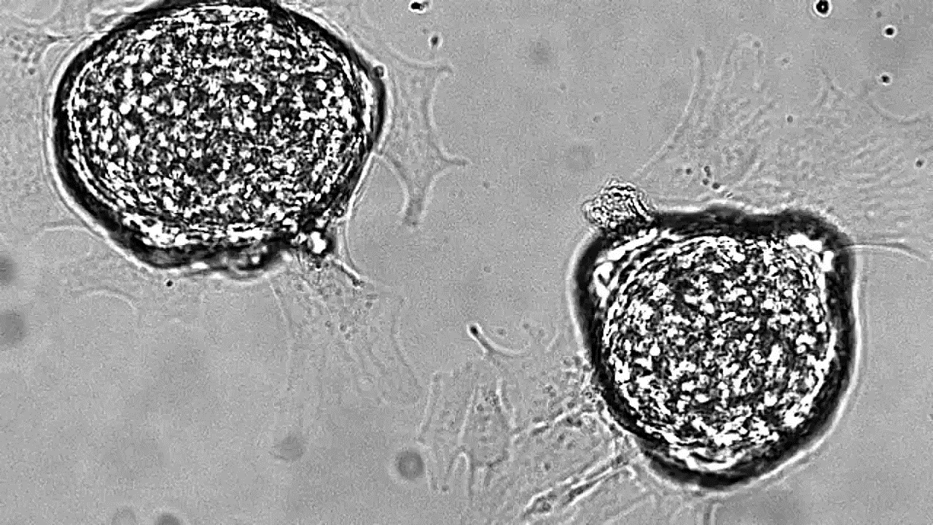
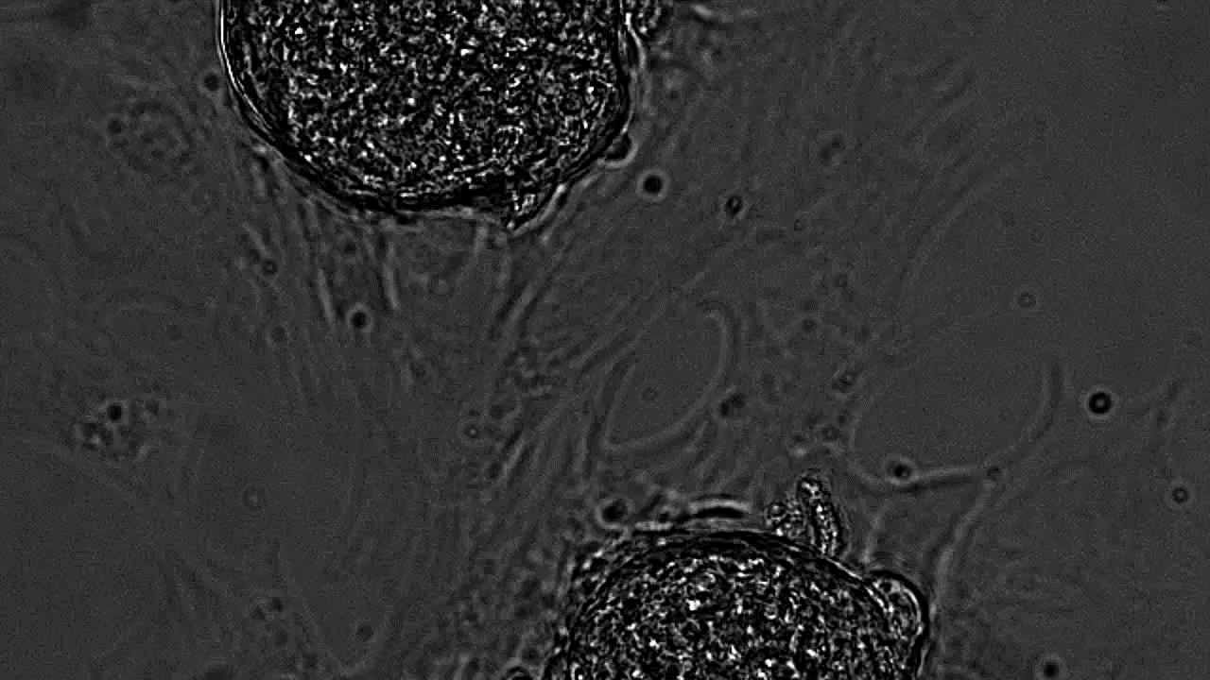
Combining two clusters
synchronized twins
Pivato et al. 2022

Slide 27
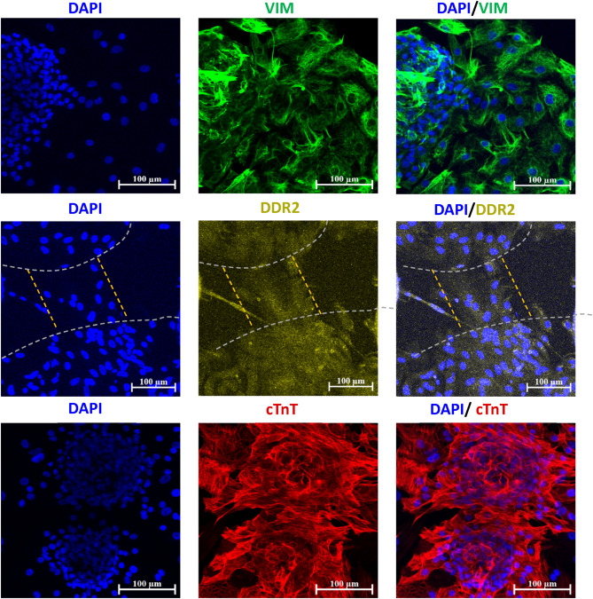
Combining two clusters
seeding clusters in agarose mask
200um apart
within 96h after seeding forming conductive „bridge“
synchronizing contraction pattern
DDR2 Discoidin Domain Receptor
cTnT Cardiac Troponin T
VIM Vimentin
Pivato et al. 2022

Slide 28
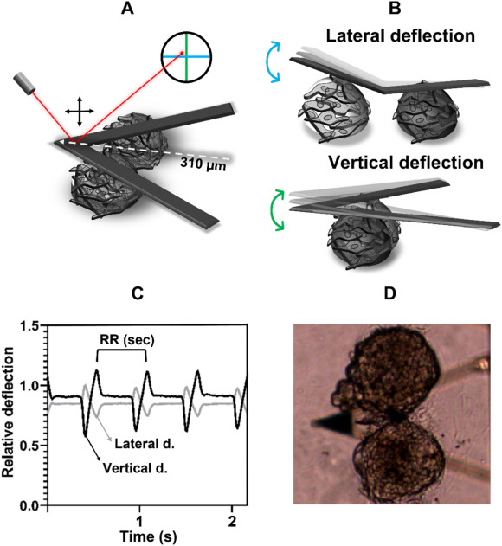
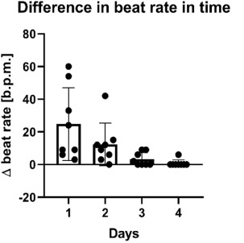

Synchronizing two clusters
synchronized twins
ImageJ/Fiji macro Musclemotion
Pivato et al. 2022
Notes:
3. Synchronization of the syncytium. The evolution of the difference between contraction frequency (Δ beat rate) of the two EBs is plotted against time (days) in panel A. Difference between total times of contraction of the two EBs (Δ beat time) is plotted against time (days) in panel B. The two graphs show that full synchronization of the syncytium was achieved on day 4, as they developed a common beating frequency and synchronized their beating. N = 10.

Slide 29
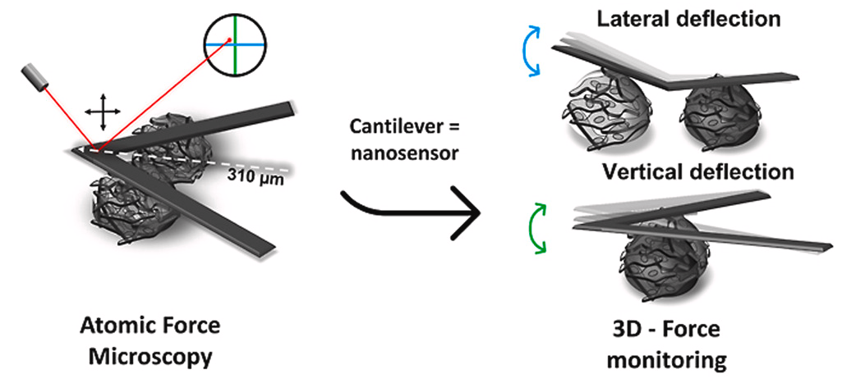
AFM monitoring two clusters
JPK/Bruker Nanowizard 3
MLCT-C cantilever Bruker
- partially coated silicon nitride cantilever
force spectroscopy mode 1 nN setpoint (active mode)
allows tracing of cantilever/ cluster drift and loss of contact
mechanical response natural to cardiac cells - as preload and afterload
Pivato et al. 2022

Slide 30
AFM monitoring two clusters
vertical and lateral deflection
mechanocardiograms (MCG)
collected in 100 Hz sampling frequency in a pilot group
vertical deflection = contraction frequency (R-R interval)
lateral (horizontal) deflection remains stable (repeating curve) until desynchronization
Data extraction performed by in-house made python script
Pivato et al. 2022

Slide 31
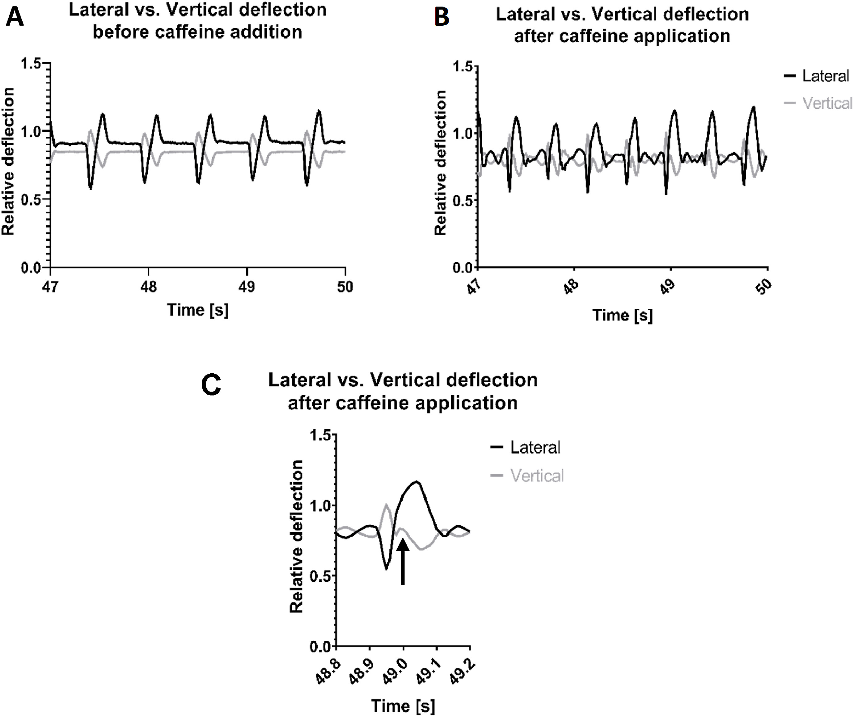
Vertical and lateral deflection „de-synchronized“ at 49 second after caffein application
Evaulation as SD comparison, SDNN and SDSD similar to heart beat variation
Pivato et al. 2022

Slide 32
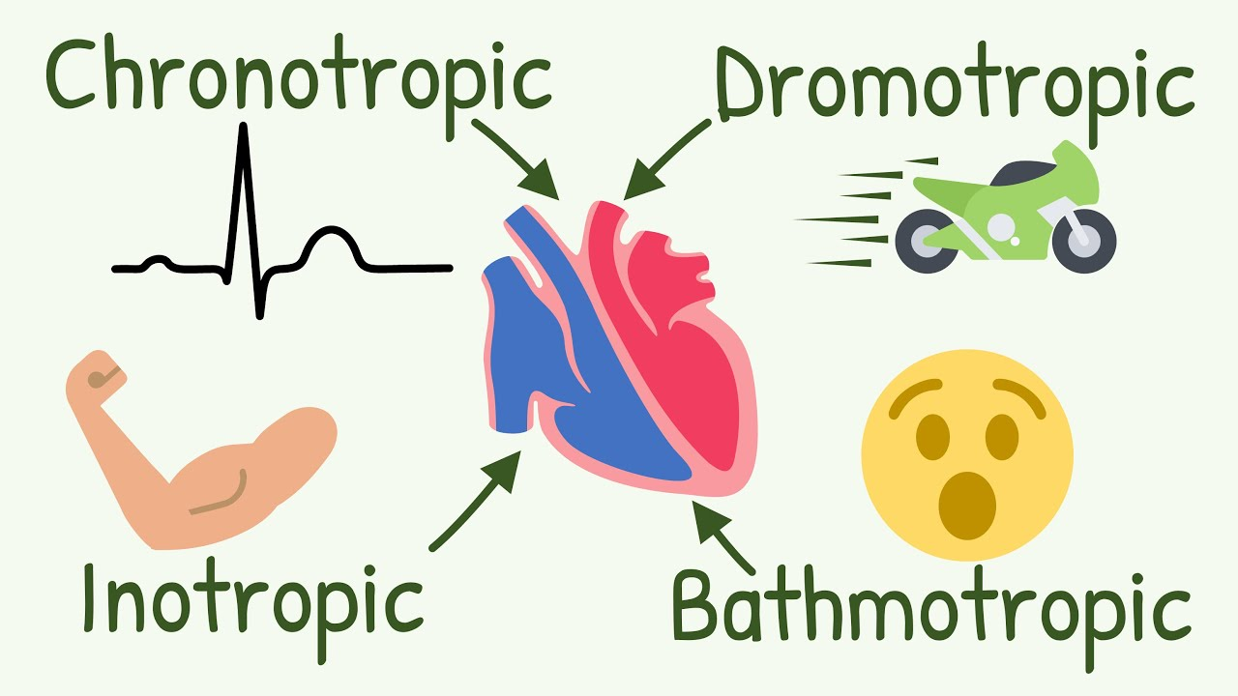
AFM CMs monitoring
Standalone and combined method for topography, rhytmicity and contractility.
Quantifing cardiac chronotrophy, inotrophy,
also dromotrophy (Dual clusters)
and bathmotrophy (Calcium imaging).
Clear differences in disease models, for testing new therapeutic strategies
Robust model for advanced drug screening and disease-drug interaction.

Slide 33

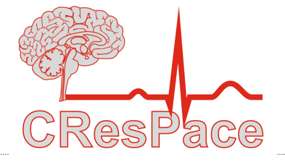









Martin Pesl
+420723860905
pesl@fnusa.cz
Supported by 7AMB13FR011, GA13-19910S, NU20-06-00156, LQ1605 LX22NPO5104, 732170 and MUNI/A/1410/2022

Slide 34

Biomechanical drug testing by atomic force microscopy combined with human pluripotent stem cell derived cardiomyocytes
RESEARCH PROGRAM NAME (change)
Martin Pesl1,2,3, Jan Pribyl4, Simon Klimovic4, Martin Scurek5, Tomas Urban1, Sarka Jelinkova1,2, Kristian Brat5, Vladimir Rotrekl1,2, Petr Skladal6
1Dep. of Biology, Medical faculty, Masaryk University, Czech Republic; 2ICRC, St. Anna University Hospital; 3Internal medicine-Cardioangiology, St. Anna University Hospital and Masaryk University; CZ 4Nanobiology, CEITEC, Masaryk University; CZ 5Department of Pulmonary Diseases and Tuberculosis, Faculty of Medicine, University Hospital Brno and Masaryk University, CZ 6Department of Biochemistry, Faculty of Science, Masaryk University, CZ
Drug response tests: Tyrode solution standard stabilization (CaCl2 1.8mM), then applied increasing concentrations of aminophylline (10 µM, 100 µM, 1 mM, and overdose 10 mM) followed. MCG was recorded for further analysis; each measurement point consisted of 10 minutes of stabilization time followed by 10 minutes of measurement. Contraction of beating EBs was recorded as a force value in time (MCG), further analyzed in via in-house Matlab script (ASalykin/PeakInspector) to obtain average beat force value (contraction force, typically reaching units of tens of nano newtons) and beat rate (BR) frequency, in beats per minute. Both values were normalized to the respective baseline value recorded in the Tyrode solution.
Intro: Drugs entering clinical usage, has to be tested on arrhythmic adverse effects, nevertheless effect on cardiomyocyte contraction has been tested in very few substances, only related to cardiac pathologies. AFM-based biosensor allows in-vitro disease modelling (Pesl et al 2016, Caluori et al 2019) but also enables to monitor the effect of cardiomyocyte-contraction affecting drugs.
Results: Overdose concentration of aminophylline significantly increased BR compared to the clinically relevant concentrations (Figure 2B, p<0.01). A similar effect was observed in individual concentrations analysis (Figure 2A, p<0.05). There are no statistically significant inotropic effects of aminophylline on the hPSC-CMs when comparing the contraction force between all groups and concentrations (Figures 2C-D).
A number of embryoid bodies underwent atypical arrhythmic pattern, which we named the "stop&go effect" (Figure 3). These were excluded from chrono/inotropic aminophillin evaluation. To our knowledge, this is the first experimental demonstration of the "stop&go" arrhythmic effect due to exposure of hPSC-CM to aminophylline.
Figure 3: Atypical arrhythmic pattern: "stop&go effect."
Fig. 1: Atomic force microscopy setup in A) contraction, B) basal position and C) active relaxation. Beta = metoprolol, Iso = isoproterenol, detection limit 200 pN /, 20 nm displacement.
Methods: Stem cell differentiated cardiomyocyte clusters for 28 days (Pesl et al 2014) provide realistic wild type phenotype analysis as well as disease modelling for neuromuscular diseases, cardiomyopathies and channelopathies. Especially action potential propagation as electrophysiology parameter and contraction as mechanistic parameter. AFM (JPK NanoWizard 3, Bruker) combined with an inverted light microscope (IX-81S1F-3) was used to obtain mechanocardiograms (MCG) of beating EBs as previously described (Pribyl et al., 2019).
Figure 2: Effect of aminophylline (A) on contractile properties of 3D cardiac clusters (mean ± standard deviation) of BR (blue) and contraction force (red) changes, normalized to a baseline measurement (relative response). A) BR of measured EBs with 10 mM aminophylline (A 10mM) was significantly increased in comparison of 100 µM and 1 mM aminophylline (p<0.05, ANOVA with Holm-Sidak's test). (B) Similarly, BR of embryoid bodies treated with overdose concentration of aminophylline was significantly increased over clinically relevant concentrations (p<0.05, Unpaired t-test). (C, D) no significant changes of contraction force between various concentrations of aminophylline.
Conclusions: Aminophylline has two parallel arrhythmogenic mechanisms of action on EBs: a deterministic, concentration-dependent, presenting with an increased BR (potential clinical correlate: sinus tachycardia) and a stochastic effect, named the "stop&go effect," that was independent on aminophylline concentration (potential clinical correlate: atrial fibrillation). Our AFM based monitoring system is a unique and valuable tool for cardiotoxicity vs. safety testing of various molecules or drugs.
Ref.: Pesl M, Pribyl J, Acimovic I, et al. Atomic force microscopy combined with human pluripotent stem cell derived cardiomyocytes for biomechanical sensing. Biosens Bioelectron. 2016 Nov 15;85:751-757. doi: 10.1016/j.bios.2016.05.073. 2016 May 28, Caluori G, Pribyl J, Pesl M, Jelinkova S, Rotrekl V, Skladal P, Raiteri R. Non-invasive electromechanical cell-based biosensors for improved investigation of 3D cardiac models Biosens Bioelectron. 2019 Jan 15;124-125:129-135. doi: 10.1016/j.bios.2018.10.021. Epub 2018 Oct 16. Pribyl J, Pešl M, Caluori G, Acimovic I, Jelinkova S, Dvorak P, Skladal P, Rotrekl V. Biomechanical Characterization of Human Pluripotent Stem Cell-Derived Cardiomyocytes by Use of Atomic Force Microscopy. Methods Mol Biol. 2019;1886:343-353. doi: 10.1007/978-1-4939-8894-5_20. PMID: 30374878.
Authors declare no conflict of interest
Acknowledgements This project was supported by research grant project AZV Czech Ministry of Health / Program for support of applied medical research for the years 2020-2023 NU20-06-00156 and Masaryk University´s specific research MUNI/A/1455/2019. We acknowledge CEITEC CF Nanobiotechnology and European Regional Development Fund FNUSA-ICRC project ENOCH CZ.02.1.01/0.0/0.0/16_019/0000868

