Slide 1

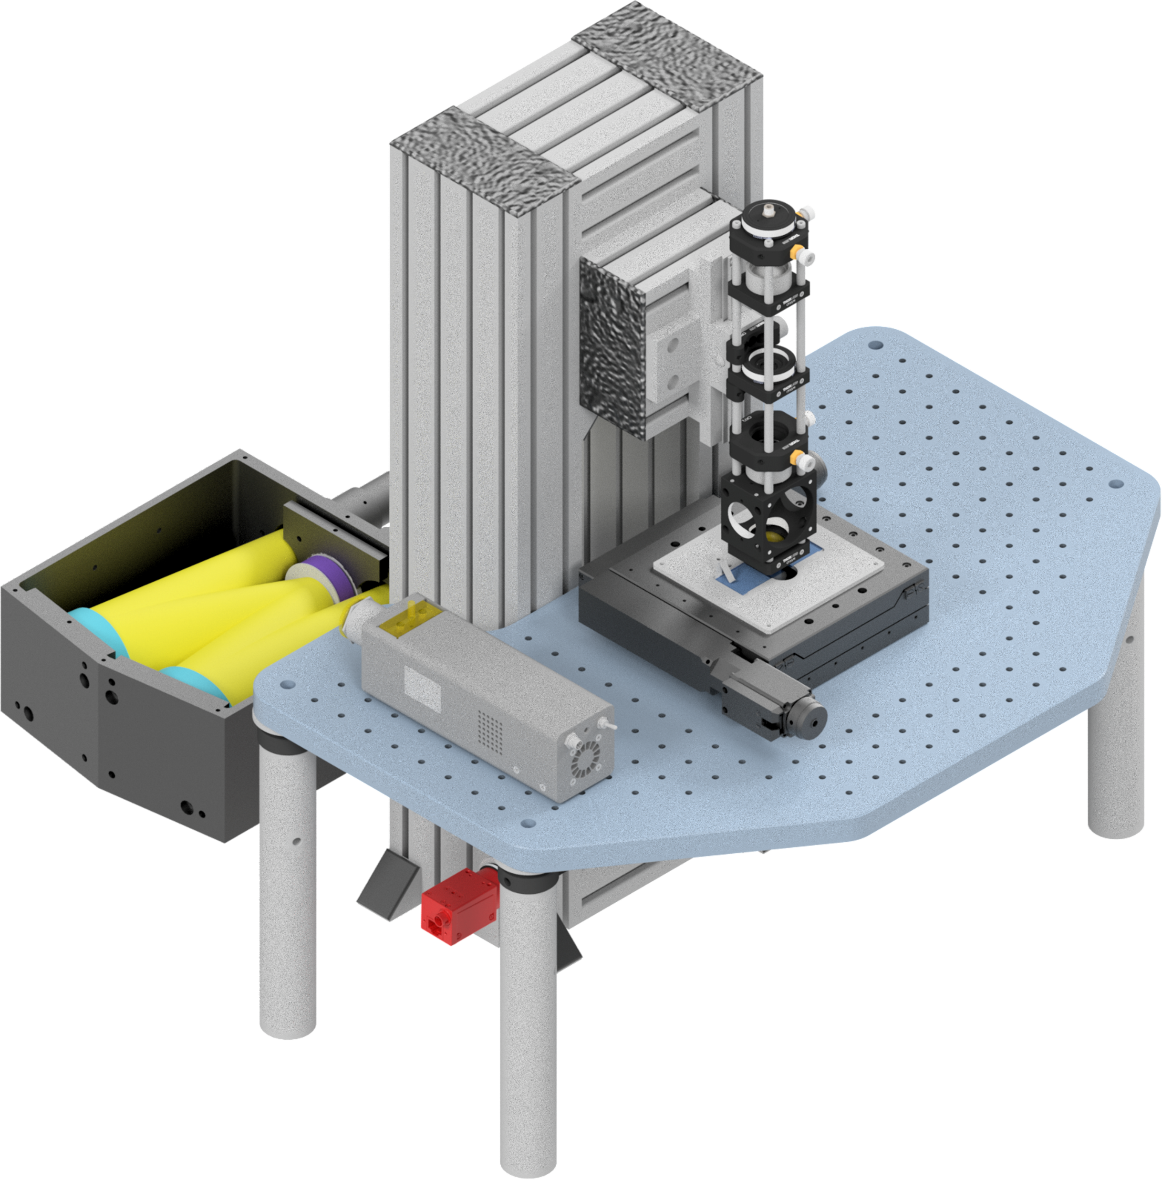
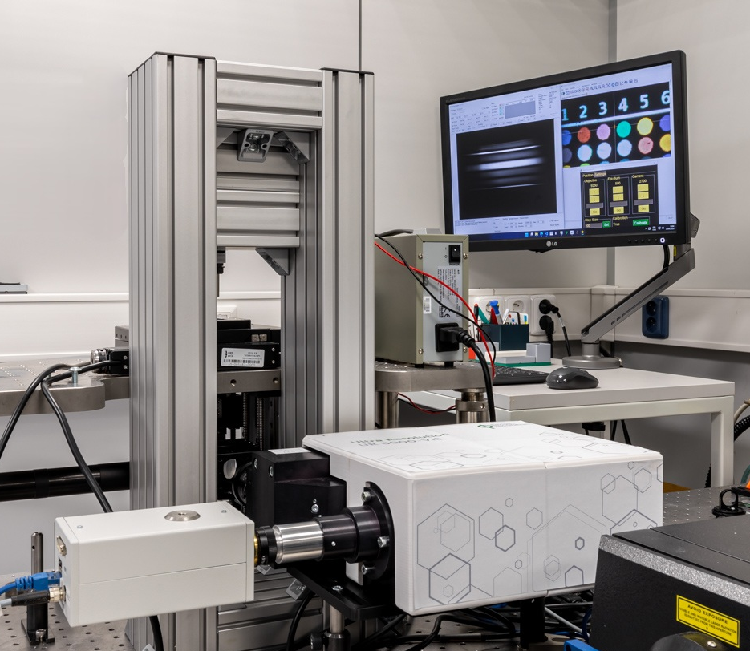
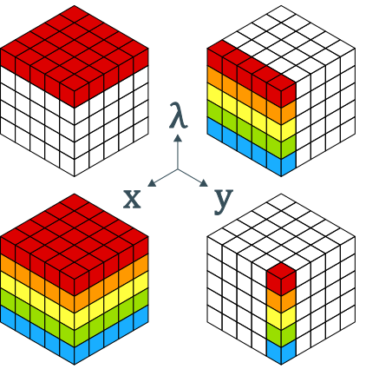
Ondřej Vaculík
High-Resolution Hyperspectral Microscopy for Efficient Analysis of Biological Systems

Slide 2
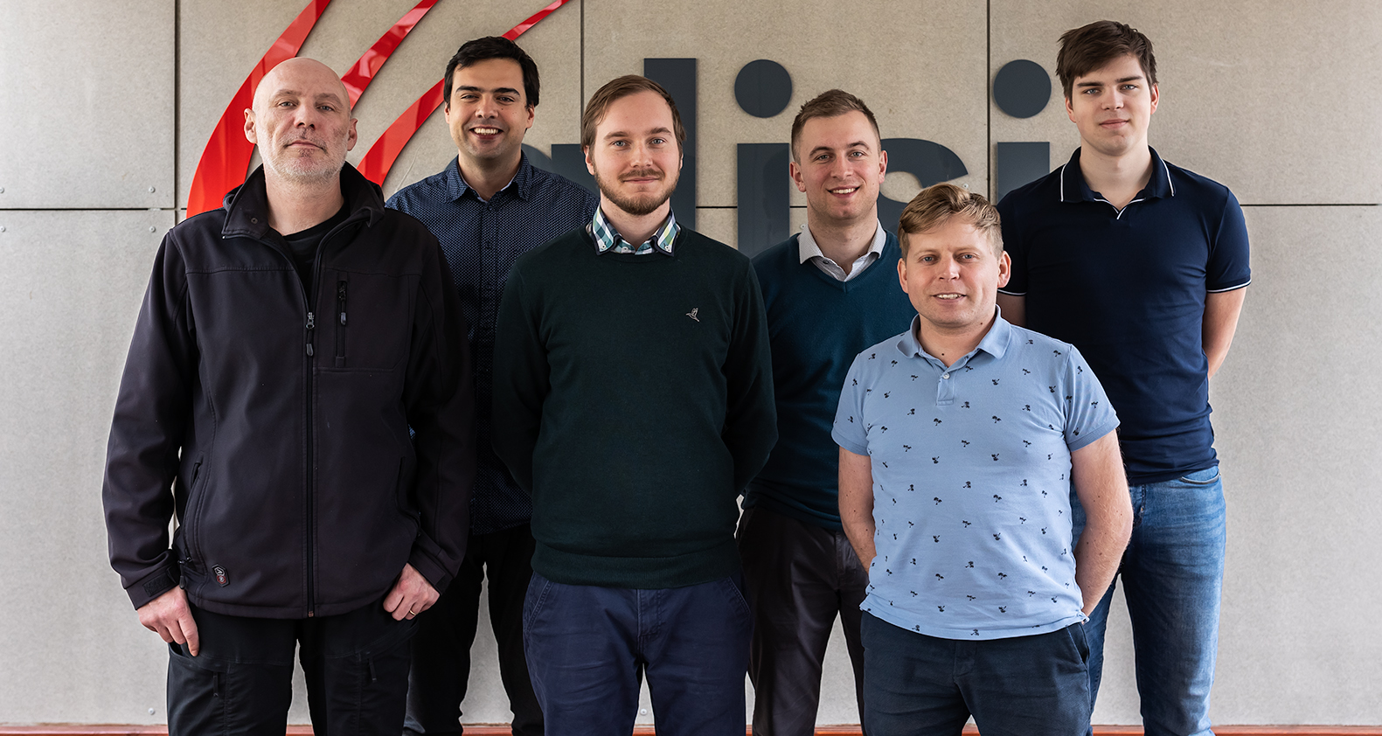
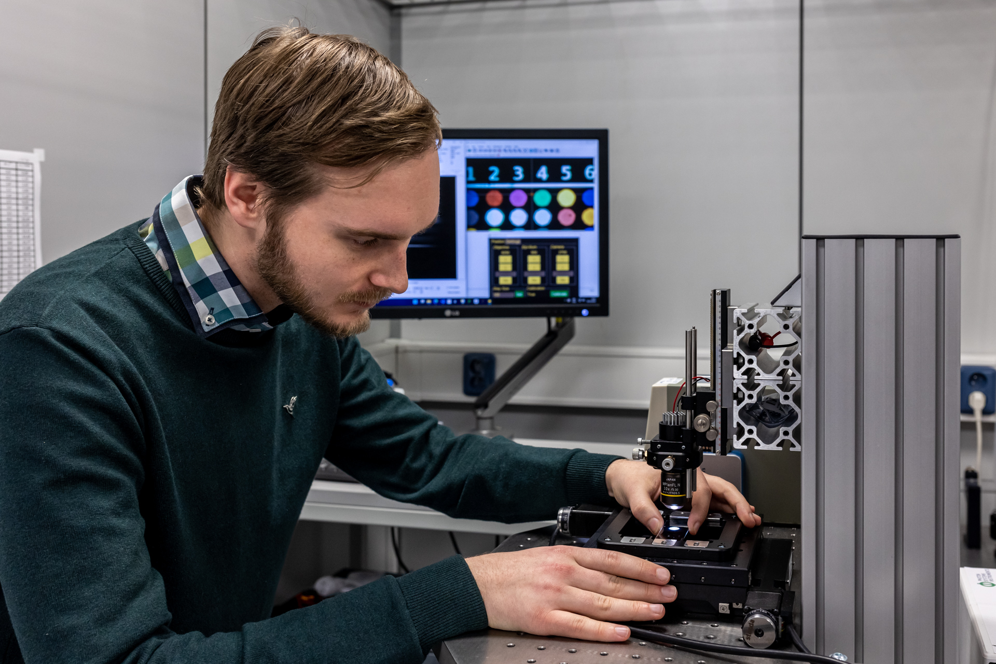
My Background
Masters in Optics and Optoelectronics – Palacký University Olomouc
  Multispectral image acquisition and analysis
PhD student – Brno University of Technology
  Thesis title: Advanced Spectral and Image Processing of Hyperspectral Data
Institute of Scientific Instruments of CAS
  Applied and Integrated Photonics group member (aip.isibrno.cz)

Slide 3
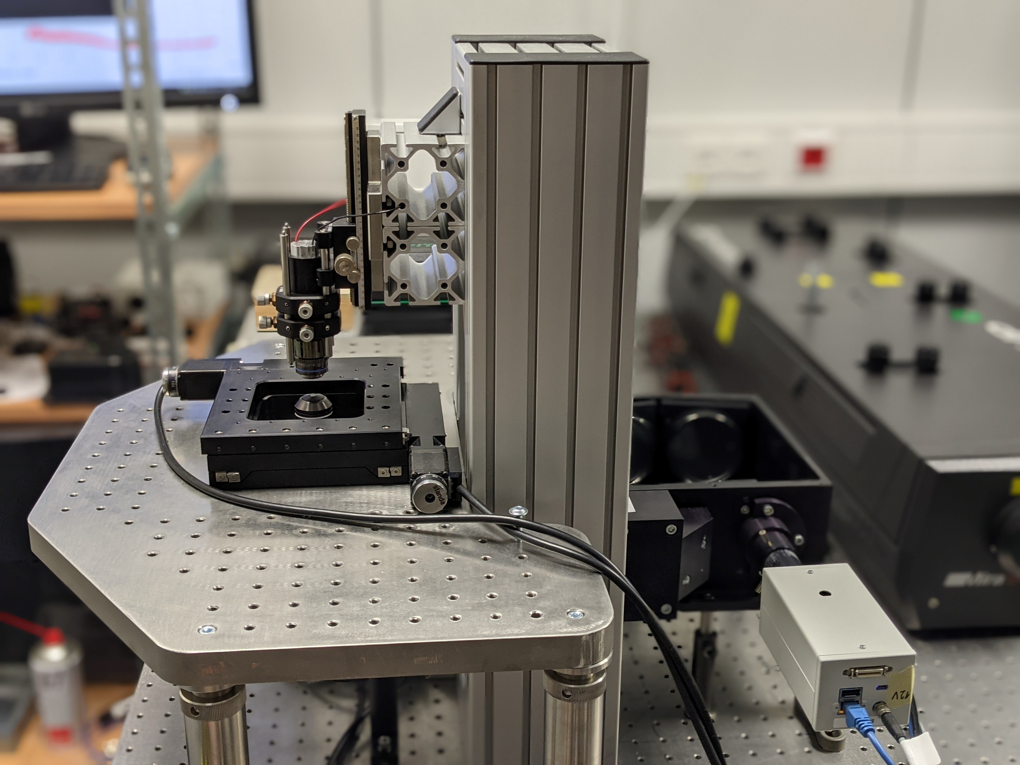
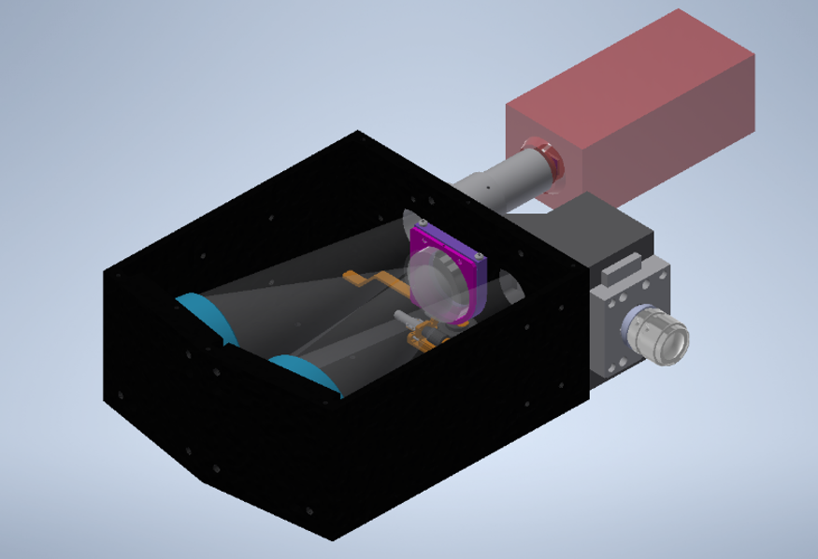
Hyperspectral Microscope System Specs
Inverted configuration
Transmission spectra
Offner based imaging spectroscope
4-100x magnification (RMS/M25)
0.1 nm spectral resolution (FWHM)
120 nm bandwidth tunable
in 450-900 nm range
Automated measurement
and calibration (Python)

Slide 4
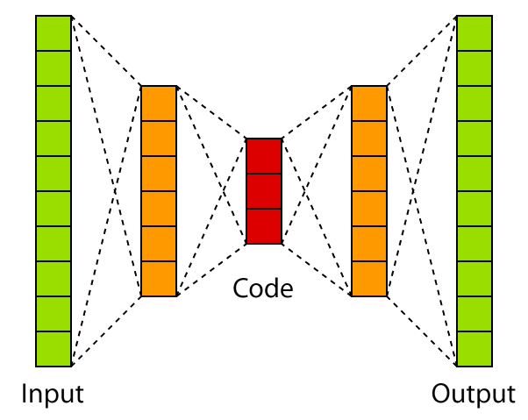
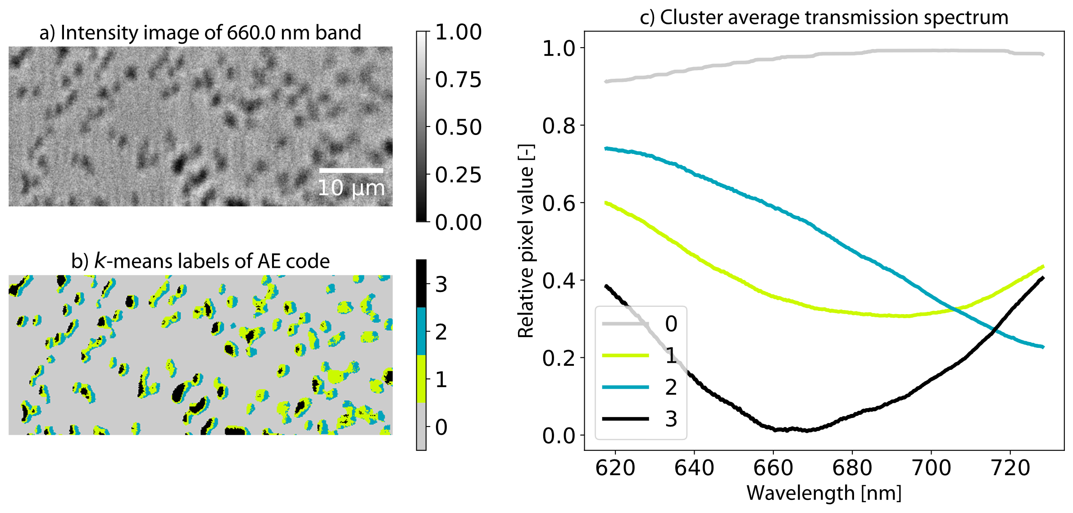
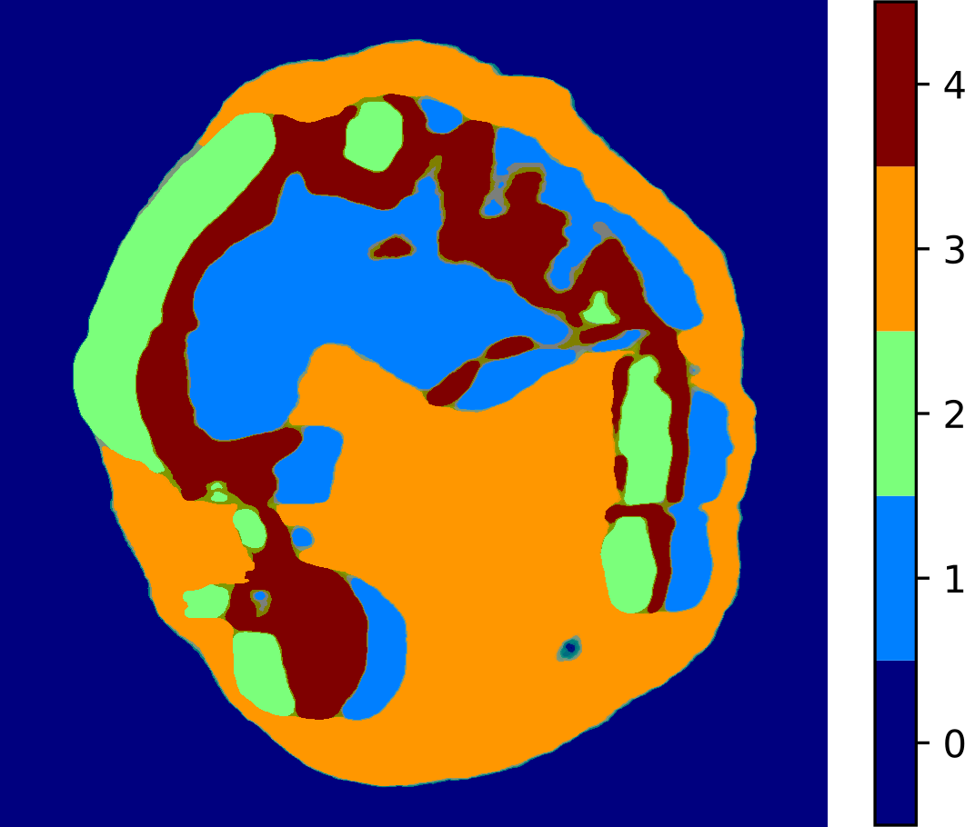
Autoencoder for Spectral Dimensionality Reduction
Autoencoder
Reducing the spectral dimension
Clustering using the encoded spectrum → processing speed up
Working with full spectrum of regions of interest
1µm
Synechocystis sp. PCC6803
Trachydiscus minutus

Slide 5

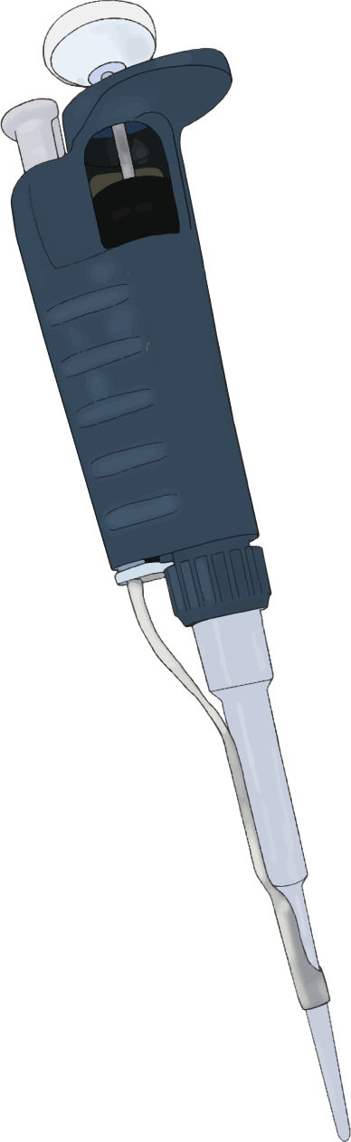
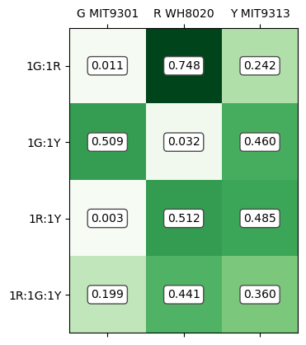
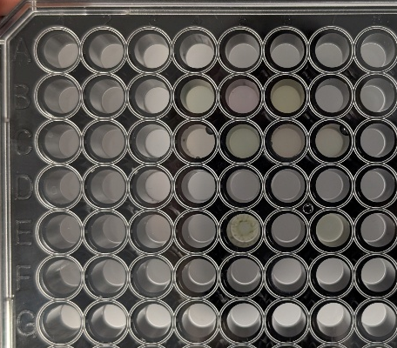


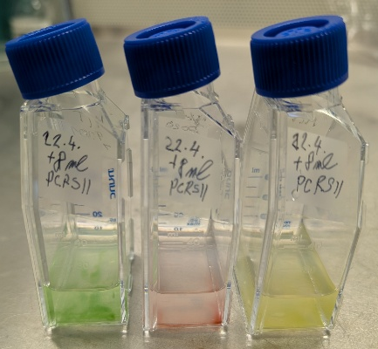
Marine Cyanobacteria Spectral Unmixing
3 strains of marine cyanobacteria with different pigments
96-well microplate with 1:1, 1:2, 1:4, 1:1:1, and 1:2:3 ratios
Ratio estimation using Multivariate Curve Resolution (MCR)
(0.76±0.12)% identification accuracy
96% processing speedup when using dim. reduction (3 component NMF)
Spectral
Unmixing
Samples
G
R
Y
Mixtures
Calculated
Concentration
HS Measurement
Notes:
PHOTOMACHINES - Photosynthetic cell redesign for high yields of therapeutic peptides

