Slide 1
New Immobilization Techniques
Šimon Vrana, Ph.D.

Slide 2
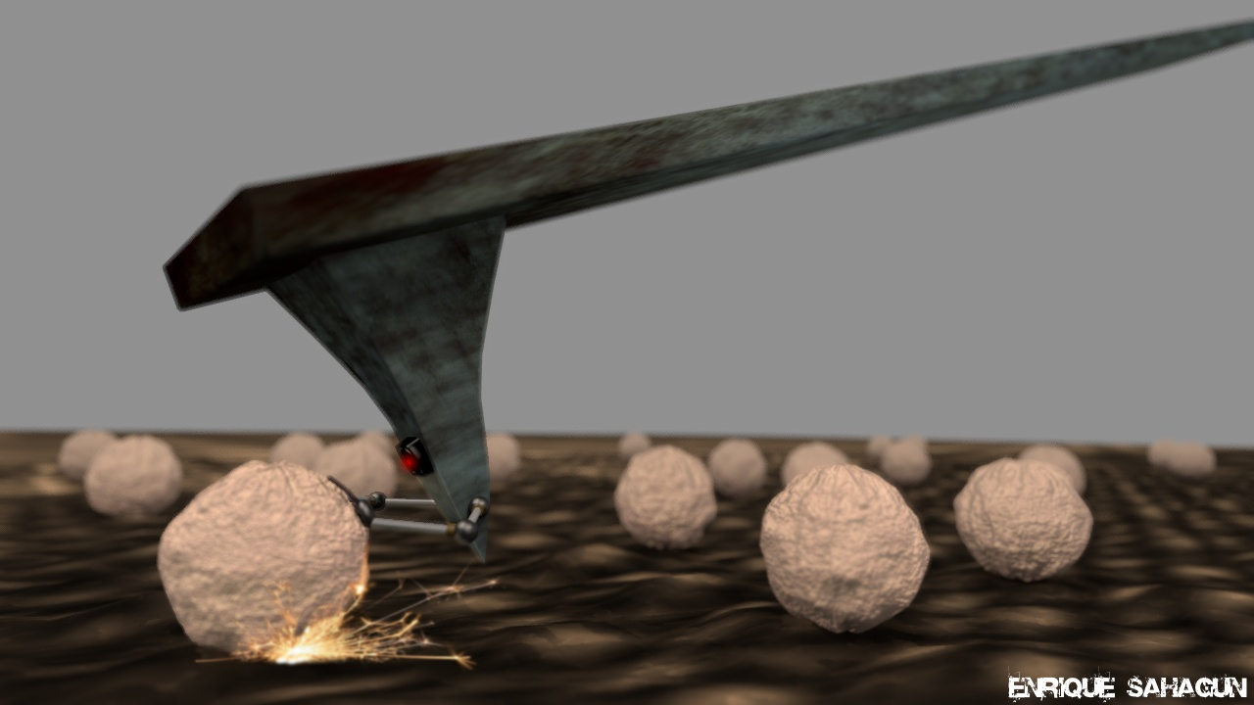
Why is immobiliazation important?
Prevents drift and detachment under AFM tip.
Preserves native structure and activity.
Balances stability vs. distortion.
Tailored approaches for different biomolecules/cells.

Slide 3
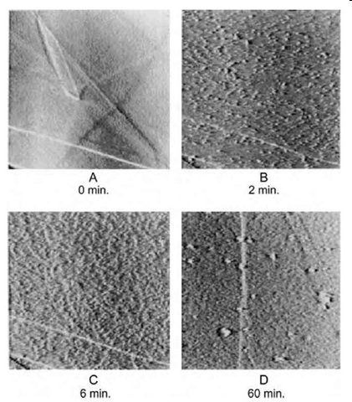
Proteins
Small sized (nm) biomolecues, danger of denaturization, charge is given by IEP + pH
Physical adsorption: simple, but orientation is random, risk of unfolding.
Lysozyme molecules on HOPG

Slide 4
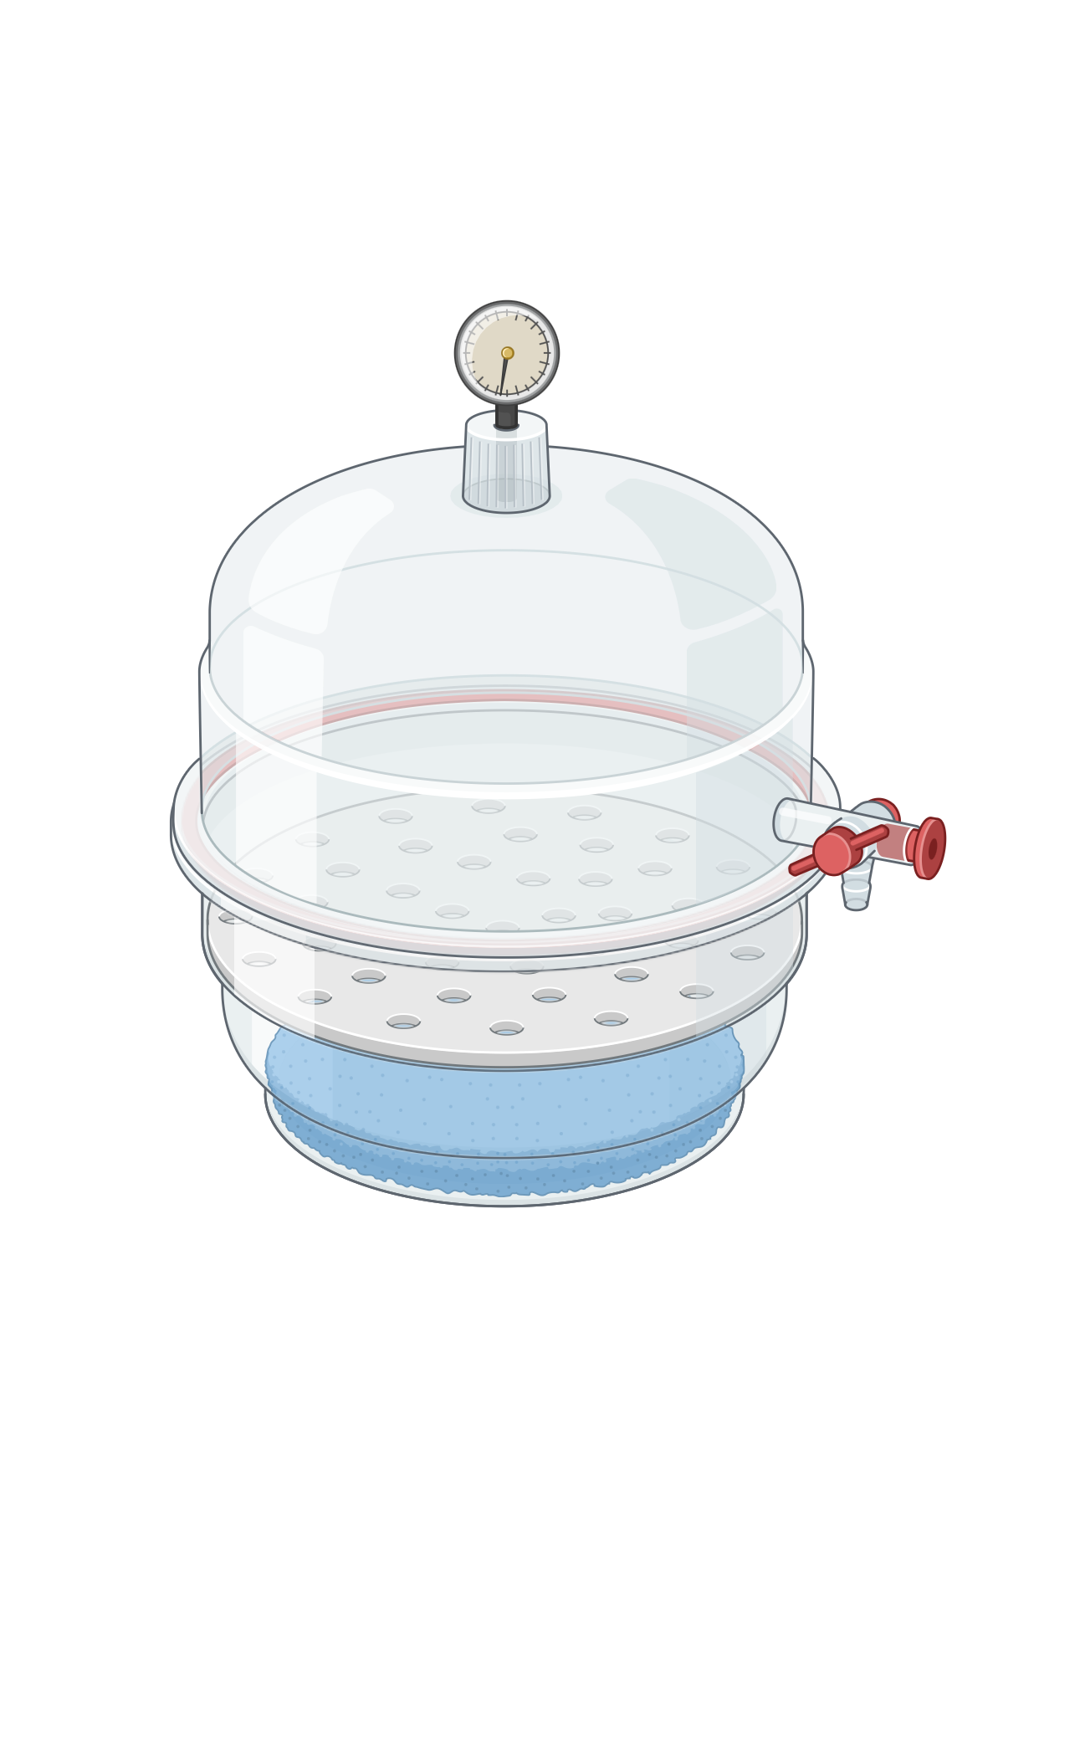
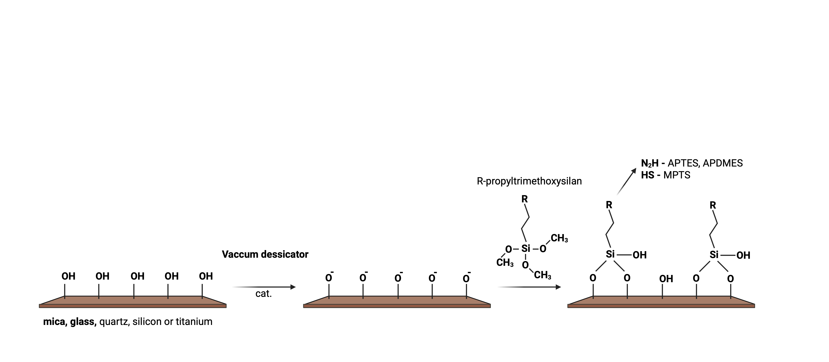
Proteins
Small sized (nm) biomolecues, danger of denaturization, charge is given by IEP + pH
Physical adsorption: simple, but orientation is random, risk of unfolding.
Chemical coatings (PLL, silanization): strong electrostatic binding.
Vacuum dessicator

Slide 5
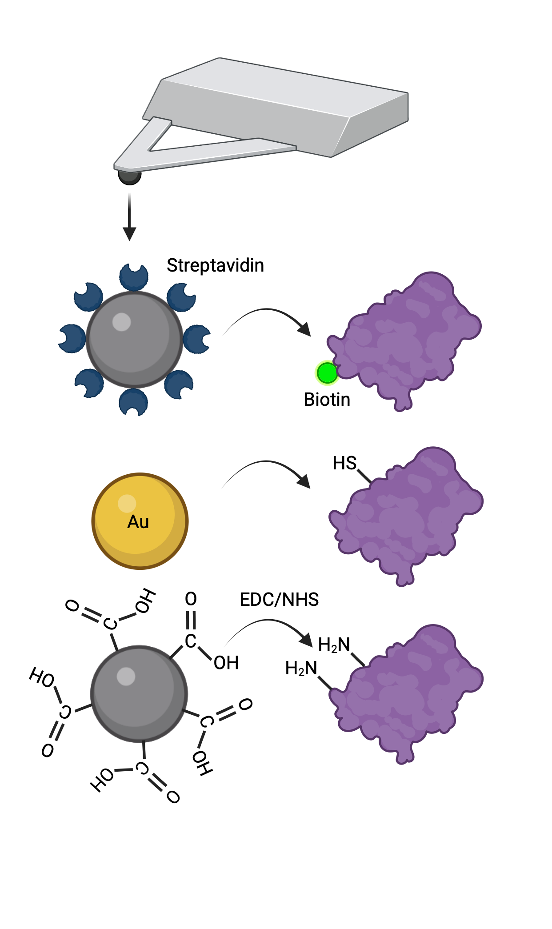
Proteins
Small sized (nm) biomolecues, danger of denaturization, charge is given by IEP + pH
Physical adsorption: simple, but orientation is random, risk of unfolding.
Chemical coatings (PLL, silanization): strong electrostatic binding.
Single-molecule force studies:
  Streptavidin-biotin bond
  Thiol-gold bond
  Amine bond (EDC/NHS reaction)
  Antibodies

Slide 6
Viruses
Nanoscale, fragile capsid structure.
Analogous to proteins
Poly-L-Lysine (PLL) coating
Antibody capture for specific orientation.
Crosslinking agents – Glutaraldehyde, EDC/NHS, ..
Bacteriophage P68 on PLL-coated mica
P68 on Stahylococus Aureus

Slide 7
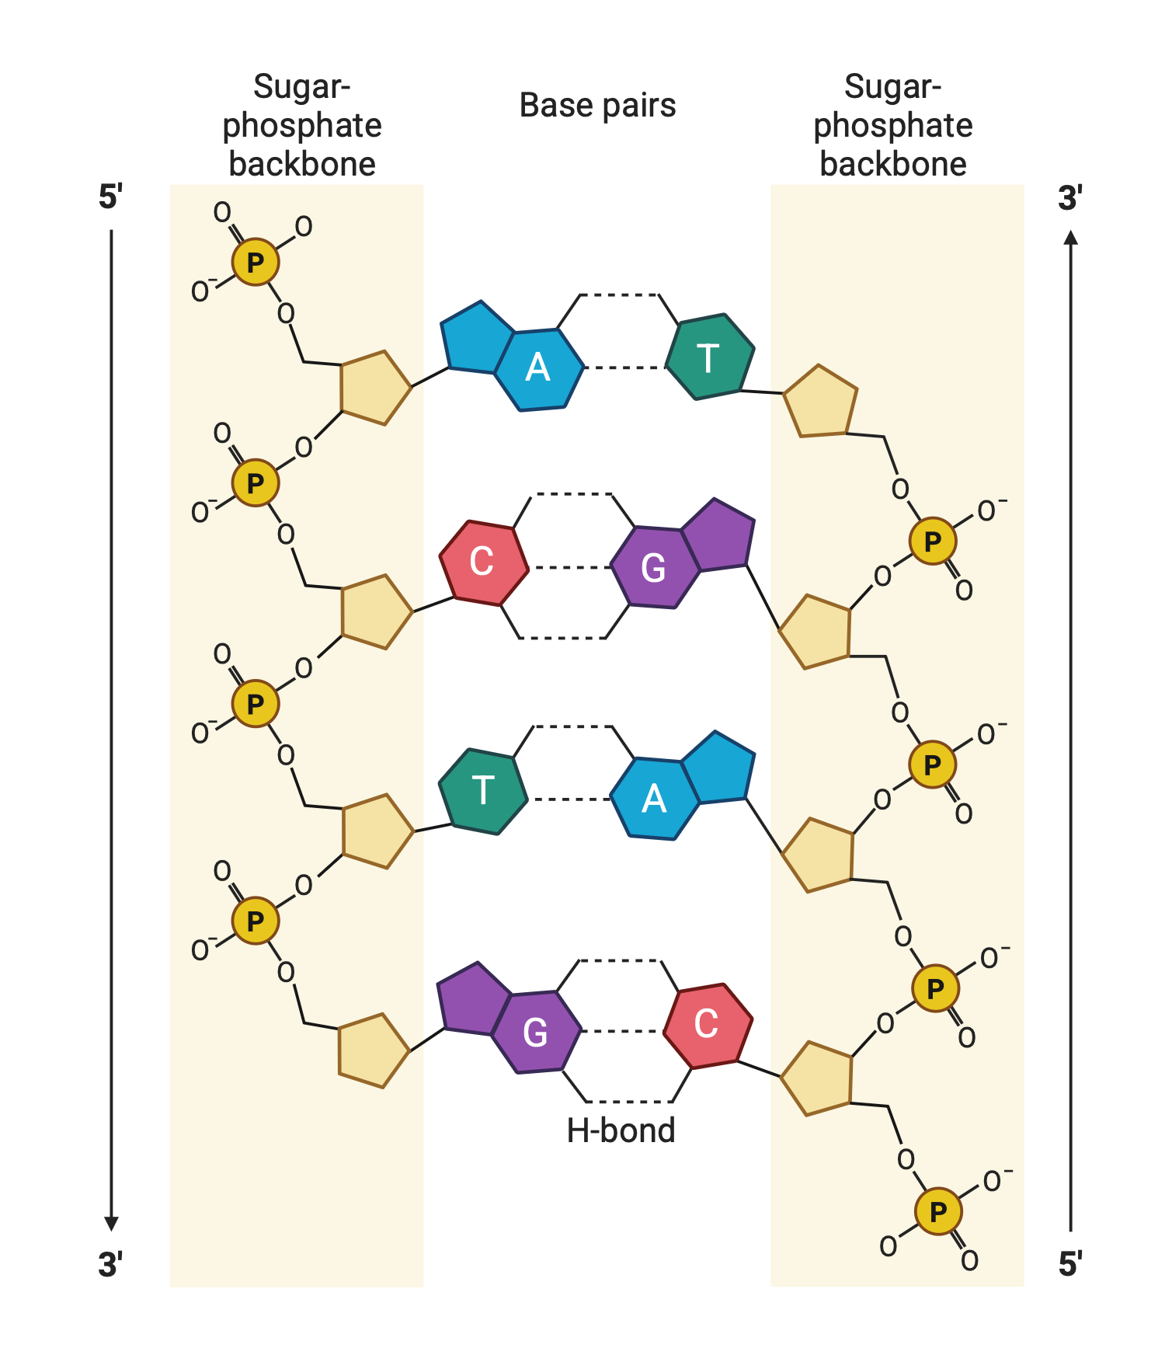
DNA
Long molecules, negatively charged
Divalent ions → bridging agent between mica and DNA
  Mg²⁺,Ca²⁺ → mild binding, relaxed conformation
  Ni²⁺, Co²⁺ → stronger, DNA deformation

Slide 8
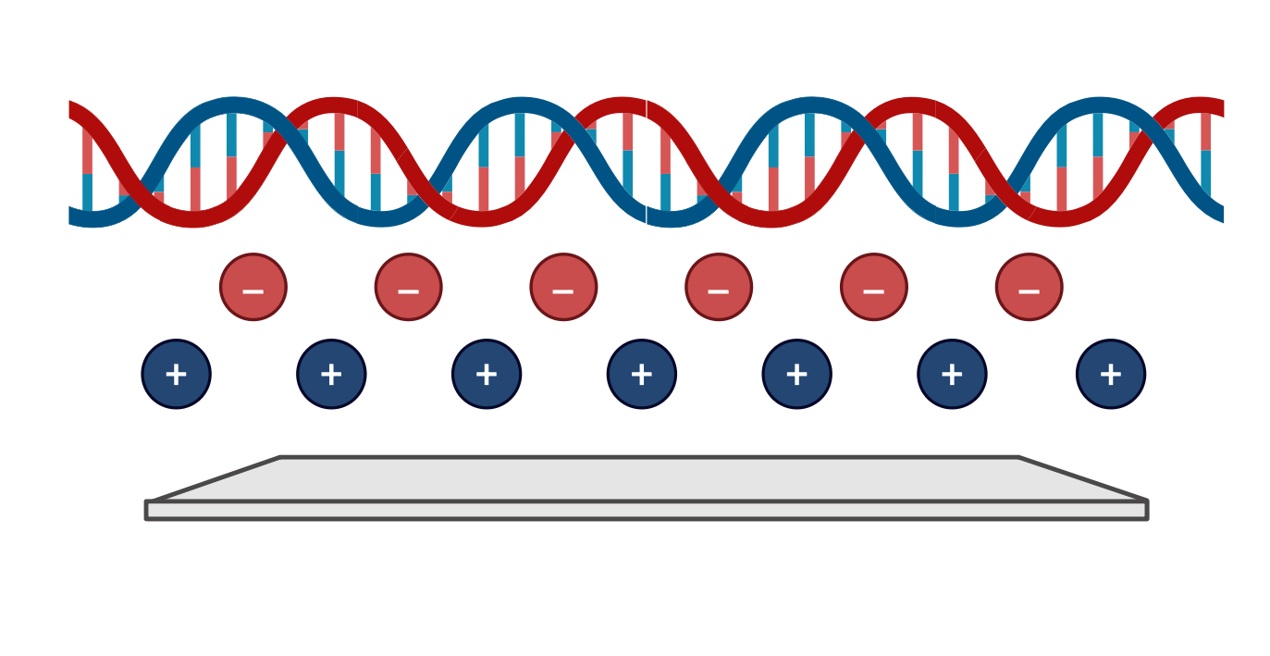

DNA
Long molecules, negatively charged
Divalent ions → bridging agent between mica and DNA
  Mg²⁺,Ca²⁺ → mild binding, relaxed conformation
  Ni²⁺, Co²⁺ → stronger, DNA deformation
Introducing postive charge on surface
  Silanization with APTES,

Slide 9
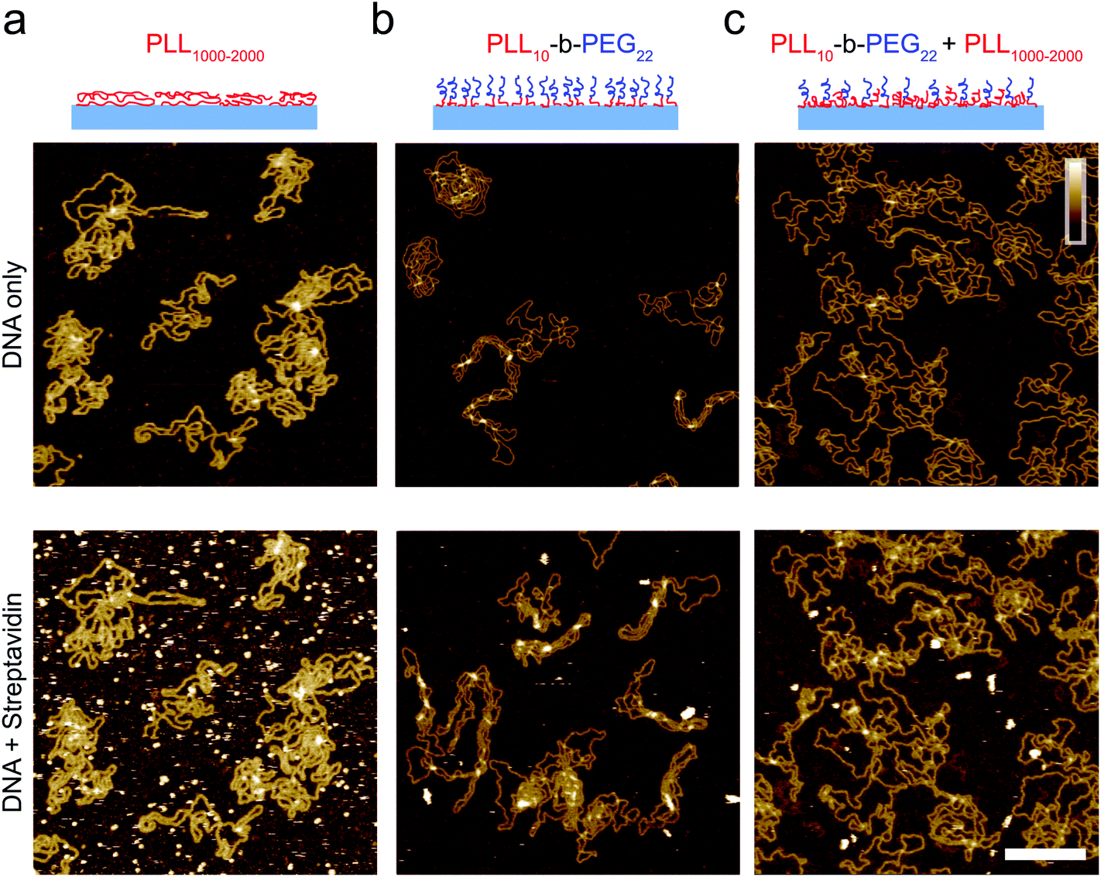
DNA
Long molecules, negatively charged
Divalent ions → bridging agent between mica and DNA
  Mg²⁺,Ca²⁺ → mild binding, relaxed conformation
  Ni²⁺, Co²⁺ → stronger, DNA deformation
Introducing postive charge on surface
  Silanization
  PLL → stronger binding, linear stretching possible.
  PEG–PLL → reduces unwanted binding of proteins.
Akpinar, B., Haynes, P. J., Bell, N. a. W., Brunner, K., Pyne, A. L. B., & Hoogenboom, B. W. (2019). PEGylated surfaces for the study of DNA–protein interactions by atomic force microscopy. Nanoscale, 11(42), 20072–20080. https://doi.org/10.1039/c9nr07104k

Slide 10
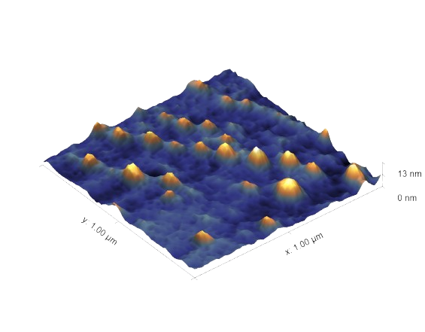
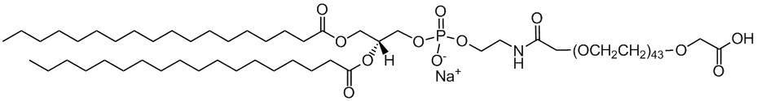
Lipid-based particles
soft, fragile, tip-induced deformation.
Direct adsorption on mica/glass, electrostatic bond
Incorporation of phospolipides PEG conjugate with -COOH, -NH₂, or -OH group
  COOH, OH → silanized mica/ glass (APTES) with or without EDC
  NH₂ → silanized mica/glass (GPTMS)
Solid lipid particles on glass
DSPE-PEG(2000) Carboxylic Acid

Slide 11
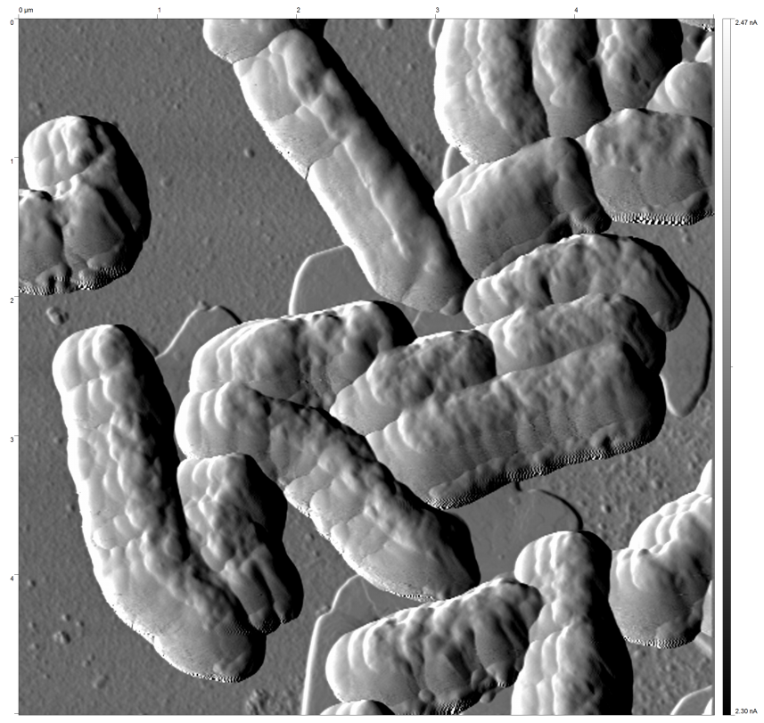
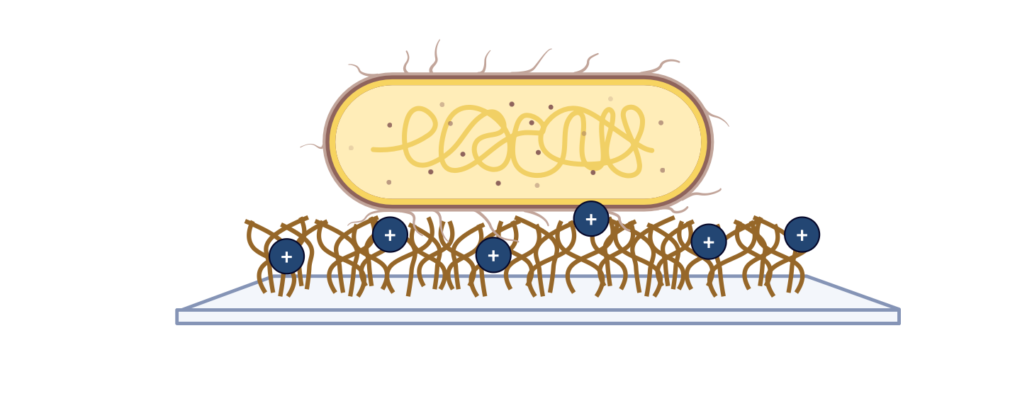
Bacteria
Negatively charged cell walls → PLL coating works well.
Live vs. fixed choice depends on your experiment:
  Live → physiology preserved, immobilization can be tricky
  Fixed → easier imaging, no drift.
Poly-L-lysine on glass, plastic

Slide 12
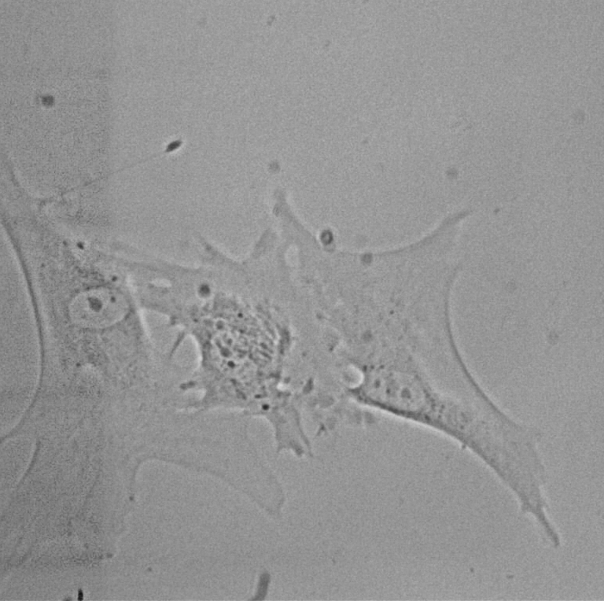
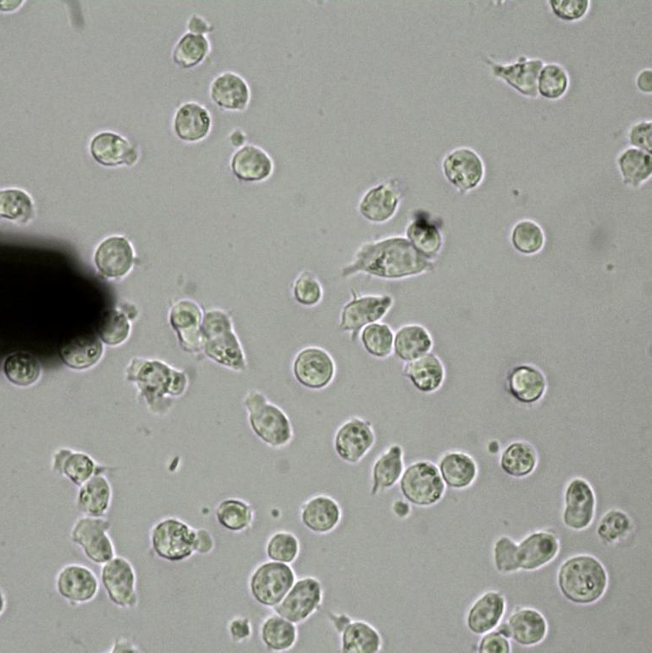
Eukaryotic cells
Depends on a cell type
30 µm
30 µm
Human embryonic fibroblasts
Lymphocytes

Slide 13
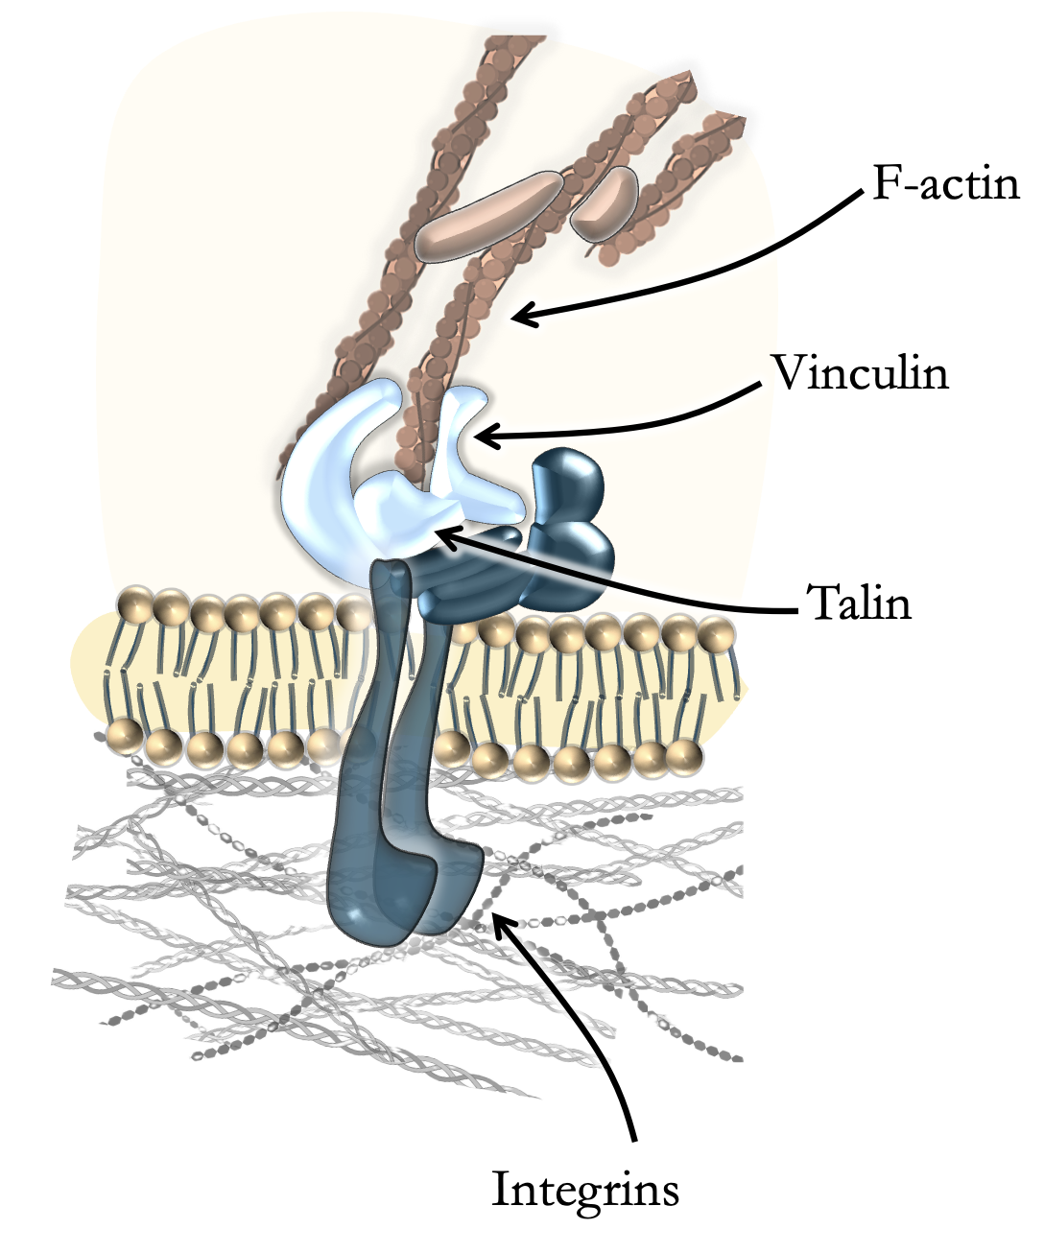
Eukaryotic cells
Depends on a cell type
  Adhesive cell types → Gelatin or PLL usually works well
  Non-adhesive → Extracellular proteins (fibronectin, laminin)
    → Molecular glue - Cell-tak

Slide 14
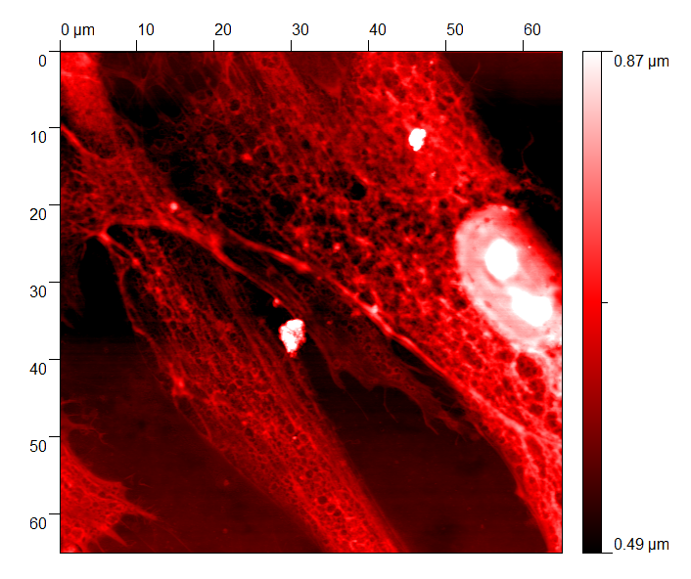
Eukaryotic cells
Depends on a cell type
  Adhesive cell types → Gelatin or PLL usually works well
  Non-adhesive → Extracellular proteins (fibronectin, laminin)
    → Molecular glue - Cell-tak
Live vs. fixed
Fixed cells - long term studies
→ EtOH, acetic acid, paraformaldehyde, glutardialdehyde
Cell wall destruction
Fixed cells by PFA

Slide 15
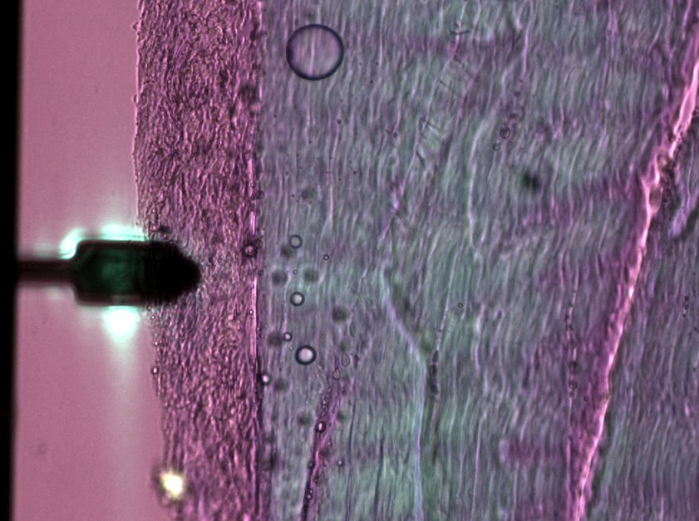
Tissues and plant samples
20 – 100 µm sections cuted by cryotome
→ Silanized or PLL coated glass slides
→ Cell-Tak
Fascia sample under AFM

Slide 16
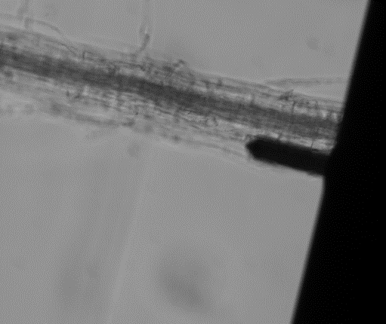
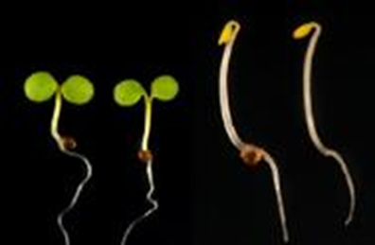
Tissues and plant samples
20 – 100 µm sections cuted by cryotome
→ Silanized or PLL coated glass slides
→ Cell-Tak
Whole seedlings roots or hypocotyl
→ Biocompatible glue (NuSil, Kwik-Sil)
→ Agarose on glass slide
10% mannitol solution to remove turgor pressure
Hypocotyl and seedling roots under AFM
Marçal Gallemí Eva Benkova Lab & Jan Hejatko Lab

Slide 17
Conclusion
Sample | Immobilization Method | Key Benefit
Protein on surface | Electrostatic binding - silanization | Ease of use, strong bond
Protein on cantilever | Biotin–Streptavidin | Orientation, stability
Viruses | PLL | Ease of use
DNA | Bivalent ionts | Ease of use, but can be unstable
LNPs | phospholipedes PEG conjugates | Very flexible, strong bond
Bacteria | PLL | Live imaging possible
Live cells | ECM proteins (fibronectin) | Physiological adhesion
Fixed cells | PFA | Standard method, cheap
Tissues | PLL-coated glass slides | Ease of use
Plant samples | Agarose pads | Cheap and moderately easy
No one-size-fits-all → method choice depends on sample type + research question.

Slide 18
Thank you for your attention!
Šimon Vrana, Ph.D.

