Slide 1

Visualization of bacterial biofilm using AFM
Bengisu Yöney, M.Sc.
Ph.D. Student
Department of Biochemistry
Faculty of Science
Masaryk University
Supervisor: prof. RNDr. Petr Skládal, CSc.
1

Slide 2
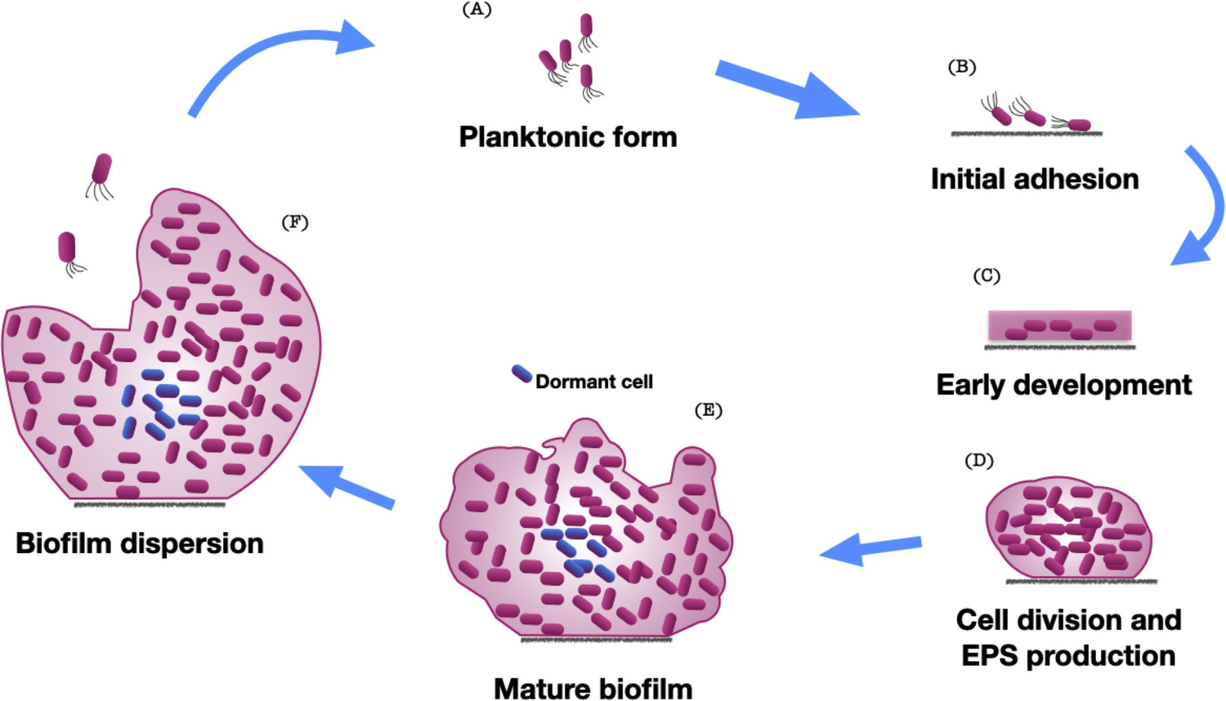
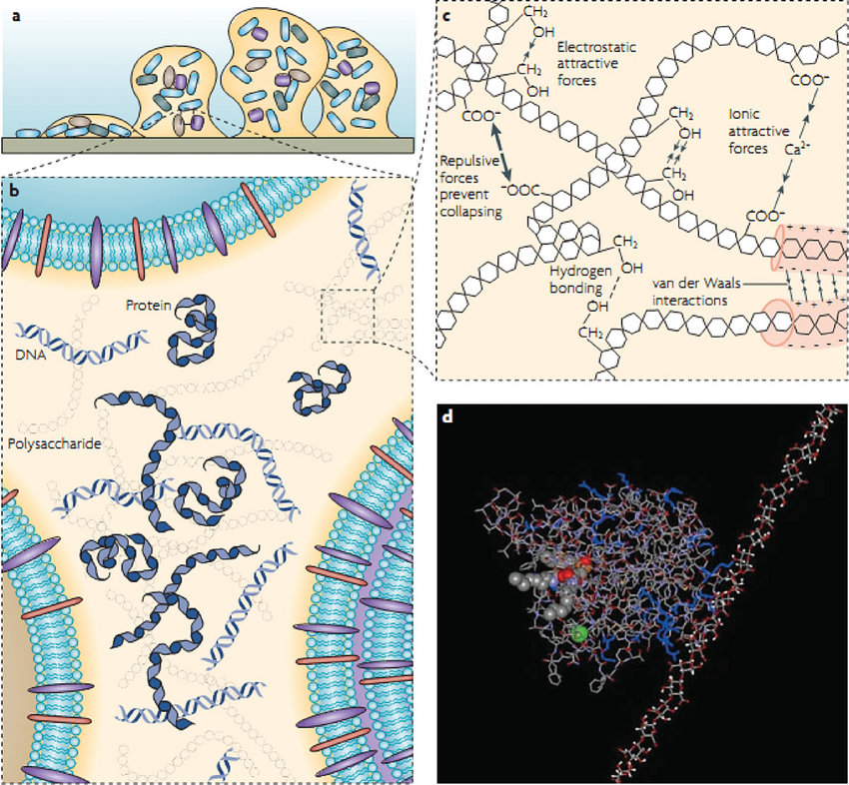
Biofilms
Extracellular Polymeric Substances:
Kreve, S., & Dos Reis, A. C. (2021). Bacterial adhesion to biomaterials: What regulates this attachment? A review. Japanese Dental Science Review, 57, 85–96.
Gour, N., Ngo, K. X., & Vebert-Nardin, C. (2014). Anti-infectious surfaces achieved by polymer modification. Macromolecular Materials and Engineering, 299(6), 648–668.
2

Slide 3
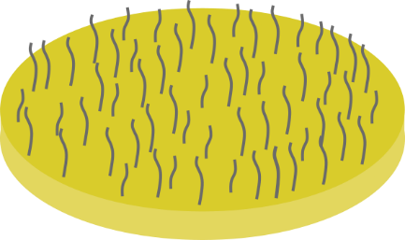
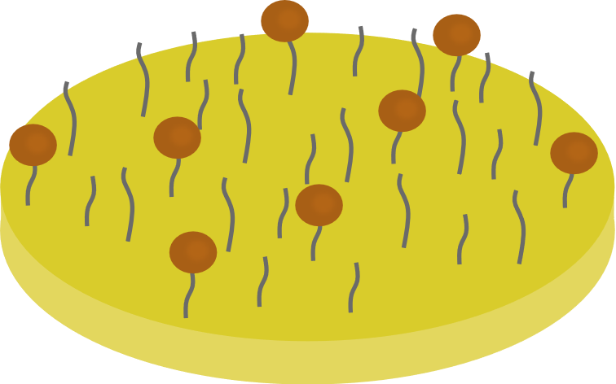

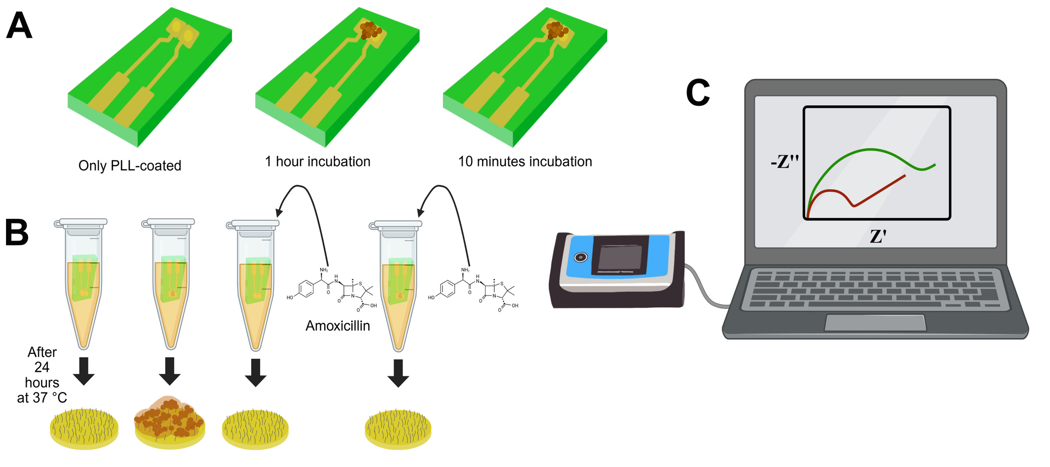
Methods
Electrochemical Impedance Spectroscopy
Poly-L-Lysine
Initial Attachment
  5 ml of 5 mM potassium ferro/ferricyanide solution in PBS.
  100 kHz to 2 Hz.
  AC amplitude: 10 mV.
  Solution resistance R_{s} and charge transfer resistance R_{ct}
Biofilm
Formation
Biofilm
Inhibition
3

Slide 4
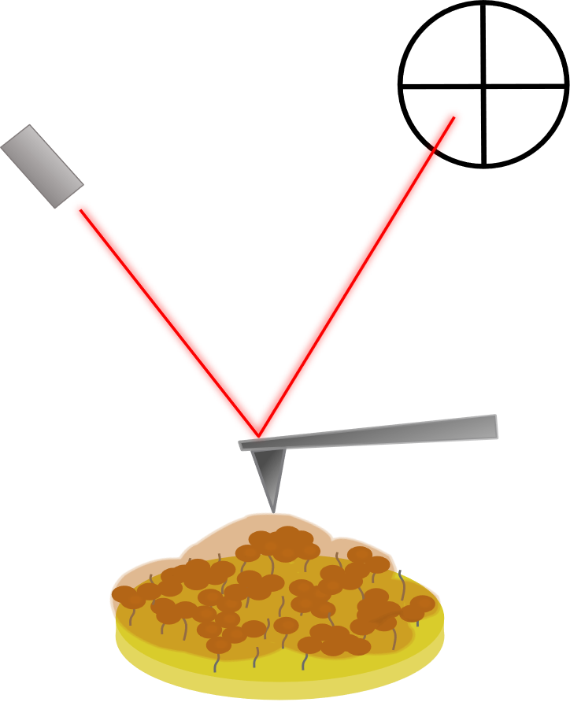
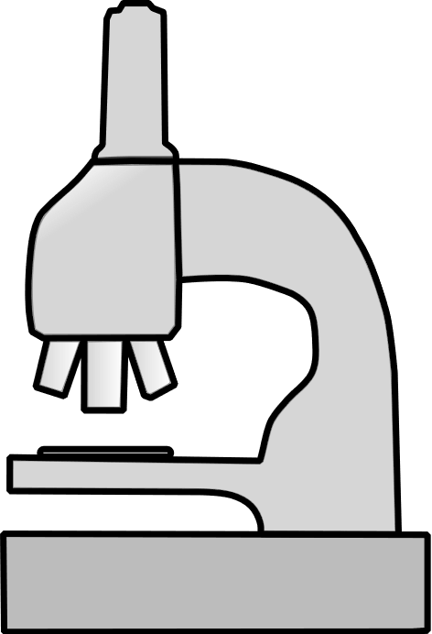
Methods
Microscopy Methods
Optical Microscopy
Atomic Force Microscopy
  Stained with safranin (0.5 %) for 15 min.
  Magnifications / Exposure:
20× / 450 ms, 40× / 1000 ms.
  PeakForce Tapping mode.
  To visualize the shape of the samples: height profiles.
4

Slide 5
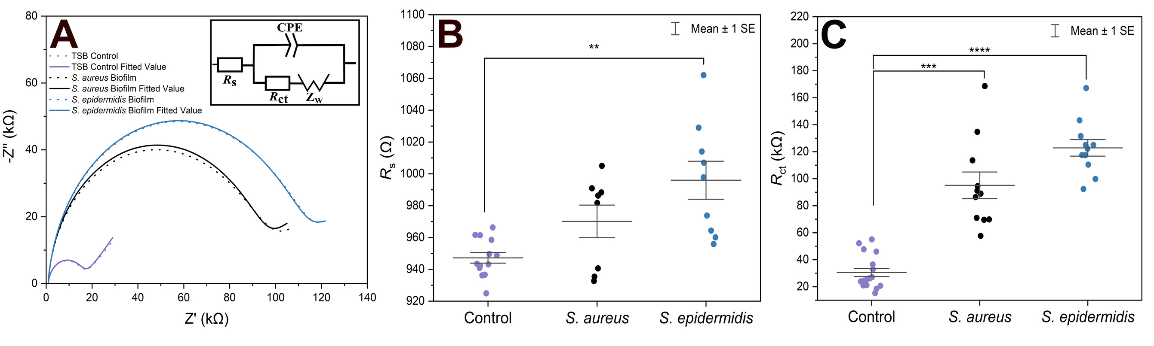
Results
EIS Results of Biofilm Formation
5

Slide 6
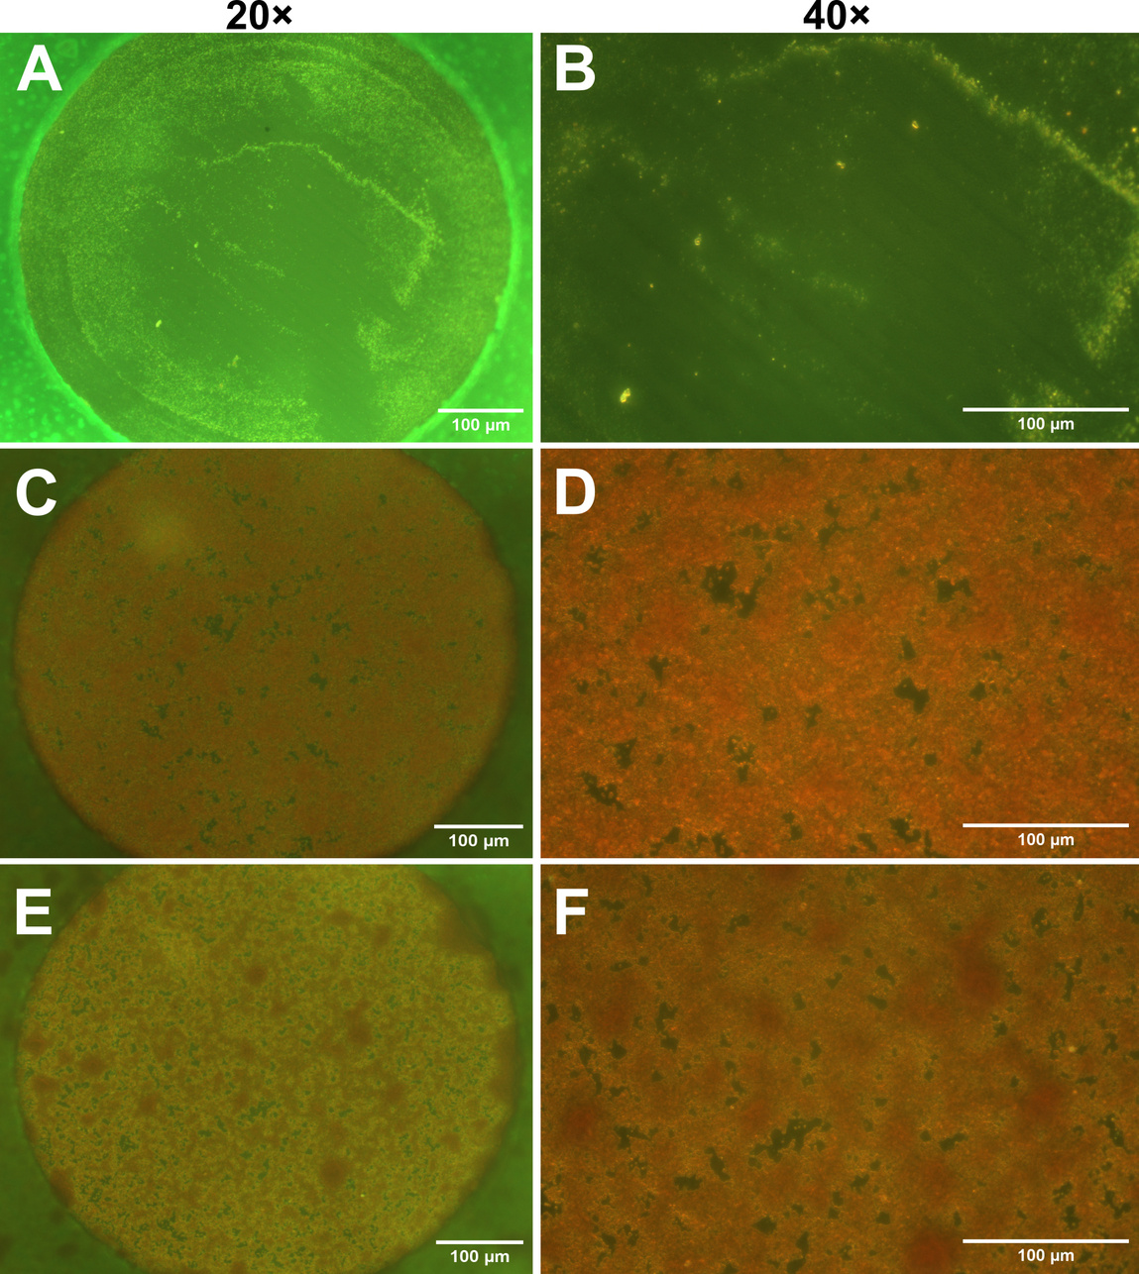
Optical Microscopy Evaluation
6

Slide 7
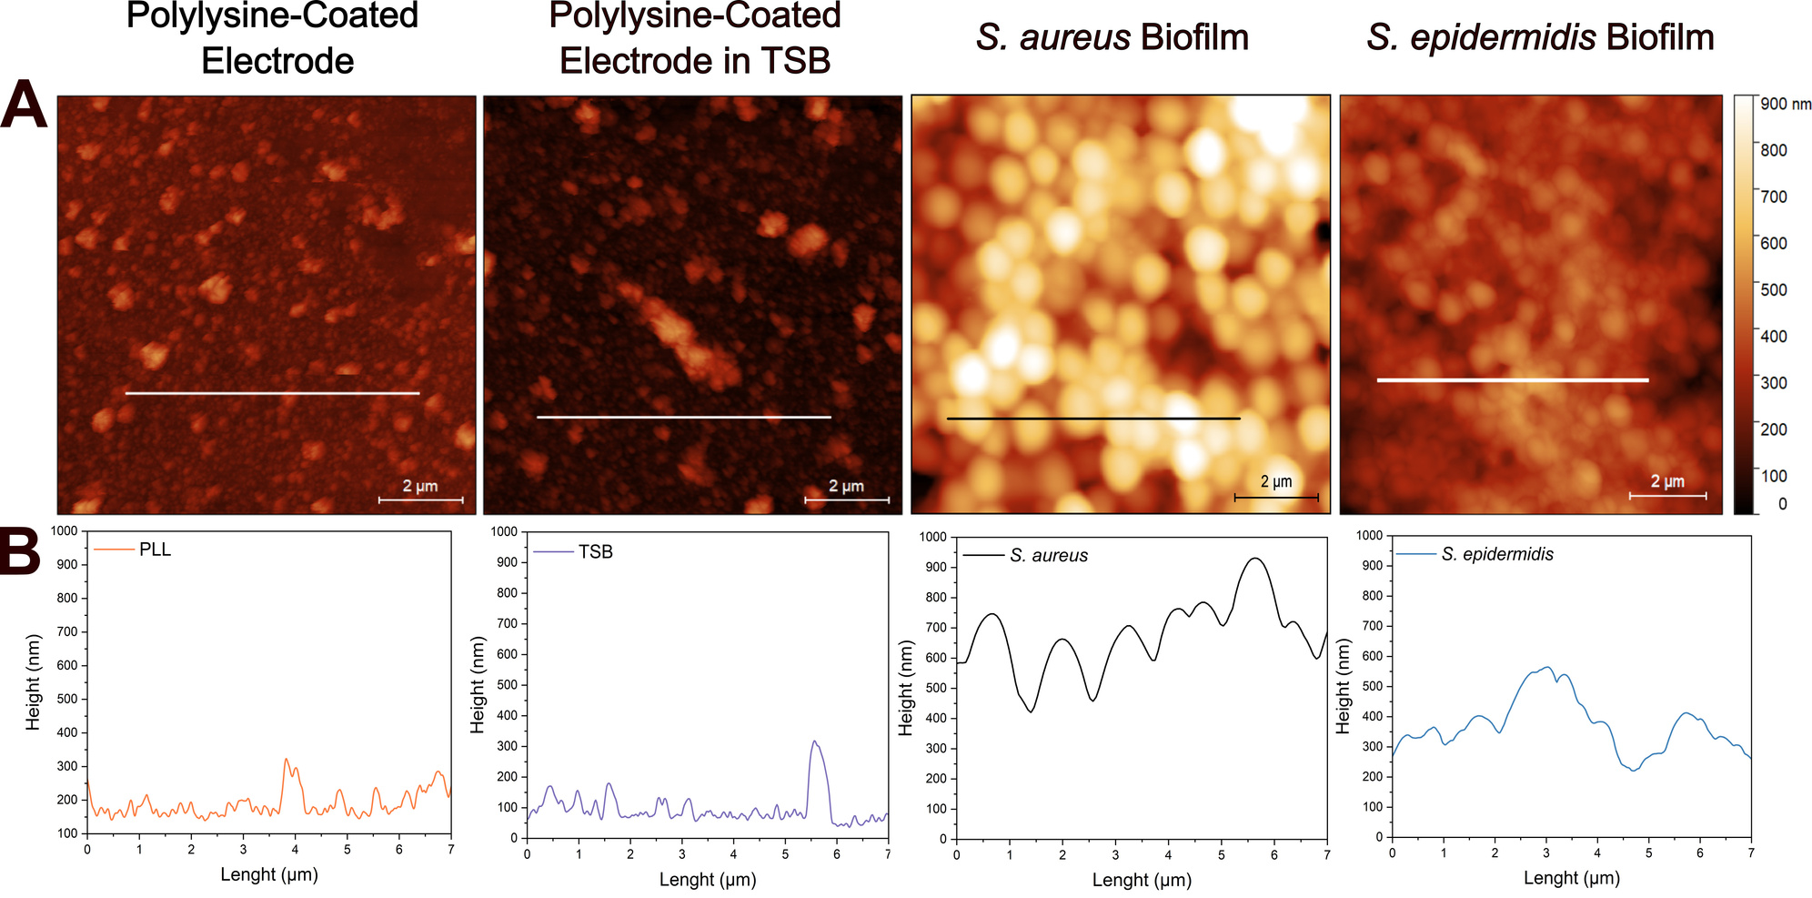
Visualization using AFM
7

Slide 8
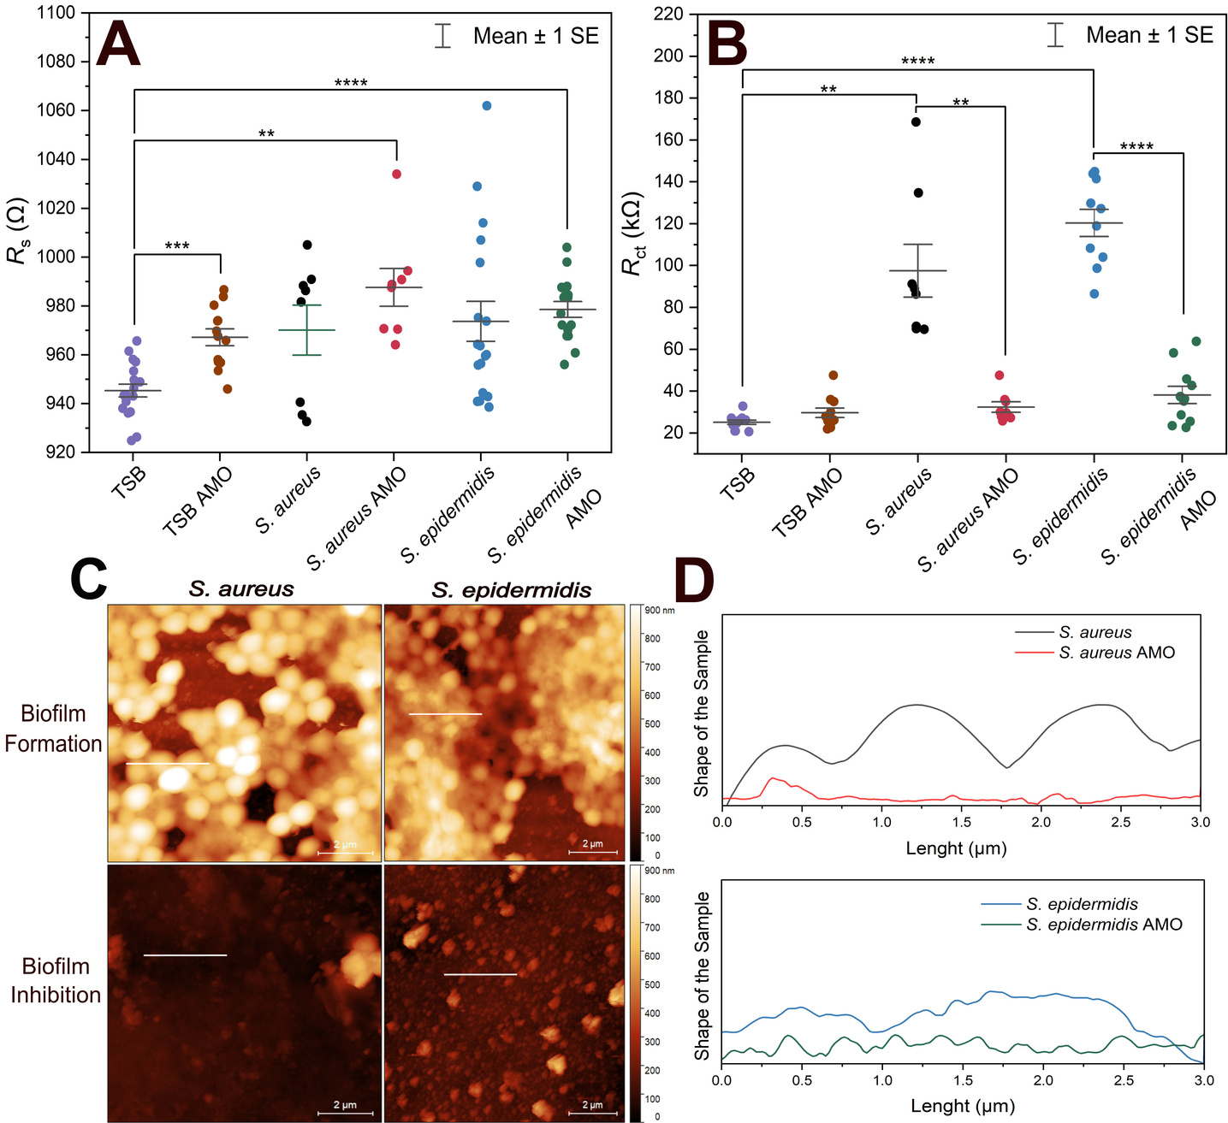
Inhibition of the Biofilm
8

Slide 9
THANK YOU
FOR YOUR ATTENTION
9

