Slide 1



Molecular Imprinting as a Solution for Environmental Problems
Eliška Birgusová
Department of chemistry and biochemistry, MENDELU
1

Slide 2

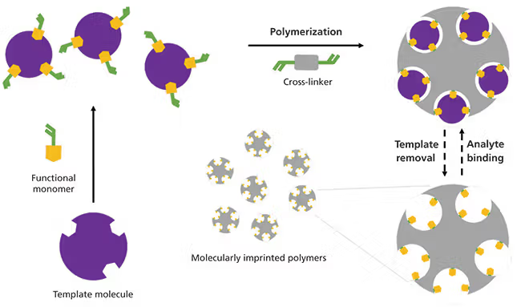
  What is Molecular Imprinting?
2

Slide 3
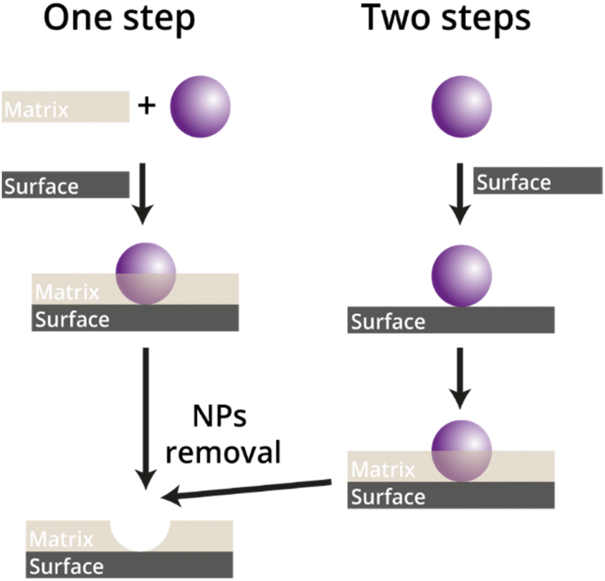

Future of molecular imprinting
From small to larger
  Nanomaterials
  Nanoplastics / microplastics
  Bacteria
Sensors
  QCM
  Electrochemistry
3

Slide 4
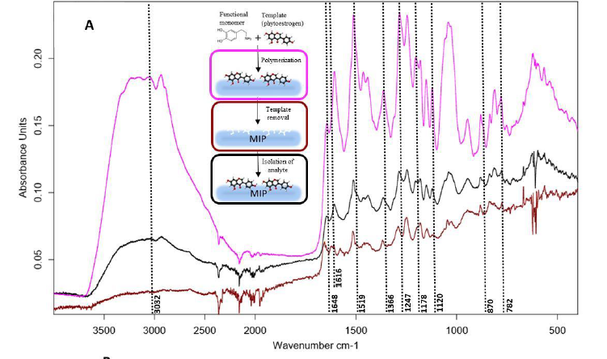
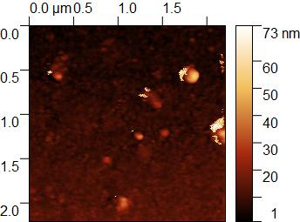
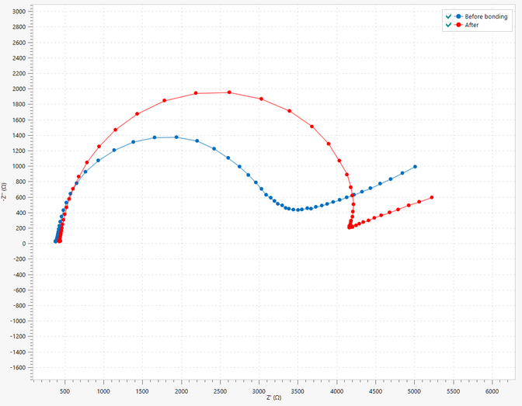
  Characterisation of traditional MIPs
Ramans spectroscopy
Ftir
AFM, SEM, TEM
Sensors
4

Slide 5
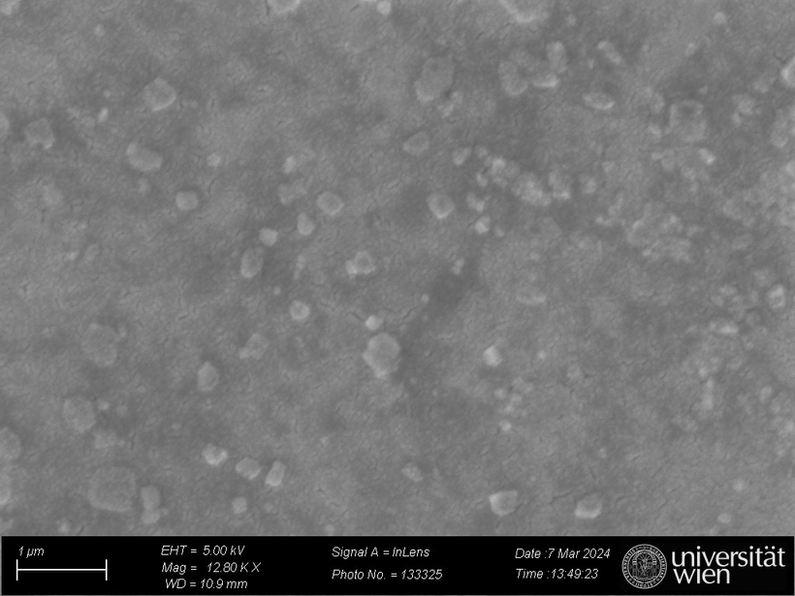
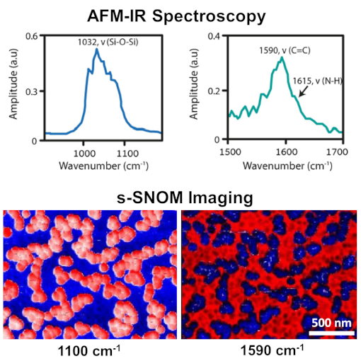
  Particles printing -Actual visualisation of cavities from printing
Before
After
AgNPs on the surface of electrode
5

Slide 6
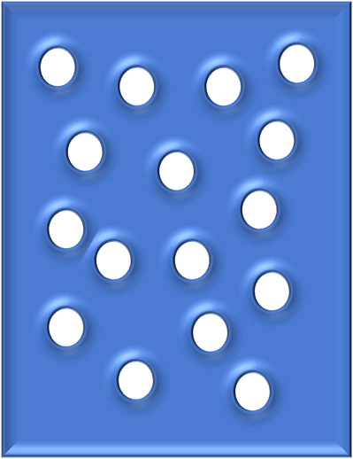


  Detection and removal
Electrodes with polymers on the surface
Special filter targeting only one component
Detection for specific plastics
or specific nanoparticles
6

Slide 7
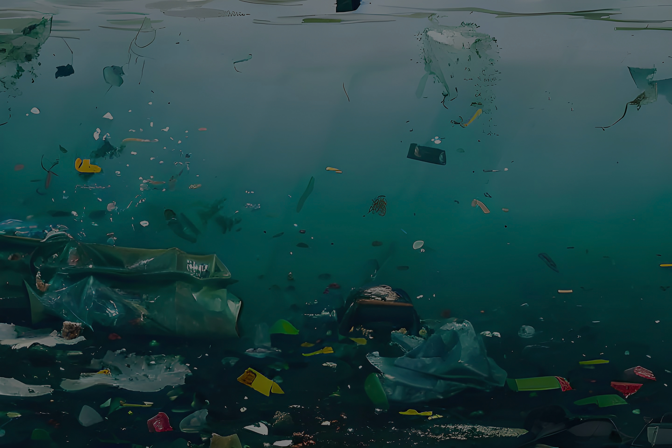
  Summary
MIP = robust synthetic receptors
Can be scaled up to complex particles
Coupled with sensors → real solutions for monitoring & remediation
  Thank you
7

